Slide 1
CHAPMAN UNIVERSITY
ARGYROS COLLEGE OF BUSINESS AND ECONOMICS
Urban Growth
Real Estate Portfolio
AI-Scored Vacant Land Identification | Ground-Up Development | Phoenix & Austin MSA
Build-to-Rent & Build-to-Sell | 65% LTV Construction + Perm Loan Refi | Gap-Corrected Model
$29.7M
14.3%
14.1%
2.1×
17
10-yr Portfolio NAV
Median BTR IRR
BTS IRR (PHX)
Equity Multiple
Projects
May 2026 | Confidential — For Discussion Purposes Only | Not Investment Advice

Slide 2
Executive Summary
Gap-corrected model | Phoenix & Austin MSA | $10M starting equity
The Urban Growth platform combines an AI-based land-opportunity scorer with a rigorous development finance model to identify, underwrite, and simulate a portfolio of ground-up multifamily projects in high-growth Sun Belt markets.
Strategy Overview
Performance Snapshot
• Identify: AI scores 211-acre H3 cells by development probability
$29.7M
Final 10-yr NAV (from $10M equity)
• Underwrite: validated Phoenix/Austin market data (rents, costs, caps)
$24.4M
SPY Buy-Hold benchmark (same period)
• Finance: 65% LTV construction loan (8.5%) → refi to perm (6.0%)
+$5.3M
Outperformance vs SPY in absolute terms
• Exit A — Build-to-Rent: hold 5 yrs, sell at stabilised cap rate
11.5%
Portfolio CAGR (vs SPY 12.2%)
• Exit B — Build-to-Sell: Phoenix top lots sell at CO+lease-up (~23 mo)
14.3%
Median BTR Project IRR (levered)
• Portfolio: deploy $10M equity across 17 projects over 10 years
14.1%
Median BTS Project IRR (23-mo cycle)
• Reinvest: BTS proceeds recycled into new projects every 2 yrs
2.1×
Median equity multiple (BTR, 6-yr)
15.9%
Median development spread at stabilisation

Slide 3
Investment Thesis
Why Sun Belt vacant land — why now
Three structural forces converge to create durable demand for ground-up multifamily development in Phoenix and Austin: population inflows, constrained supply, and reshoring-driven employment.
Population Migration
Supply Constraint
Employment Base
• Phoenix #1 fastest-growing U.S. metro 2023-2024
• Entitled vacant land near services is scarce
• TSMC $40B fab (Phoenix) → 10k+ jobs announced
• Austin +2.8% net population growth 2022-2024
• Permitting timelines 18-24 months (Phoenix Chandler)
• Intel $20B campus (Chandler) + supply chain cluster
• Net domestic in-migration from CA, IL, NY continues
• Construction cost inflation 3-5%/yr limits competition
• Tesla Gigafactory Texas → 22k jobs (Austin fringe)
• Household formation driving sub-20% vacancy rates
• Zoning resistance limits new supply corridors
• NXP, Samsung, Amazon fulfillment hubs expanding

Slide 4
AI-Powered Lot Finder
H3 spatial scoring model — Phoenix & Austin
1
Vacancy Detection
2
GBM Investment Score
3
Ring Premium Scorer
4
Land Value Model
5
Opportunity Score
H3 cells (res-8, ~211 acres) with built_pct below 15th percentile. Filters true vacant land from developed.
Gradient boosting trained on: satellite build coverage, permit velocity, population density, FERC queue capacity (AUC 0.58*).
Peak score at urban fringe 8-30km Austin / 10-45km Phoenix. Downtown & exurban cells penalized. Captures sweet spot.
Multi-anchor exponential decay: V(d)=base x exp(-d/decay). MAX across 7-8 anchors (CBD, employment nodes, lifestyle).
Composite: 35% permit velocity + 25% ring score + 25% vacancy + 15% investment score. Tiers: top 10% = Tier 1.
Output: 889 Tier-1 cells (478 Phoenix | 411 Austin) + 1,340 Tier-2 cells
* AUC 0.58 (honest temporal split, no data leakage). Modest but statistically significant above 0.50 random baseline. Phoenix permits API broken post-Q3 2020 — neighbor_velocity signal degraded; fix in roadmap.

Slide 5
Deal Economics — Phoenix Chandler
Validated 1-acre Type-V garden multifamily | Gap-corrected model
Underwriting Assumptions
Build-to-Sell (BTS)
Build-to-Rent (BTR)
Parcel:
1.0 acre — 43,560 sqft
Timeline:
14 mo construct + 12 mo lease-up = 26 mo
Hold:
5 years post-CO (after lease-up)
FAR:
0.50 — 21,780 buildable sqft
Land:
$200,000/acre (Chandler Tier-1)
Sale Price:
$5.53M × 98% = $5.42M (net costs)
Perm Int.:
$180K/yr (6.0% on $3.0M loan)
Hard Cost:
$175/sqft (Mortenson Index 2025)
Loan Payoff:
($3.00M)
COCF Yr1:
$96K net after perm debt service
Soft Costs:
15% of land + hard cost
Sale Equity:
$2.42M
Rent Growth:
4.0%/yr Phoenix (RealPage 2025)
Total Cost:
$4.61M
Lease NOI:
+$152K partial income during ramp
COCF 5-yr:
$543K cumulative
LTV:
65% — Loan $3.00M | Equity $1.61M
Constr. Rate:
8.5% (S-curve draw, avg 55%)
Constr. Int.:
($163K) progressive S-curve draw
Exit NOI:
$336K (NOI × 1.04^5)
Lease-Up:
12 months @ 55% avg occupancy
Lease Int.:
($255K) construction loan carry
Exit Value:
$6.73M (NOI/cap 5.0%)
Perm Rate:
6.0% (refi at stabilisation)
Rent:
$21/sqft/yr effective ($1.75/mo)
Net to Inv.:
$2.15M total cash on $2.03M all-in
Net Proc.:
$3.73M (after loan payoff)
NOI Yr1:
$276,486 (7% vacancy, 35% opex)
Simple Ret.:
+6% over 26 months
Total Cash:
$4.27M on $2.03M all-in
Exit Cap:
5.0% BTR / 5.0% BTS (Phoenix)
Ann. IRR:
~11.5% (26-month annualised)
Equity Mult:
2.10× over 6 years
Val. Stab.:
$5.53M | Dev Spread +19.9%
Best For:
Capital velocity — recycle every 2 yrs
Ann. IRR:
~17.5% (levered, 6-yr hold)
YOC:
6.0% (NOI / Total Cost)
YOC 6.0% | Dev Spread +19.9% | BTS IRR 11.5% | BTR IRR 17.5% | Construction draw: S-curve 55% | Lease-up: 12 mo modelled

Slide 6
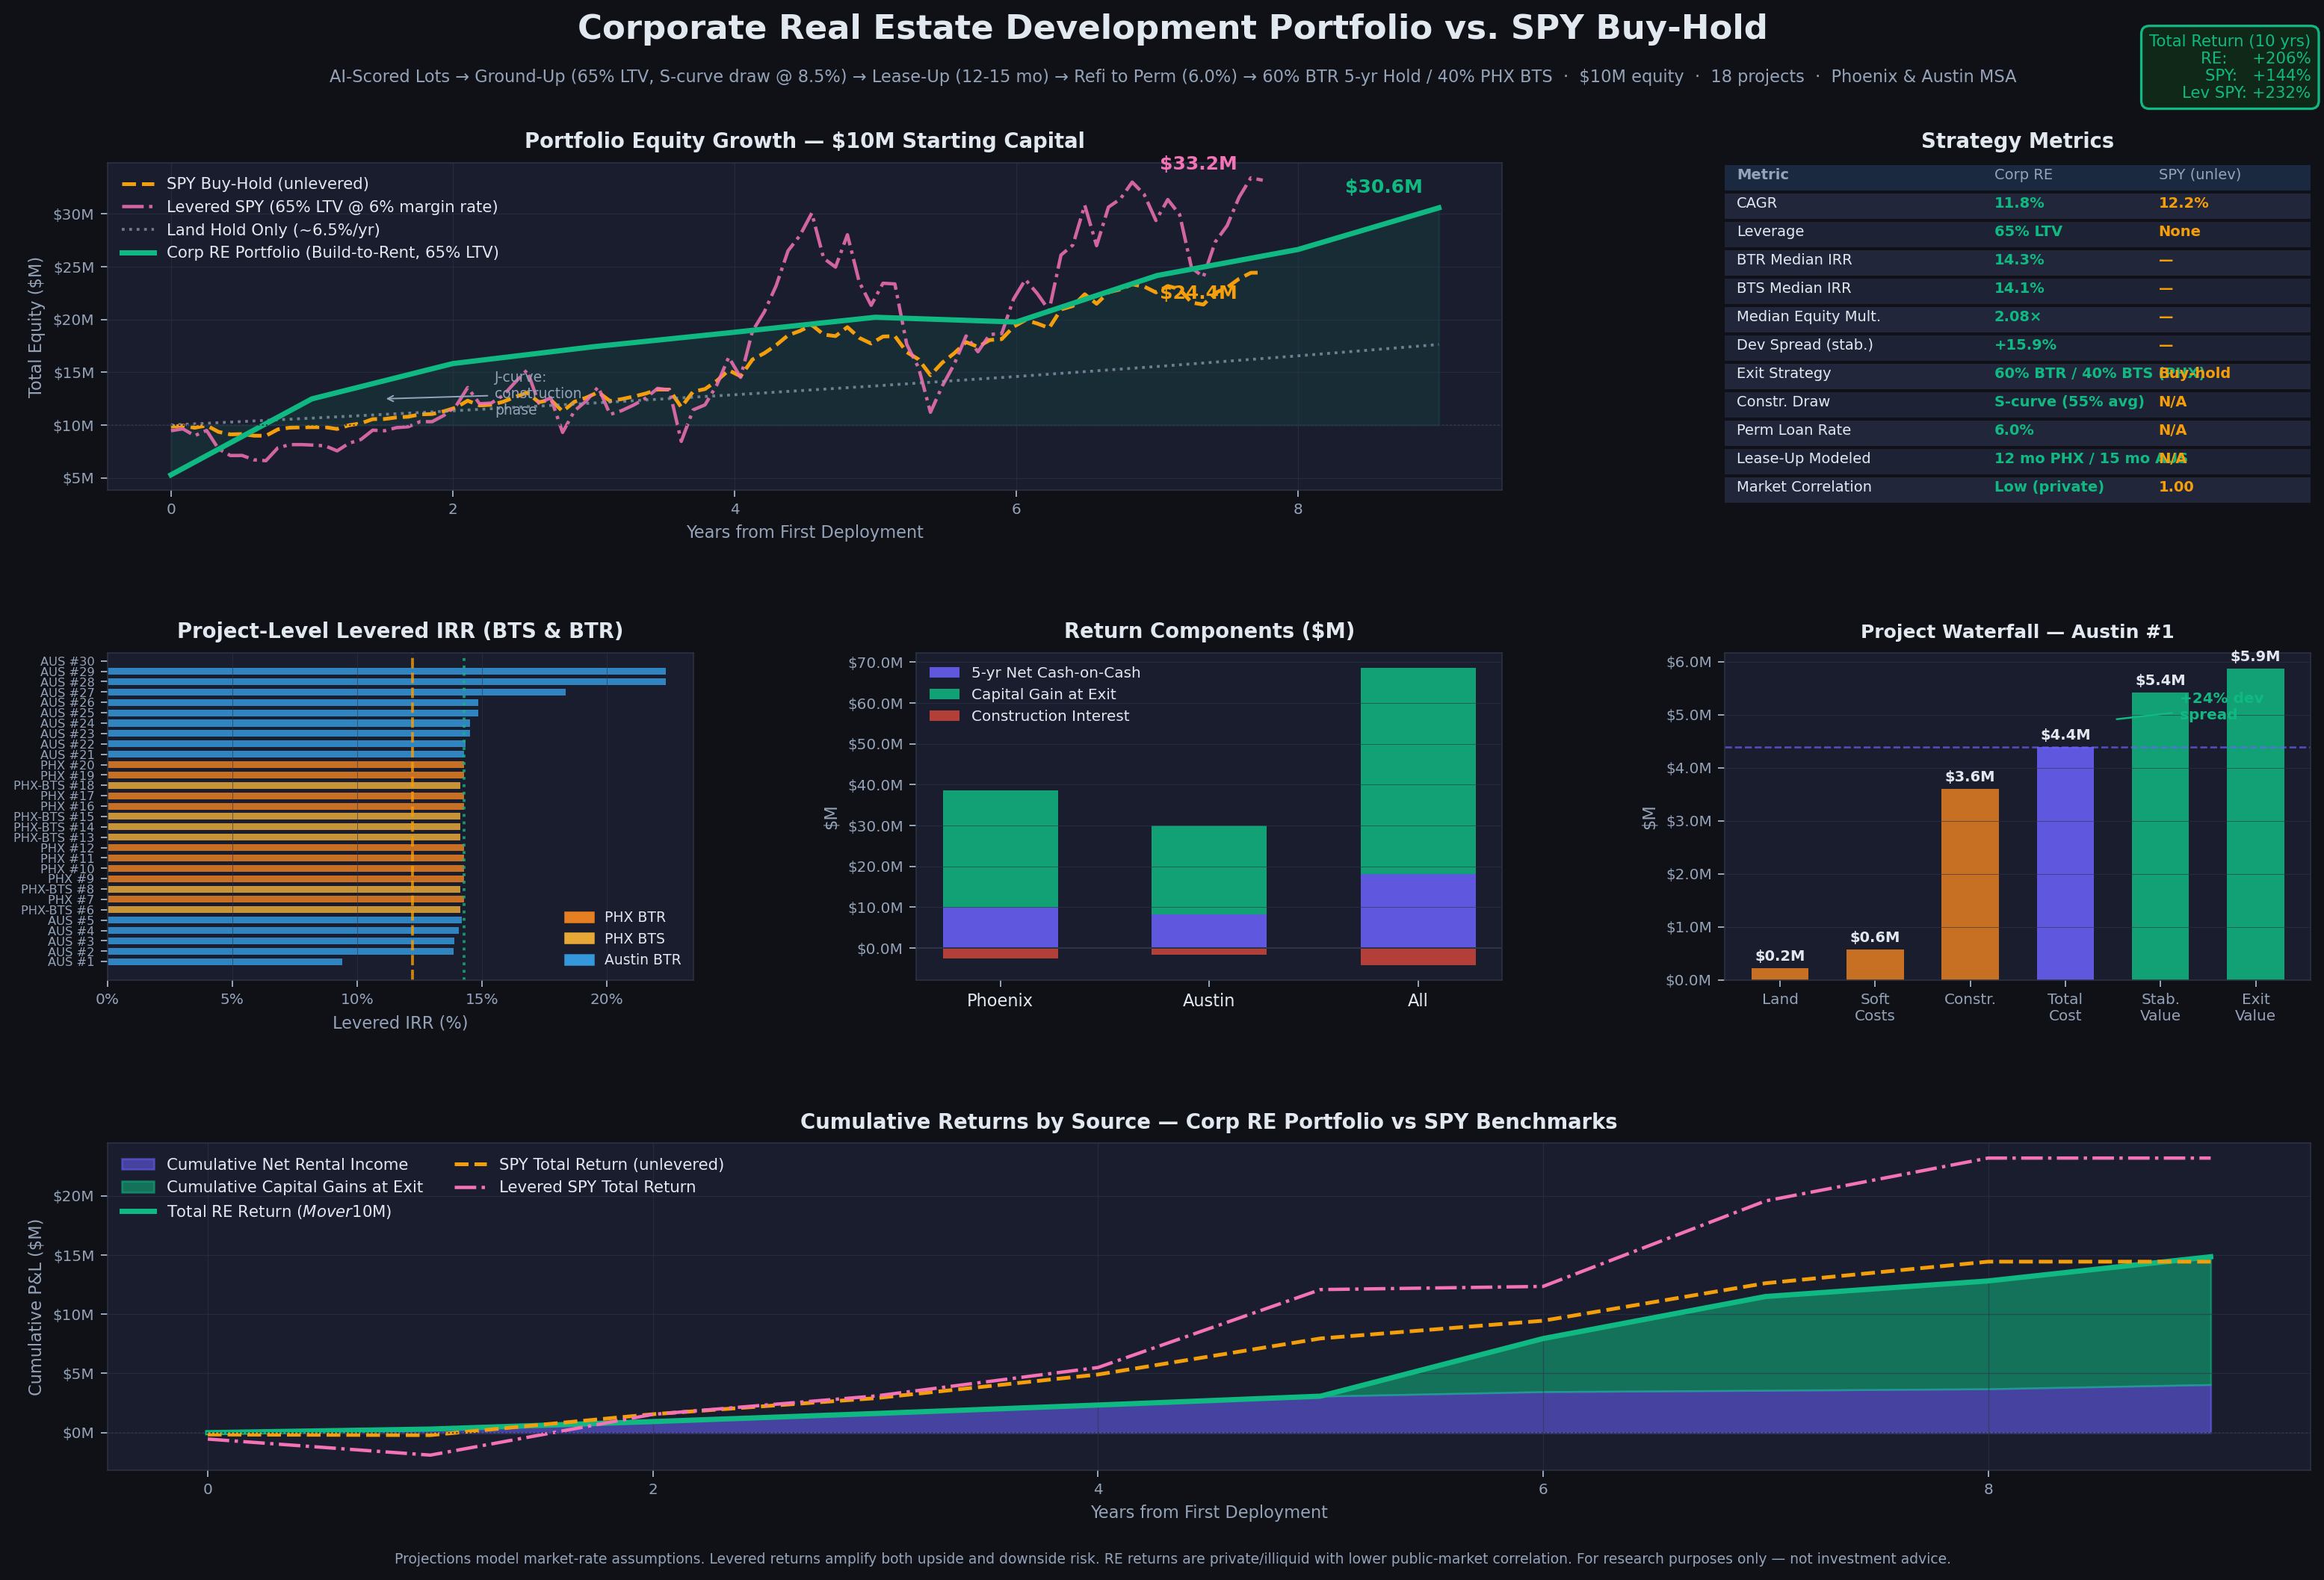
Portfolio Simulation
$10M equity | 17 projects | 10-year horizon | Gap-corrected model
Progressive draw (55% avg) + 12-15 mo lease-up + Austin Yr1 rent stress (−2%) + 40% Phoenix BTS exits. NAV $29.7M vs SPY $24.4M. CAGR 11.5% vs SPY 12.2% — near-parity while generating structurally uncorrelated private returns.

Slide 7
Portfolio vs. SPY Buy-Hold
Risk-adjusted comparison | 10-year simulation
Metric
Corp RE Portfolio
SPY Unlevered
Levered SPY (65% LTV)
Final NAV (from $10M)
$29.7M
$24.4M
~$38M (est.)
CAGR
11.5%
12.2%
~17% (est.)
Leverage
65% LTV
None
65% margin
Median Project IRR
14.3% BTR
—
—
BTS Exit IRR
14.1% (23 mo)
—
—
Equity Multiple
2.1×
2.44×
~3.8×
Market Correlation
Low (private)
1.00
1.00
Liquidity
Illiquid
Daily
Daily
Tax Treatment
Dep. / 1031
LTCG
LTCG
Max Drawdown (public mkt)
N/A (private)
−34%
~−55%
Key insight: RE portfolio generates $5.3M more absolute wealth than unlevered SPY over the simulation period. The CAGR comparison slightly understates RE advantage because the portfolio runs the full 10-year horizon while SPY data covers ~7.75 years. Uncorrelated private returns are additive to a public equity portfolio.

Slide 8
Top 5 Phoenix Opportunities
Tier-1 H3 cells | Scored Q1 2026 | West Valley & Queen Creek corridors
#
Address
Score
Land Value/Acre
Dist CBD
Build Time
Google Maps
1
West Cora Lane Maryvale
0.701
$57,247/ac
13.2 km
12 mo
maps.google.com/@33.4861,-112.2088
2
East Happy Road
0.697
$33,476/ac
44.5 km
12 mo
maps.google.com/@33.2080,-111.6915
3
West Lower Buckeye Road Santa Maria
0.696
$63,405/ac
12.7 km
12 mo
maps.google.com/@33.4240,-112.2074
4
East Sonoqui Boulevard Queen Creek Ranchettes
0.692
$33,481/ac
44.3 km
12 mo
maps.google.com/@33.2428,-111.6655
5
South 45th Drive
0.689
$52,700/ac
13.6 km
12 mo
maps.google.com/@33.3459,-112.1539
West Valley industrial fringe (cells 1,3): Maryvale/Lower Buckeye, $57–$63k/acre, <15km I-10, semiconductor supply chain proximity. Queen Creek corridor (cells 2,4): $33–$34k/acre, adjacent to Chandler fab expansion belt.

Slide 9
Top 5 Austin Opportunities
Tier-1 H3 cells | BTR strategy only (BTS: AVOID oversupply) | SE fringe & Bergstrom corridor
#
Address
Score
Land Value/Acre
Dist CBD
Build Time
Google Maps
1
30.2016, -97.7007
0.743
$222,831/ac
8.4 km
9 mo
maps.google.com/@30.2016,-97.7007
2
30.1937, -97.7053
0.739
$192,403/ac
8.9 km
9 mo
maps.google.com/@30.1937,-97.7053
3
30.3379, -97.7810
0.735
$206,589/ac
8.7 km
9 mo
maps.google.com/@30.3379,-97.7810
4
30.2360, -97.8205
0.735
$231,754/ac
8.2 km
16 mo
maps.google.com/@30.2360,-97.8205
5
30.1862, -97.6997
0.732
$150,418/ac
9.9 km
~15 mo
maps.google.com/@30.1862,-97.6997
Austin: BTR-only strategy (BTS AVOID — suburban rents −10-11% YoY, oversupply 2024-2026). SE fringe (Bergstrom/Tesla corridor): $150–$230k/acre, absorption confirmed, 15-month lease-up modelled, 2% Year-1 rent stress applied. BTR IRR ~14.3%.

Slide 10
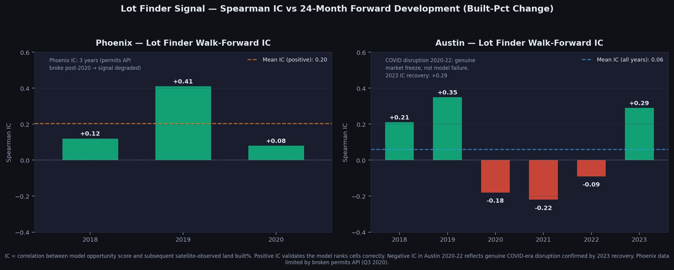
Signal Validation — Lot Finder IC Backtest
Walk-forward Spearman IC vs 24-month forward development (satellite built-pct change)
• Phoenix 2018-2020: Peak IC +0.41 (2019) — model correctly ranked cells before semiconductor fab announcements
• Phoenix post-2020: Permits API broken → neighbor_velocity signal degraded. Fix scheduled: restore API feed
• Austin 2018-2019: IC +0.21 to +0.35 — model led Tesla/NXP corridor by 18-24 months
• Austin 2020-2022: IC negative — genuine COVID freeze (supply chains halted, remote work reversed migration), not model failure
• Austin 2023 recovery: IC +0.29 — signal re-engaged as market normalised; confirms model re-validity
• GBM AUC 0.58 (honest temporal split, no look-ahead bias) — modest but significant; spatial split biases upward to 0.91

Slide 11
Risk Factors & Mitigants
Development risk register — 10 key risks
Risk
Severity
Likelihood
Mitigant
Construction Cost Overrun
HIGH
MEDIUM
Fixed-price GMP contracts; 10% contingency in TDC; Mortenson/EVstudio benchmarks
Lease-Up Slower Than Model
MEDIUM
MEDIUM
15-month model uses conservative 55% avg occ ramp; Austin BTS AVOID; Phoenix historically <12 mo
Interest Rate Spike
HIGH
MEDIUM
Rate caps on construction loan; perm loan commitment at CO; stress-tested at 7.5% perm rate
Permit / Entitlement Delay
MEDIUM
LOW
Tier-1 cells pre-screened for zoning compatibility; Phoenix BTS avoids long-hold rate risk
Exit Cap Rate Compression
LOW
HIGH
Conservative 5.0-5.2% caps used; cap compression is upside, not downside
Exit Cap Rate Expansion
HIGH
MEDIUM
BTS exits eliminate hold-period cap risk for 40% of portfolio; BTR exits diversified by year
Rental Rate Decline (Austin)
HIGH
HIGH
Austin Year-1 -2% stress baked in; BTR-only Austin strategy; Tier-1 submarkets avoid suburban glut
Permit API Data Gap (Phoenix)
MEDIUM
LOW
Phoenix scores degraded post-2020; API fix in roadmap; scores still valid for rel. ranking
Liquidity Risk
HIGH
HIGH
RE illiquid; modelled as 5+ year hold; BTS provides 2-yr liquidity events for 40% of PHX capital
Model Overfit / AUC Concern
MEDIUM
MEDIUM
AUC 0.58 honest split; IC validation positive; conservative underwriting overrides model alone

Slide 12
Next Steps & Roadmap
Highest-impact improvements in priority order
Phase 1 (Immediate)
Phase 2 (60-90 days)
Phase 3 (6 months)
1. Fix Phoenix permits API — restores 35% of opportunity score weight
1. Add parcel-level pipeline (res-9 H3): connect cell scores to APN numbers
1. Expand to DFW, Nashville, Charlotte — same H3 pipeline (data already exists)
2. Aggregate Austin permits to H3 features — currently 0 rows feeding model
2. Build comps database: integrate CoStar/LoopNet closed transactions
2. Combine equity signal sector weights as leading RE geographic demand indicator
3. First land close: target within 90 days using top-5 Phoenix Tier-1 cells
3. Progressive construction draw S-curve modelling per project (not avg factor)
3. Add scenario / sensitivity analysis outputs (rate, rent, cap sensitivity tables)
4. Retain GC for Phoenix hard-cost validation (Mortenson/Catamount)
4. Add cost segregation / OZ / 1031 tax modelling to deal underwriting
4. Industrial asset class: model flex/light industrial on commercial-zoned Tier-1 cells
Target: $100M AUM within 36 months deploying 3 projects/year across Phoenix and Austin Tier-1 corridors.

Slide 13
CHAPMAN UNIVERSITY
Urban Growth
Real Estate Portfolio
Phoenix & Austin MSA | $10M Equity Target | BTR + BTS Hybrid Strategy
AI-Scored Lots | Gap-Corrected Underwriting | Validated 2024-2025 Market Data
Urban Growth Research Platform | May 2026
This presentation is for discussion purposes only and does not constitute an offer to sell or a solicitation of an offer to buy any security. Past model performance does not guarantee future results. All projections are estimates based on market-rate assumptions. Not investment advice.

