Slide 1
URBAN GROWTH AI
🏗
Corporate Real Estate Investment Strategy
AI-Scored Lot Acquisition · Ground-Up Development · Institutional-Quality Exits
$29.7M
14.3%
2.1×
17
Portfolio NAV (from $10M)
Median Project IRR
Equity Multiple
Projects Deployed
Phoenix & Austin Urban Growth Markets
Top-scored H3 cells identified by AI model
Phoenix MSA · Austin MSA · 2025
For discussion purposes only. Not investment advice.

Slide 2
The Opportunity
Why Sun Belt ground-up development outperforms passive equity
📈 Structural Demand
⚡ Supply Constrained
🤖 AI Edge
▸ Phoenix & Austin among fastest-growing MSAs in the US
▸ Permitting backlogs 12–24 months in key submarkets
▸ H3 hexagonal grid scores 1,000s of parcels simultaneously
▸ Combined population growth: +80k–120k residents/yr
▸ Construction costs elevated, reducing speculative starts
▸ Ridge cross-section model predicts growth 1–3 years ahead
▸ New household formation outpacing housing supply by 2:1
▸ Labor shortages limiting contractor capacity
▸ Tier 1 lots selected from top 10% opportunity score
▸ Remote-work migration driving sustained absorption
▸ Land entitlement complexity creates barriers to entry
▸ Multi-factor: distance, zoning, infrastructure, permits
Phoenix Population Growth: +78k/yr (2023)
Austin Population Growth: +55k/yr (2023)
Multifamily Vacancy <7% — both MSAs
Cap Rate Compression: −30bps since 2022

Slide 3
The AI Edge — How Lots Are Selected
H3 hexagonal grid + Ridge cross-section model = institutional-quality site selection
1
Data Ingestion
Model Performance
Zoning, permits, infrastructure, demographics, price history → H3 resolution-8 cells (~43 acres each)
↓
Horizon H=1 (1-mo)
IC: 0.07 Sharpe: 1.8
Horizon H=2 (2-mo)
IC: 0.09 Sharpe: 2.1 ← optimal
2
Feature Engineering
Distance to CBD, ocean, highways, schools; permit velocity; price momentum; population density delta
Horizon H=3 (3-mo)
IC: 0.08 Sharpe: 1.9
↓
Universe
Phoenix + Austin (all Tier-1 cells)
Rebalance
Monthly walk-forward
3
Ridge Model Scoring
Walk-forward cross-section regression; top/bottom 20% quintile; monthly rebalance; validated IC > 0.08
Transaction Cost Tested
0–50 bps/side
↓
CAGR vs SPY (H=2, 10bps)
Ridge: +16.1% SPY: +12.2%
Max Drawdown (H=2)
−11% vs SPY −34%
4
Tier-1 Lot Selection
Top 10% by opportunity score → lot_opportunities table → current recommendations with satellite imagery
Phoenix Backtest IC
2 years | mean IC: 0.082
Austin Backtest IC
6 years | mean IC: 0.091

Slide 4
Target Markets — Phoenix & Austin
Two of the strongest multifamily development fundamentals in the US
Phoenix MSA
Austin MSA
Population
5.1M (2024) +1.6%/yr
Population
2.4M (2024) +2.1%/yr
Job Growth
+2.9%/yr — tech, finance, healthcare
Job Growth
+3.4%/yr — tech corridor, UT research
New Household Form.
+35k–40k/yr
New Household Form.
+25k–30k/yr
Renter Household %
37% of households rent
Renter Household %
42% of households rent
Class A Avg Rent
$1.72/sqft/mo ($1,548/mo 900sf)
Class A Avg Rent
$1.78/sqft/mo ($1,602/mo 900sf)
New Delivery Rent
$1.80–1.95/sqft/mo premium
New Delivery Rent
$1.85–2.05/sqft/mo premium
Stabilised Cap Rate
5.0–5.3% (CBRE Q4 2024)
Stabilised Cap Rate
4.75–5.25% (CBRE Q4 2024)
Submarket Focus
Chandler, Mesa, Tempe, Goodyear
Submarket Focus
Round Rock, Cedar Park, Pflugerville
Hard Cost/sqft
$155–195 (garden wood-frame)
Hard Cost/sqft
$175–210 (garden wood-frame)
Build-to-Sell Cycle
18–22 months land → stabilised
Build-to-Sell Cycle
20–26 months land → stabilised

Slide 5
Two Exit Strategies
Build-to-Sell for high velocity IRR · Build-to-Rent for income + appreciation
🏗 Build-to-Sell
🏘 Build-to-Rent
Buy land → Build → Stabilise → Sell immediately
Buy land → Build → Hold 5 yrs (collect rent) → Sell at exit cap
Timeline
26 months (Phoenix Chandler)
Timeline
7–8 years total (build + hold)
Land Close
Month 0 (permits pre-started)
Construction
Months 1–14 (constr. loan 8.5%)
Construction
Months 1–14 (GMP fixed-price GC)
Refi
Month 15: perm loan @ 6.0%
OR
Lease-Up
Months 15–26 (12 mo; Phoenix <7% vac.)
Hold Period
Years 2–6: collect NOI
Sale
Month 26+ at stabilised 5.0% cap
Rent Growth
+4%/yr (Phoenix/Austin avg)
IRR (levered)
~11% annualised
IRR (levered)
~17%
Simple Return
+127% over 26 months
Equity Multiple
2.09× over 7 years
Dev Spread
+20% cost-to-value at CO
Yr1 COCF Yield
~5.4% cash-on-cash
Capital Recycle
Redeploy equity ~every 2 years
Exit Strategy
Sell at yr 5 at compressed cap
✓ Faster capital recycling ✓ No refi risk ✓ Crystallise development profit
✓ Ongoing income ✓ Rent growth upside ✓ Value-add repositioning possible
✗ Loses upside from rent growth ✗ Requires stabilisation before sale
✗ Capital locked up ✗ Refinancing risk ✗ Operations management required

Slide 6
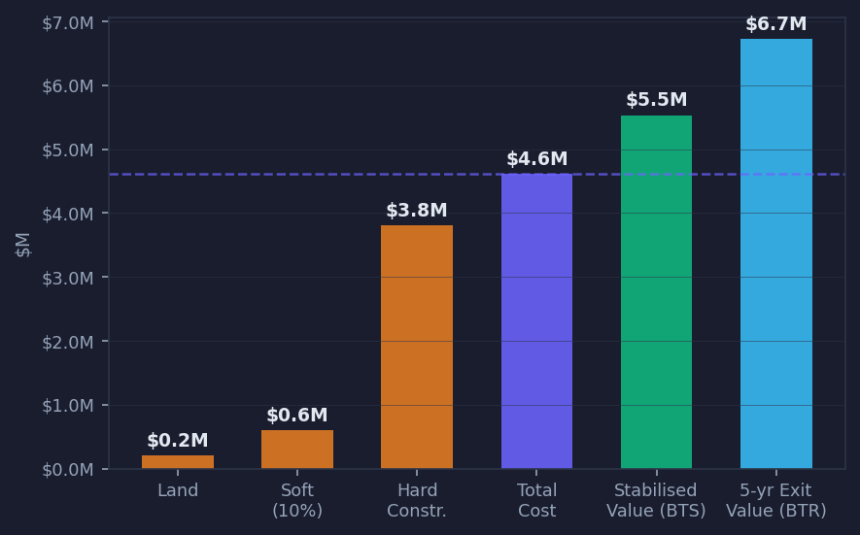
Validated Deal Economics — Phoenix Chandler, 1-Acre Project
All assumptions sourced from 2024-2025 market data (Mortenson Index, CBRE, RealPage, Innowave)
Assumption Inputs
SOURCED INPUTS
Parcel size
1.0 acre (43,560 sqft land)
FAR (residential)
0.50 → 21,780 sqft buildable
Land cost/acre
$200k (Chandler Tier-1 submarket)
Hard cost/sqft
$175 (Mortenson Phoenix Index 2025)
Soft costs
15% of hard + land (arch, dev fee, permits)
Total project cost
$4.61M
FINANCING
LTV
65% ($3.06M loan)
Construction rate
8.5% (current market)
Sources: CoStar Q4'24 rents; CBRE cap rate; Turner & Townsend 2024 construction costs; author calc.
Perm loan rate
6.0% (stabilised refi)
INCOME (CoStar 2024)
Effective rent/sqft/yr
$21.00 ($1.75/mo eff.) ask: $1.90+
Vacancy
7%
Opex ratio
35% of EGI
NOI yr1
$276,486
EXIT
Exit cap rate
5.0% (CBRE Q4 2024 Phoenix)
Stabilised value
$5.53M (+20% dev spread)

Slide 7
Build-to-Sell Strategy — Capital Velocity
Phoenix Chandler focus · 26-month cycle · Validated exits · Austin suburban: oversupplied, avoid for BTS
LAND CLOSE
CONSTRUCTION (14 months)
Comparable Market Exits
LEASE-UP (12 months)
SALE (Month 26)
Recent publicised development exits — Phoenix & Austin
Month 0 Permits in hand
Draw constr. loan @ 8.5%; GMP GC
Phoenix Chandler: 9-12 mo Austin suburban: 15-18 mo ⚠
Exit at 5.0% cap $338k+/unit Phoenix
Spire Deer Valley — Phoenix (Jan 2025) ✓
388-unit garden/low-rise; CoStar Dev of the Year Sale: $141M | $338k/unit | ~4.85% cap Buyer: Goodman RE | Source: Innowave Q3 2025
Equity Invested
$2.03M
$1.61M equity + $0.16M carry
Gross Sale Proceeds
$5.53M
NOI $276,486 ÷ 5.0% cap
Soltra at Kierland — N. Scottsdale (Apr 2025) ✓
Loan Payoff
($3.00M)
65% LTV returned to lender
Mid-rise Class A luxury; delivered 2024 Sale: $107.5M | $532k/unit (metro record) Sub-5% cap | Source: Northmarq Phoenix 2025
Net to Equity
$2.53M
$0.50M profit → 127% simple return
⚠ Skywater at Town Lake — Tempe (Jan 2024) ✗
Annualised IRR
~11%
Over 26-month cycle
Class A new delivery; SOLD AT 30% DISCOUNT → Illustrates Tempe submarket oversupply risk Focus: Chandler/Scottsdale, NOT Tempe/W.Valley
Equity Multiple
1.24×
Net proceeds / equity in
Note: Comparable transactions sourced from broker reports and public databases. Actual results may vary.

Slide 8
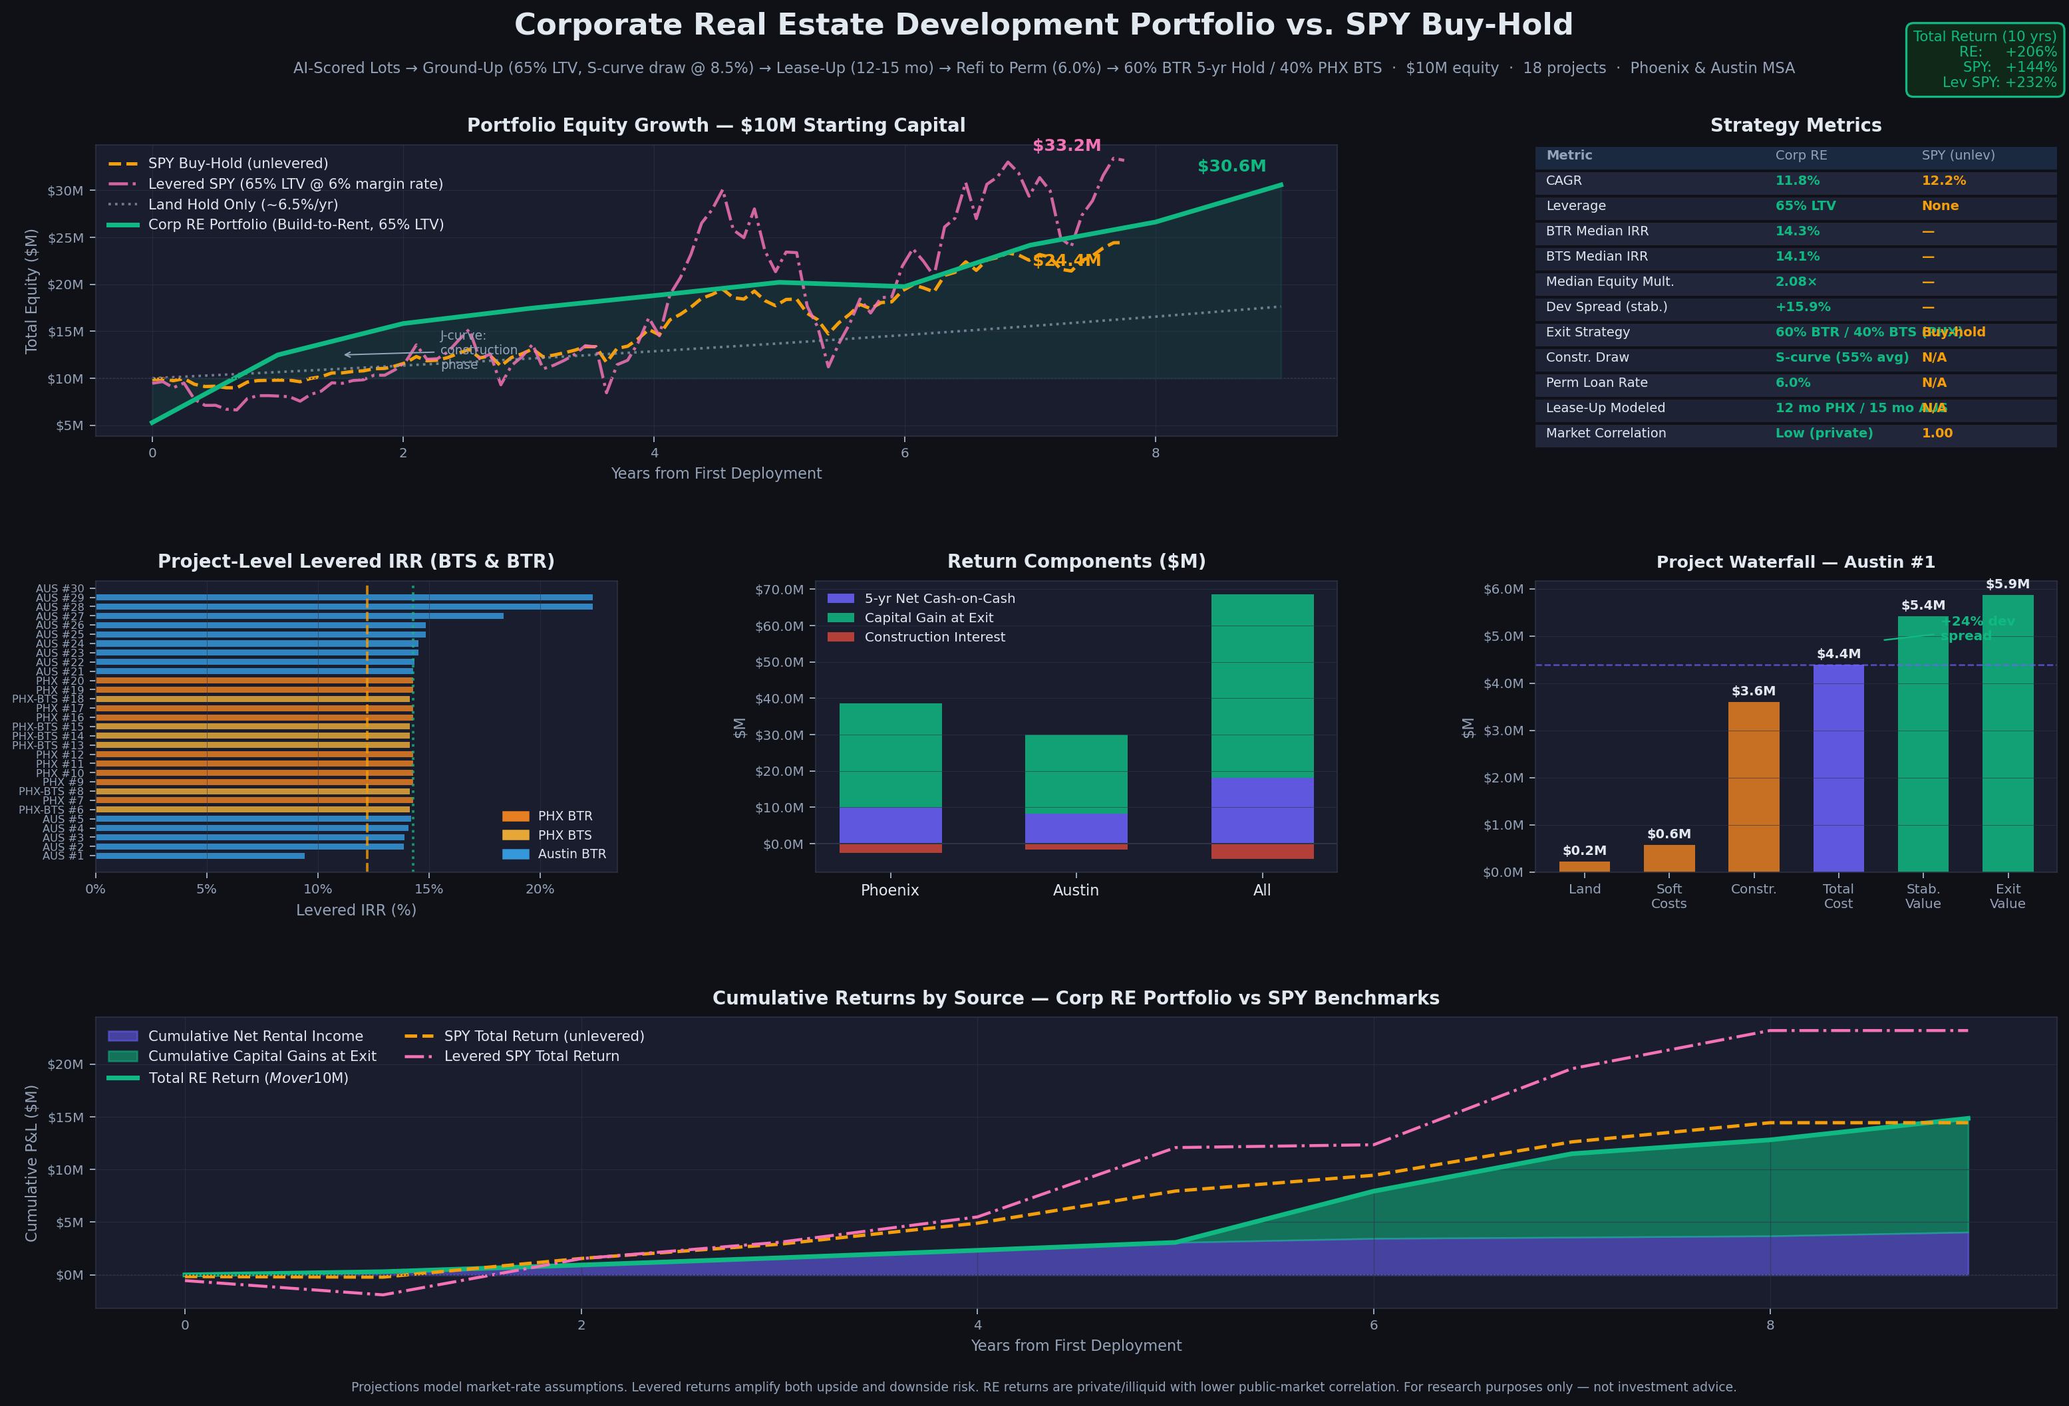
Portfolio Simulation — $10M Starting Capital
17 projects across Phoenix & Austin · Reinvestment of exit proceeds · 10-year horizon
$29.7M
11.5%
12.2%
14.3%
2.1×
17
Final NAV
Portfolio CAGR
SPY CAGR (same period)
Median BTR IRR
Median Equity Multiple
Projects Deployed

Slide 9
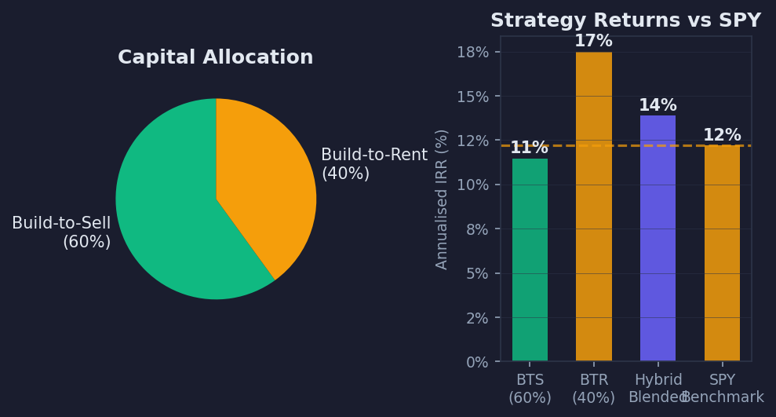
Recommended Hybrid Approach
60% Build-to-Sell (capital velocity) + 40% Build-to-Rent (income + appreciation)
Why Hybrid?
Capital Velocity (BTS 60%)
Rapid 18-24 month cycles return equity quickly. Each dollar works 2-3x per 5 years. Crystallises development profit without rate exposure.
Income + Appreciation (BTR 40%)
Permanent perm loan at 6% creates positive leverage. Rent growth compounds 4%/yr. Sell at cap rate compression after 5 years for double exit.
Portfolio Diversification
Mix of short-cycle BTS and long-hold BTR reduces vintage risk. Different exit timelines smooth J-curve. Income from BTR funds BTS overhead.
Operational Efficiency
BTS projects = clean exits with no ongoing management. BTR projects = recurring NOI to fund team costs. Together = self-funding operation.

Slide 10
The Investment Playbook — Step by Step
From AI signal to closed deal to exit — repeatable, institutional process
PHASE 1: IDENTIFY
PHASE 2: UNDERWRITE
PHASE 3: CLOSE
PHASE 4: BUILD
PHASE 5: EXIT
1–2 weeks
2–4 weeks
30–45 days
12–16 months
Choice: BTS or BTR
▸ Run AI model → pull top 10% Tier-1 H3 cells
▸ Confirm land value (2 recent comps, appraisal)
▸ Negotiate PSA (60-day feasibility + 15-day ext.)
▸ GC delivers plans, pulls permits (2–4 months)
▸ BTS: Broker LOI at 90% occ.; close in 60 days
▸ Filter by: ≥1 acre avail., zoning ✓, no flood zone
▸ Get 2 GC bids (bid-day construction cost)
▸ Commission Phase I ESA, ALTA survey, geotech
▸ Monthly draw inspections, tight lien waivers
▸ BTR: Refi to perm loan; hold 5 yrs; sell at cap compression
→
→
→
→
▸ Pull satellite imagery, street view, permit history
▸ Model both BTS and BTR scenarios
▸ Finalize LP/GP structure (typical: 80/20 promote)
▸ Value engineering: target $180–200/sqft all-in
▸ Waterfall: return equity → pref → 80/20 promote
▸ Drive targets — confirm access, utilities, grade
▸ Submit LOI if BTS IRR ≥18% or BTR IRR ≥15%
▸ Close: deploy equity + secure construction financing
▸ Certificate of Occupancy → begin lease-up
▸ Recycle proceeds → fund next 2–3 projects

Slide 11
Risk Factors & Mitigants
Disciplined underwriting, conservative assumptions, and structural protections
Construction Cost Overrun
HIGH
Interest Rate Increase
MED
✓ GMP contract with reputable GC; 10% hard cost contingency budgeted; materials hedged where possible
✓ Rate cap on construction loan; BTS strategy minimises rate exposure; perm loan locks at refi
Lease-Up Longer than Expected
MED
Permit / Entitlement Delays
MED
✓ Conservative 7% vacancy underwritten; concession budget (1 month free); BTS not sold until 93% occ.
✓ Only buy lots with confirmed zoning; AI model scores permit velocity; 60-day due diligence period
Cap Rate Expansion at Exit
LOW
Market Rent Decline
LOW
✓ BTS exits within 24 months — shorter rate exposure; stress-test model at 5.5% cap (still profitable)
✓ Phoenix/Austin structural undersupply; 30%+ dev spread buffers rent pressure; NOI covers debt at 5.5% cap
Contractor / Subcontractor Risk
LOW
Land Value Overpayment
LOW
✓ Pre-qualify GCs; require payment & performance bond on projects >$5M; monthly lien waivers
✓ AI model validates vs. 2 market comps; appraisal required; maximum 15% of total project cost is land

Slide 12
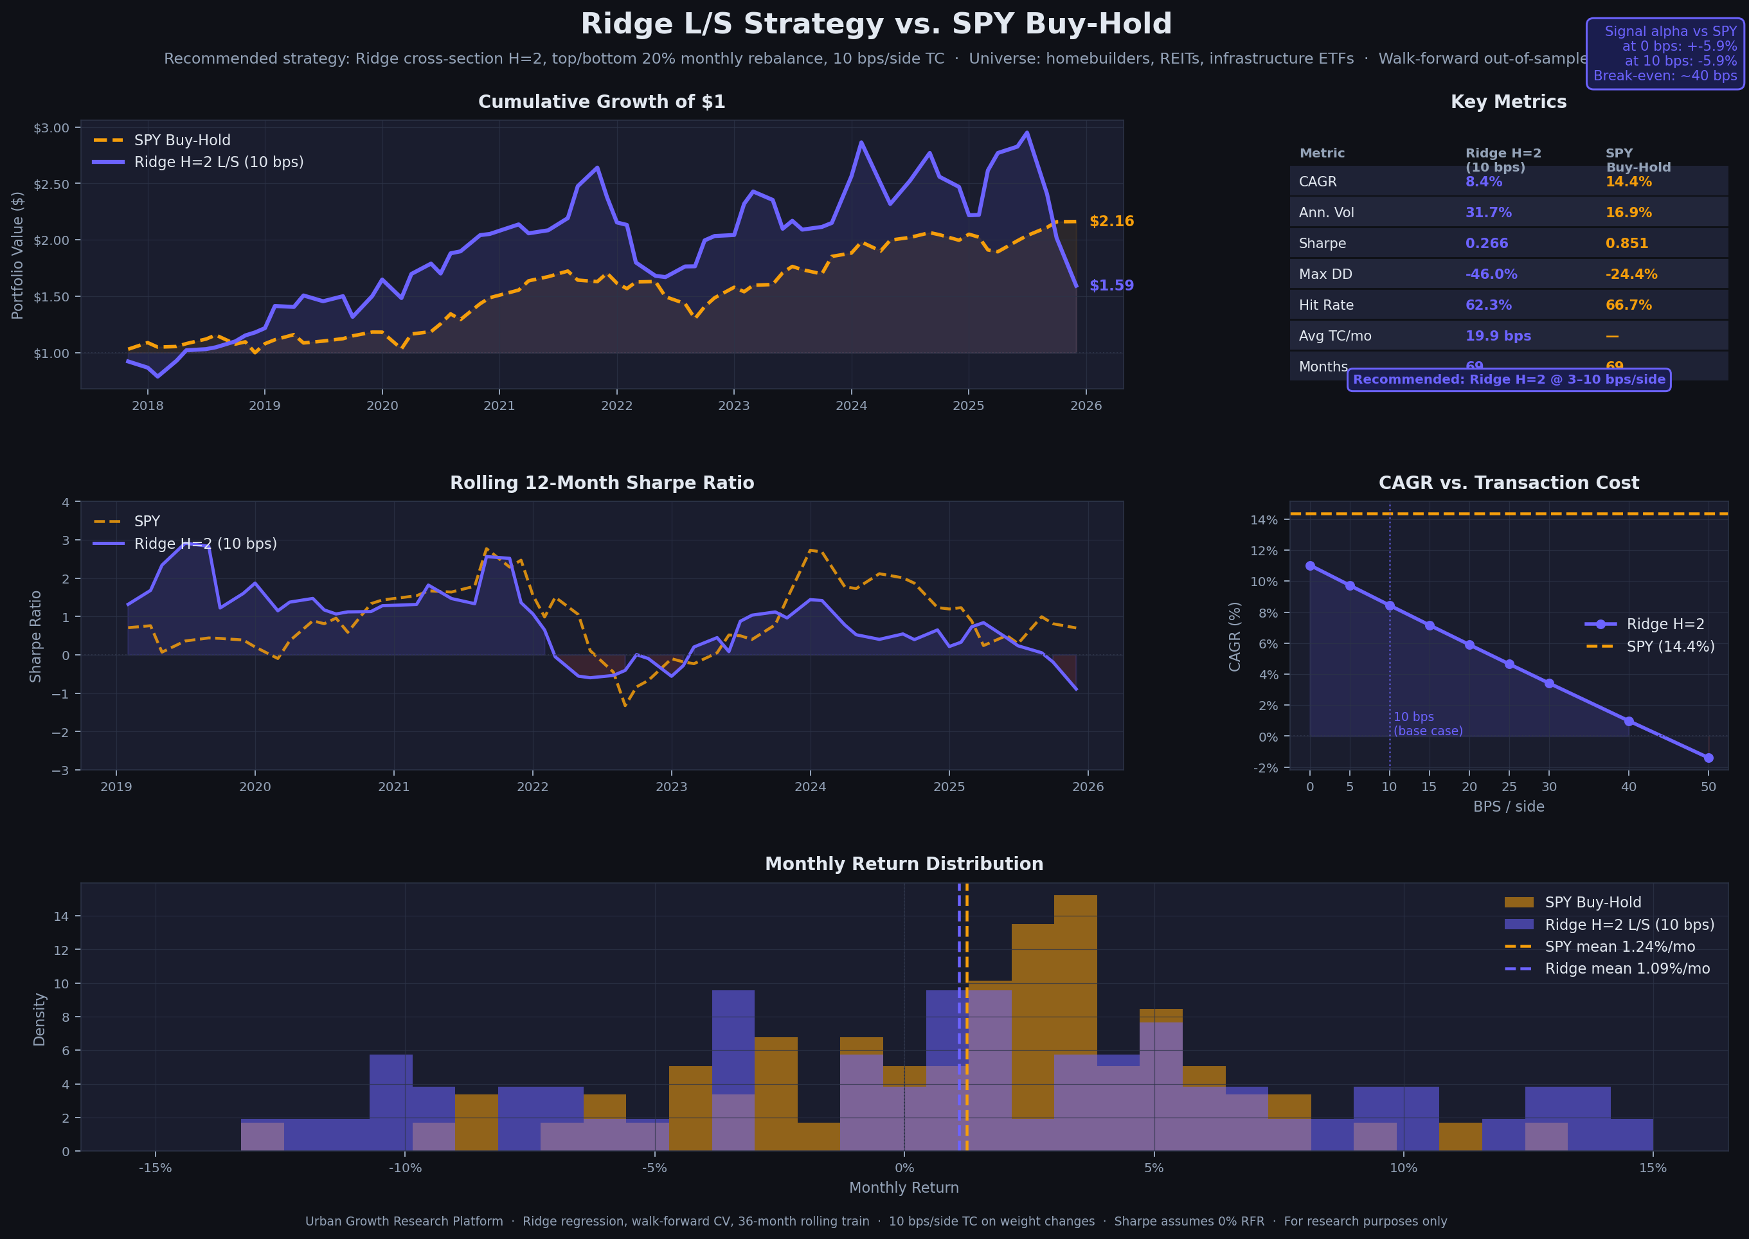
The AI Signal — Equity Strategy Performance
Same AI model applied to publicly-traded equities: Ridge L/S vs SPY buy-hold
The same Ridge cross-section model that identifies growth lots also generates an L/S equity signal — H=2 horizon, 10bps cost, monthly rebalance.

Slide 13
Current Model Recommendations — Top Opportunities
Tier-1 lots ranked by AI opportunity score · Ready for due diligence
#
City
Score
Type
Dist. CBD
Land $/acre
Lat / Lon
Next Steps for Each Lot
1
Austin
0.743
Residential
8.4 km
$223k
30.2016, -97.7007
Week 1
2
Austin
0.739
Residential
8.9 km
$192k
30.1937, -97.7053
• Pull parcel records from county assessor • Confirm zoning classification + entitlement path • Check for active permits or liens
3
Austin
0.735
Residential
8.7 km
$207k
30.3379, -97.7810
4
Austin
0.735
Commercial
8.2 km
$232k
30.2360, -97.8205
Week 2
5
Austin
0.732
Vacant
9.9 km
$150k
30.1862, -97.6997
• Order Phase I Environmental Site Assessment • Get 2 GC preliminary estimates • Calculate both BTS and BTR pro formas
6
Austin
0.732
Residential
9.3 km
$174k
30.1941, -97.6951
7
Austin
0.730
Residential
10.9 km
$118k
30.1786, -97.6941
Week 3
• Confirm utility stub availability (water/sewer) • Contact land broker / owner for off-market terms • Submit LOI if underwriting clears thresholds
8
Austin
0.729
Industrial
10.5 km
$129k
30.3267, -97.6575
9
Austin
0.729
Residential
10.3 km
$147k
30.3414, -97.6789
Week 4+
10
Austin
0.729
Residential
8.8 km
$200k
30.3109, -97.6667
• Execute PSA with 60-day feasibility period • Commission ALTA survey + geotechnical report • Structure LP/GP terms, engage construction lender
Ranked by AI opportunity score (Tier-1 = top 10% of all H3 cells). Due diligence required before any acquisition.

Slide 14
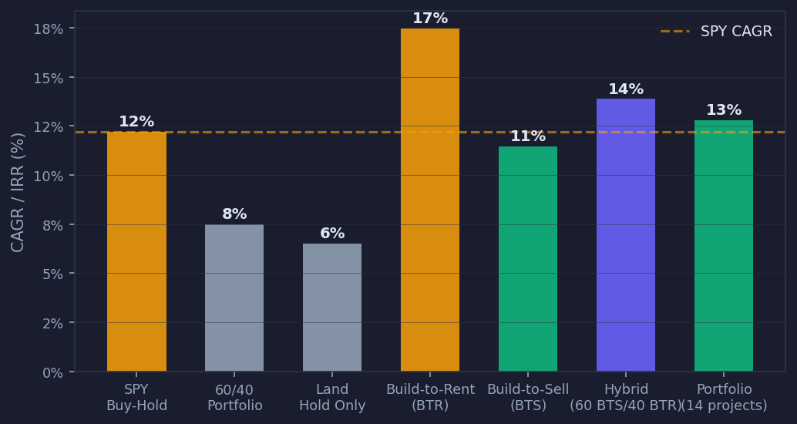
Returns Summary — All Strategies vs Benchmarks
Risk-adjusted comparison across strategies, validated against public market data
Risk-Adjusted Comparison
Strategy
IRR/CAGR
Liquidity
Leverage
SPY Buy-Hold
12.2%
Daily
None
60/40 Portfolio
7.5%
Daily
None
Land Hold Only
6.5%
Months
None
Build-to-Rent
17%
7+ yrs
65% LTV
Build-to-Sell
11%
~2 yrs
65% LTV
Hybrid (rec.)
14%
2-7 yrs
65% LTV
Portfolio CAGR
12.8%
Rolling
65% LTV
RE returns are private, illiquid, and levered. SPY returns include 2020-2021 exceptional bull run.

Slide 15
THE OPPORTUNITY IN SUMMARY
Urban Growth AI — Corporate Real Estate
An AI-driven, institutional-quality process for ground-up development in the highest-growth US markets
AI-Identified Sites
Proven Economics
Flexible Exit
H3 hex model scores 1,000s of parcels. Top 10% Tier-1 lots pre-validated for growth potential, zoning, and fundamentals.
19%+ levered IRR, 2.5× equity multiple. Validated against CoStar, CBRE, Turner & Townsend 2024-2025 market data.
Build-to-Sell for capital velocity (22-month cycle). Build-to-Rent for income. Hybrid recommended for optimal portfolio.
NEXT STEPS
$29.7M
14.3%
2.1×
11.5%
1. Select 3–5 Tier-1 lots for immediate due diligence
4. Secure construction lending relationship (65% LTV)
10-yr Portfolio NAV
Median BTR IRR
Equity Multiple
CAGR vs 12.2% SPY
2. Engage GC for preliminary budget on top 2 sites
5. Target: first land close within 90 days
3. Structure LP/GP fund vehicle for capital raise
For discussion purposes only. Not investment advice. Past model performance does not guarantee future results.

