Slide 1
A Comparative Analysis Of Transformer-Based Architectures For Enhancing Suicidal Ideation And Detection Using Pre-Trained Language Model

Slide 2
Presented By:
Mainul Islam 190104016
Samia Afrin 190104132
Md Kamrul Hasan 190104144
Abdullah Al Mahmud 190104146
Supervised by
Dr. Taslim Taher Assistant Professor, CSE (AUST)

Slide 3
Introduction
Motivation
Literature review
Background Studies
Dataset
Methodology
Dataset Analysis
Model train
Result Analysis
Future Work
Conclusion
Table of Contents

Slide 4
Introduction
Alarming Suicide Statistics:
Suicide remains a significant global concern, with an estimated annual global death toll of approximately 80,000 lives lost to suicide.
Role of Machine Learning Techniques:
Machine learning techniques offer a promising avenue to aid in suicide risk detection and prevention
Identifying Suicide Risk Factors:
Various risk factors, including mental health disorders, social isolation, previous suicide attempts, and other psychosocial stressors, contribute to increased vulnerability to suicidal ideation and behaviors.
1

Slide 5
Motivation
Saving Lives:
Suicide is a global public health concern, and developing effective suicide ideation detection methods can save lives by identifying individuals at risk and providing timely interventions and support.
Early Intervention:
Early detection of suicidal ideation allows for proactive intervention, enabling mental health professionals, support helplines, and communities to reach out to individuals in distress and provide the necessary assistance before the situation escalates.
Addressing the Stigma:
Suicide is often surrounded by stigma and silence. By implementing suicide ideation detection methods, we can break the barriers of communication and encourage open conversations about mental health, promoting a supportive and empathetic society.
2

Slide 6
Literature Review
Title | Methodology of selection | Accuracy/Result
A Transformer Based Approach To Detect Suicidal Ideation Using Pre-Trained Language Models | Pretrained systems like BERT and its variants ALBERT, Roberta, and XLNET. | Bi-LSTM: 84.39; BERT: 88.3; ALBERT: 87.77; ROBERTa: 95.21; XLNET: 89.01.
Detection of Suicide Ideation in Social Media Forums Using Deep Learning | Random forest, Support vector machine, Naive bayes, XGBOOST, LSTM-CNN. | Random forest: 85.6 ; Support vector machine: 83.5; Navies bayes: 82.5; XGBOOST: 88.3; LSTM-CNN: 93.8 .
3

Slide 7
Literature Review
Title | Methodology of selection | Accuracy/Result
Detection of Depression and Suicide Risk Based on Text From Clinical Interviews Using Machine Learning | The Naive Bayes classifier algorithm, constructing an ensemble model. | Demographic model: 0.542; text model: 0.602; Ensemble model: 0.747;The sensitivity and specificity of the ensemble model were 0.816 and 0.647, respectively, with an AUC of 0.800.
4

Slide 8
Literature Review
Title | Methodology of selection | Accuracy/Result
Suicidal Ideation Detection: A Review of Machine Learning Methods and Applications | psychological lexicon dictionaries, Support Vector Machines (SVM), Convolutional Neural Networks (CNNs), Recurrent Neural Networks (RNNs), and Bidirectional Encoder Representations from Transformers (BERT) | the paper lacks specific accuracy values for the discussed models and only focuses on reviewing machine learning methods and their applications in suicidal ideation detection.
5

Slide 9
Literature Review
Title | Methodology of selection | Accuracy/Result
Comparative Analysis on Suicidal Ideation Detection Using NLP, Machine, and Deep Learning | DL models, such as LSTM, BiLSTM, BiGRU, and C-LSTM, using Keras, a high-level API based on TensorFlow. | LSTM: 93.6%, BiLSTM: 93.5%, BiGRU: 93.4%, CLSTM: 93.2%, Random Forest (RF): 93.0%, Support Vector Classifier (SVC): 91.9%, Stochastic Gradient Descent (SGD): 91.7%, Logistic Regression (LR): 91.2%, Multinomial Naive Bayes (MNB): 84.6% .
6

Slide 10
Transformer in NLP
A Transformer is a modern deep learning architecture that uses attention to process text sequences effectively.
Transformer works is based on two key components :
Attention
Transformer Blocks.
Text Pretrained models :
1.Bert
2.Albert
3.RoBerta
4.DistilBert
7

Slide 11
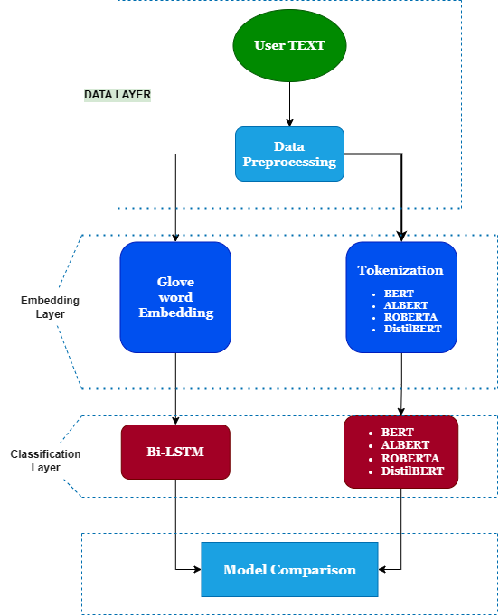
Proposed Methodology
Data Layer
Data collection
Data preprocessing
Embedding Layer
Word Embedding : GloVe
Transformer-based Tokenize : BERT, Albert, RoBERTa, DistilBert
Classification Layer
Bi-Lstm
Transformer Models (BERT, Albert, RoBERTa, DistilBert)
Model Comparison
8

Slide 12
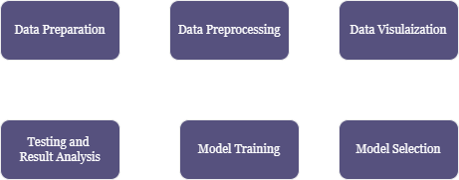
Working Methodology
9

Slide 13
Data Collection
Data Acquisition:
The data was collected using the Pushshift API, which allowed the researchers to collect all posts made on the "Suicidewatch" subreddit from December 16, 2008, to January 2, 2021, and all posts made on the "Depression" subreddit from January 1, 2009, to January 2, 2021
10

Slide 14
Data Collection
Dataset Shape:
Consists of 2,33,370 suicidal text
2 columns (texts, suicidal_ideation).
Name | Type | Description
Text | Continuous | Text containing the presence of persistent thoughts, and fantasies of one's mental health condition
Suicide_ideation | Discrete | suicide/not suicide
11

Slide 15
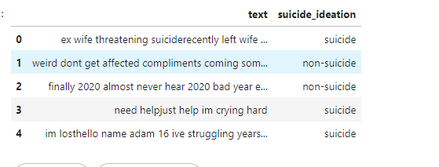
Dataset Preprocessing
Steps of Data Preprocessing:
Remove Outliers
Data Cleaning
Data Split
12

Slide 16
Dataset Preprocessing
Remove Outliers:
Sentence Noise
Remove blank text
Remove text with only numeric
Remove text with only special characters
Remove text with only punctuation
Text with any alpha or alphaNumeric value
Remove long text (99.97%) - 79 sentences
Word Noise
Considerable Emojis
Number of words
Considerable Punctuation
Considerable Repeated words
Numbers of words without stopwords
13

Slide 17


Dataset Preprocessing
After Date Cleaning:
Beforefore data Cleaning:
Data Cleaning:
Lower case & Extra space
Handling Null & Duplicate Value
Remove Emojis
Remove Html Tags
Do Contractions
Remove other Languages characters
Remove Non Printable Characters
Special characters removal
StopWord Removal
Lemmatization
14

Slide 18
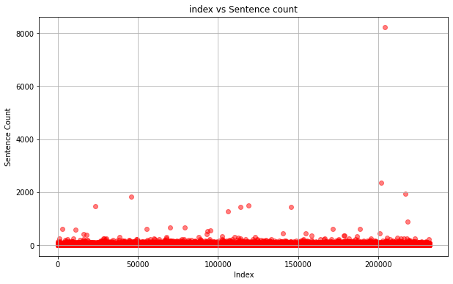
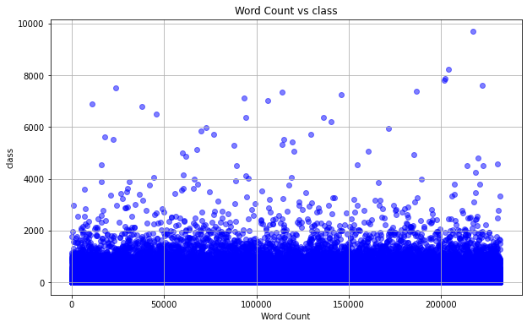
Data Visualization
Outliers/Noise:
Sentence Noise
Words Noise
99.97%
99.97%
15

Slide 19
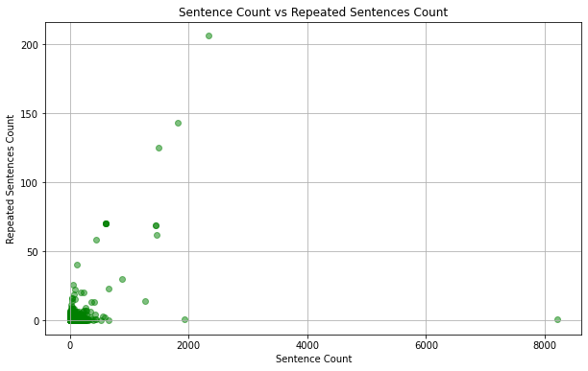
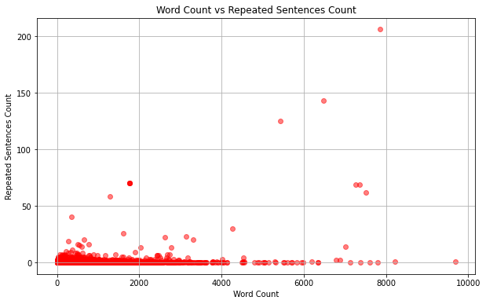
Data Visualization
Outliers/Noise:
Repeated Sentence Noise
Repeated Words Noise
16

Slide 20
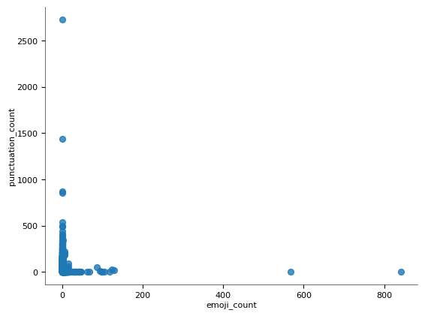
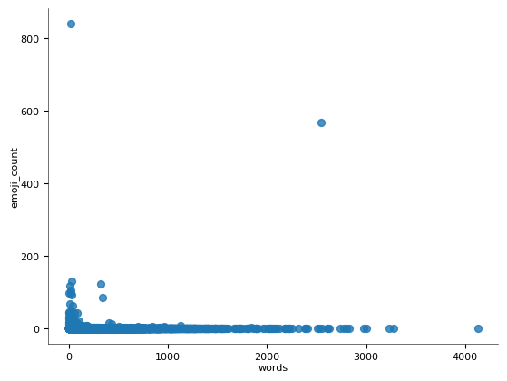
Data Visualization
Outliers/Noise:
Punctuation Noise
Emojis Noise
17

Slide 21
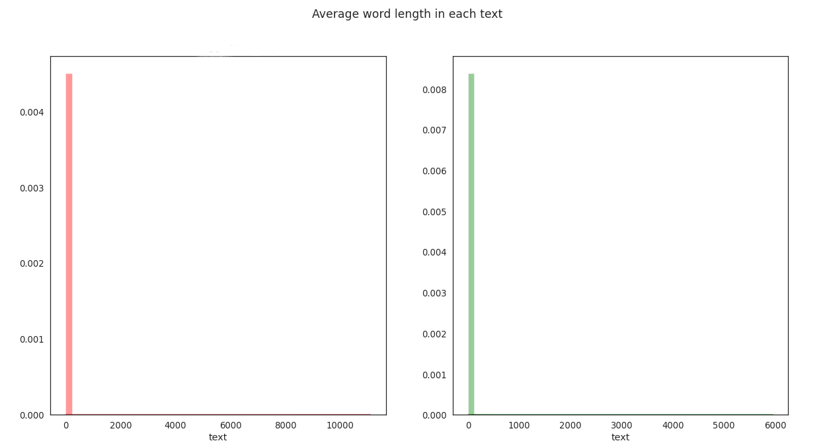
Data Visualization
Avg. Word in length in each text
The plot shows that the suicidal text word length contains less than the non-suicidal text word length. The left plot indicates the suicidal text and the right plot indicates the non-suicidal text.
18

Slide 22
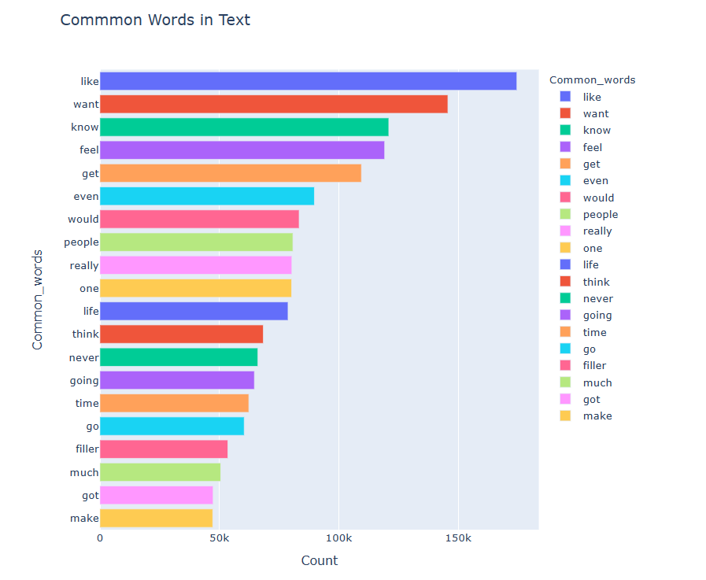
Data Visualization - UNIGRAM
Most common frequent words
like,want, know, get, even, would, people, feel,
filler, get, much, got, make
19

Slide 23
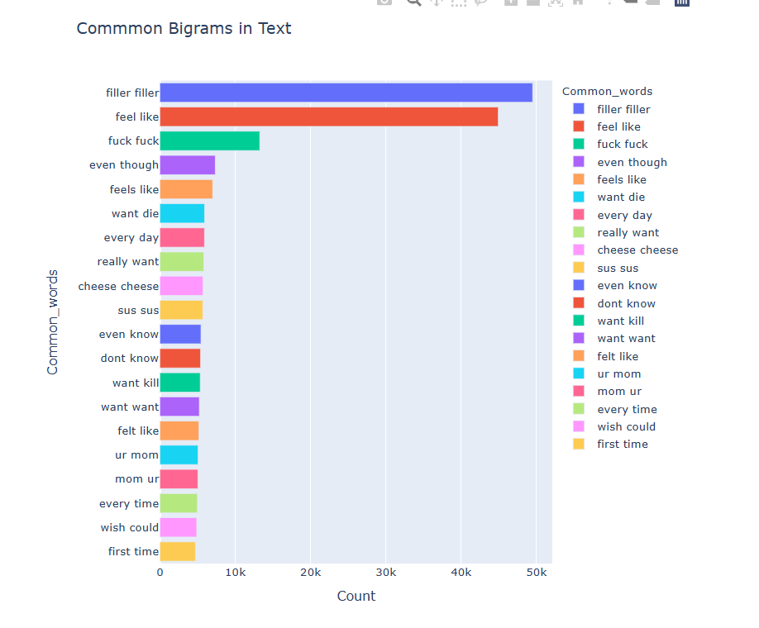
Data Visualization - BIGRAM
Text Compression and Prediction:
Bigram models enable text compression and prediction, generating coherent and contextually appropriate text.
20

Slide 24
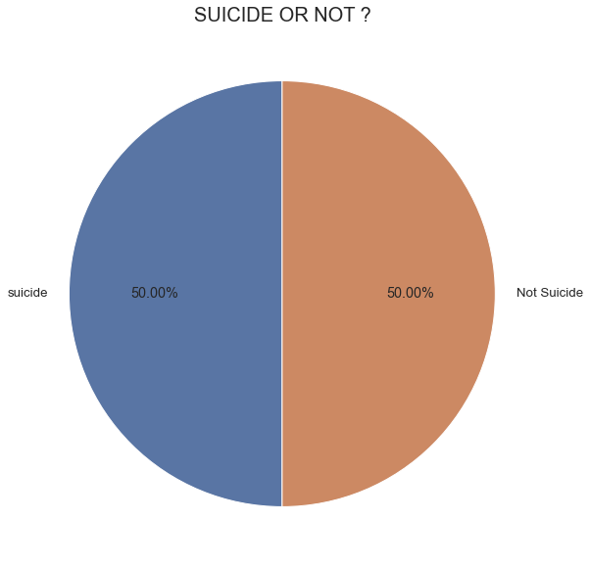
Data Visualization
Data Balancing (Before Outliers Remove):
Suicide= 50%
Non-suicide=50%
Suicide_ideation (suicide, Non-suicide)=
(1,16,037; 1,16,037)
Total: 2,33,370
21

Slide 25
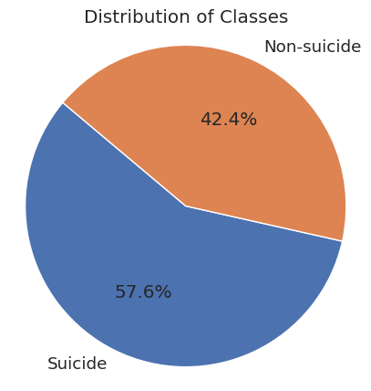
Data Visualization
Data Balancing (After Outliers Remove):
Suicide= 57.6%
Non-suicide=42.4%
Suicide_ideation (Suicide, Non-suicide) = (1,07,620; 79,221)
Total: 1,86,841
So, there are total 46,529 (19.93%) data has been remove
22

Slide 26
Dataset Preprocessing
Data Split:
Train Data (70%) - 85,015
Test Data (20%) - 24,465
Validation Data (10%) - 11,960
Hyper-parameter Tuning:
Learning Rate: 3e-5
Batch Size: 16/18/10
Epoch - 3
Optimizer - Adama Torch
Weight-decay - 0.01
23

Slide 27
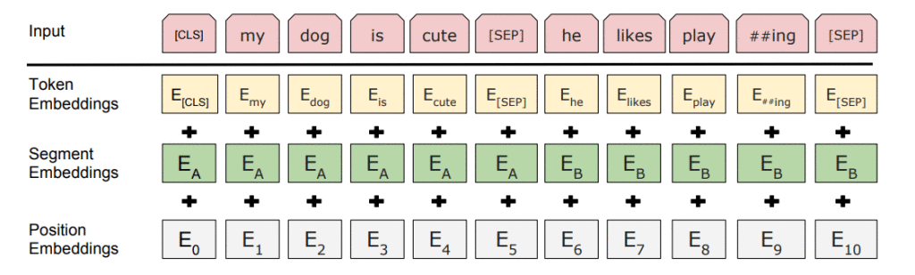
Model Selection- BERT
BERT can capture the complex language patterns and contextual information present in suicide-related posts, allowing for more accurate detection.
Fine-tuning BERT on a suicide detection task can further enhance its performance by adapting it to the specific characteristics of the dataset.
Using BERT for suicide detection can contribute to early identification of individuals at risk, enabling timely interventions and potentially saving lives.
24

Slide 28
Model Selection- BERT
Bert-Base-Uncased
Original Text : ‘ This is an example for BERT Tokenization ’ Tokens: ['[CLS]', 'this', 'is', 'an', 'example', 'sentence', 'for', 'bert', 'token', '##ization', '.', '[SEP]']
Token IDs: [101, 2023, 2003, 2019, 2742, 6251, 2005, 14324, 19204, 3989, 1012, 102]
BERT TEXT
Tokens + Token IDs
25

Slide 29
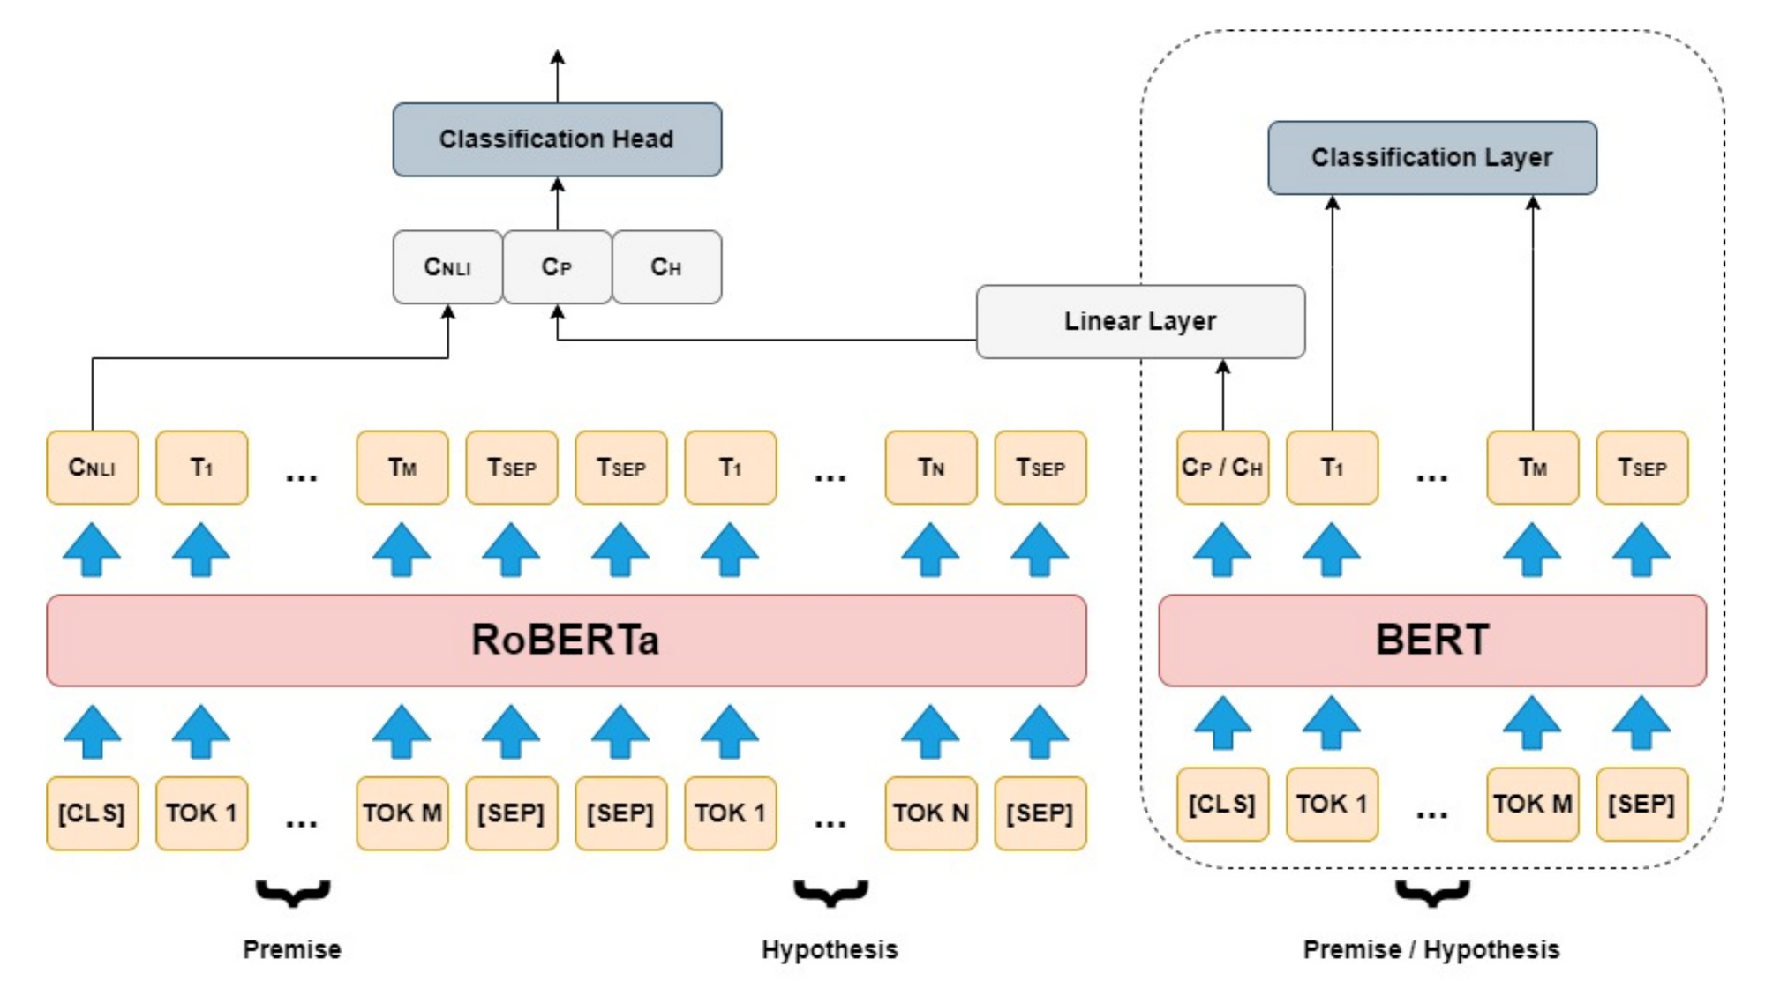
Model Selection- ROBERTA
Removal of NSP Objective
Training with Larger Batches &
Sequences
Dynamic Masking Pattern
26

Slide 30
Model Selection- ROBERTA
ROBERTA-BASE
Original Text : ‘ This is an example for ROBERTA Tokenization ’ Tokens: ['[CLS]', 'this', 'is', 'an', 'example', 'sentence', 'for', 'bert', 'token', '##ization', '.', '[SEP]']
Token IDs: [101, 2023, 2003, 2019, 2742, 6251, 2005, 14324, 19204, 3989, 1012, 102]
ROBERTA TEXT
Tokens + Token IDs
27

Slide 31
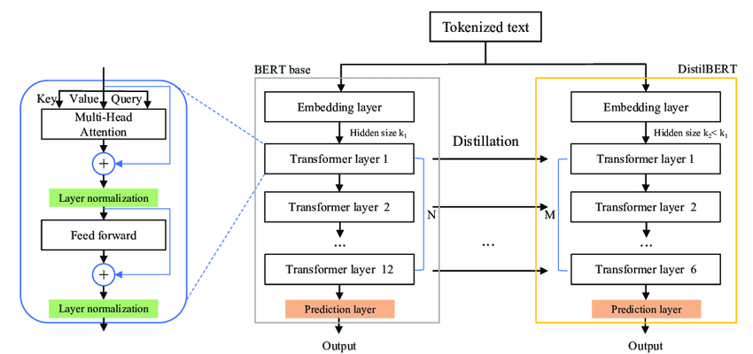
Model Selection- DistilBERT
Transformer Architecture
Efficiency without Sacrificing
Performance.
Transfer of Knowledge for
Model Compression
28

Slide 32
Model Selection- DistilBERT
DistilBert-base-uncased
Original text: This is an example sentence for DistilBERT tokenization.
Tokens: ['[CLS]', 'this', 'is', 'an', 'example', 'sentence', 'for', 'di', '##sti', '##lbert', 'token', '##ization', '.', '[SEP]']
Token IDs: [101, 2023, 2003, 2019, 2742, 6251, 2005, 4487, 16643, 23373, 19204, 3989, 1012, 102]
DistilBert TEXT
Tokens + Token IDs
29

Slide 33
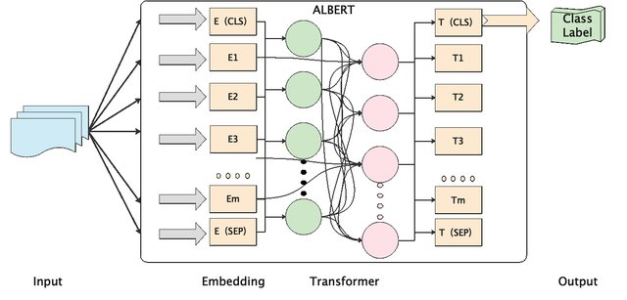
Model Selection- ALBERT
Efficient Parameterization
Faster Training and Inference
Memory Efficiency
Scalability and Generalization
30

Slide 34
Model Selection- ALBERT
AlBert-Base-V2
Original Text : ‘ This is an example for ALBERT Tokenization ’ Tokens: ['[CLS]', 'this', 'is', 'an', 'example', 'sentence', 'for', 'albert', 'token', '##ization', '.', '[SEP]']
Token IDs: [101, 2023, 2003, 2009, 2742, 6252, 2005, 14324, 19204, 3989, 1012, 102]
ALBERT TEXT
Tokens + Token IDs
31

Slide 35
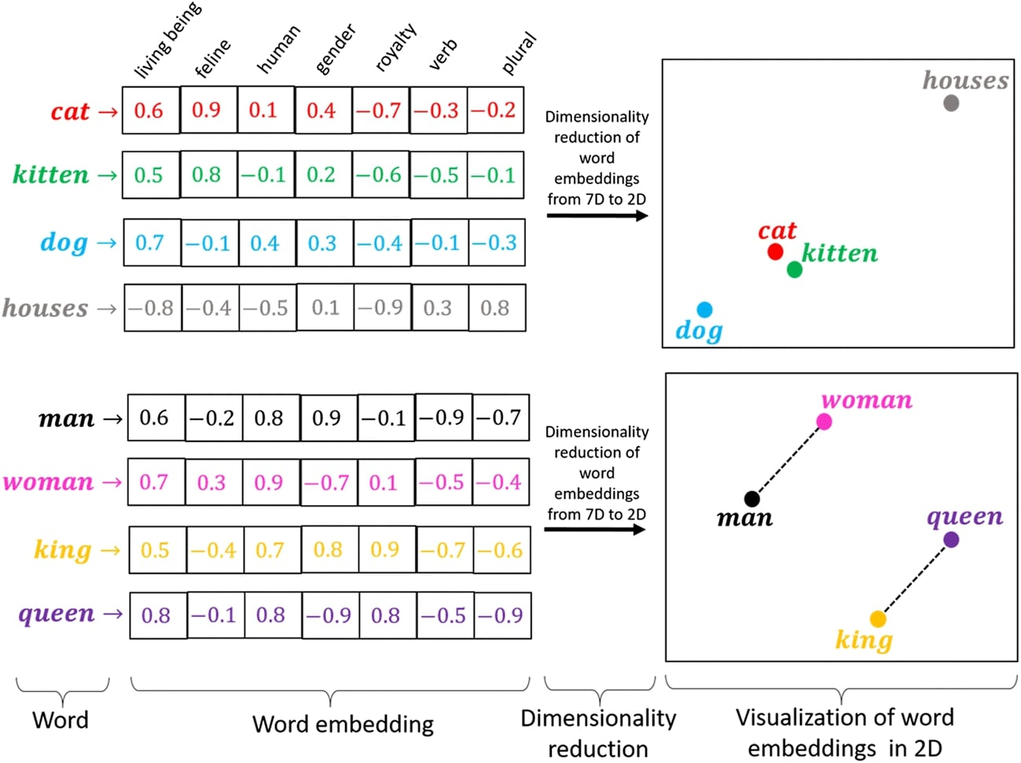
Model Selection- GloVe
GloVe embeddings provide vector representations that encode the meaning and context of words, allowing for a deeper understanding of the text.
GloVe models are trained on large-scale datasets, which helps them capture a broad range of language patterns
32

Slide 36
Model Selection- GloVe
SUMMARY:
Total params: 92,566,013
Trainable params: 31,313
Non-trainable params: 92,534,700
Layer (type) | Output Shape | Param #
embedding_10 (embedding) | [(None, 40,300)] | 92534700
LSTM_10(LSTM) | ((None, 40, 20),) | 25680
global_max_polling_id_10 | [(None, 20)] | 0
dense_2 (Dense) | (None, 256) | 769
33

Slide 37
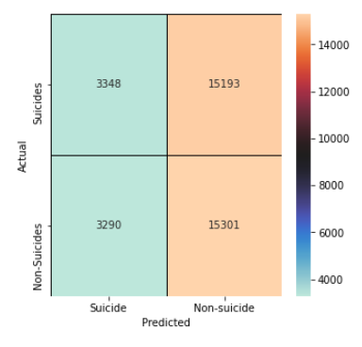
Data Prediction- GloVe
Confusion Matrix:
This is the actual and Predicted data
plot from GloVe MODEL:
FP : 3290
TN : 15301
TP : 3348
FN : 15193
34

Slide 38
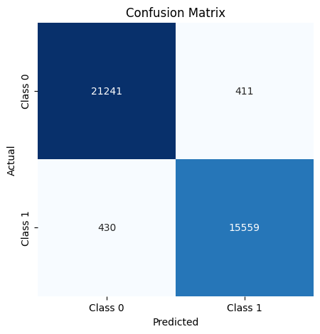
Data Prediction- BERT
Confusion Matrix:
This is the actual and Predicted data plot from BERT MODEL:
TP : 21241
TN : 15559
FP: 430
FN : 411
35

Slide 39


Data Prediction
Distilebert
Albert
 | Distilbert | Albert
TP | 21497 | 21197
TN | 15519 | 15505
FP | 470 | 484
FN | 155 | 455
36

Slide 40
Result Analysis
Model Comparison:
Analysis | Precision | Recall | F1-Score | Accuracy
BERT | 0.98 | 0.98 | 0.98 | 97.77%
AlBERT | 0.98 | 0.98 | 0.98 | 98.34%
RoBERTa | 0.95 | 0.95 | 0.95 | 95%
DistilBERT | 0.97 | 0.97 | 0.97 | 97.51%
GloVe + Bilstm | 0.98 | 0.98 | 0.98 | 92.93%
37

Slide 41
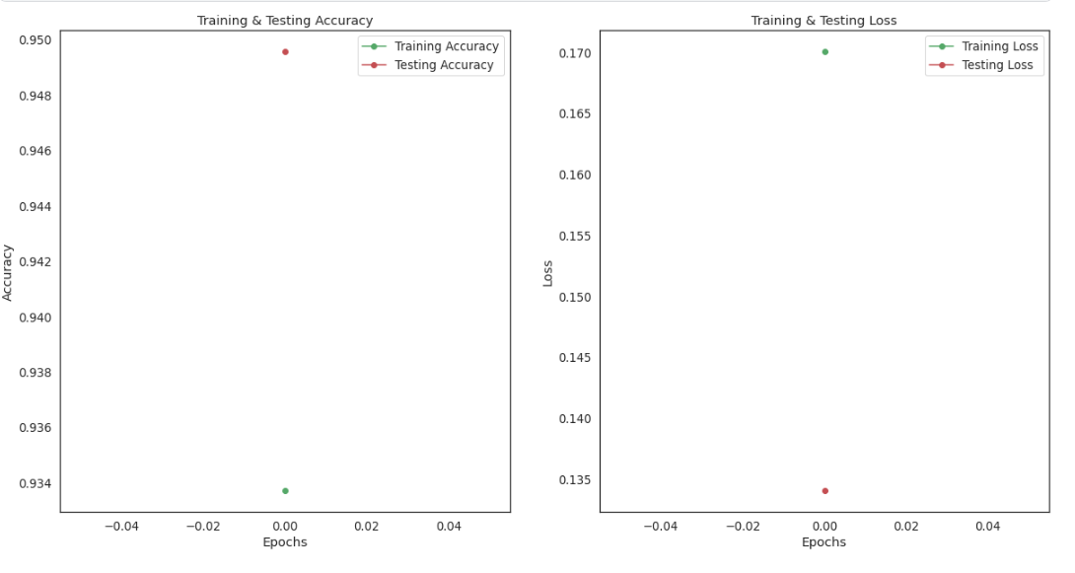
Result Analysis
Training & Testing Accuracy:
Testing accuracy and epoch are plotted on the same y-axis, it allows for easy comparison between the model's performance on the testing data at different epochs.
38

Slide 42
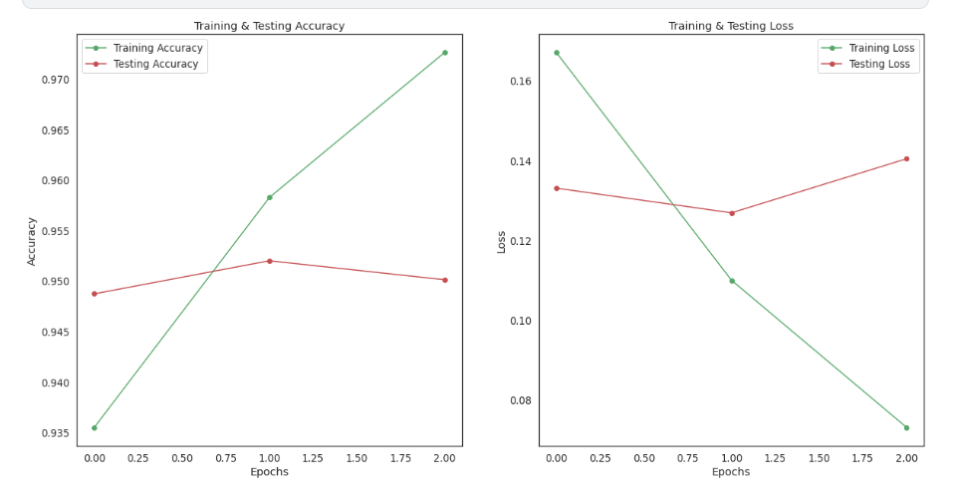
Result Analysis
Training & Testing Loss:
The loss represents the discrepancy between the predicted and actual values, so a decrease in loss signifies that the model is improving its predictions and minimizing errors.
39

Slide 43
Future Work
Multimodal Enrichment: Integrate audio and video content into the dataset to enhance the model's understanding of context and emotional nuances in mental health-related social media posts.
Performance Analysis: Conduct longitudinal analyses to track the model's evolving performance over time, considering the dynamic nature of language use on social media platforms.
Temporal Suicidal Ideation Detection: Investigate real-time detection of suicidal ideation in data streams, focusing on temporal information to identify stages of suicide risk and enable timely monitoring for changes in mental status.
Improve Accuracy and Speed: Acknowledge the current effectiveness of the models in recognizing suicidal content but emphasize the ongoing pursuit of improvement. Future efforts will focus on utilizing advanced machine learning methods and exploring additional data sources to enhance both accuracy and speed.
40

Slide 44
Research Gap
The experiment was conducted only in English. It can be replicated in other languages, such as Bangla.
There are various reasons and problems that lead to suicidal ideation, each with its own causes. One is different from the other. As this dataset was collected from the suicide API & is convenient in English, this research can also be conducted on Bangladeshi socioeconomic factors.
Other transformer models can be performed so that it may be achieved with a higher accuracy than ours.
In addition, it can be performed with emojis as it has a substantial impact on suicidal ideation.
41

Slide 45
Conclusion
The main objective was to tackle global suicide issue by detecting suicidal ideation at an early stage in a automated way, we hope to make a significant impact on individuals and communities, ultimately saving lives and improving mental health outcomes.
Our study utilizes machine learning and deep learning methods to enhance the accuracy of identifying suicidal ideation automaticaly.
Among the Transformer Models that are Used BERT and ALBERT has the highest accuracy , that is 98%.
We believe that our research will contribute to global suicide prevention efforts using technology and machine learning.
42

Slide 46
References
1 | “The daily star.” https://www.thedailystar.net/.
2 | A. Name, “Suicidal thought detection dataset.” https: //www.kaggle.com/code/abhijitsingh001/ suicidal-thought-detection, Year.
3 | A. S. Denney and R. Tewksbury, “How to write a literature review,” Journal of criminal justice education, vol. 24, no. 2, pp. 218–234, 2013.
4 | F. Haque, R. U. Nur, S. A. Jahan, Z. Mahmud, and F. M. Shah, “A transformer based approach to detect suicidal ideation using pre-trained language models,” in 2020 23rd International Conference on Computer and Information Technology (ICCIT), pp. 1–5, 2020.
5 | M. M. Tadesse, H. Lin, B. Xu, and L. Yang, “Detection of suicide ideation in social media forums using deep learning,” no. 1-19, p. Page range, 2020.
6 | D. Shin, K. Kim, S.-B. Lee, C. Lee, Y. S. Bae, W. I. Cho, M. J. Kim, C. H. K. Park, E. K. Chie, N. S. Kim, and Y. M. Ahn, “Detection of depression and suicide risk based on text from clinical interviews using machine learning: Possibility of a new objective diagnostic marker,” Frontiers in Psychiatry, vol. 13, 2022.
43

Slide 47
References
7 | S. Ji, S. Pan, X. Li, E. Cambria, G. Long, and Z. Huang, “Suicidal ideation detection: A review of machine learning methods and applications,” IEEE Transactions on Computational Social Systems, vol. 8, no. 1, pp. 214–226, 2020
8 | R. Haque, N. Islam, M. Islam, and M. M. Ahsan, “A comparative analysis on suicidal ideation detection using nlp, machine, and deep learning,” Technologies, vol. 10, no. 3, p. 57, 2022.
9 | NVIDIA, “What is a transformer model?,” 2022.
10 | A. Chandra, L. Tünnermann, T. Löfstedt, and R. Gratz, “Transformer-based deep learning for predicting protein properties in the life sciences,” Elife, vol. 12, p. e82819, 2023.
11 | “Top 5 pre-trained model in nlp.” https://shorturl.at/wxyJ9
12 | W. De Vries, A. van Cranenburgh, A. Bisazza, T. Caselli, G. van Noord, and M. Nissim, “Bertje: A dutch bert model,” arXiv preprint arXiv:1912.09582, 2019.
13 | “Bert explained: State of the art language model for nlp.” https:// shorturl.at/bcnY8.
44

Slide 48
References
14 | Y. Liu, M. Ott, N. Goyal, J. Du, M. Joshi, D. Chen, O. Levy, M. Lewis, L. Zettlemoyer, and V. Stoyanov, “Roberta: A robustly optimized bert pretraining approach,” arXiv preprint arXiv:1907.11692, 2019.
15 | “Overview of roberta model.” https://www.geeksforgeeks.org/ overview-of-roberta-model/.
16 | Z. Lan, M. Chen, S. Goodman, K. Gimpel, P. Sharma, and R. Soricut, “Albert: A lite bert for self-supervised learning of language representations,” arXiv preprint arXiv:1909.11942, 2019.
17 | V. Sanh, L. Debut, J. Chaumond, and T. Wolf, “Distilbert, a distilled version of bert: smaller, faster, cheaper and lighter,” arXiv preprint arXiv:1910.01108, 2019.
18 | J. Pennington, R. Socher, and C. D. Manning, “Glove: Global vectors for word representation,” pp. 1532–1543, 2014.
19 | N. Komati, “Suicide watch dataset.” https://www.kaggle.com/ datasets/nikhileswarkomati/suicide-watch, Year
45

Slide 49
Thank You

Slide 50
Any Questions
?

