Slide 1
Desktop Console UI Design
Mark Gonsalves
2/9/2018

Slide 2
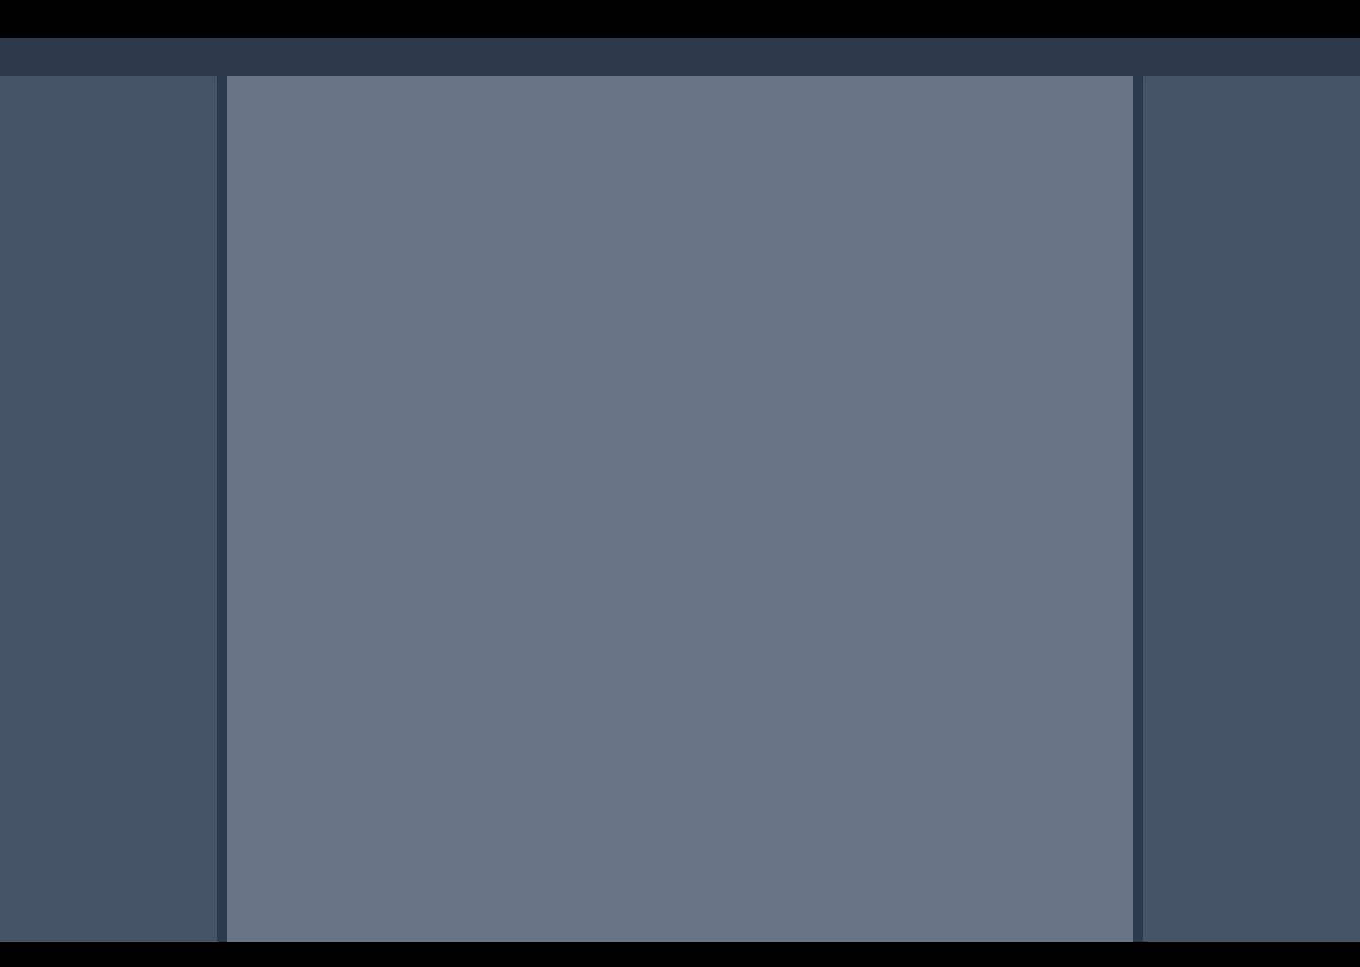
Desktop UI Layout
HEADER - Fixed height
- Intended for user account related information and operations
General layout of the console UI.
Dimensions are 1440x1024 for reference.
Header height: 48 pixels
Tab area height: 48 pixels
Footer height: 32pixels
Gutter (between left, center and right panels) width: 12 pixels
Header color: 0x000000
Footer color: 0x000000
Background color (includes tab area): 0x2c3a4b
Left panel color: 0x445366
Right panel color: 0x445366
Center panel color: 0x 677587
Icon size: 32x32
TAB AREA - Fixed height
- Intended to render tabs for the left, center and right panels.
LEFT PANEL - Variable height - Vertically scrollable
- Fixed width (1/6th of window width)
- Intended for provisioned groups, channels, cameras and received alerts. ( See later slides)
RIGHT PANEL - Variable height - Vertically scrollable
- Fixed width (1/6th of window width)
- Intended to display members of groups and channels, or history of usage. ( See later slides)
CENTER PANEL - Variable height
- This is the main workspace. - Displayed contents depend on which left panel tab is selected and which item within that tab is selected.
LEFT PANEL OVERLAY
- Bottom of left panel.
- Not scrollable.
- Only visible if the user joins a channel and controls are stacked on the bottom. (See later slides)
LEFT PANEL OVERLAY
- Bottom of left panel.
- Not scrollable.
- Only visible if DialConnect is enabled/licensed.
FOOTER - Fixed height
- Reserved for future use, possibly for server status, etc.

Slide 3
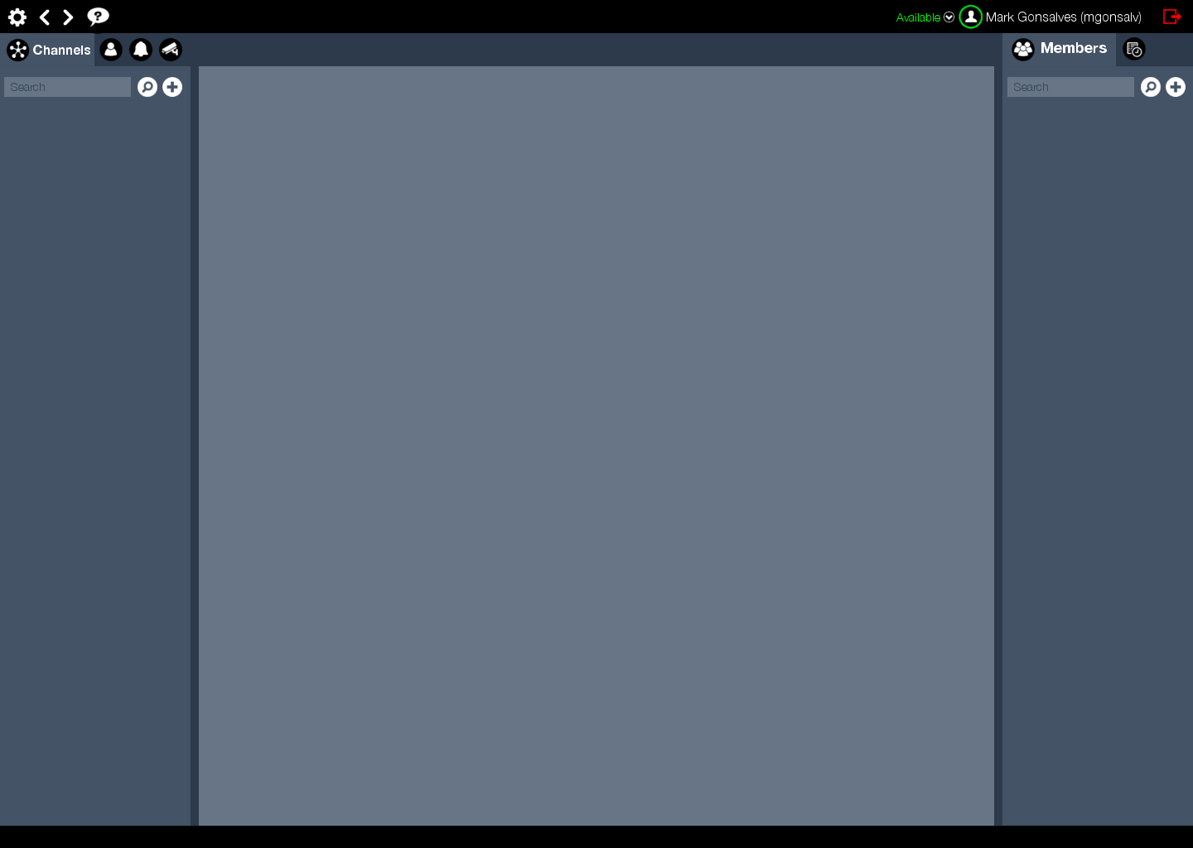
Header Layout
HELP Context sensitive help to be implemented later.
STATUS Three parts:
- Status text (colored) - Status halo around user icon or avatar - Drop down icon to select status
Only for header after login.
Remainder of the screen has been muted for this slide.
Status colors:
Green: Available
Red: Busy
Orange: Away
Allow user entry for status color and string.
SETTINGS Allows a user to modify their account settings
LOGOUT
NAVIGATION Allows a user to navigate back and forth in the UI. For example they can be in a group, then tap on a user and then tap the back arrow and go back to the previously selected group. This is an advanced feature and can come later.
AVATAR Display avatar clipped into a circle. Use default user icon when no avatar selected.
NAME &USERNAME Display full name and username in parenthesis.

Slide 4
Left Panel Layout
TABS User can switch between channels, users, alerts and cameras view.
Contains tabs for the following:
Channels – This includes grouped channels. More in upcoming slides.
Users – This includes grouped users. More in upcoming slides.
Alerts – These are incoming alerts where the logged in user is either a direct recipient, or belongs to a group that the notification was sent to.
Cameras – Includes fixed cameras provisioned in the system or live streaming by a user.
The user can select any of the tabs by clicking on it. When a tab is selected, the name of the tab appears with the icon. Unselected tabs only display the icon.
The user can filter entities listed in each tab by searching the following:
Channels – Name of channel or channel group.
Users – First/last name or user name of the user. Name of the user group.
Alerts – Subject or description.
Cameras – Name of the camera.
The user can add channels (including channel groups), users (including user groups) and fixed cameras.
Incoming alerts and live streaming from a user’s device is added to the list on the fly.
Clicking on an entry will highlight that entry and the center panel will display details pertaining to that entry. See later slides for more details.
SEARCH Allows a user to find entries that are based on title searches. .
ADD ENTITY Allows a user to add an entity depending on the selected left panel tab.
FILTER ENTITIES Allows a user to specify filters to control the searched entities.

Slide 5
Right Panel Layout
TABS User can switch between channels, users, alerts and cameras view.
Contains tabs for the following:
Members – Channels (and groups), alerts and cameras have users associated with them. These are users that belong to the entity or have received a notification pertaining to that entity. These users are listed in the members tab.
History – Each entity on the left panel that is selected has a history associated with it. Those are listed in chronological order from newest to oldest. Additional history is retrieved in demand as the list is scrolled.
The user can select any of the tabs by clicking on it. When a tab is selected, the name of the tab appears with the icon. Unselected tabs only display the icon.
The user can filter users listed in the members tab by searching for the first/last name and usernames.
Clicking on a user will highlight that entry and the center panel will display details pertaining to that user. See later slides for more details.
SEARCH Allows a user to find entries that are based on title searches. .
ADD ENTITY Allows a user to add an entity depending on the selected left panel tab.
FILTER ENTITIES Allows a user to specify filters to control the searched entities.

Slide 6
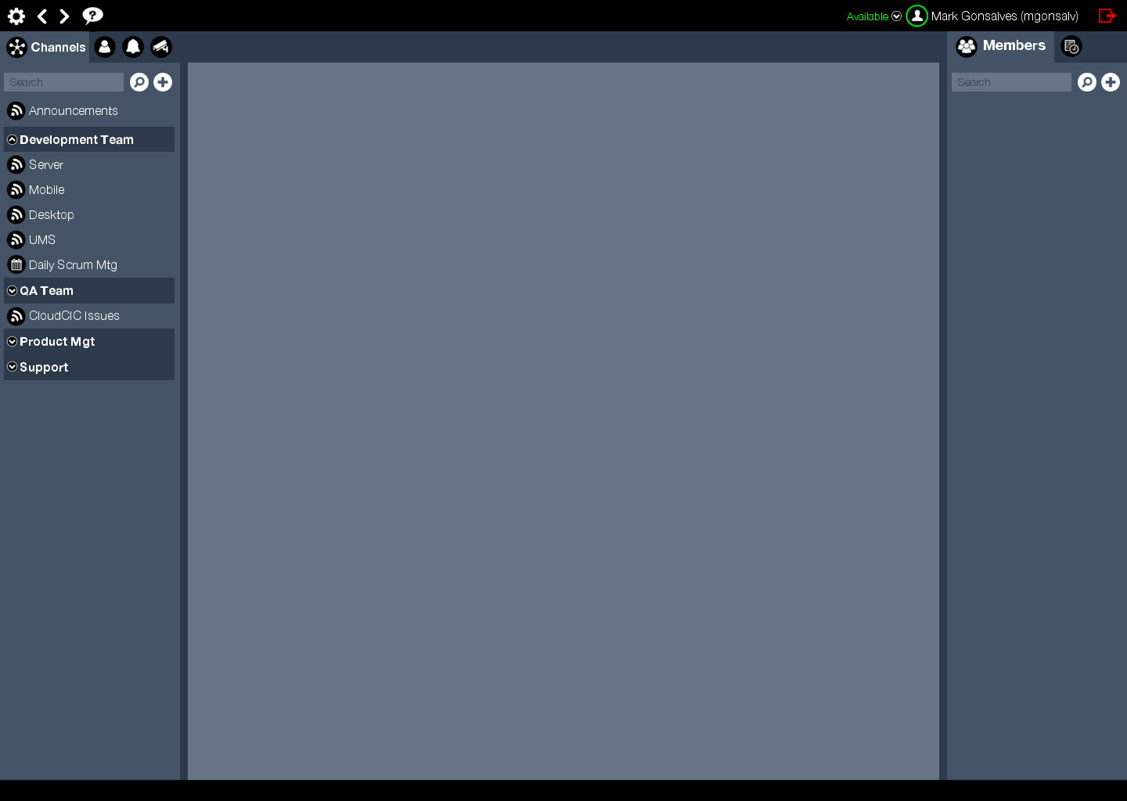
Channels (Unselected)
Provisioned channels and channel groups are displayed in the channel tab.
When a channel is added/removed for the logged in user, the list immediately reflects the changes without a manual refresh.
When no channel or channel group is selected, then the center or right panel (members) is not rendered.
Channel with no group.
Channel group.
Channels belonging to the channel group.
Expand/collapse channel group. Pointed upwards when expanded and downwards when collapsed.

Slide 7
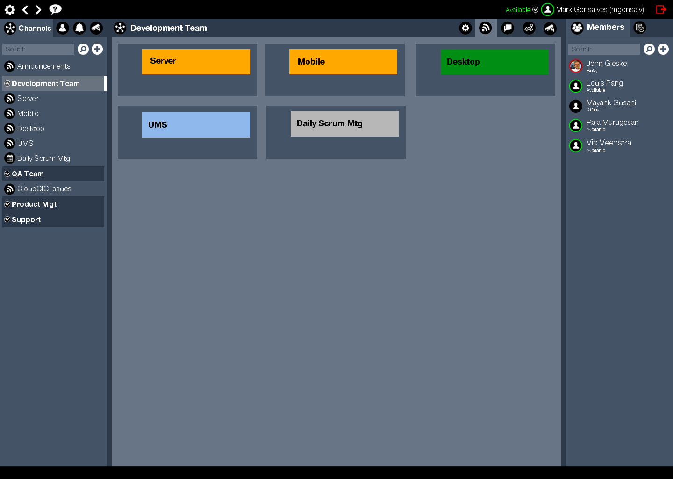
Channel Group Selected
This tab allows the user to change settings of the selected entity.
Center tab displays the icon of the selected entity and its name.
When a user selected a channel group, the center panel has one extra tab for dispatchers where all PTT channels belonging to the group are displayed. The user can activate/deactivate any or all channels and directly communicate via PTT. Detailed elements of the dispatch view to follow.
The user can click on any member to switch to the user view in the center panel.
This is the default tab when a channel group is selected and provides a dispatch view of all channels in the group.
Selected channel group is highlighted.
This is the chat tab and shows messages for the selected channel group.
This is the map tab and displays all the members of this channel group.
Members belonging to the selected channel group, along with the avatars and status.,

Slide 8
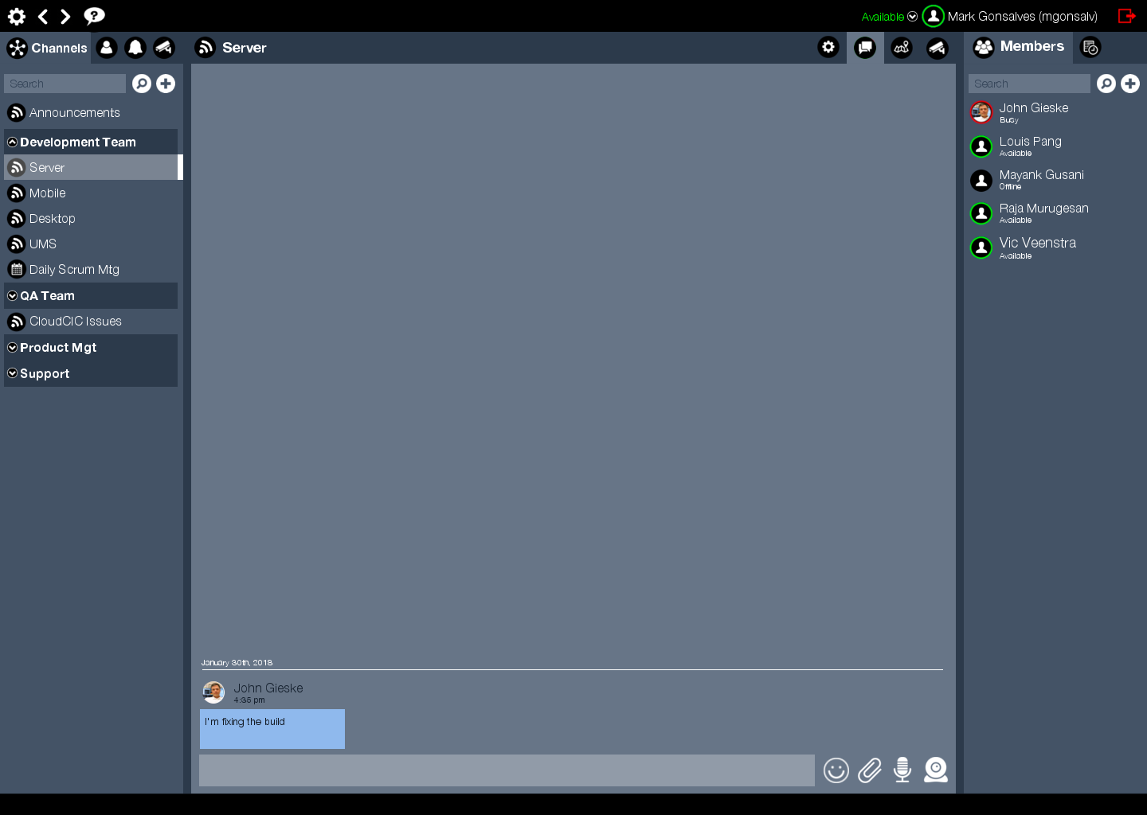
Channel Selected
This tab allows the user to change settings of the selected entity.
Center tab displays the icon of the selected channel and its name.
When a user selects a channel, the center panel defaults to the chat tab.
The user can click on any member to switch to the user view in the center panel.
This is the chat tab and shows messages for the selected channel.
Selected channel is highlighted.
This is the map tab and displays all the members of this channel.
Members belonging to the selected channel, along with the avatars and status.,

Slide 9
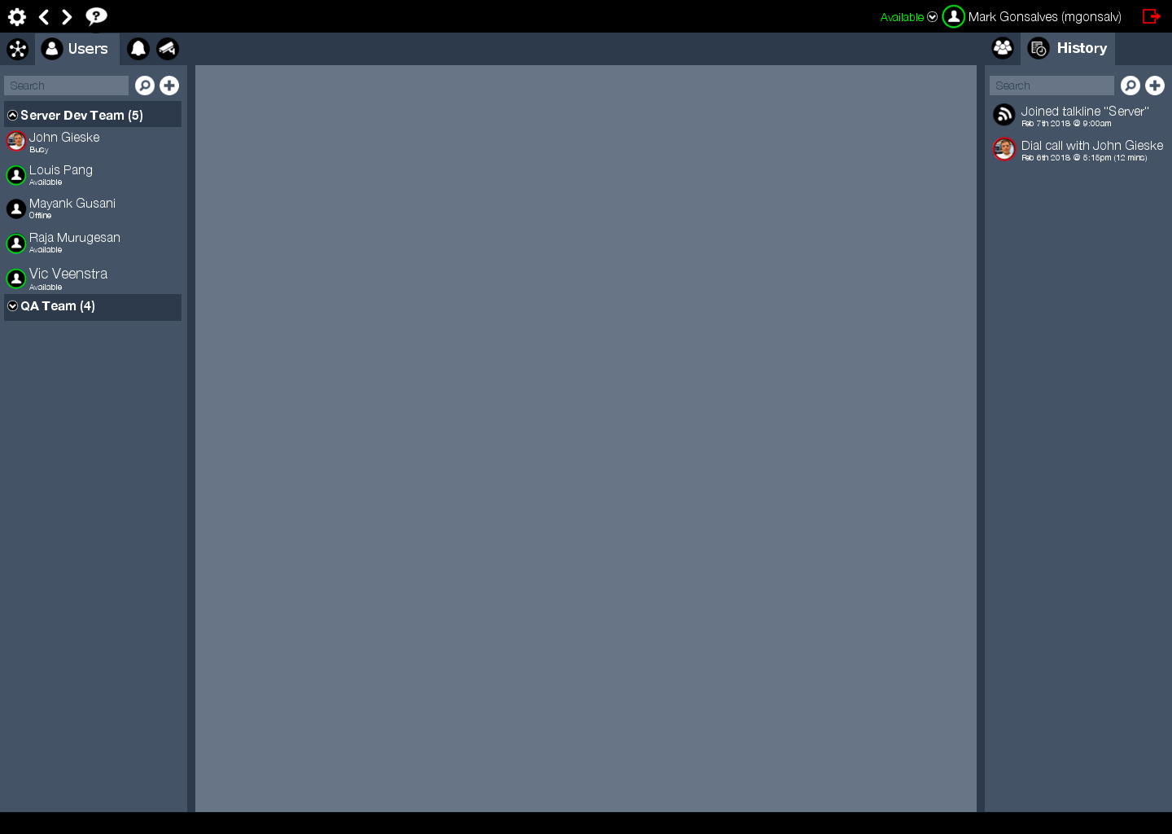
Users (Unselected)
Provisioned users and user groups are displayed in the user tab.
When a user is added/removed for the logged in user’s company or any of the user’s user groups, the list immediately reflects the changes without a manual refresh.
When no user or user group is selected, then the center panel is not rendered.
There is no member tab in the right panel for users.
History pertaining to this user is displayed be default, because there are no members in users. The member tab should be hidden. Not hidden here.
User group showing total number of members.
User with avatar and status.
Users belonging to the user group.
Expand/collapse channel group. Pointed upwards when expanded and downwards when collapsed.

Slide 10
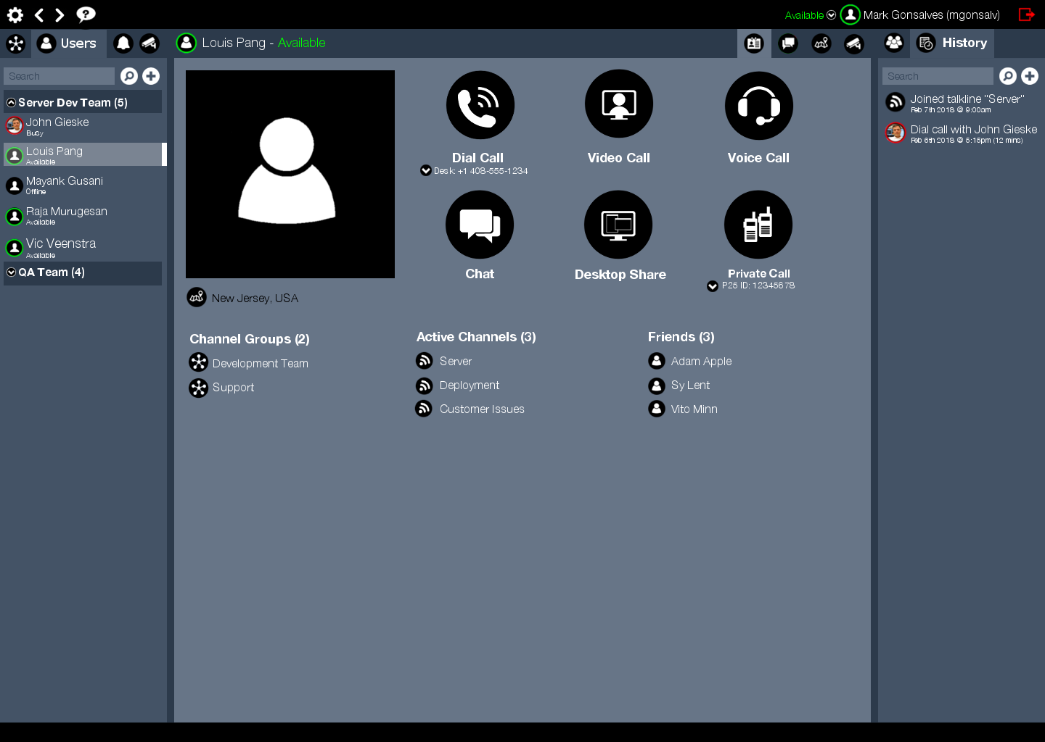
User Selected
Center tab displays the avatar of the selected user, status and name.
This tab allows the user to view the profile of the selected user.
This is the map tab and displays all the members of this channel.
When a user is selected, the default tab is the profile tab as shown here.
Apart from viewing the avatar, location and associations. The logged in user can initiate actions as follows:
Dial call – If a call manager is provisioned, the feature licensed and if there is at least one number associated with this user, the logged in user can select a dial number and click on the icon to place a dial call.
Video call – A video server must be provisioned and the feature licensed.
Voice call – A video server must be provisioned and the feature licensed. We intend to use the video server to place a voice call.
Chat – Chat server provisioned and licensed.
Desktop share – A video server must be provisioned and the feature licensed. We intend to use the video server to do desktop sharing.
Private call – The feature must be licensed and at least one radio id must be provisioned for the selected user. A radio or radio gateway must be provisioned as well.
This is the chat tab and shows messages for the selected user.
User’s avatar
Selected user is highlighted.
User’s location
Channel groups, this user belongs to. (May need to show channel membership too)
Active channels for this user.
Selected user’s friends.

