Slide 1





MAJICAST
DEVELOPERS
Aluoch Phanela
Anthony Chege
Diana Mayalo
Lewis Mwaki
Margaret Kariuki
Predicting contamination risk for water points across Kenya through machine learning, satellite data, and citizen science.

Slide 2





PROBLEM statement
💧 Background:
Clean water is a fundamental human right, yet over 2 billion people worldwide still lack access to safely managed drinking water.
Project Goal:
Develop a machine learning model that predicts contamination risk in rural water points using environmental and infrastructure data, reducing reliance on costly and time-consuming laboratory testing.
🌍Impact:
Enable NGOs and governments to take proactive action, preventing public health crises and improving access to safe water.
.

Slide 3

OBJECTIVES
WHAT WE AIM TO ACHIEVE
Collect and preprocess geospatial, weather, and textual data for Kenyan rural communities.
Develop a dashboard or app for actionable insights
Enable actionable intervention planning.
Build and validate a contamination risk prediction model.
Integrate NLP for early-warning signals.

Slide 4


Data Sources
➢ GEMS/UNEP Water Quality Monitoring (GEMStat)
➢ WPDx Kenya– Water Point Metadata
➢ Remote sensing - GEE (Google Earth Engine) - vegetation indices (population, temperature,ndvi,chirps)
➢ World Bank WASH Infrastructure Data
➢ NGO field reports (simulated or public reports)

Slide 5


Modeling Overview
WPDx attributes merged with environmental variables from Google Earth Engine. (WPDx+GEE)
➢ Structured Data Models:
Logistic Regression
Random Forest
XGBoost
LightGBM
➢ NLP Models:
TF-IDF + SVM
Fine-tuned DistilBERT
➢ Interpretability: SHAP and LIME for feature impact analysis

Slide 6
XGBoost Model
Risk score based on population, water pressure, and surface temp
Risk levels: 0 (Low) to 3 (High)
Balanced data using smart sampling
Final model: XGBoost—high accuracy

Slide 7
GEMS Dataset & Isolation Forest
GEMS - enhancing our data quality.
Maintained the XGBoost model while adding GEMS to include chemical accuracy
Trained an Isolation Forest: pH, temperature, conductivity.
Enabled real-time anomaly detection even without expensive lab testing.

Slide 8
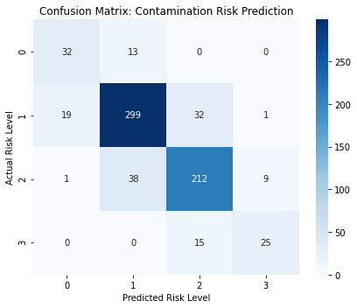
Model Performance
XGBoost
81% overall accuracy
63% accuracy in predicting high-risk areas
Supports targeted interventions

Slide 9
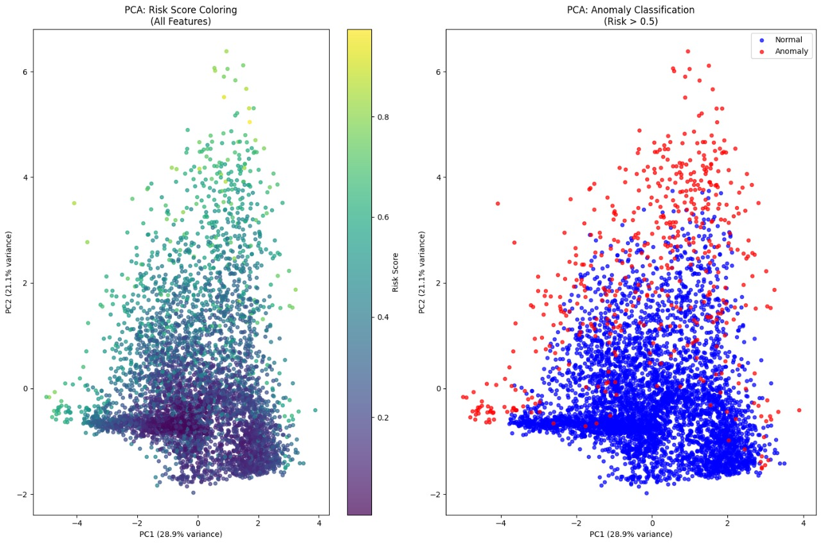
Model Performance
Isolation forest

Slide 10
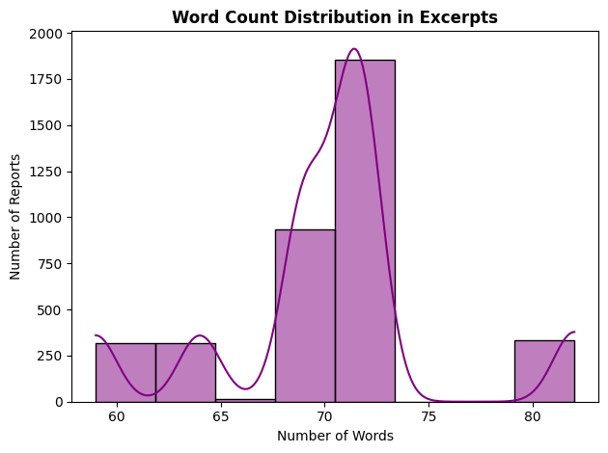
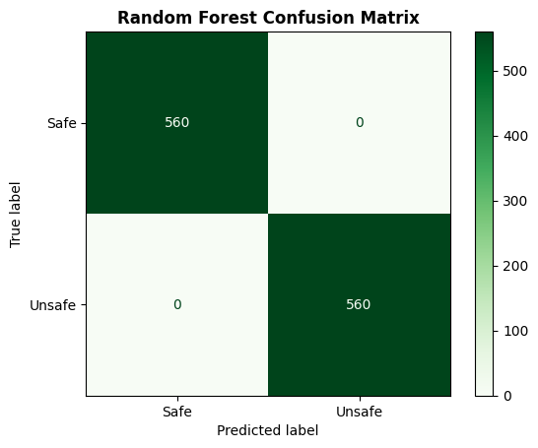

NLP Model from Field Reports
Text Preprocessing
Cleaned, tokenized, lemmatized
Removed noise (stop words, digits, punctuation)
Feature Extraction
TF-IDF vectorization on critical terms: contaminated, sewage, outbreak
Binary classification: Safe vs. Unsafe

Slide 11



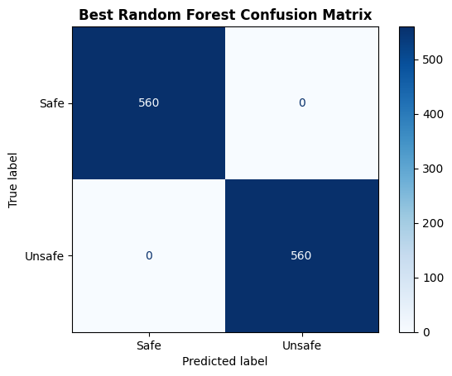


Key Insights
Frequent in Unsafe: diarrheal, untreated, sewage
“Safe” reports were fewer and textually repetitive
Results
Accurately classified unseen water-related news
Combined NLP + structured data = explainable, high-performing model

Slide 12

DEPLOYMENT
Hosting: Frontend deployed via Vercel; Backend APIs deployed via Render.
Frontend: Developed using Next.js (React 18) and TailwindCSS, offering a highly responsive, modern dashboard interface for water point risk tracking.
Backend: Service-oriented architecture using a separate FastAPI server that loads XGBoost, IsolationForest, and NLP models via joblib/pickle to serve predictions on demand.
Future iterations will focus on adding persistent storage (PostgreSQL) and expanding the real-time sensor API capacity.

Slide 13




Next Steps
Integrate real-time geospatial feeds
Expand model to other East African regions
Fine-tune NLP with more field reports
Incorporate user feedback into app
Collaborate with local water boards for on-ground validation
Integrate live water crisis feeds using web scraping or APIs
Expand Next.js app with multi-language support

Slide 14

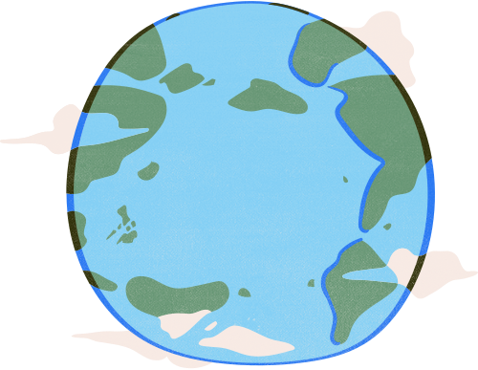



Challenges
Data Quality Gaps: Incomplete metadata, uneven field reports
Scalability: Backend and API constraints
Model Bias: Underrepresented regions
Limited Labels: Few verified contamination ground truths

Slide 15


Every drop counts!
Recommendations
Collaborate with local NGOs for data collection
Combine mobile + satellite data for more context
Involve community feedback loops
Prioritize mobile-first deployment
Thank you

