Slide 1
REX: Wind Projects
Sibelco - DESSEL
Reactive Power regulation
Roel Vloebergs

Slide 2
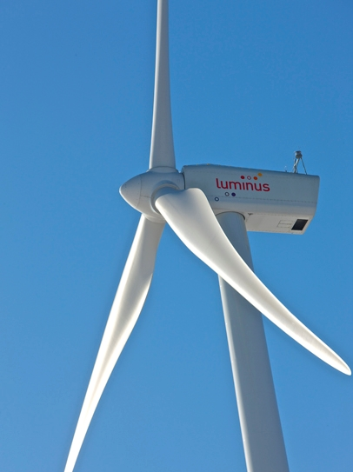
sibelco dessel contract
Consumption : 8000 kVA
Injection : 10500 kVA
→ installation 3* Siemens SWT3.2

Slide 3
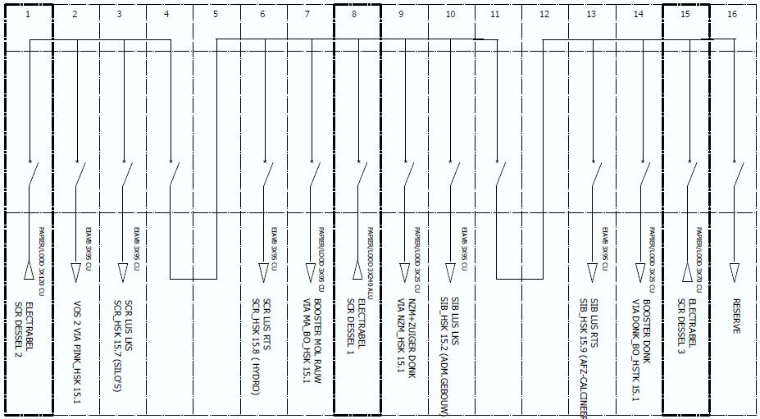
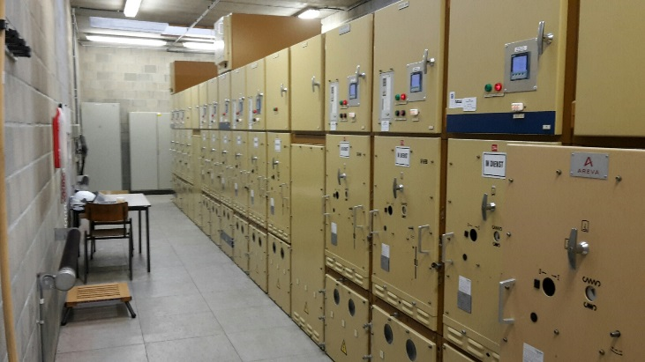
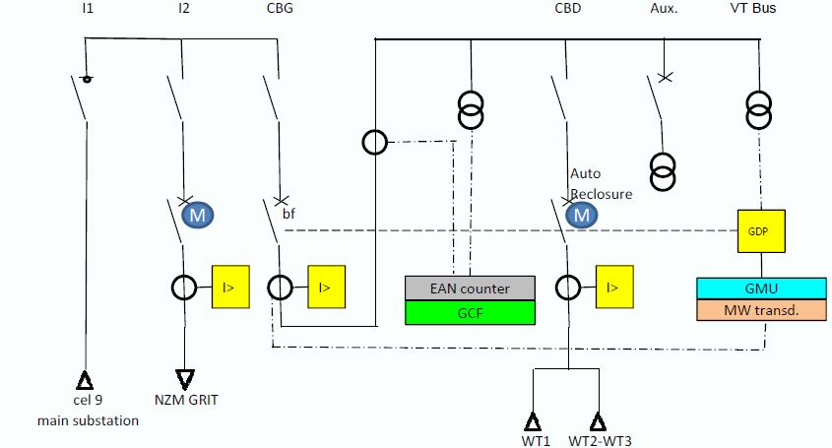
Electric configuration
Grid distributor = Fluvius (EANDIS)
15 kV grid
Consumption 8,5 MW
Max 10,5 injection

Slide 4
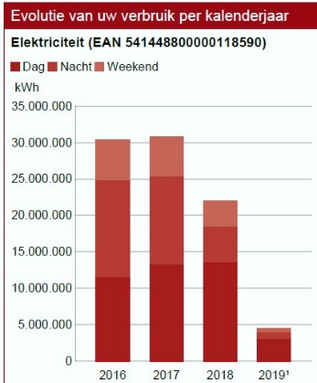
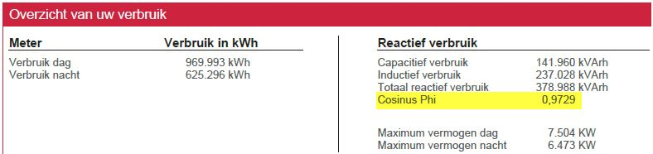
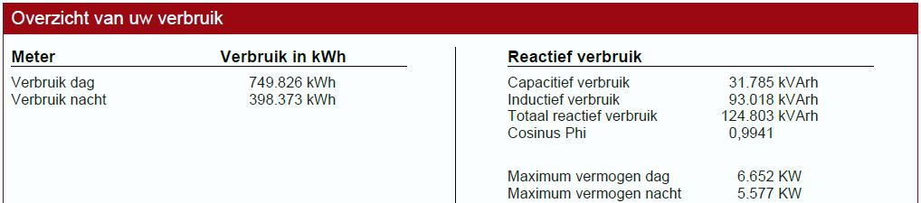
Invoicing sibelco dessel
Sibelco Dessel has WKK 500 kW (630 kVA) and 250 kW photovoltaic !!!
Turbines are not running → always consumption at Factory Sibelco.
Injection into the grid when turbines are producing more than consumtion Sibelco
Max constumption 8000kVA ; Max Injection 10500 kVA
Previous data. Contract Cos phi 0,995 inductive or better
With the turbines in march 2019
less Active power + compensation Reactive
→ Amount Reactive lowers

Slide 5

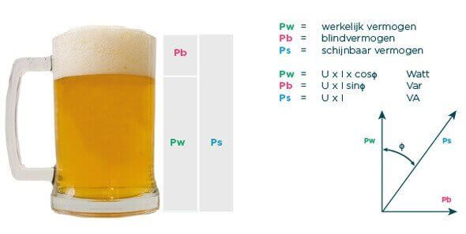
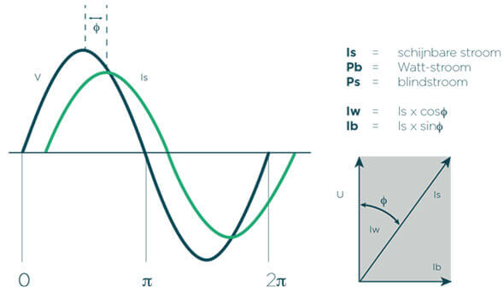
Reactive power
Reactive power is bad for
  DGO (heating of the cable I² = losses)
  Losses in Client Transfo and cables
  Harmonics create VAr (frequency regulators, LED)
  Client : maximalisation installation can better (smaller I = more free capacity)
Turbine

Slide 6
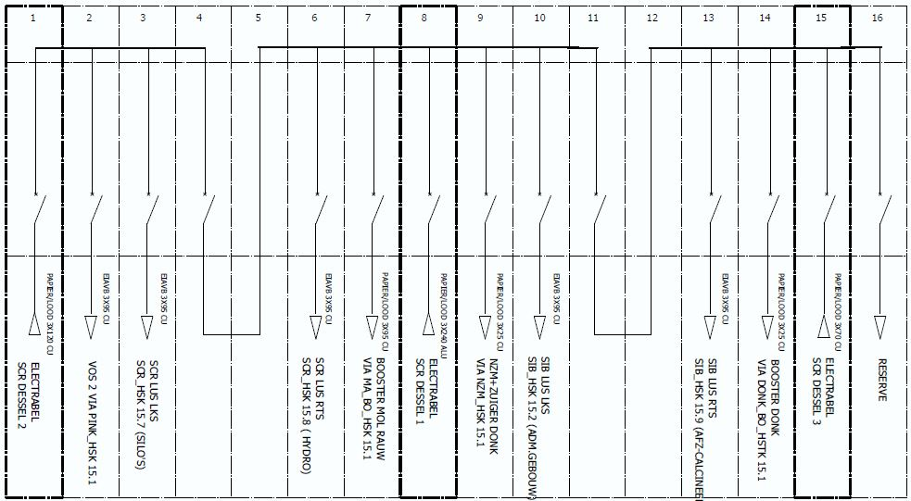
Reactive Power Regulation
Active Power
Measure P,Q,S,cos phi,U at the 3 feeders
  Measurement Sentron pack
  transfer data via Modbus to Scada Luminus
Look if a swith on the busbar is open
Calculate the Reactive (compensation) setpoint
3
2
1
Cos phi = 0,99
Cos phi = 0,97
Compensation
Reactive Power

Slide 7
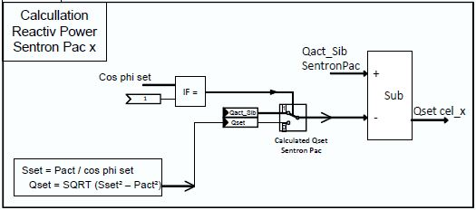
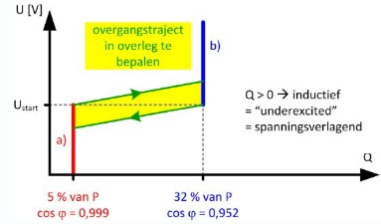
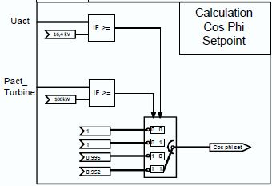
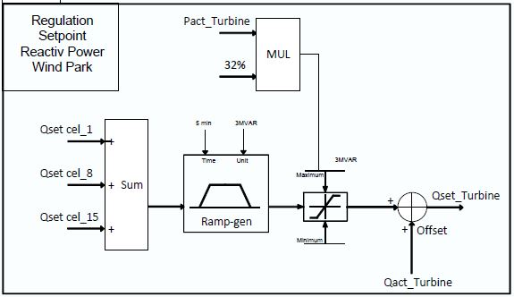
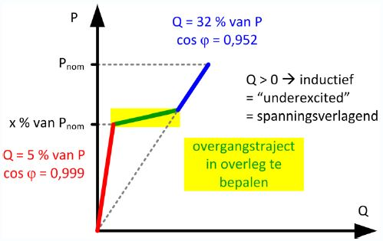
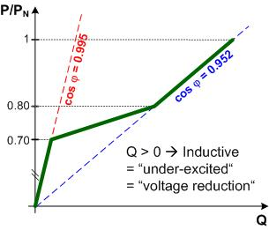
Calculation Reactive power
Calculate amount reactive power
needed per feeder for compensation
Measure P,Q,S,cos phi,U at the 3 feeders
  Measurement Sentron pack
  transfer data via Modbus to Scada Luminus
Look if a swith on the busbar is open
Choose the correct Cos Phi setpoint
Add all compensations + the existing reactive power from the turbines

Slide 8
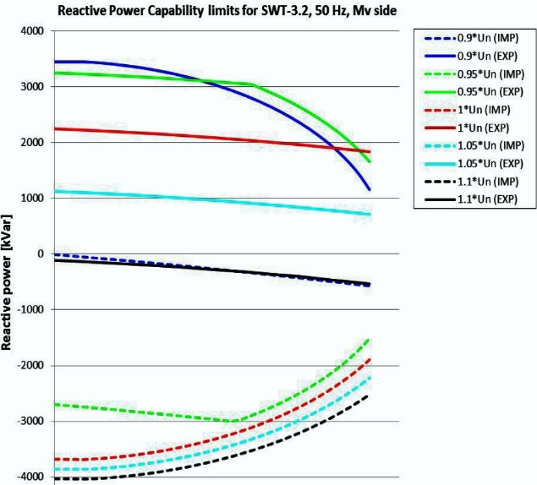
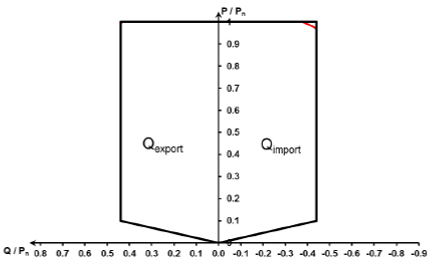
Siemens SWT -3,2MW Enercon E115 4,2MW
The Reactive Power capability is determined by the
- active power and the - grid Voltage
Max export or import is 1850kVAr

Slide 9
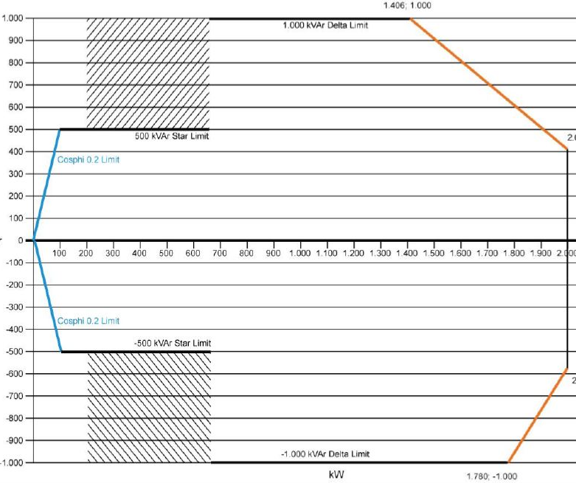
Vestas 2 MW vestas 112 3,45Mw

Slide 10
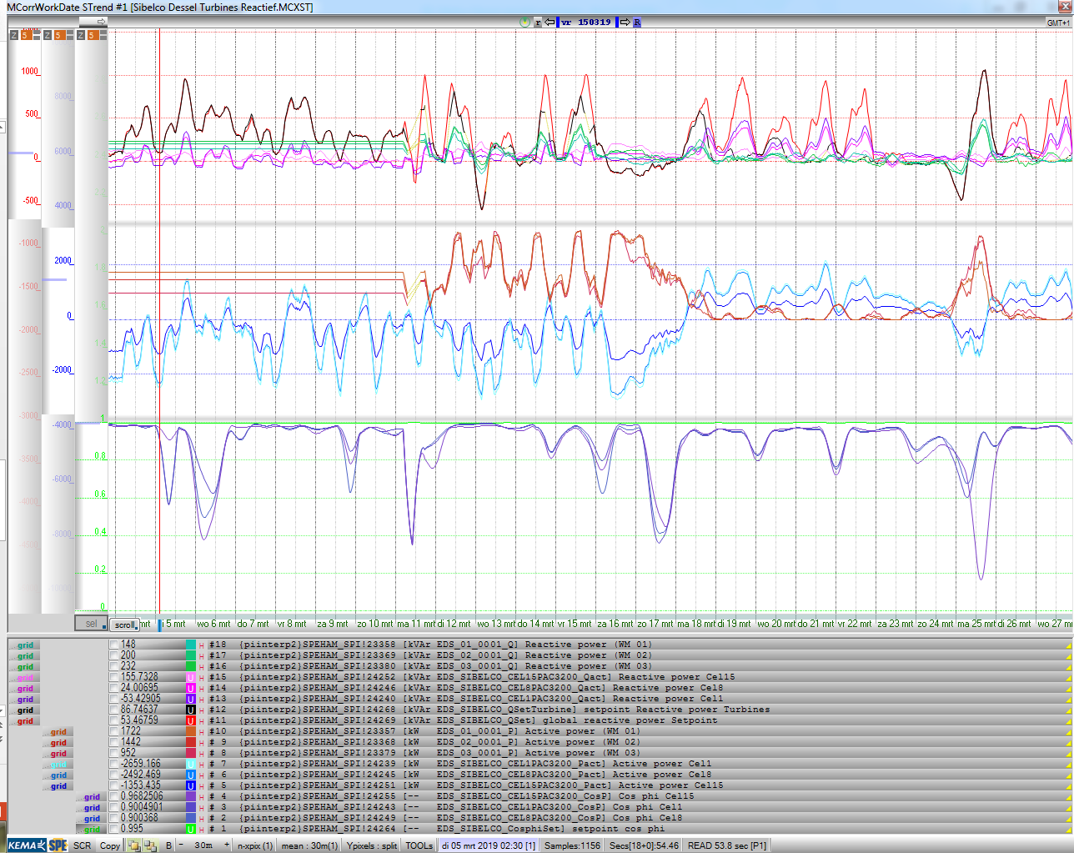
Measurements
Overview
Setpoint Reactive power for 3 turbines
After Ramp Setpoint Reactive power for 3 turbines
Start logging in Magic Corr via PI
Monday 12 march = all data
What stands out:
Reactive power
Active power
from -2MW to +2MW
Cos phi deviates from 1
Calculation ramp not fast
Since 26/4/19 ramp is 5 time faster
Adaptation 10 kVAr/s
Total amount of Reactive power =
124803 kVArh for March 2019
With cos phi = 0,9941
Measured Reactive power at the 3 feeders
Measured Reactive power per turbine
Measured Active power per turbine
Measured Active power at the 3 feeders
Measured Cos phi at the 3 feeders

Slide 11
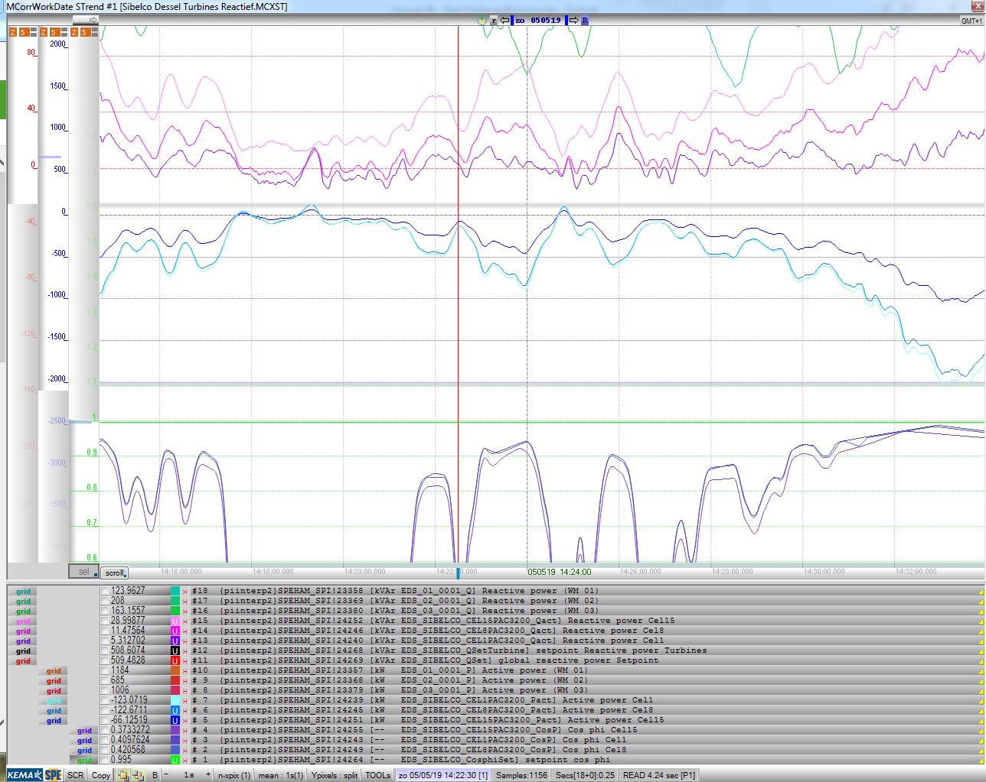
Detail PF
Measured Reactive power at the 3 feeders
View on measurements feeders
Reactive power
Active power
PF
P
Cos phi = ---------------------
SQRT (P² + Q²)
Bad when active power is around 0
When injection to 500kW/feeder
Cos phi better than 0,9
When injection to 2MW/feeder
Cos phi 0,99
Measured Active power at the 3 feeders
Here we don’t look at the production of the turbines
Active power = 0 means
Consumption Sibelco = Production Turbines
Measured Cos phi at the 3 feeders

Slide 12
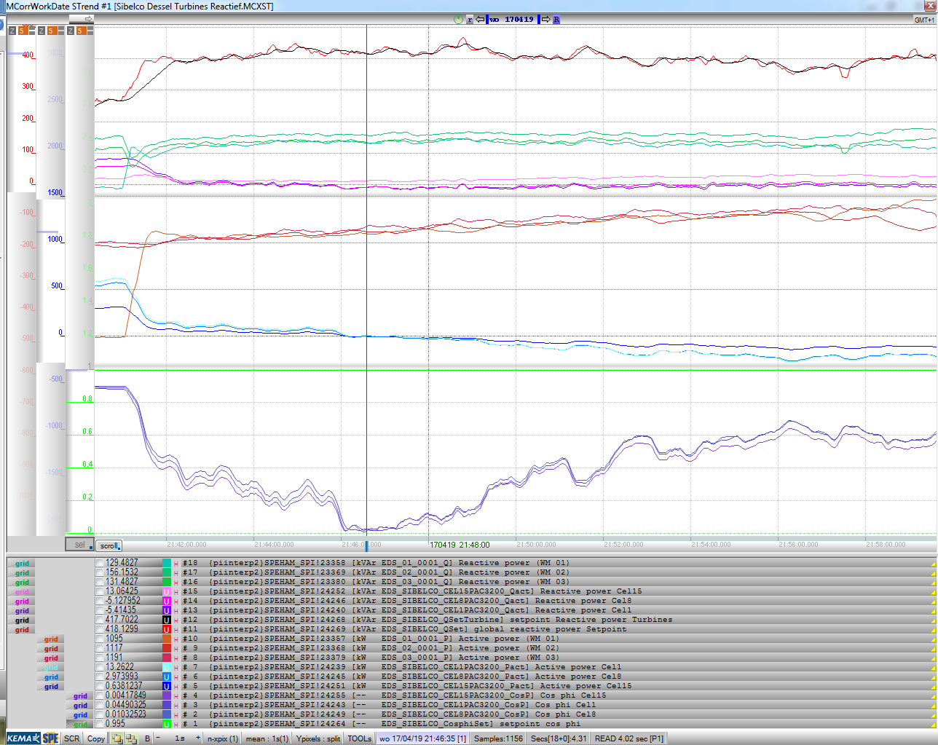
Production passing 0 Amps
Setpoint Reactive power for 3 turbines
After Ramp Setpoint Reactive power for 3 turbines
Measured Reactive power per turbine
Turbines are making more energy, resulting in less power at the 3 feeders.
The amount of Reactive power at the 3 feeders is not decreasing fast enough.
Because of this cos phi is deterioration.
Ramp generator is adapted.
When Active power is passing 0, this means from consumption to injection, the smallest amount of reactive power is creating a bad cos phi. Even when reactive power is 0 and active power is 0 cos phi will be 0 because of division.
Measured Reactive power at the 3 feeders
Measured Active power per turbine
Measured Active power at the 3 feeders
Measured Cos phi at the 3 feeders

Slide 13
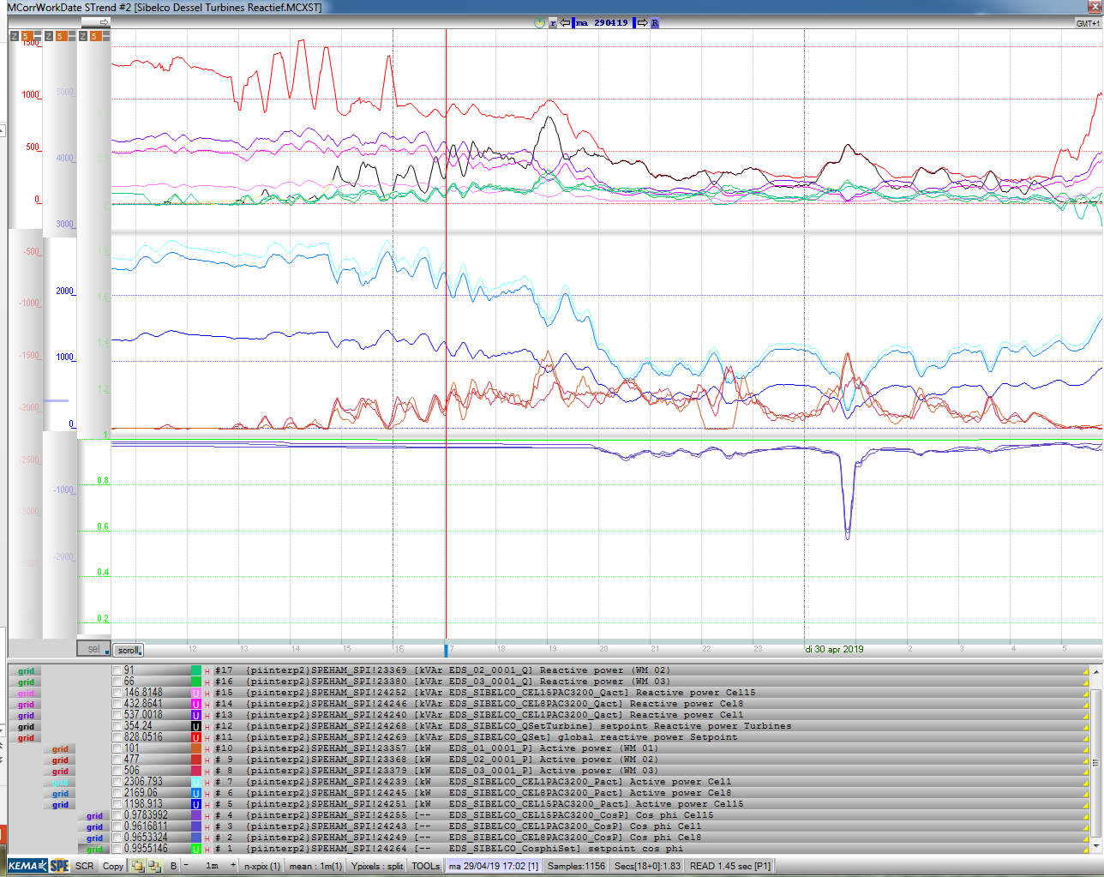
Turbines starts
Production
Setpoint Reactive power for 3 turbines
Measured Reactive power at the 3 feeders
Only Consumption from Sibelco
No power from the turbines.
Cos phi 3 feeders = 0,97
The total amount calculated for compensation is very high
Because the amount of Reactive power on the feeders cannot be denied.
Impact on cos phi is negligible because of high amount of Active Power.
The Ractive setpoint and production for the turbines =0 because they do not run.
Later on when turbines start running total Active power at the feeders decreases a lot. We start compensating but get a cos phi worse than 0,97.
The closer Active power comes to 0 the worse cos phi becomes.
Measured Reactive power per turbine
Measured Active power at the 3 feeders
Measured Active power per turbine
Measured Cos phi at the 3 feeders

Slide 14
Summary / Remarks / questions
Cos phi becomes 0 when I = 0 A.
PF is not a good value for evaluation. Amount of reactive power is.
Delay between measurement, transfer data, calculation, reaction Turbines on setpoint. !!pumping or oscillation!!
Measuring point not always same for DGO. (here 1km away)
Cost penalties for bad cos phi (Elia – Fluvius – Ores,..)
Amount of penalties previous - today (important for next clients)
Limits Generated power turbine when reactive is to high.

Slide 15
Elia Tarification (see Tarifs for transport 2016 – 2019)
Luminus is directly inning and transferring € t(penalty) towards Elia
Rate for monthly peak (€/kW) - 380,220,150 kV / 70,36,30 kV / lower
Rate for max year peak (€/kW)
Rate for R3 (€/kVA) Power employable by Elia
Rate for Black start (€/kWh) Power start from scratch Elia
Rate power consumption (€/kWh)
Rate for Reactive Power (€/kVArh) – no penalty < 9 MVAr and 2,5 MVAr
  Calculation done on Tang phi = 0,329 (= cos phi 0,95) for amount on quarterly calculation
  If active power < 10% Yearly peak → calculation on 32,9% of 10%
  Rates are calculated on zone 1 max Tang phi 0,329 (0,95) or zone 2 max Tang phi 0,767 (0,8)
  Tarif : 0,007/kVArh in zone 1 – 0,009/kVArh zone 2 → (Month invoice 141960 kVArh Cap. / 237028 kVArh Ind.)
Rate for Reactive Power (€/kVArh) when PF > 0,95 = 0,0175 (based on monthly calculation)
Fluvius Tarification (based on data 1 client)

Slide 16

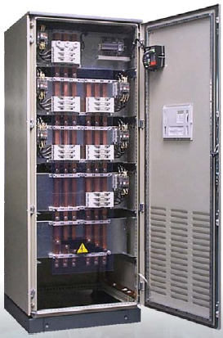
Harmonic filters and reactive compensation
Can be used instead of compensation with turbine
Instead of compensation with the Turbine
Install Condenser Batteries and bobbins
Also For harmonics between 175 Hz and 1350 Hz.
Solutions from 90 till 540 kVAr
Price for HarmoFit5 330 kVAr
  7745 €

