Slide 1
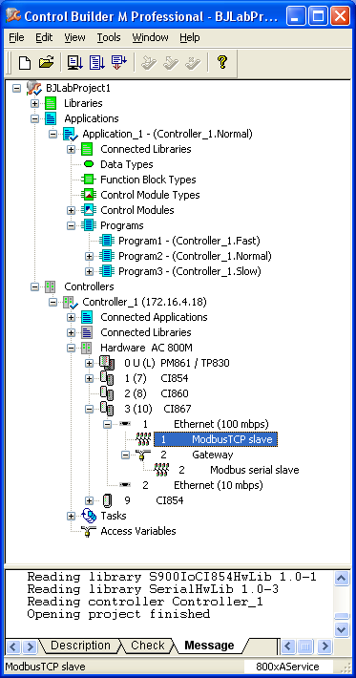
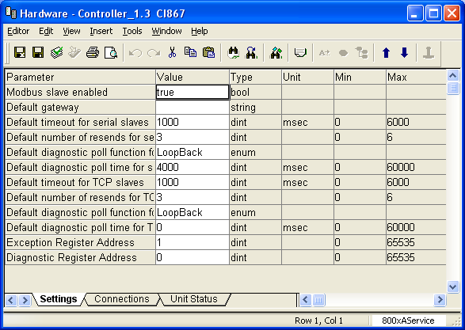
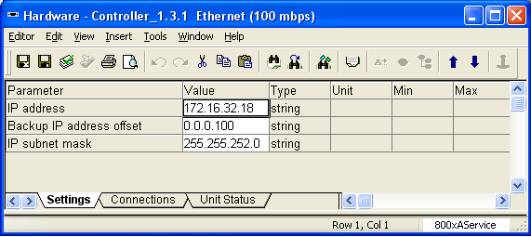
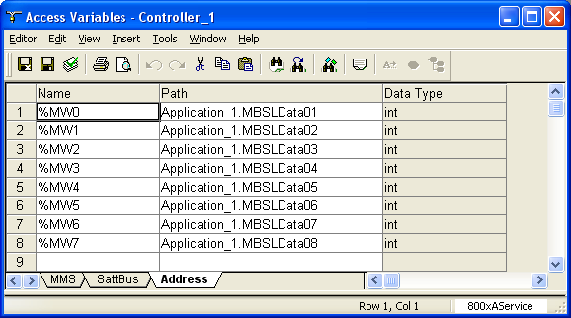
CI867 Acting as Modbus TCP Slave
CI867 Communication and Access Variables Settings
Enable CI867 Modbus Slave Function
Ch1 Set IP Address etc.
Define Access Variables.

Slide 2
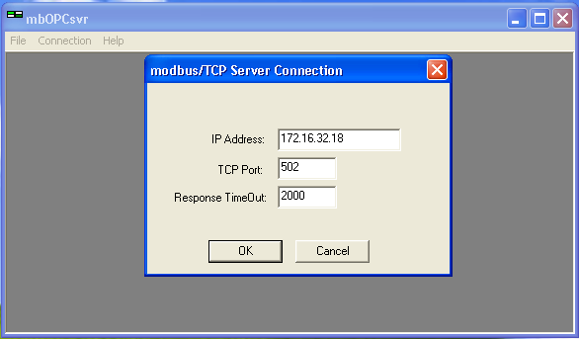
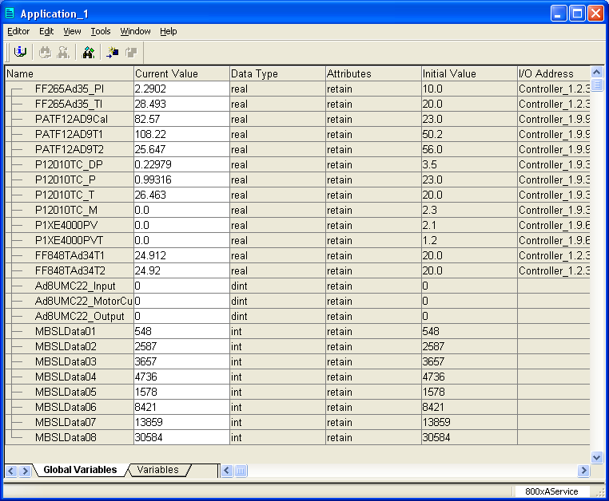
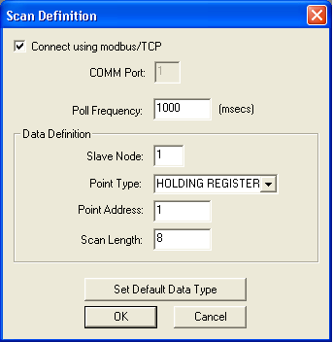
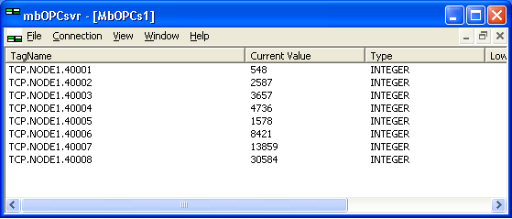
CI867 Acting as Modbus TCP Slave
Test Communication with Modbus OPC Server software
AC800M Communication data Value
Build a Connection
Define a New Data Scan
Display the Communication data

