Slide 1
HL planning FS Rat – High Prio sites
PMO-103
date: 15/04/2022

Slide 2
SERVERS listed
Agile stream 10-3
BE-DES-FIS-001 → Dessel → Myke Theodorou; Thierry Guffens; Tony Lemmens
BE-HQH-FIS-001 → Peter Peters

Slide 3

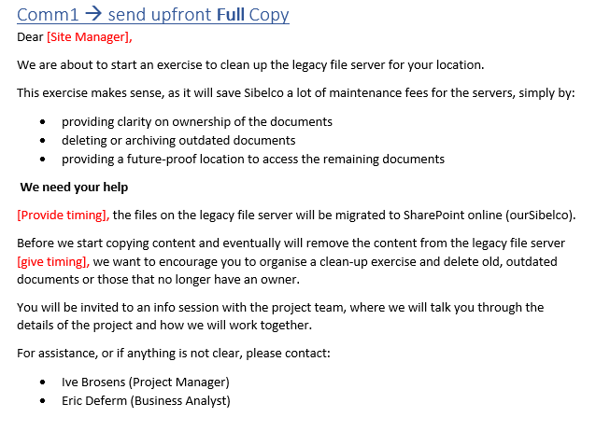
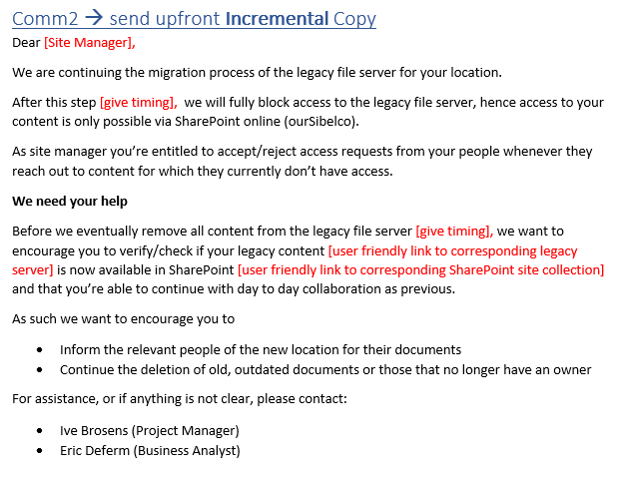
High-level Process & communication
BE-DES-FIS-001
BE-HQH-FIS-001
BE - Belgium
Informing Netw : (Charles) Source and destination
Informing End user support (Zoltan + Service Desk)
Block Edit access
TAB
Hyper Care
RFC
CAB
Scan Data
Copy Data
Copy Data
Delta Copy Data
Communication users
Com
Com
Communication + Meeting Site manager

