Slide 1
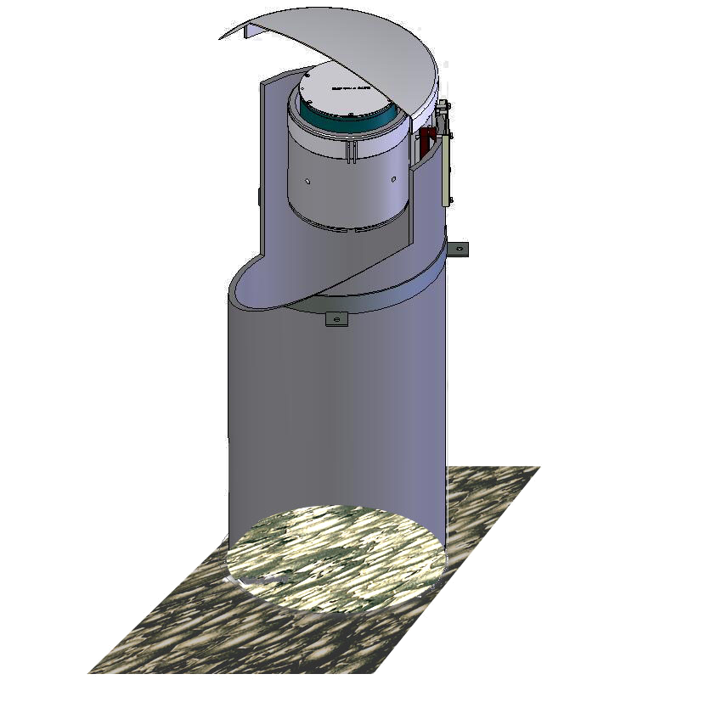
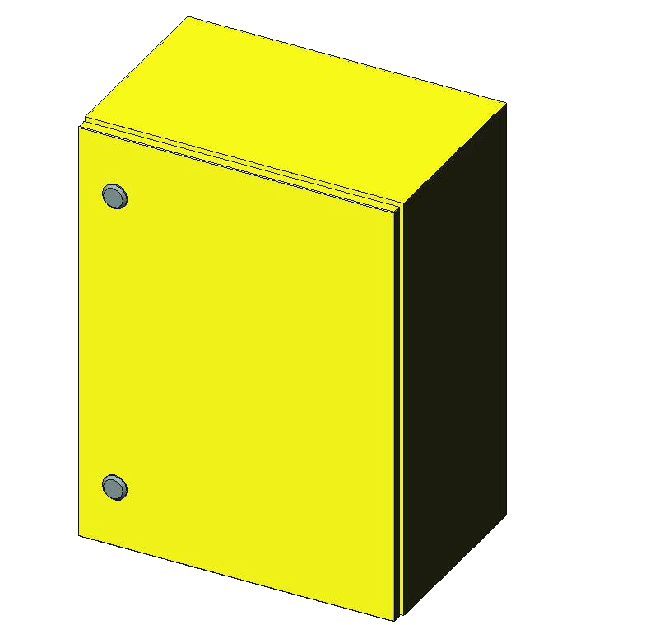
Froth Imager
Connection box
110 / 230 VAC
Ethernet for OPC
and video streaming
Optional analog
video out
Optional 4…20 mA
analog outputs

Slide 2
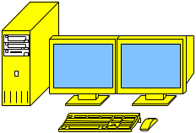
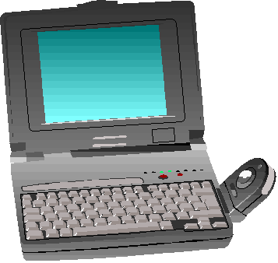
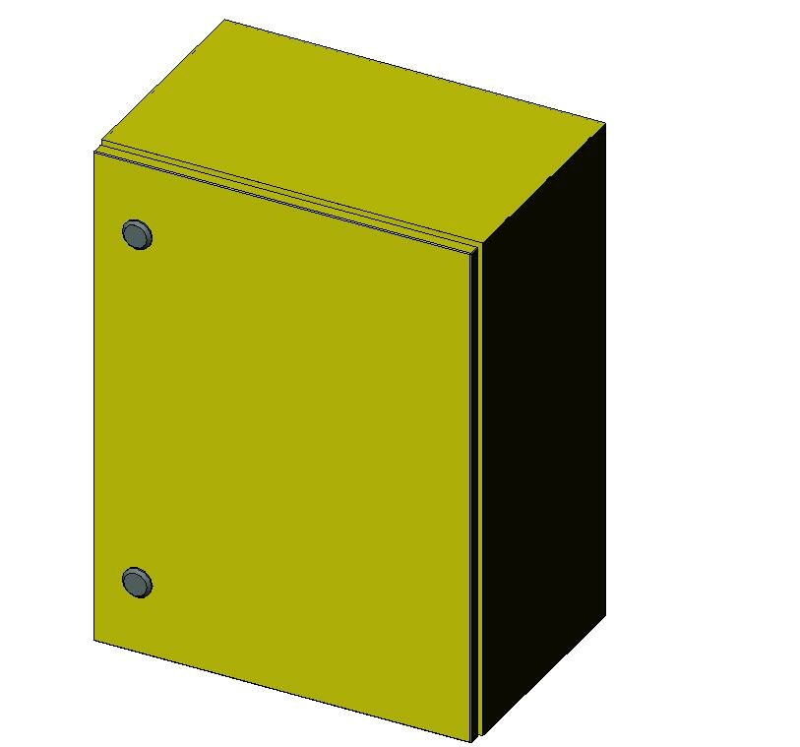
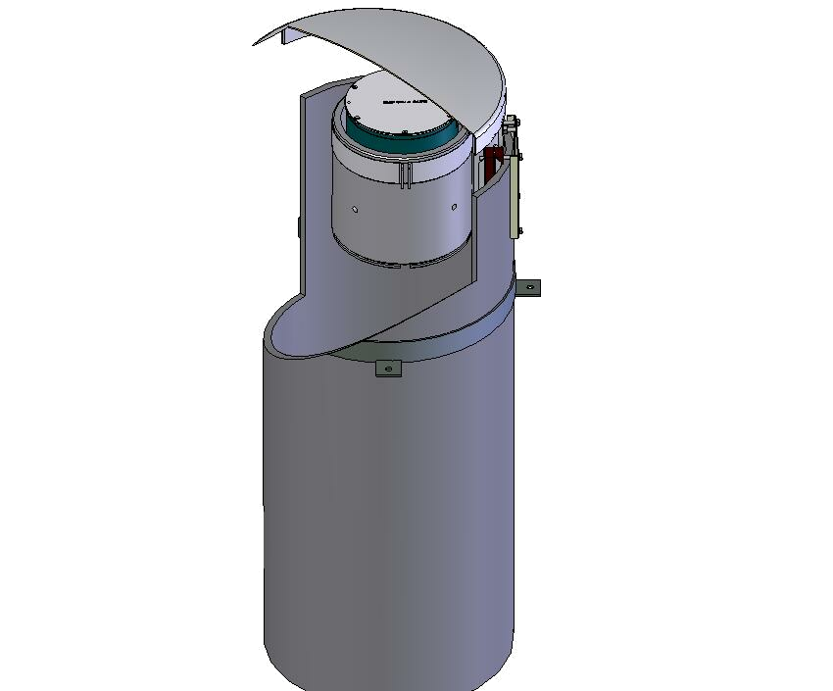
WWW browser to access
Frothmaster video stream
Customer DCS reads measurements from
OPC server
Configuration via
WWW browser
during commisioning
office workstation with
WWW browser
(customer)
HMI for DCS
(customer)
Plant network
Froth Management station with OPC server
(ACT and Nexus options)
FrothMaster network
FrothMaster 2
Connection box 1
FrothMaster 2
Imager 1

Slide 3
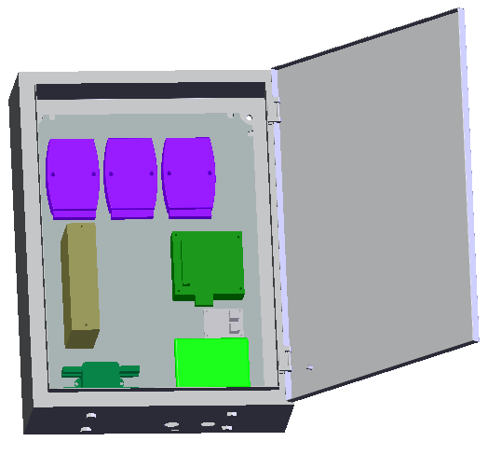
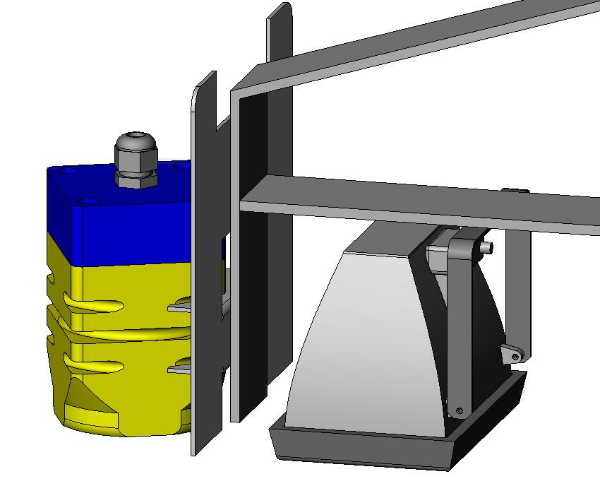
WWW browser to access
Frothmaster video stream
Customer DCS reads measurements for
OPC server
Configuration via
WWW browser
during commisioning
office workstation with
WWW browser
(customer)
HMI for DCS
(customer)
Outokumpu ACT
(optional)
Plant network
Outokumpu delivery scope limit
Gateway
+ OPC server
(+ACT optionally)
FrothMaster network
FrothMaster 2
processing unit
FrothMaster 2
Camera module

Slide 4
WWW browser to access
Frothmaster video stream
Customer DCS reads measurements for
OPC server
office workstation with
WWW browser
(customer)
HMI for DCS
(customer)
Outokumpu ACT
(optional)
Plant network
Configuration via
WWW browser
during the commisioning
Gateway
+ OPC server
(+ACT optionally)
FrothMaster network
FrothMaster 2
processing unit
FrothMaster 2
Camera module

Slide 5
uses FrothMasterComm’s
GetImage() to get uncompressed image file.
WWW browser to access
Frothmaster video stream
via FrothMasterComm
Customer DCS reads measurements for
OPC server
office workstation with
WWW browser
(customer)
HMI for DCS
(customer)
Outokumpu ACT
(optional)
Outokumpu Image
analysis station (optional, future)
Plant network
Configuration via
WWW browser
during the commisioning
Gateway with
FrothMasterComm and
OPC server
(+ACT optionally)
FrothM;aster network

Slide 6
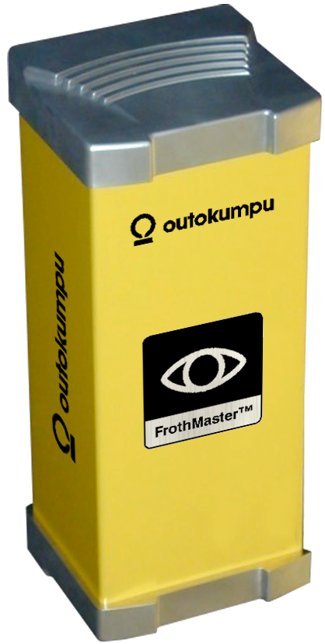
WWW browser to access
Frothmaster video stream
?via FrothMasterComm?
office workstation with
WWW browser
(customer)
HMI for DCS
(customer)
Outokumpu ACT with
FrothMasterComm and
OPC server
Plant network
Configuration via
WWW browser
during the commisioning

Slide 7
WWW browser to access
Frothmaster video stream
directly via www server.
office workstation with
WWW browser
(customer)
HMI for DCS
(customer)
Plant network
Configuration via
WWW browser
during the commisioning
Measurements
via 4…20mA
Measurements
via 4…20mA

Slide 8
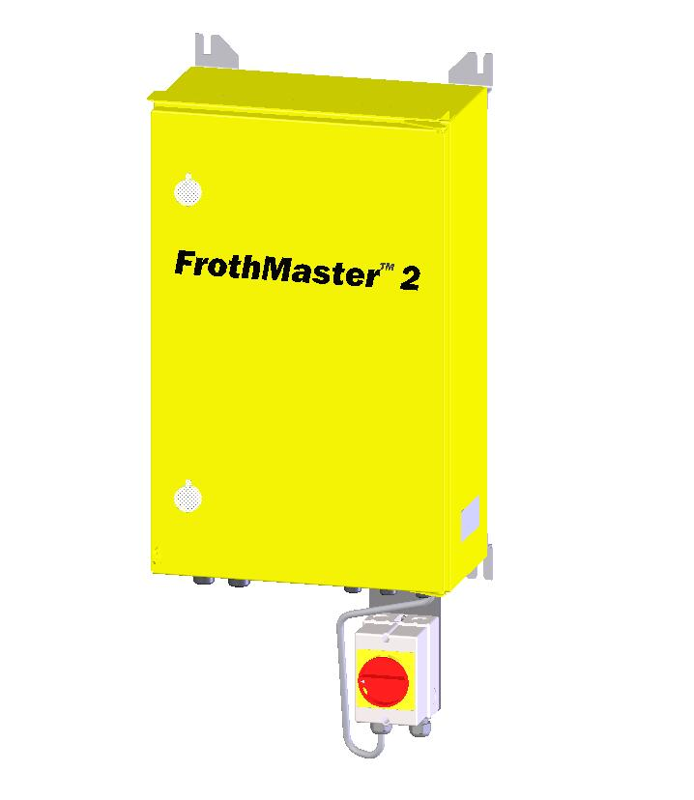
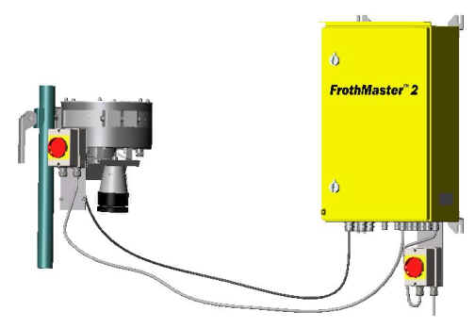
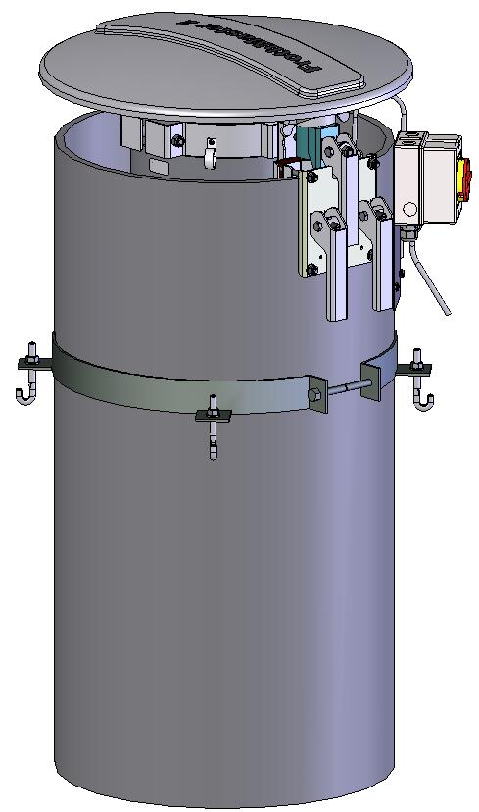

Slide 9
Froth Imager
Connection box
110 / 230 VAC
Ethernet for OPC
and video streaming
Optional analog
video out
Optional 4…20 mA
analog outputs

Slide 10
WWW browser to access
Frothmaster video stream
Customer DCS reads measurements from
OPC server
Configuration via
WWW browser
during commisioning
office workstation with
WWW browser
(customer)
HMI for DCS
(customer)
Plant network
Froth Management station with OPC server
(ACT and Nexus options)
FrothMaster network
FrothMaster 2
Connection box
Up to 4 imagers
can be connected to each connection box
FrothMaster 2
Imager

