Slide 1

Inventory Management System
Presented By:
Rabbil Sarker
ID: 315173001
Sumaiya Akter
ID: 315173007
Department of CSE
Supervised By:
Md. Abul Hasnat
Lecturer, Department of CSE
Hamdard University Bangladesh
Hamdard Nagar, Gazaria, Munshiganj-1510

Slide 2
Outlines
Introduction
Objectives
System Specifications
Progress Chart
Entity Relationships Diagram
Flow Chart
Implementation
Background Study
Conclusion
Future Work

Slide 3
Introduction
Inventory management refers to the process of ordering, storing, using
and selling a company's inventory.
Inventory is stock of items held meet future demand.
It is collection of goods processed to form desired output to the organization.

Slide 4
Objectives
The objectives of the project works are to:
Easy management of Inventory
Handle details of sales, purchase and balance stock
Make Stock Management
Deals with day to day requirement of any production organization

Slide 5
System Specifications
Hardware Configurations:
Processor : Intel(R) Core(TM) i3-4005U CPU @ 1.70GHz
Hard Disk : 1 TB
RAM : 4GB.
Software Specifications:
Operation System : Windows 10 Pro
Front-End : HTML-5, CSS-3, Bootstrap-4, Jquery
Back-End : PHP 8.0.3, Laravel 7, MySQL
Tools : VS Code, Xampp, Composer, Command Prompt

Slide 6
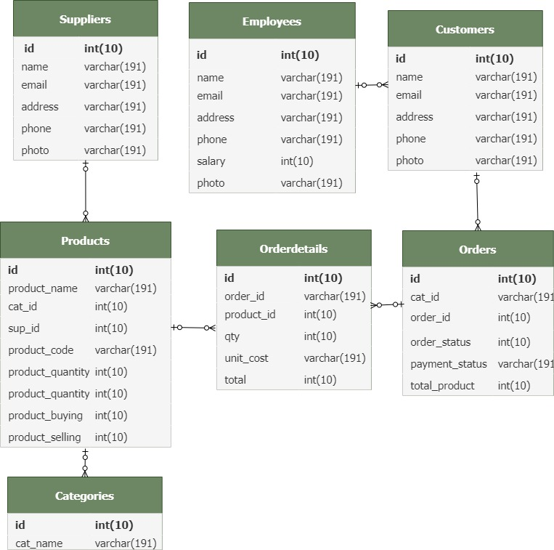
Entity Relationships Diagram

Slide 7
Progress Chart
Employees
POS
Sales Report
Suppliers
Expenses

Slide 8
Flow Chart
Admin Start
Register
Login
Company Details
Product Entity
Purchase & Sales
Store
Supplier
No
Stock
Available
Yes
Create Invoice
Decrease From Stock
Stock
Payment
Customer
WholeSaler
Logout
End

Slide 9
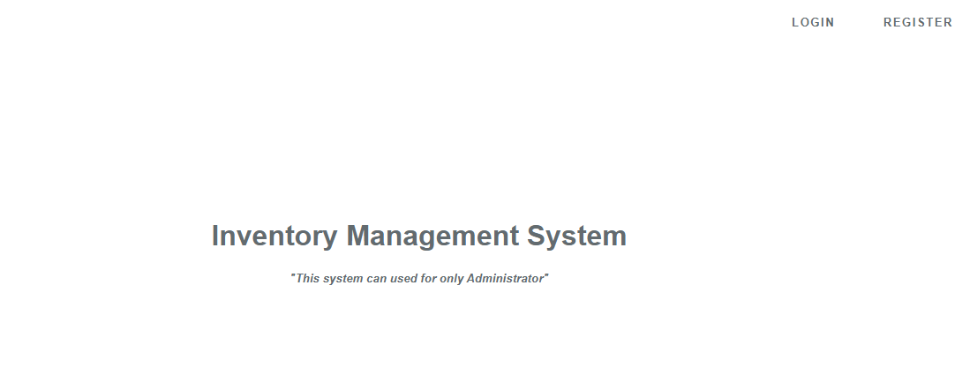
Implementation
Live Demo

Slide 10
Background Study
The following scopes in developing this project-
Self analysis.
Support Supervisor
List for Reference of Online survey study.
https://www.slideshare.net/pratikslideshare1/inventory-management-system-25878761
https://search.slidegeeks.com/powerpoint/Inventory-Management-System
https://slideplayer.com/slide/9386555/
https://www.academia.edu/26004152/Final_Year_Project_on_Inventory_Management_System

Slide 11
Conclusion
Almost accurate output.
Simple desktop IMS application
Overall production inventory management

Slide 12
Future Work
Online payment system.
Use of Oracle as database.
System flexible in any type.

Slide 13
Thanks to All

