Slide 1

An Online News Portal: STNEWS
Presented by
Fazle Rabbi
ID:315173002
Nur Alam Farhad Sakil
ID:315173006
Batch:13th
Department of CSE
Supervised by
Md. Ashifur Rahman
Lecturer
Department of CSE
Hamdard University Bangladesh
Gazaria, Munshigonj-1510
In pursuit of knowledge

Slide 2
Outlines
Introduction
Objectives
Key Features
Hardware Specification
Software Specification
Modules
Use Case Diagram of Admin
Use Case Diagram of Reporter
ER-Diagram
Activity Diagram
Live Demo
Comparison Chart
Conclusion
2
An Online News Portal: STNEWS

Slide 3
Introduction
News Portal is an online communication medium for internet users which are read all over the world. The news portal development allows to publish publications, press releases, columns, articles, blogs and other news related content.
A news portal is an access point to news. This is generally thought of as a internet connection to a news source but the definition of a “Portal” would include a newspaper, magazine or any other access to news.
This online news portal will allows users to read up-to-date news related to many fields like Entertainment, National, International, Business, Politics, Sports, Education etc.
An Online News Portal: STNEWS

Slide 4
Objectives
The objectives of this project work is to,
Develop a web application for Online News Portal that can aware mass people.
Provide all types of current and important news related to business, sports, national, international, education etc.
Provide information dynamically, like live status of a current situation will be updated frequently almost every moment.
Upload news from any where at any time through web using mobile, tablets, etc. with registered login id & password.
Add any new information without any complexity on an easy and minimalistic user friendly editor interface.
Develop an admin panel where admins can check day wise uploads and editing happened by reporters.
An Online News Portal: STNEWS

Slide 5
Key Features
Search
International Market Rate
Today in History
Horoscope
Featured News
Most Views
New news can be added or modified by only the admin and reporter.
An Online News Portal: STNEWS

Slide 6
Hardware Specification
At Developer End
Processor : Intel Core 2 Duo(similar or Above)
RAM : 1 GB or More
Storage Capacity : 10 GB or More
At End User
Internet connection available device will be required.
An Online News Portal: STNEWS

Slide 7
Software Specification
AT Developer End
Front-end : JavaScript, HTML5, CSS.
Back-end : Laravel ( 8.x), MYSQL (8.0).
Operating System : Window XP or above, Linux or any other OS.
Other tools : Xampp Server Version (8.0.0), Sublime Text 3, Visual Studio Code or any other Web IDE, Git Bash.
AT End User
Any Latest Web Enabled Browser.
Window XP or above, Linux or any other web feature enabled OS.
An Online News Portal: STNEWS

Slide 8
Modules
Log In
Admin
Reporter
Contact Us
Searching
An Online News Portal: STNEWS

Slide 9
Use Case Diagram of Admin
Add/Delete/Modify User Role
Add/Delete/Modify User
Admin
Login
Add/Delete/Modify News
Add/Delete/Modify Category
An Online News Portal: STNEWS

Slide 10
Use Case Diagram of Reporter
Reporter
Login
Add/Delete/Modify News
An Online News Portal: STNEWS

Slide 11
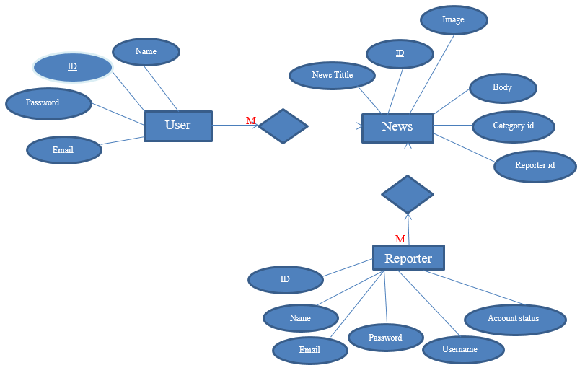
ER Diagram
An Online News Portal: STNEWS

Slide 12
Activity Diagram
Obtain email and password
No
Both Details Available
Validate Details
Incorrect information
Yes
Open Default Page
Exit
An Online News Portal: STNEWS

Slide 13
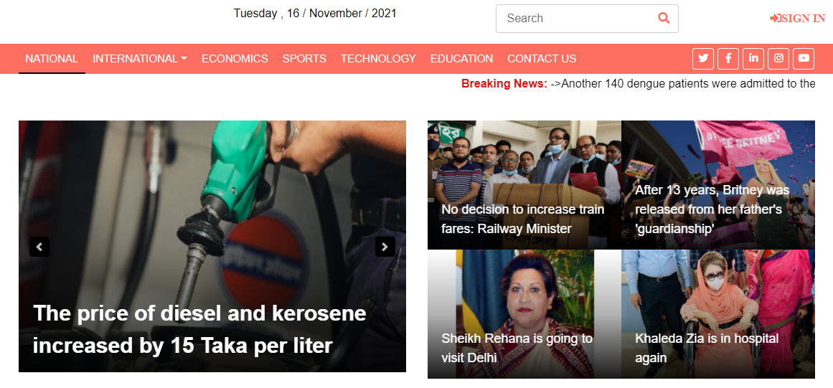
Implementation
Live Demo
An Online News Portal: STNEWS

Slide 14
Comparison Chart
Features | The Azadi | Jaijaidin | Alokito Bangladesh | The Sangbad | Proposed System
Search | No | Yes | No | No | Yes
Most Views | No | No | No | No | Yes
International Market Rate | No | No | No | No | Yes
Horoscope | No | No | No | No | Yes
Featured News | No | No | No | No | Yes
An Online News Portal: STNEWS

Slide 15
Conclusion
In our project work, people will get unmodified and authentic news quickly from the news portal. Also it will helps people to understand better about the current situation and increase their awareness
To develop this project we have faced many problem but we tried hard to develop this project. Our supervisor helps us by giving his valuable opinion, decision and time.
An Online News Portal: STNEWS

Slide 16
Thanks To All

