Slide 1
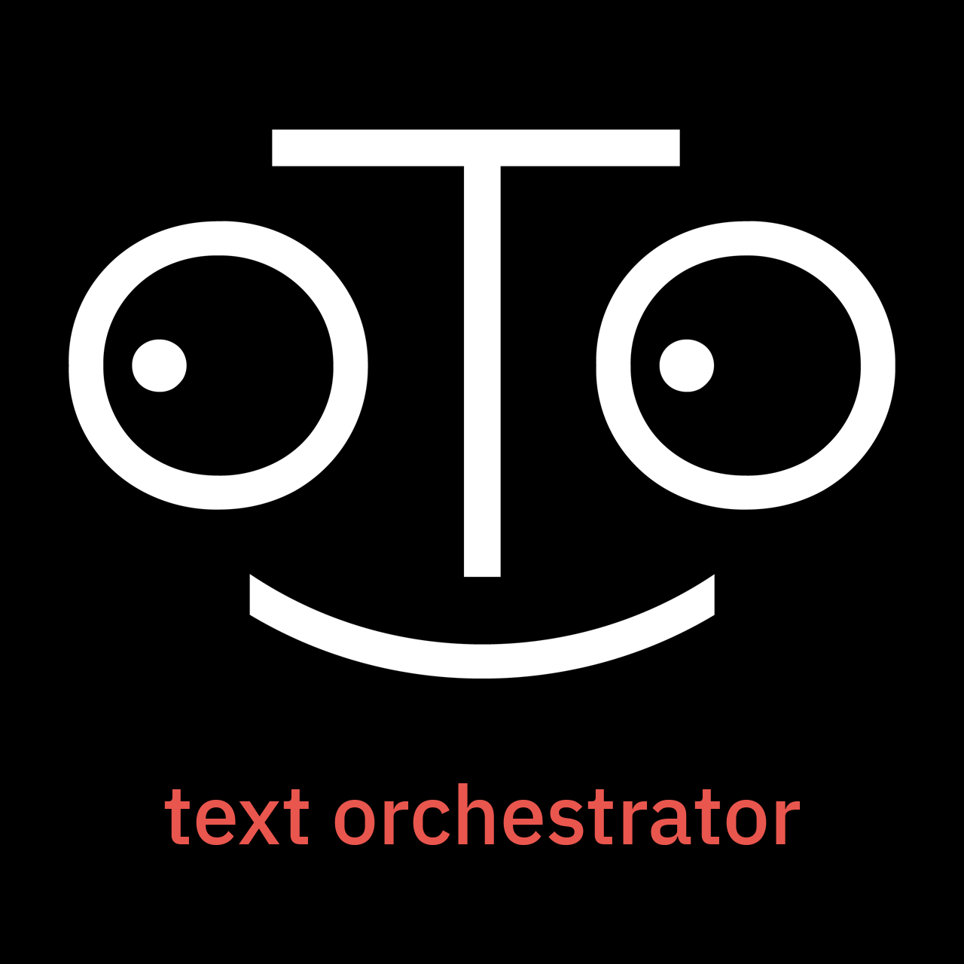
SLIDE 1
Notes:
Welcome to OtO, the premier teleprompting software solution.

Slide 2
SLIDE 2
Notes:
Welcome to OtO, the premier teleprompting software solution.

Slide 3
SLIDE 3
Notes:
Welcome to OtO, the premier teleprompting software solution.

