Slide 1
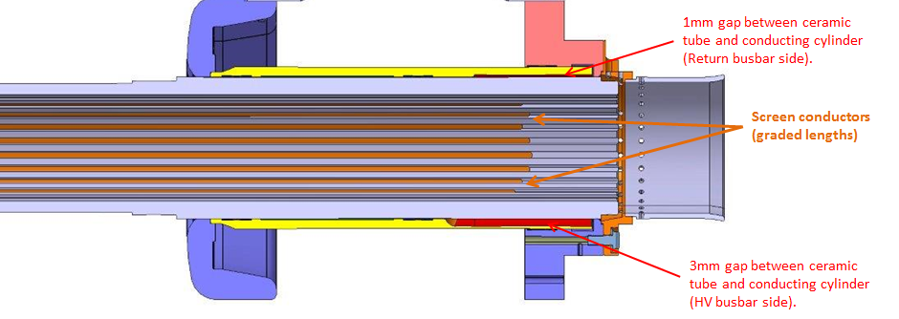
Region with stepped off metal cylinder
Holders for ferrite damping rings

