Slide 1
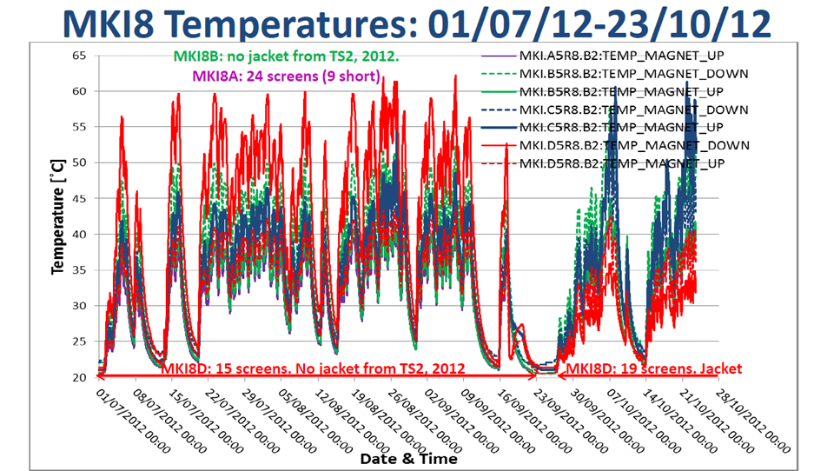
The LHC Injection Kicker Magnets (MKIs) saw high temperatures during the 2012 run of the LHC due to high current beams driving strong longitudinal wakefields in the device.
The MKIs contain a beam screen inserted into the ferrite yoke consisting of a ceramic cylinder supporting metal wires running the length of the kicker magnet to give a good conducting path for the beam image currents
Ceramic
Conductor
Ferrite
One MKI in particular showed higher temperatures than the others – MKI8D (at IP8 injection point, magnet D of 4 magnets at that injection point). This was replaced in September 2012 during a technical stop

