Slide 1
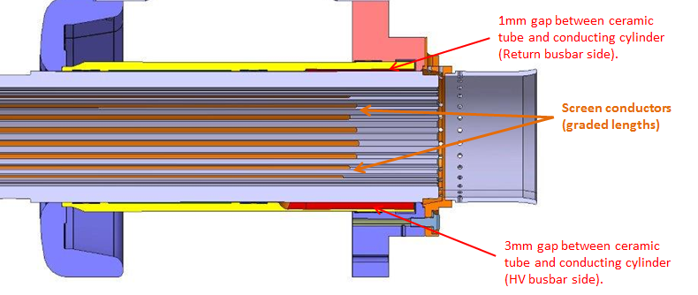
HV deflector
External cylinder
L_{overlap}
Screen conductors
1mm gap along bottom
Region with 3mm stepped off metal cylinder

