Slide 1
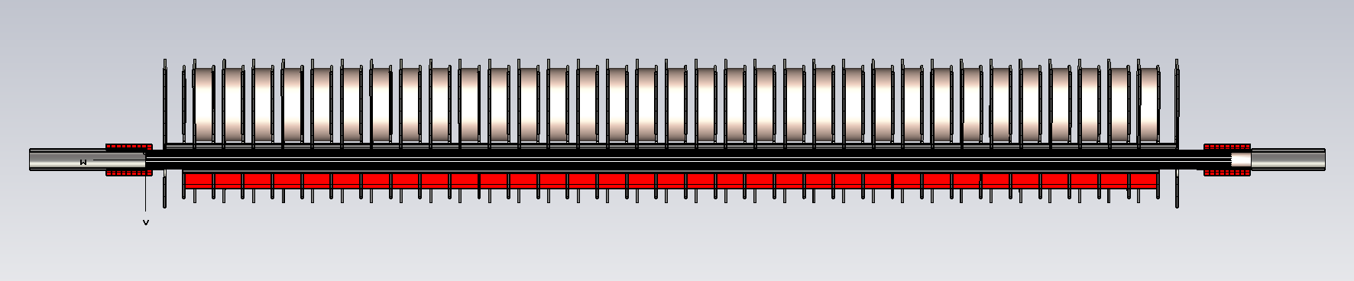
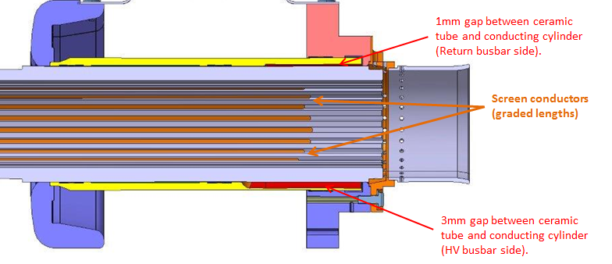
Ceramic capacitor
High voltage (HV) plate
Ground plate
Damping ferrites
Beam
2.7m
Ferrite yoke
Capacitively coupled end
1mm gap between ceramic tube and conducting cylinder
Screen conductors
3mm gap between ceramic tube and conducting cylinder
L_{overlap}

