Slide 1
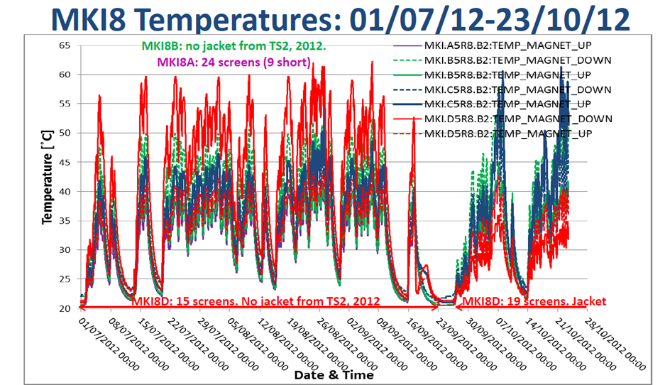
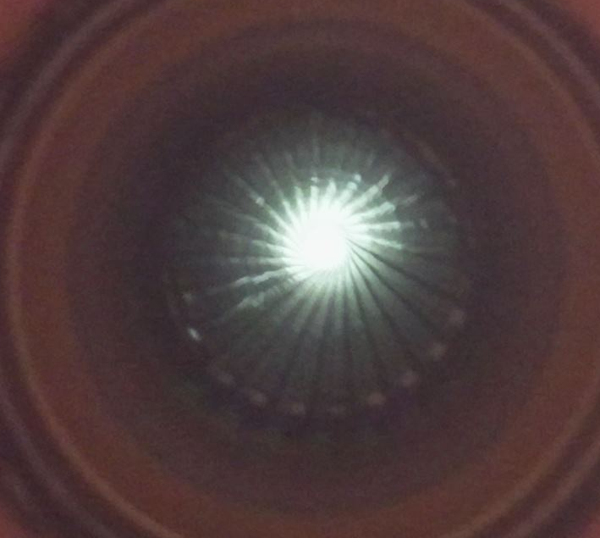
The LHC Injection Kicker Magnets (MKIs) saw high temperatures during the 2012 run of the LHC due to high current beams driving strong longitudinal wakefields in the device. The MKIs contain a beam screen, inserted into the ferrite aperture, consisting of a ceramic cylinder supporting metal wires running the length of the kicker magnet to give a good conducting path for the beam image currents
Ceramic
Conductor
Ferrite
Cross-section of beam screen and ferrite yoke, showing the screen conductors on the internal face of the ceramic tube. Due to poor high voltage performance 9 conductors (in the black box) were originally removed to prevent electrical breakdown during pulsing.
One MKI in particular showed higher temperatures than the others – MKI8D (the solid red line above). This was replaced in September 2012 during, technical stop 3 (TS3), with a beam screen with 19 conductors (in the red box above-left), which was predicted to have a much lower power loss due to improved screening of the ferrite yoke from the beam. This magnet had the lowest temperature after TS3.
MKI8D was found to have a 90⁰ twist in its ceramic screen. This cause a significant portion of it’s ferrite yoke to be directly exposed to the beam, resulting a very high beam coupling impedance

