Slide 1
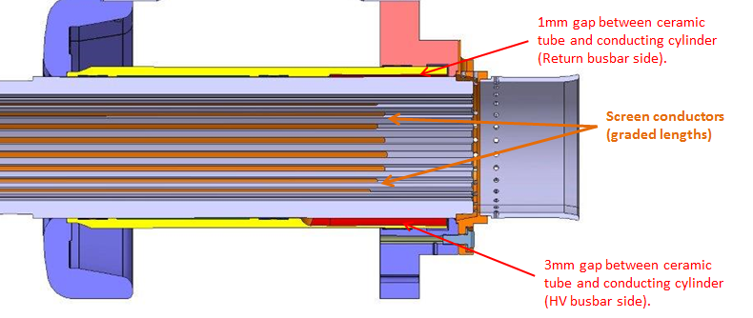
Holders for ferrite damping rings
Region with stepped off metal cylinder

