Slide 1
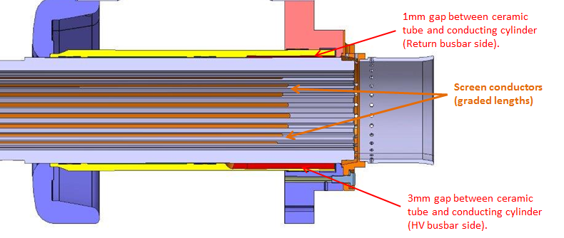
HV deflector
External cylinder
L_{overlap}
1mm gap along bottom
Holders for ferrite damping rings
Region with 3mm stepp off metal cylinder

