Slide 1
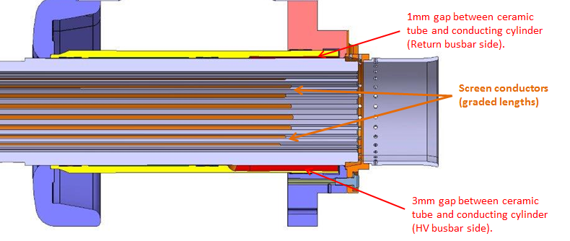
HV deflector
External cylinder
L_{overlap}
Conductors removed prior to LS1
Holders for ferrite damping rings
Region with stepped off metal cylinder

