Slide 1
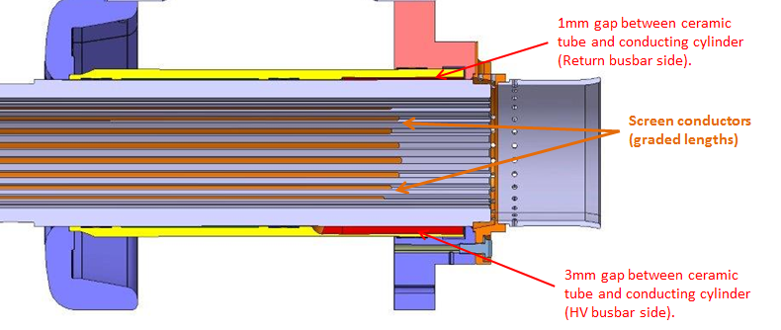
HV deflector
External cylinder
L_{overlap}
Screen conductors
Conductors removed prior to LS1
Region with stepped off metal cylinder

