Slide 1
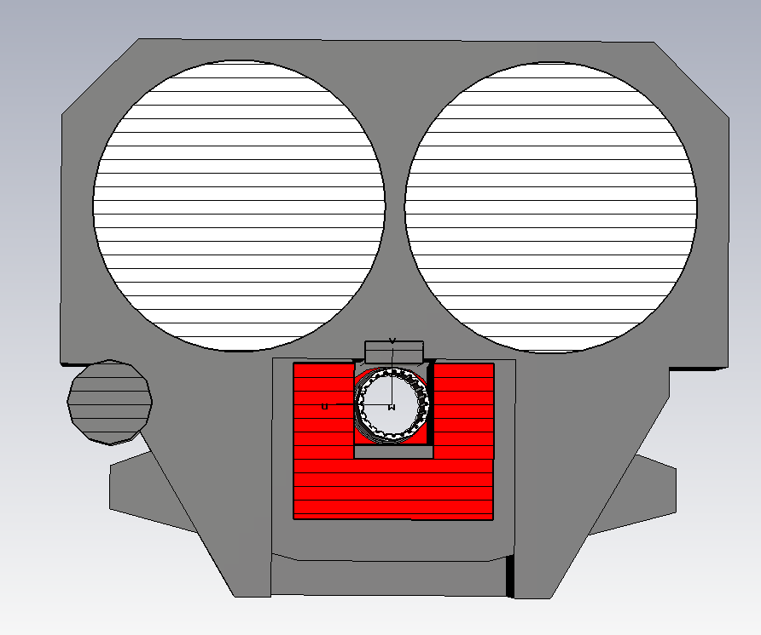
Ceramic capacitor plates
53mm
Ground/return busbar
Beam screen -
Ceramic tube
Screen conductors
HV busbar
Ferrite yoke
Counter-rotating beam pipe

