Slide 1
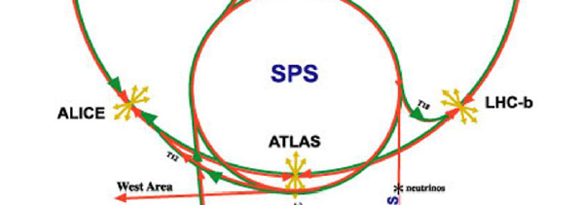

Injection IP2
Injection IP8

