Slide 1
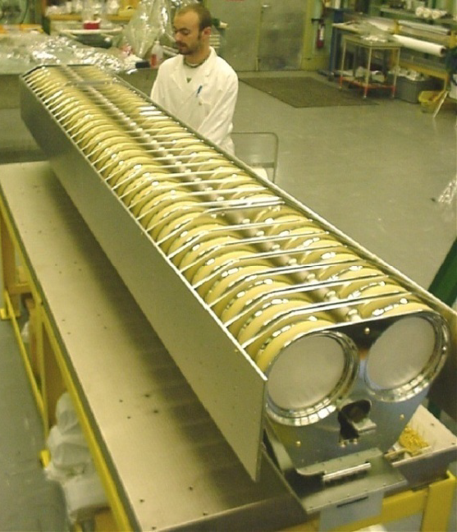
Ground/HV Plates
Ceramic Capacitors
Ground/return busbar
Beam

