Slide 1
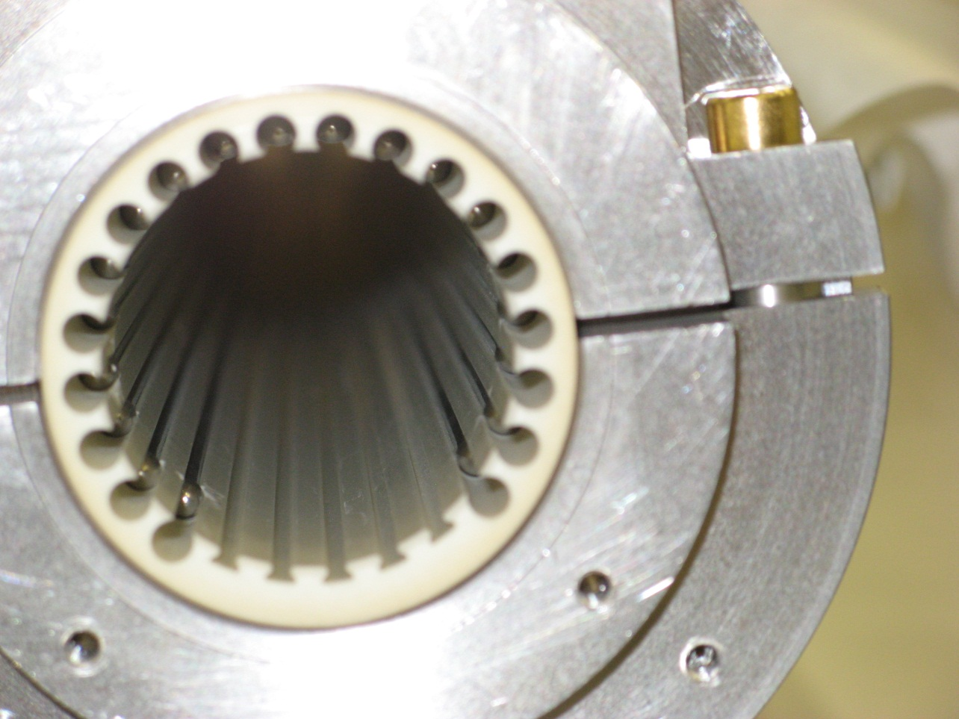
Elongated metal sphere
Empty screen conductor slots (5 total)

