Slide 1
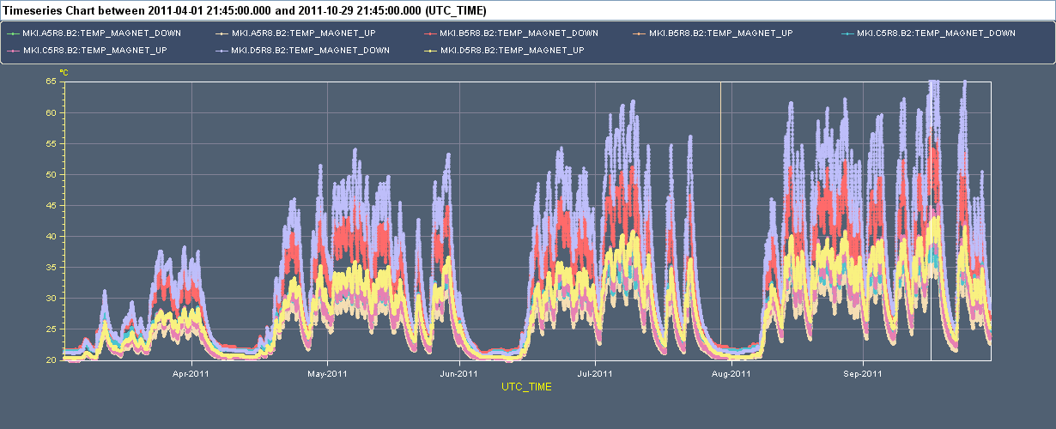
65⁰C
20⁰C
March 2011
October 2011

