Slide 1
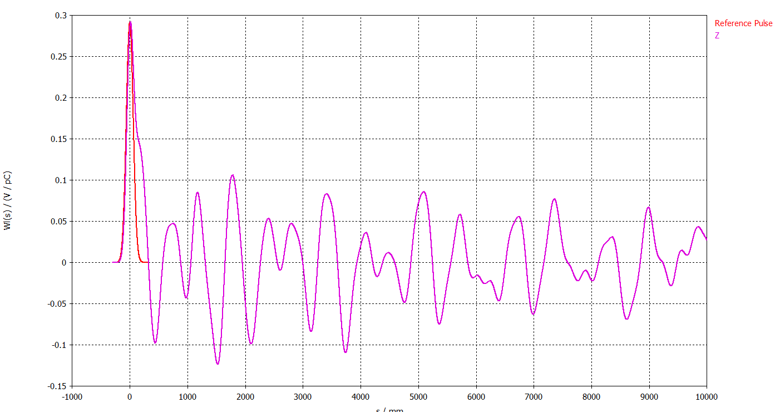
W(s) / (V/pC)
s/mm

