Slide 1
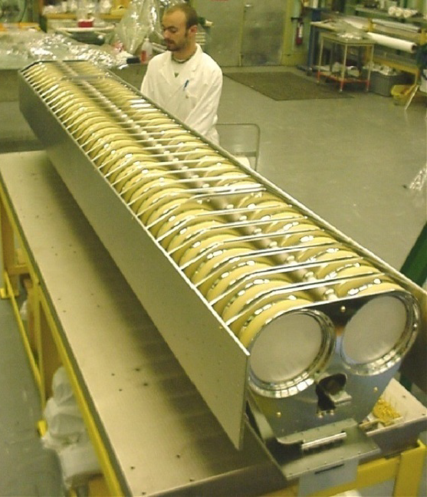
Ground/HV Plates
Ceramic Capacitors

