Slide 1

PROFESSIONAL SERVICE LINKING SYSTEM FOR HOME AND OFFICE REPAIRS
PRESENTED BY: CHUAN HAAR AJACH
ROLL NUMBER: 2247084, BSC
SUPERVISED BY: DR. NILKANTA DAS, ASSISTANT PROFESSOR, SCA
KIIT UNIVERSITY

Slide 2






INTRODUCTION
The Service-Linker project connects professionals with clients. It allows for easy communication and collaboration. Professionals can showcase their expertise. Clients find service providers tailored to their needs. Modern technologies like React.js emphasize scalability and ease of use.
Efficiency
Time-saving solutions.
Connection
Direct professional links.
Communication
Clear message exchange.

Slide 3


PROBLEM STATEMENT
Inefficient Connections
Delays in finding qualified professionals
Lack of Verification
Uncertainty about service provider credentials
Traditional methods like word-of-mouth referrals and manual searches lead to inefficiencies, delays, and poor service quality. Both customers and professionals struggle to connect efficiently in the current system.

Slide 4




OBJECTIVES
Easy Access to Professionals
Find skilled repair experts based on expertise and location
Clear Professional Listings
Detailed profiles with qualifications, experience, and reviews
Simple Booking System
Schedule appointments with just a few clicks
Trustworthy Reviews
Honest feedback from verified customers

Slide 5



KEY FEATURES
Secure Authentication
Verified access for legitimate professionals and customers
Messaging System
Direct communication between users and professionals
Geolocation Services
Find nearby professionals within your preferred range

Slide 6
BENEFITS FOR CUSTOMERS
Reliable Access
Transparent Reviews
Quick connections with verified technicians, reducing delays and uncertainties
Make informed choices based on genuine feedback from other users

Slide 7
BENEFITS FOR PROFESSIONALS
1
Enhanced Visibility
2
Communication
3
Client Management
Showcase expertise to a broad audience. Increase reach and potential client base.
Direct and organized client communication. Clarity and efficiency in interactions.
Track client conversations and progress. Reduce administrative overhead.

Slide 8

TECHNOLOGY STACK
1
Frontend
React.js ensures a dynamic user interface. CSS and Bootstrap create a user-friendly design.
2
State Management
React Hooks like useState manage component states, for example, user interactions.
3
Storage
Local Storage persists messages. It simulates a database for user interactions.
4
Development Tools
Visual Studio Code is the IDE. Browser DevTools debug and test UI.

Slide 9
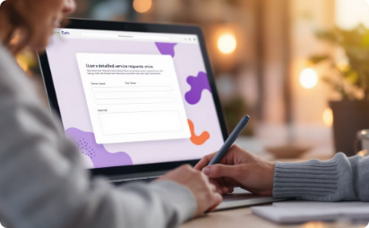
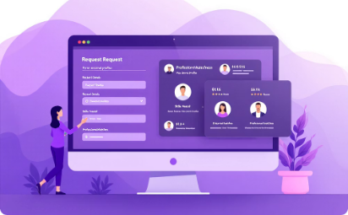

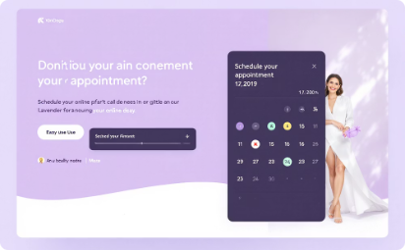

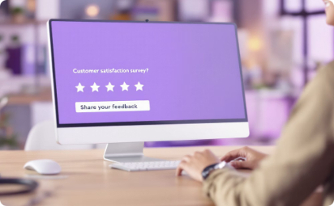
PLATFORM WORKFLOW
User Request
Professional Matching
Direct Communication
Customer submits a service request with details.
System matches request with qualified professionals.
Professionals and customers communicate directly.
Scheduling
Service Execution
Review & Rating
Appointment is scheduled through the platform.
Professional provides service and completes the job.
Customer provides feedback and rates the service.

Slide 10






DEVELOPMENT METHODOLOGY
Analysis
Design
Implementation
Define requirements and user needs
Design UI and system architecture
Develop key components
Testing
Deployment
Iteration
Perform unit and manual testing
Package and deploy the application
Gather feedback and improve

Slide 11
CONCLUSION
Streamlined Service
Enhanced Reliability
Improved Communication
Our platform offers a streamlined way to connect customers with verified professionals.
We ensure quality through a strict verification process and constant quality control.
Direct communication between users ensures the best results for everyone.
This improves efficiency and satisfaction. Our platform ensures service delivery is fast and dependable.
By connecting trusted professionals with customers, our platform elevates service standards.

Slide 12
THANK YOU

