Slide 2
Antra SEP Program
Cascading Style Sheet (CSS)
Day 1

Slide 3
What is CSS?
/* Styles for sitename.com*/
body { font-family:Arial; background: #000; }
#container { text-align:left; width:1020px;
}
#header { height:232px; }
#footer { width: 100%; padding: 0 10px; margin-bottom: 10px;
}
And so on….
CSS stands for Cascading Style Sheets
Styles define how to display HTML elements
Styles are normally stored in Style Sheets
Styles were added to HTML 4.0 to solve a problem
External style sheets can save a lot of work
External style sheets are stored in CSS files
Multiple style definitions will cascade into one
* To create a style sheet, create a file using Notepad (PC) or Text Edit (Mac), save it as a .css document and start
writing the CSS code (see right).

Slide 4
CSS Benefits
Separates structure from presentation
Provides advanced control of presentation
Easy maintenance of multiple pages
Faster page loading
Better accessibility for disabled users
Easy to learn

Slide 5
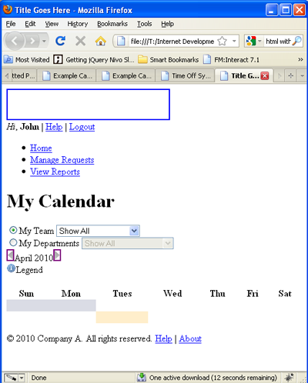
HTML Without CSS
“HTML without CSS is like a piece of candy without a pretty wrapper.”
Without CSS, HTML elements typically flow from top to bottom of the page and position themselves to the left by default.
With CSS help, we can create containers or DIVs to better organize content and make a Web page visually appealing.

Slide 6
HTML & CSS
HTML and CSS work together to produce beautiful and functional Web sites
HTML = structure
CSS = style

Slide 7
HTML CSS
div id=“header”
#content {
background-color: #ccc;
margin-bottom: 10px;
border: 1px dashed blue;
color: #fff;
width: auto;
}
div id=“content”
div id=“footer”

Slide 8
Attaching a Style Sheet
Attach a style sheet to a page by adding the code to the <head> section of the HTML page. There are 3 ways to attach CSS to a page:
1. External Style Sheet: Best used to control styling on multiple pages.
<link rel="stylesheet" type="text/css" media="all" href="css/styles.css" />
2. Internal Style Sheet: Best used to control styling on one page.
<style type=“text/css”> h1 {color: red) </style>
3. Inline Style Sheet*: CSS is not attached in the <header> but is used directly within HTML tags.
<p style=“color: red”>Some Text</p>

Slide 9
CSS Style Rule
p {
font-size: x-large ;
background-color: yellow
}
property names
declarations
selector string
declaration block

Slide 10
CSS Syntax
A CSS comprises of style rules that are interpreted by the browser and then applied to the corresponding elements in document. A style rule is made of three parts
Selector − A selector is an HTML tag at which a style will be applied. This could be any tag like <h1> or <table> etc.
Property - A property is a type of attribute of HTML tag. Put simply, all the HTML attributes are converted into CSS properties. They could be color, border etc.
Value - Values are assigned to properties. For example, color property can have value either red or #F1F1F1 etc.
Syntax:
selector { property: value }
Example:
table{ border :1px solid #C00; }
Notes:
Here table is a selector and border is a property and given value 1px solid #C00 is the value of that property

Slide 11
CSS Selectors
Selectors can be defined in various ways as following:
Type Selectors
Universal Selectors
Descendant Selectors
Class Selectors
ID Selectors
Child Selectors
Attribute Selectors
Grouping Selectors

Slide 12
Type Selectors
CSS type selectors match elements by tag name. Used alone, therefore, a type selector for a particular tag name selects all elements of that type — that is, with that tag name — in the document. For example
h1 {
color: #36CFFF;
}

Slide 13
Universal Selectors
An asterisk (*) is the universal selector for CSS. It matches a single element of any type. Rather than selecting elements of a specific type, the universal selector quite simply matches the name of any element type.
* {
color: #000000;
}
This rule renders the content of every element in our document in black

Slide 14
Descendent Selectors
Descendant selectors typically are represented by a single space character — It combines two selectors such that elements matched by the second selector are selected if they have an ancestor element matching the first selector. Selectors that utilize a descendant combinator are called descendant selectors.The descendant selector matches all elements that are descendants of a specified element.
The following example selects all <p> elements inside <div> elements:
div p {
background-color: yellow;
}

Slide 15
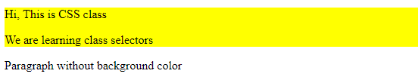
Class Selectors
You can define style rules based on the class attribute of the elements. All the elements having that class will be formatted according to the defined rule.
.intro { background-color: yellow; }
you can use this class in html elements as shown below:-
<div class="intro">
<p>Hi, This is CSS class</p>
<p>We are learning class selectors</p>
</div>
<p> Paragraph without intro class</p>

Slide 16

Id Selectors
CSS ID selectors match an element based on the contents of that element's id attribute, which must match exactly the value given in the selector.
#identified {
background-color: DodgerBlue;
}
<span id="identified">Here's a span with some text.</span>
<span>Here's another.</span>
Output:-

Slide 17
Child Selectors
The child Selector (>) separates two selectors and matches only those elements matched by the second selector that are children of elements matched by the first.
The element>element selector is used to select elements with a specific parent.
Note: Elements that are not directly a child of the specified parent, are not selected.

Slide 18

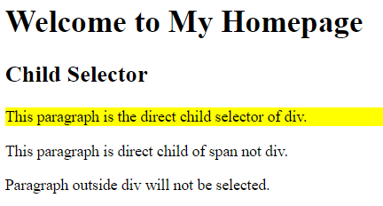
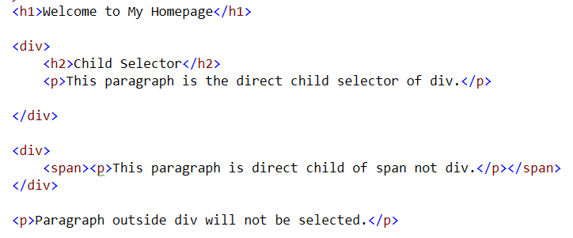
Child Selectors
Code
Output

Slide 19
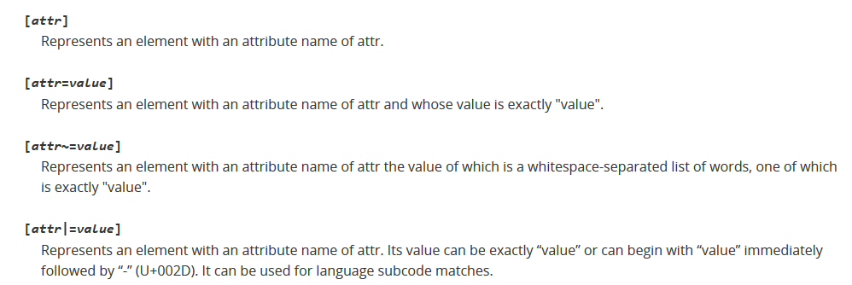
Attribute Selectors
Attribute selectors select an element using the presence of a given attribute or attribute value.

Slide 20
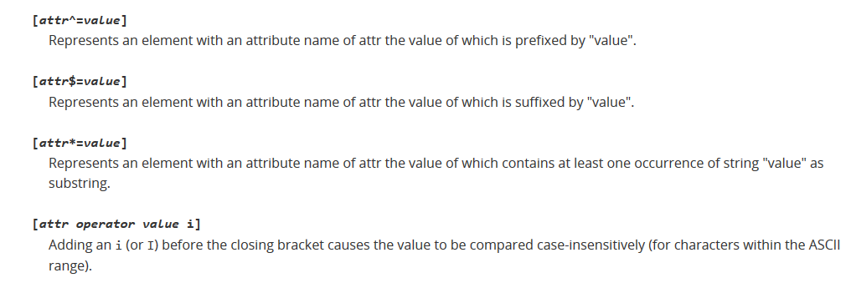
Attribute Selectors

Slide 21
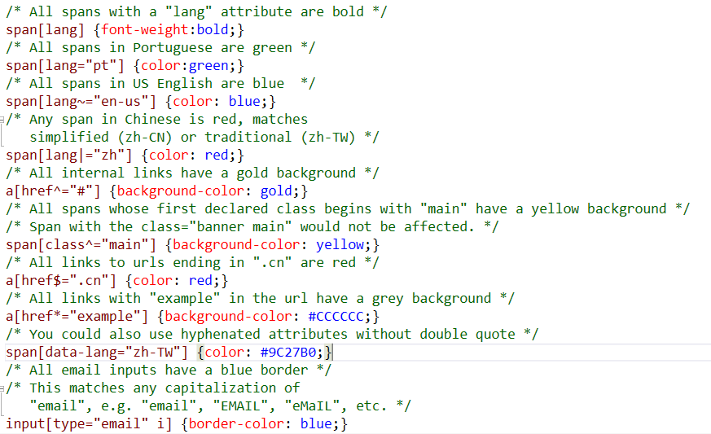
Attribute Selector (code)

Slide 22
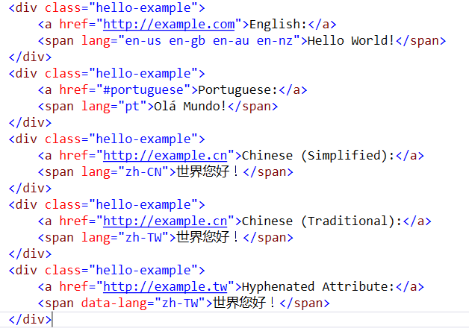
Attribute Selector (Code)

Slide 23
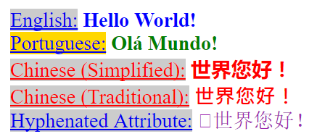
Attribute Selectors (Output)

Slide 24
Grouping Selectors
Group the same selector with different declarations together on one line.
h1 {color: black;}
h1 {font-weight: bold;}
h1 {background: white;}
h1 {
color: black;
font-weight: bold;
background: white;
}
Example of grouping selectors (both are correct):

Slide 25
Grouping Selectors
Group different selectors with the same declaration on one line.
h1 {color: yellow;}
h2 {color: yellow;}
h3 {color: yellow;}
Example of grouping selectors (both are correct):
h1, h2, h3 {color: yellow;}

Slide 26
CSS Inclusion
There are four ways to associate styles with your HTML document. Most commonly used methods are inline CSS and External CSS.
Embedded CSS - The <style> Element
Inline CSS - The style Attribute
External CSS - The <link> Element
Imported CSS - @import Rule

Slide 27
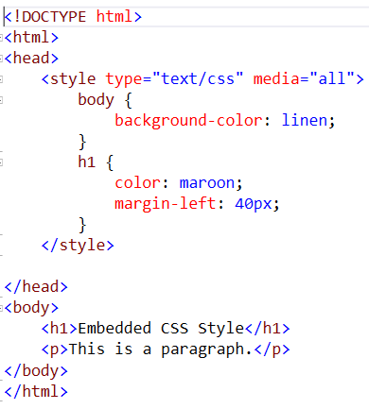
Embedded CSS - The <style> Element
You can put your CSS rules into an HTML document using the <style> element. This tag is placed inside <head>...</head> tags. Rules defined using this syntax will be applied to all the elements available in the document. Here is the generic syntax

Slide 28
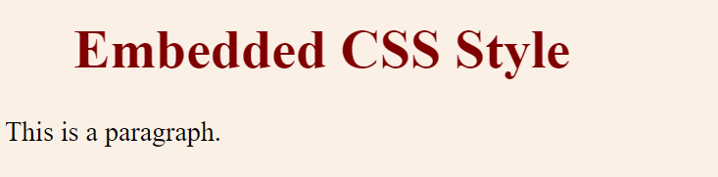
Embedded Style (output)

Slide 29
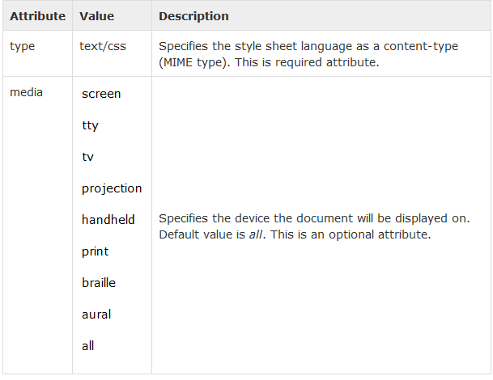
Attributes associated with <style> elements are

Slide 30
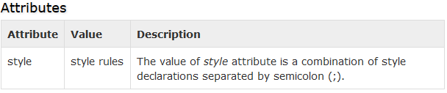
Inline CSS - The style Attribute
You can use style attribute of any HTML element to define style rules. These rules will be applied to that element only. Here is the generic syntax
<element style = "...style rules....">

Slide 31
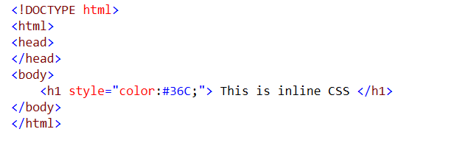

Inline CSS - The style Attribute
Output

Slide 32
External CSS - The <link> Element
The <link> element can be used to include an external stylesheet file in HTML document.
An external style sheet is a separate file with .css extension. One can define all the Style rules within this file and then can include this file in any HTML document using <link> element
Syntax is
<head>
<link type = "text/css" href = "..." />
</head>

Slide 33
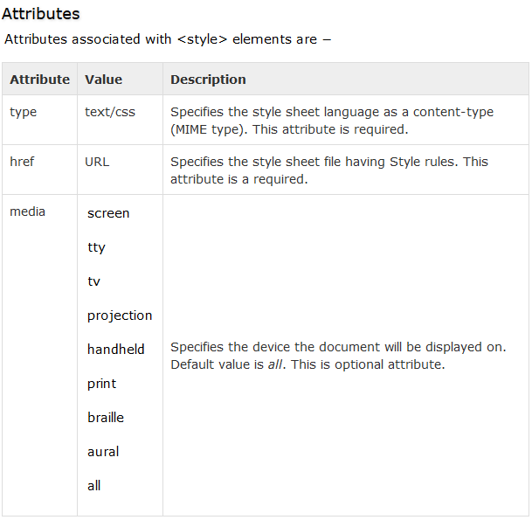
External CSS - The <link> Element (Attribute)

Slide 34
Imported CSS - @import Rule
@import is used to import an external stylesheet in a manner similar to the <link> element. Here is the generic syntax of @import rule.
<head>
<@import "URL";
</head>
Here URL is the URL of the style sheet file having style rules. You can use another syntax as well
<head>
<@import url("URL");
</head>

Slide 35
CSS Overriding Rules
Any inline style sheet takes highest priority. So, it will override any rule defined in <style>...</style> tags or rules defined in any external style sheet file.
Any rule defined in <style>...</style> tags will override rules defined in any external style sheet file.
Any rule defined in external style sheet file takes lowest priority, and rules defined in this file will be applied only when above two rules are not applicable

Slide 36
Comments in CSS
Explain the purpose of the coding
Help others read and understand the code
Serve as a reminder to you for what it all means
Starts with /*and ends with*/
p {color: #ff0000;} /*Company Branding*/

Slide 37
Measurement Units

Slide 38
Measurement Units
CSS supports a number of measurements including absolute units such as inches, centimeters, points, and so on, as well as relative measures such as percentages and em units. You need these values while specifying various measurements in your Style rules e.g border = "1px solid red"

Slide 39
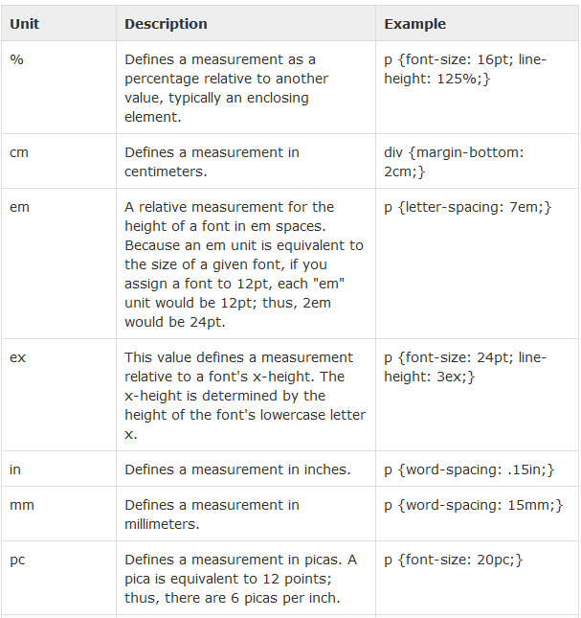
Measurement Units

Slide 40
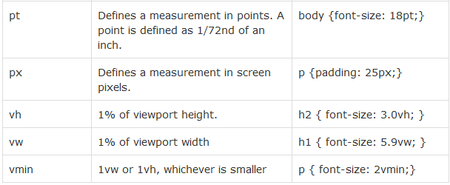
Measurement Units

Slide 41
CSS Colors

Slide 42
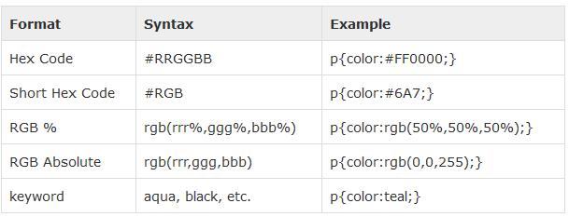
CSS Colors
CSS uses color values to specify a color. Typically, these are used to set a color either for the foreground of an element (i.e., its text) or else for the background of the element. They can also be used to affect the color of borders and other decorative effects.
One can specify your color values in various formats. Following table lists all the possible formats

Slide 43
CSS Background

Slide 44
CSS Background
The background-color property is used to set the background color of an element.
The background-image property is used to set the background image of an element.
The background-repeat property is used to control the repetition of an image in the background.
The background-position property is used to control the position of an image in the background.
The background-attachment property is used to control the scrolling of an image in the background.
The background property is used as a shorthand to specify a number of other background properties.

Slide 45
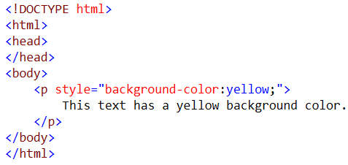

Setting background-color
Output

Slide 46
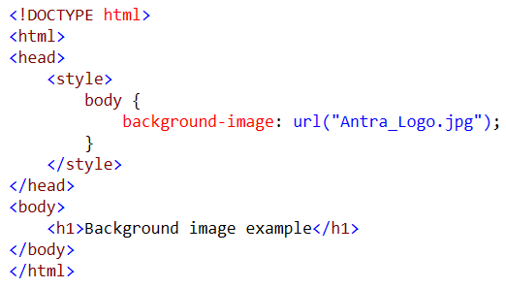
Setting Background Image

Slide 47

Background Image

Slide 48
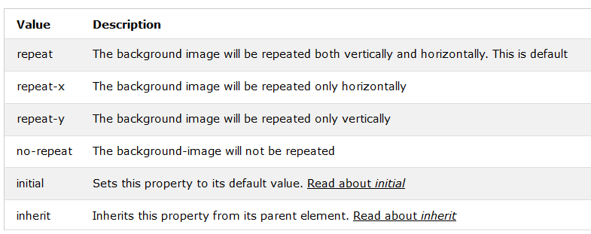
Background-repeat

Slide 49

Image Positioning
left
top
center
top
The background-position property positions the image using either combined keywords (top, bottom, left, right, and center); length values; or percentage values.
left
bottom
center
bottom
right
bottom
background-position: right top; /*can also use number values*/
The background-attachment property fixes or scrolls an image in the browser window. Values include fixed and scroll.
background-attachment: fixed; /*can also use ‘scroll’*/

Slide 50
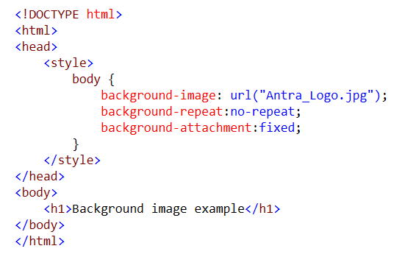
Background attachment

Slide 51
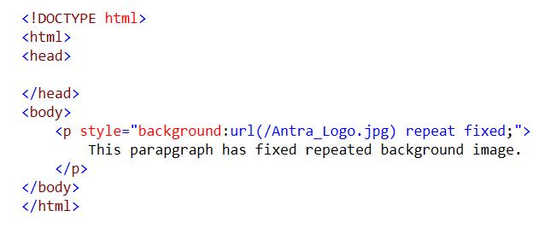
Background (shorthand property)

Slide 52
Font
The font-family property is used to change the face of a font.
The font-style property is used to make a font italic or oblique.
The font-variant property is used to create a small-caps effect.
The font-weight property is used to increase or decrease how bold or light a font appears.
The font-size property is used to increase or decrease the size of a font.
The font property is used as shorthand to specify a number of other font properties

Slide 53
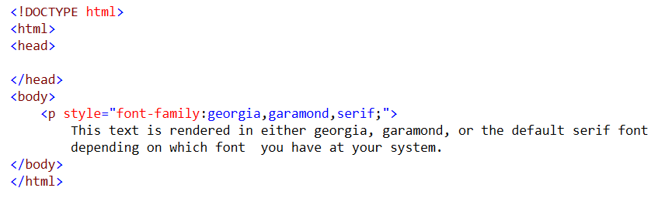
Setting Font Family
OUTPUT

Slide 54
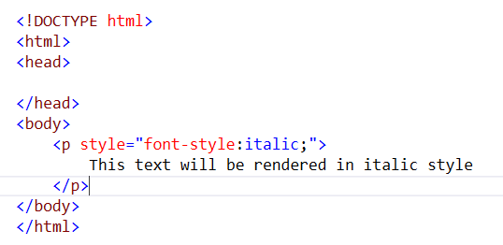

Font Style
Output

Slide 55
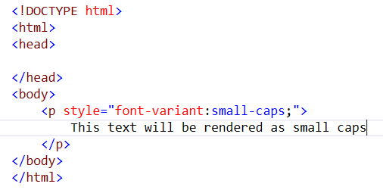

Font variant

Slide 56
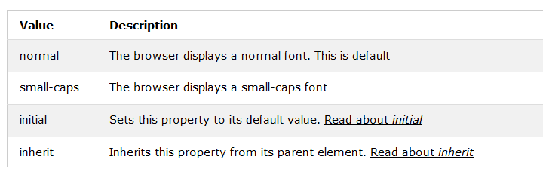
Font Variant

Slide 57
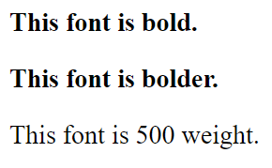
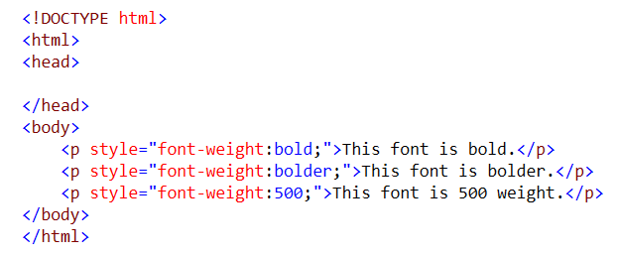
Font Weight
The font-weight property provides the functionality to specify how bold a font is. Possible values could be normal, bold, bolder, lighter, 100, 200, 300, 400, 500, 600, 700, 800, 900

Slide 58
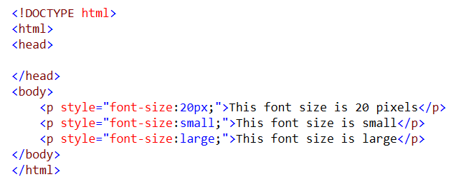
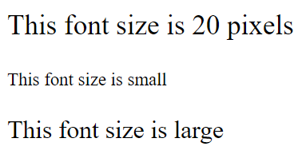
Font Size
The font-size property is used to control the size of fonts. Possible values could be xx-small, x-small, small, medium, large, x-large, xx-large, smaller, larger, size in pixels or in %

Slide 59
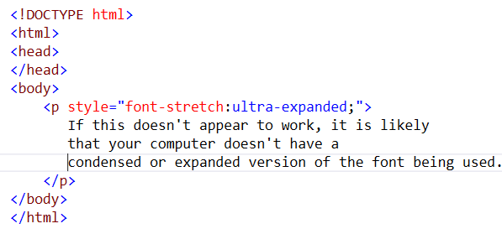
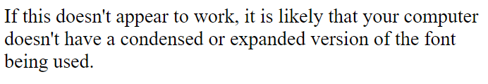
Font Stretch
This property relies on the user's computer to have an expanded or condensed version of the font being used.
Possible values could be normal, wider, narrower, ultra-condensed, extra-condensed, condensed, semi-condensed, semi-expanded, expanded, extra-expanded, ultra-expanded

Slide 60
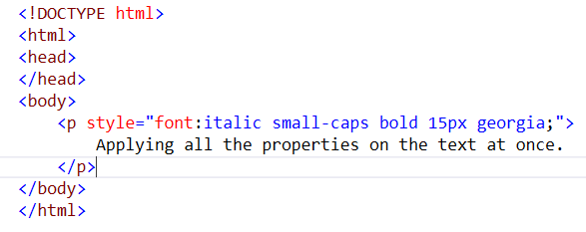
Font (shorthand property)
Output

Slide 61
CSS - TEXT

Slide 62
CSS - Text
The color property is used to set the color of a text.
The direction property is used to set the text direction.
The letter-spacing property is used to add or subtract space between the letters that make up a word.
The word-spacing property is used to add or subtract space between the words of a sentence.
The text-indent property is used to indent the text of a paragraph.
The text-align property is used to align the text of a document.
The text-decoration property is used to underline, overline, and strikethrough text.
The text-transform property is used to capitalize text or convert text to uppercase or lowercase letters.
The white-space property is used to control the flow and formatting of text.
The text-shadow property is used to set the text shadow around a text

Slide 63
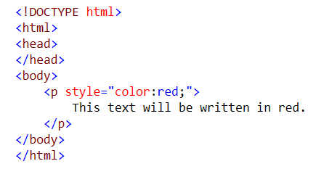

Setting Text Color
Output

Slide 64
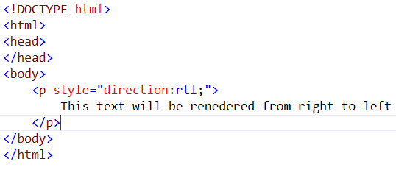
Set Text Direction
Possible values are ltr or rtl
Output

Slide 65
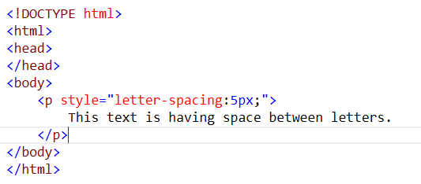
Space between Characters
Possible values are normal or a number specifying space.

Slide 66
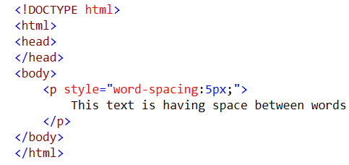

Set space between words
OUTPUT

Slide 67
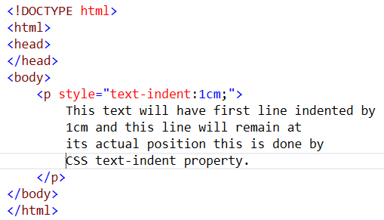
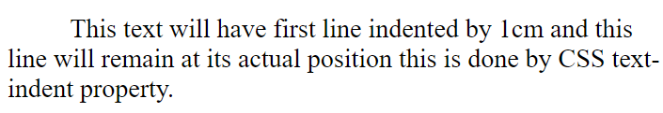
Set Text Indent
Indent the first line of a paragraph. Possible values are % or a number specifying indent space

Slide 68
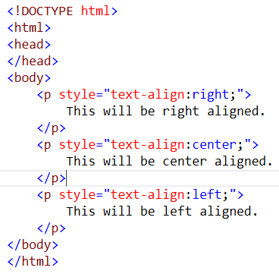
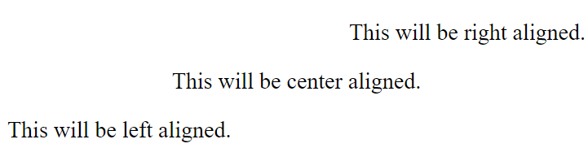
Set Text Alignment
It is used to align a text. Possible values are left, right, center, justify.
Output

Slide 69
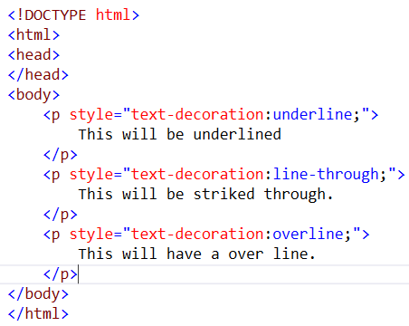
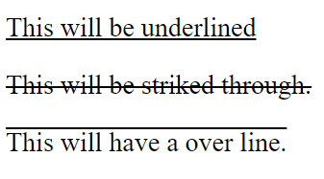
Decorating the Text

Slide 70
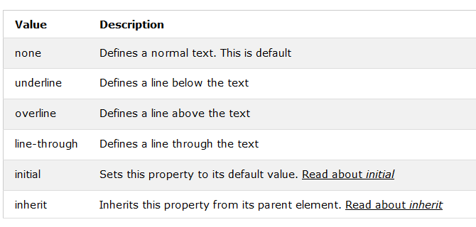
Text Decoration

Slide 71
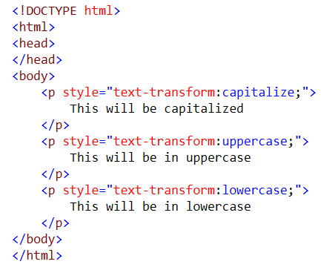
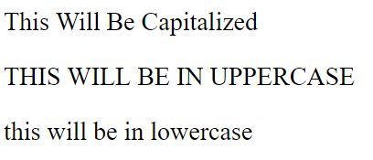
Set Text Cases
Output

Slide 72
CSS - Links

Slide 73
CSS - Links
The :link signifies unvisited hyperlinks.
The :visited signifies visited hyperlinks.
The :hover signifies an element that currently has the user's mouse pointer hovering over it.
The :active signifies an element on which the user is currently clicking

Slide 74
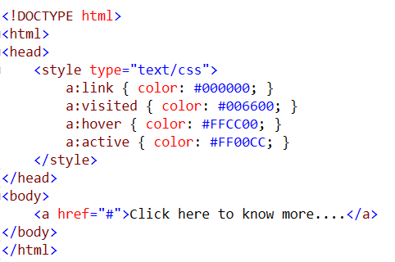
Links

Slide 75
CSS – Tables

Slide 76
CSS Tables
The border-collapse specifies whether the browser should control the appearance of the adjacent borders that touch each other or whether each cell should maintain its style.
The border-spacing specifies the width that should appear between table cells.
The caption-side captions are presented in the <caption> element. By default, these are rendered above the table in the document. You use the caption-side property to control the placement of the table caption.
The empty-cells specifies whether the border should be shown if a cell is empty.
The table-layout allows browsers to speed up layout of a table by using the first width properties it comes across for the rest of a column rather than having to load the whole table before rendering it

Slide 77
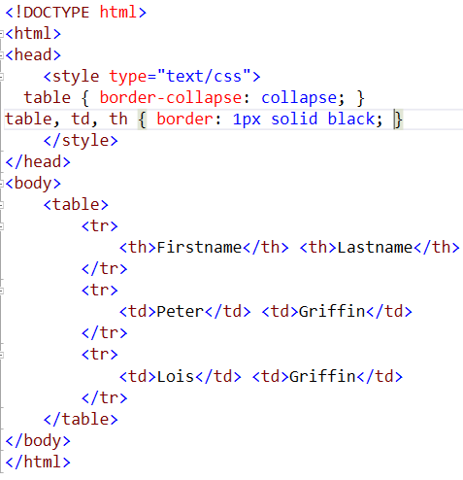
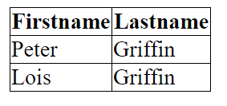
Border-collapse
The border-collapse property sets whether the table borders are collapsed into a single border or detached as in standard HTML

Slide 78

Border-collapse

Slide 79
Borders

Slide 80
Border
The border properties allow you to specify how the border of the box representing an element should look. There are three properties of a border you can change
The border-color specifies the color of a border.
The border-style specifies whether a border should be solid, dashed line, double line, or one of the other possible values.
The border-width specifies the width of a border

Slide 81
Border Color Property
border-bottom-color changes the color of bottom border.
border-top-color changes the color of top border.
border-left-color changes the color of left border.
border-right-color changes the color of right border

Slide 82
Border Style property
none: No border. (Equivalent of border-width:0;)
solid: Border is a single solid line.
dotted: Border is a series of dots.
dashed: Border is a series of short lines.
double: Border is two solid lines.
groove: Border looks as though it is carved into the page.
ridge: Border looks the opposite of groove.
inset: Border makes the box look like it is embedded in the page.
outset: Border makes the box look like it is coming out of the canvas.
hidden: Same as none, except in terms of border-conflict resolution for table elements

Slide 83
Border-width property
The border-width property allows you to set the width of an element borders. The value of this property could be either a length in px, pt or cm or it should be set to thin, medium or thick.
You can individually change the width of the bottom, top, left, and right borders of an element using the following properties −
border-bottom-width changes the width of bottom border.
border-top-width changes the width of top border.
border-left-width changes the width of left border.
border-right-width changes the width of right border.

Slide 84

Box Model

Slide 85
CSS Margins

Slide 86
Margin
The margin property defines the space around an HTML element. It is possible to use negative values to overlap content.
The values of the margin property are not inherited by the child elements. Remember that the adjacent vertical margins (top and bottom margins) will collapse into each other so that the distance between the blocks is not the sum of the margins, but only the greater of the two margins or the same size as one margin if both are equal

Slide 87
Margin
The margin specifies a shorthand property for setting the margin properties in one declaration.
The margin-bottom specifies the bottom margin of an element.
The margin-top specifies the top margin of an element.
The margin-left specifies the left margin of an element.
The margin-right specifies the right margin of an element.

Slide 88


Margin
Output

Slide 89
Padding
The padding property allows you to specify how much space should appear between the content of an element and its border −
The value of this attribute should be either a length, a percentage, or the word inherit. If the value is inherit, it will have the same padding as its parent element. If a percentage is used, the percentage is of the containing box
The following CSS properties can be used to control lists. You can also set different values for the padding on each side of the box using the following properties −
The padding-bottom specifies the bottom padding of an element.
The padding-top specifies the top padding of an element.
The padding-left specifies the left padding of an element.
The padding-right specifies the right padding of an element.
The padding serves as shorthand for the preceding properties

Slide 90
Padding
The padding property may be specified using one, two, three, or four values. Each value is a <length> or a <percentage>.
When one value is specified, it applies the same padding to all four sides.
When two values are specified, the first padding applies to the top and bottom, the second to the left and right.
When three values are specified, the first padding applies to the top, the second to the left and right, the third to the bottom.
When four values are specified, the paddings apply to the top, right, bottom, and left in that order (clockwise)

Slide 91


Padding
Output

Slide 92

CSS - Overflow
CSS provides a property called overflow which tells the browser what to do if the box's contents is larger than the box itself. This property can take one of the following values.

Slide 93


Overflow

Slide 94
CSS - Visibility

Slide 95

Visibility
Visibility allows to hide an element from view. You can use this property along with JavaScript to create very complex menu and very complex webpage layouts.
Remember that the source code will still contain whatever is in the invisible paragraph, so you should not use this to hide sensitive information such as credit card details or passwords

Slide 96

Visibility property

Slide 97
CSS Positioning
CSS helps you to position your HTML element. You can put any HTML element at whatever location you like. You can specify whether you want the element positioned relative to its natural position in the page or absolute based on its parent element
There are three different types of positioning, Relative, Absolute and Fixed

Slide 98
Relative Positioning
Relative positioning changes the position of the HTML element relative to where it normally appears. So "left:20" adds 20 pixels to the element's LEFT position.
You can use two values top and left along with the position property to move an HTML element anywhere in the HTML document.
Move Left - Use a negative value for left.
Move Right - Use a positive value for left.
Move Up - Use a negative value for top.
Move Down - Use a positive value for top
You can use bottom or right values as well in the same way as top and left.

Slide 99

Relative Positioning

Slide 100
Absolute Positioning
An element with position: absolute is positioned at the specified coordinates relative to your screen top-left corner.
You can use two values top and left along with the position property to move an HTML element anywhere in the HTML document.
Move Left - Use a negative value for left.
Move Right - Use a positive value for left.
Move Up - Use a negative value for top.
Move Down - Use a positive value for top.
NOTE − You can use bottom or right values as well in the same way as top and left.

Slide 101

Absolute Positioning

Slide 102
Fixed Positioning
Fixed positioning allows you to fix the position of an element to a particular spot on the page, regardless of scrolling. Specified coordinates will be relative to the browser window.
You can use two values top and left along with the position property to move an HTML element anywhere in the HTML document.
Move Left - Use a negative value for left.
Move Right - Use a positive value for left.
Move Up - Use a negative value for top.
Move Down - Use a positive value for top.
NOTE − You can use bottom or right values as well in the same way as top and left.

Slide 103


Fixed Position

Slide 104
CSS - Layers
CSS gives you opportunity to create layers of various divisions. The CSS layers refer to applying the z-index property to elements that overlap with each other.
The z-index property is used along with the position property to create an effect of layers. You can specify which element should come on top and which element should come at bottom

Slide 105


CSS - Layers

