Slide 2
Antra SEP Program
SQL Server and Databases
Day 2

Slide 3
Joins
Querying from More Than One Data Source
The JOIN keyword allows you to combine data from multiple tables and/or views into a single result set. It joins a column or columns from one table to another table, evaluating whether there is a match.
With the JOIN keyword, you join two tables based on a join condition. Most often you’ll see a join condition testing the equality of one column in one table compared to another column in the second table.
joined columns do not need to have the same name, only compatible data types.
SQL Server join types fall into three categories: inner, outer, and cross. Self join is not a category. Left, Right and Full are outer joins.

Slide 4

Inner Joins
Department Table
Employee Table
Department ID | Department Name
31 | Sales
33 | Engineering
34 | Clerical
35 | Marketing
Last Name | Department ID
Rafferty | 31
Jones | 33
Steinberg | 33
Robinson | 34
Smith | 34
Jasper | 36
Employee.Last Name | Employee.Department ID | Department.Department Name | Department.Department Id
Smith | 34 | Clerical | 34
Jones | 33 | Engineering | 33
Robinson | 34 | Clerical | 34
Steinberg | 33 | Engineering | 33
Rafferty | 31 | sales | 31

Slide 5

Inner Join using Where Clause
Department Table
Employee Table
Department ID | Department Name
31 | Sales
33 | Engineering
34 | Clerical
35 | Marketing
Last Name | Department ID
Rafferty | 31
Jones | 33
Steinberg | 33
Robinson | 34
Smith | 34
Jasper | 36
Employee.Last Name | Employee.Department ID | Department.Department Name | Department.Department Id
Smith | 34 | Clerical | 34
Jones | 33 | Engineering | 33
Robinson | 34 | Clerical | 34
Steinberg | 33 | Engeneering | 33
Rafferty | 31 | sales | 31

Slide 6

Cross Joins
A cross join returns the Cartesian product of the sets of records from the two joined tables. Thus, it equates to an inner join where the join-condition always evaluates to True.
Department Table
Employee Table
Department ID | Department Name
31 | Sales
33 | Engineering
34 | Clerical
35 | Marketing
Employee Name | Department ID
Rafferty | 31
Jones | 33
Steinberg | 33
Robinson | 34
Smith | 34
Jasper | 36

Slide 7
Cross Join Results
Employee.Last Name | Employee.Department ID | Department.Department Name | Department.Department Id
Rafferty | 31 | sales | 31
Jones | 33 | sales | 31
Steinberg | 33 | sales | 31
Smith | 34 | sales | 31
Robinson | 34 | sales | 31
Jasper | 33 | sales | 31
Rafferty | 31 | Engineering | 33
Jones | 33 | Engineering | 33
Steinberg | 33 | Engeneering | 33
Smith | 34 | Engineering | 33
Robinson | 34 | Engineering | 33
Jasper | 33 | Engeneering | 33
Rafferty | 31 | Clerical | 34
Jones | 33 | Clerical | 34
Steinberg | 33 | Clerical | 34
Smith | 34 | Clerical | 34
Robinson | 34 | Clerical | 34
Jasper | 33 | Clerical | 34
Rafferty | 31 | Marketng | 35
Jones | 33 | Marketng | 35
Steinberg | 33 | Marketng | 35
Smith | 34 | Marketng | 35
Robinson | 34 | Marketng | 35
Jasper | 33 | Marketng | 35

Slide 8
Outer Joins
Outer joins have three different join types:
LEFT OUTER, RIGHT OUTER, and FULL OUTER joins. LEFT OUTER and RIGHT OUTER JOINs
LEFT JOIN or LEFT OUTER JOIN The result set of a left outer join includes all the rows from the left table specified in the LEFT OUTER clause, not just the ones in which the joined columns match. When a row in the left table has no matching rows in the right table, the associated result set row contains null values for all select list columns coming from the right table.
RIGHT JOIN or RIGHT OUTER JOIN A right outer join is the reverse of a left outer join. All rows from the right table are returned. Null values are returned for the left table any time a right table row has no matching row in the left table.
FULL JOIN or FULL OUTER JOIN A full outer join returns all rows in both the left and right tables. Any time a row has no match in the other table, the select list columns from the other table contain null values. When there is a match between the tables, the entire result set row contains data values from the base tables.

Slide 9

Left Outer Join
Employee Table
Department Table
Department ID | Department Name
31 | Sales
33 | Engineering
34 | Clerical
35 | Marketing
Employee Name | Department ID
Rafferty | 31
Jones | 33
Steinberg | 33
Robinson | 34
Smith | 34
Jasper | 36
Employee Last Name | Employee.Department ID | Department.Department Name | Department.Department Id
Jones | 33 | Engineering | 33
Rafferty | 31 | Sales | 31
Robinson | 34 | Clerical | 34
Smith | 34 | Clerical | 34
Jasper | 36 | NULL | NULL
Steinberg | 33 | Engineering | 33

Slide 10

Right Outer Join
Employee Table
Department Table
Employee Name | Department ID
Rafferty | 31
Jones | 33
Steinberg | 33
Robinson | 34
Smith | 34
Jasper | 36
Department ID | Department Name
31 | Sales
33 | Engineering
34 | Clerical
35 | Marketing
Employee Last Name | Employee.Department ID | Department.Department Name | Department.Department Id
Smith | 34 | Clerical | 34
Jones | 33 | Engineering | 33
Robinson | 34 | Clerical | 34
Steinberg | 33 | Engineering | 33
Rafferty | 31 | Sales | 31
NULL | NULL | Marketing | 35

Slide 11

Full Outer Join
Department Table
Employee Table
Department ID | Department Name
31 | Sales
33 | Engineering
34 | Clerical
35 | Marketing
Employee Name | Department ID
Rafferty | 31
Jones | 33
Steinberg | 33
Robinson | 34
Smith | 34
Jasper | 36
Employee Last Name | Employee.Department ID | Department.Department Name | Department.Department Id
Smith | 34 | Clerical | 34
Jones | 33 | Engineering | 33
Robinson | 34 | Clerical | 34
Jasper | 36 | NULL | NULL
Steinberg | 33 | Engineering | 33
Rafferty | 31 | Sales | 31
NULL | NULL | Marketing | 35

Slide 12
Outer Join Tips
To select records in table A that does not have a match in table B, you can use table A left join table B, then in the where condition saying B.(primary key) is null

Slide 13
Famous Join Interview Question
If table A with a rows are joining table B with b rows. What is the max and min number of rows you can get for Inner Join and Full Join.

Slide 14
Count
Count([column]) will count the rows which has data in that column (not null).
Count(*) will simply count the rows, even there is a null value in the column.
To save performance, experienced dev will use count(1)

Slide 15
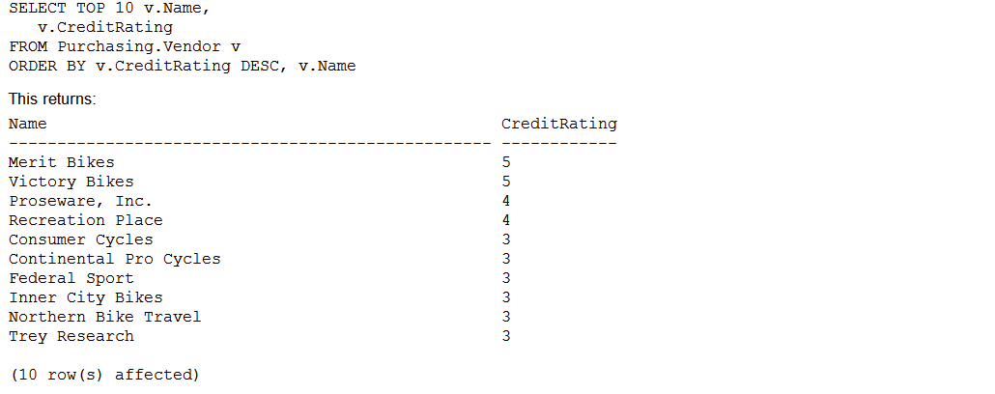
TOP Key Word
The TOP keyword allows you to return the first n number of rows from a query based on the number of rows or percentage of rows that you define. The first rows returned are also impacted by how your query is ordered

Slide 16
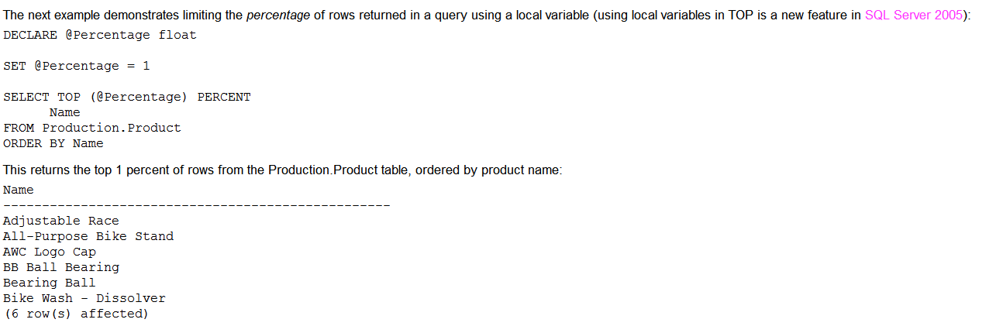
Top

Slide 17
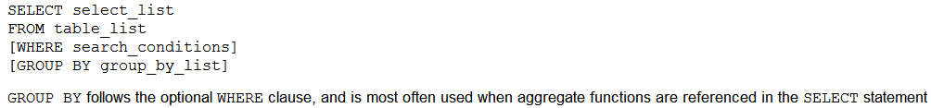
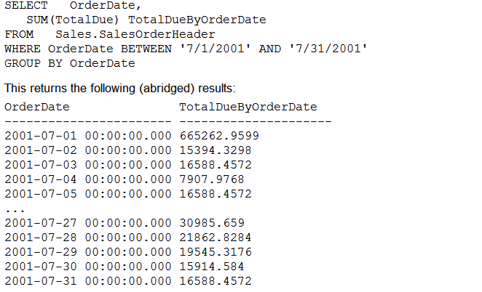
Grouping Data
The GROUP BY clause is used in a SELECT query to determine the groups that rows should be put in column that is not used in an aggregate function in the SELECT list must be listed in the GROUP BY clause

Slide 18
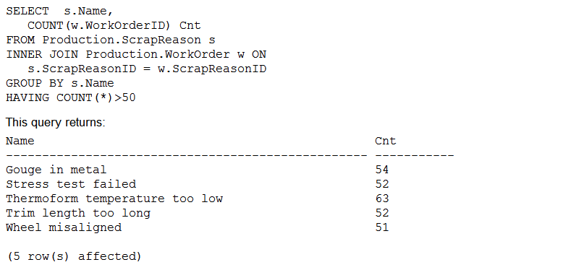
Having
Selectively Querying Grouped Data Using HAVING
The HAVING clause of the SELECT statement allows you to specify a search condition on a query using GROUP BY and/or an aggregated value
The HAVING clause is used after the GROUP BY clause. The WHERE clause, in contrast, is used to qualify the rows that are returned before the data is aggregated or grouped. HAVING qualifies the aggregated data after the data has been grouped or aggregated.

Slide 19
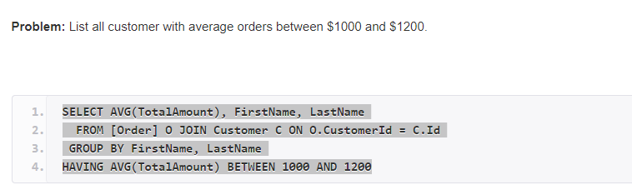
Another example on Having

Slide 20
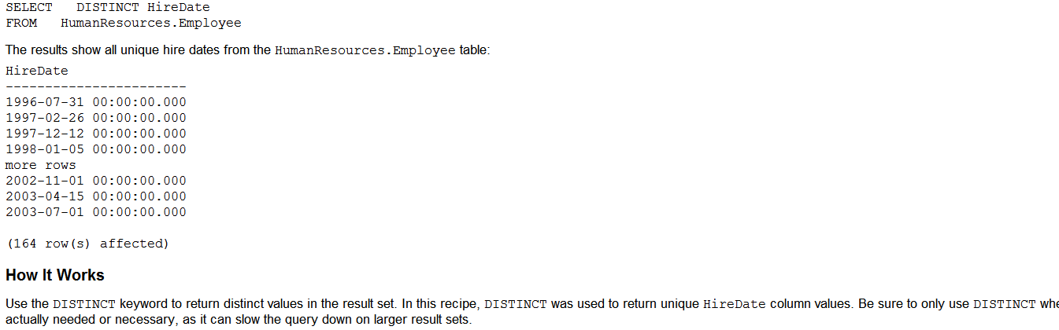
Distinct Clause
The default behavior of a SELECT statement is to use the ALL keyword (although because it is the default, you’ll rarely see this being used in a query), meaning that duplicate rows will be retrieved and displayed if they exist. Using the DISTINCT keyword instead of ALL allows you to only return unique rows in your results

Slide 21
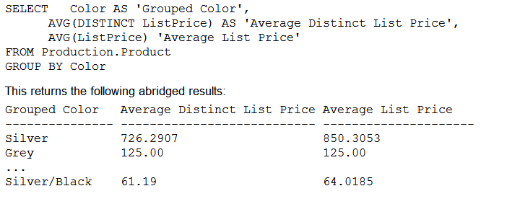
Using Column Aliases
For column computations or aggregate functions, you can use a column alias to explicitly name the columns of your query output.
You can also use column aliases to rename columns that already have a name, which helps obscure the underlying column from the calling application (allowing you to swap out underlying columns without changing the derived column name).
You can designate a column alias by using the AS keyword, or by simply following the column or expression with the column alias name.

Slide 22
INTO Clause
The INTO clause of the SELECT statement allows you to create a new table based on the columns and rows of the query results.
Ideally you should be creating your tables using the CREATE TABLE command: however using INTO provides a quick-and-dirty method of creating a new table without having to explicitly define the column names and data types
SELECT select_list [INTO new_table_name] FROM table_list
SELECT CustomerID, Name, SalesPersonID, Demographics INTO Store_Archive FROM Sales.Store
The INTO clause is followed by the new table name (which must not already exist). This can be a permanent, temporary, or global temporary table
Although the structure of the selected columns is reproduced, the constraints, indexes, and other separate objects dependent on the source table are not copied.

