Slide 2
Antra SEP Program
SQL Server and Databases
Day 1

Slide 3
General Concepts
Database definition
Organized collection of logically related data
Data
Known facts
Types: text, graphics, images, sound, videos
Database management system (DBMS)
Software package for defining and managing a database

Slide 4
DBMS
Software package for defining and managing a database.
Examples:
Proprietary: MS Access, MS SQL Server, DB2, Oracle, Sybase
Open source: MySql, PostgreSQL
Relational database and non-relational database

Slide 5
SQL Server

Slide 6
SQL Server Services
SQL Server
SQL Server Agent
SQL Server Browser
SQL Server Integration Services
SQL Server Analysis Services
SQL Server Full Text Search
Notification Services
Distribution Transaction Co-coordinator (MSDTC)
Database Mail

Slide 7
SQL Server Service
The relational database server is implemented as the SQL Server service. It receives queries from users, executes them, sends responses to calling applications, and manages data in database files

Slide 8
SQL Server Agent
SQL Server Agent is an automation service that manages the scheduled execution of tasks and notifies administrators of problems that occur on the server.

Slide 9
Analysis Services
Analysis Services is a service that implements infrastructure for On-Line Analytical Processing (OLAP) and data mining.

Slide 10
Reporting Services
Reporting Services is a system for design and delivery of relational and OLAP reports that works on top of SQL Server and IIS

Slide 11
Notification Services
Notification Services is a platform for alerting users to changes in databases Ex: Mail, SMS etc

Slide 12
Distributed Transaction Coordinator (MSDTC)
The Distributed Transaction Coordinator (MSDTC) is a service that manages two-phase commit transactions spanned over multiple servers. This service ensures that changes that need to be made to data stored on different servers complete successfully.

Slide 13
Integration Services
Integration Services provide ETL (extract, transform, and load) functionality that replaces Data Transformation Services (DTS) from previous versions of SQL Server. Users can create packages for extracting, transforming, and loading data from one data source to another

Slide 14
SQL Server Tools
SQL Server Configuration Manager
SQL Server Management Studio
SQL Server Profiler
SQL Server Books Online (BOL)
SQLCMD

Slide 15
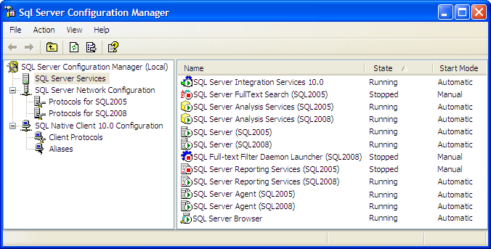
Configuration Manager
SQL Server Configuration Manager is a new tool in SQL Server. You can manage SQL Server services and connection configurations by navigating objects in the Console tree

Slide 16
Management Studio
Microsoft SQL Server Management Studio, new in Microsoft SQL Server, is an integrated environment for accessing, configuring, managing, administering, and developing all components of SQL Server.
SQL Server Management Studio combines the features of Enterprise Manager, Query Analyzer, and Analysis Manager, included in previous releases of SQL Server, into a single environment. In addition, SQL Server Management Studio works with all components of SQL Server such as Reporting Services, Integration Services, SQL Server Compact Edition, and Notification Services. Developers get a familiar experience, and database administrators get a single comprehensive utility that combines easy-to-use graphical tools with rich scripting capabilities

Slide 17
Tools:
SQLCMD Utility : SQLCMD uses OLE DB to execute Transact-SQL batches, while Management Studio uses .NET SqlClient. This difference sometimes leads to different behavior when the same scripts are executed in them.

Slide 18
Introduction
Microsoft SQL Server database is a collection of objects that hold and manipulate data
properties and features
It is a collection of many objects, such as tables, views, stored procedures, and constraints.
It is owned by a single SQL Server login account .
It maintains its own set of user accounts, roles, schemas, and security .
It has its own set of system tables and views to hold the database catalog .
It has its own transaction log and manages its own transactions.
It can range in size from 1 megabyte (MB) to a technical limit of 1,048,516 terabytes .
It can grow and shrink, either automatically or by command.
It can have objects joined in queries with objects from other databases in the same SQL Server instance or on linked servers.

Slide 19
SQL Server Instance
An SQL Server instance, or Database Engine Instance, is a complete SQL server and you can install many instances on a machine but you can have only 1 default instance. An SQL Server instance has its own copy of the server files, databases and security credentials. ... Each instance manages several system databases and one or more user databases.
An instance of the Database Engine is a copy of the sqlservr.exe executable that runs as an operating system service. Each instance manages several system databases and one or more user databases. Each computer can run multiple instances of the Database Engine. Applications connect to the instance in order to perform work in a database managed by the instance.

Slide 20
System Databases
A new SQL Server installation always includes four databases
master
model
tempdb
mssql system resource (hidden)
msdb

Slide 21
Master
The master database is composed of system tables that keep track of the server installation as a whole and all other databases that are subsequently created. Although every database has a set of system catalogs that maintain information about objects it contains, the master database has system catalogs that keep information about disk space, file allocations and usage, systemwide configuration settings, endpoints, login accounts, databases on the current instance, and the existence of other SQL servers (for distributed operations).
The master database is critical to your system, so always keep a current backup copy of it. Operations such as creating another database, changing configuration values, and modifying login accounts all make modifications to master, so after performing such actions, you should back up master

Slide 22
Model
The model database is simply a template database. Every time you create a new database, SQL Server makes a copy of model to form the basis of the new database. If you’d like every new database to start out with certain objects or permissions, you can put them in model, and all new databases will inherit them. You can also change most properties of the model database by using the ALTER DATABASE command, and those property values will then be used by any new database you create.

Slide 23
Tempdb
The tempdb database is used as a workspace. It is unique among SQL Server databases because it’s re-created–not recovered–every time SQL Server is restarted. It’s used for temporary tables explicitly created by users, for worktables that will hold intermediate results created internally by SQL Server during query processing and sorting, for maintaining row versions used in
The tempdb database sizing and configuration is critical for optimal functioning and performance of SQL Server

Slide 24
Mssql system resource
The mssql system resource database is a hidden database and is usually referred to as the resource database. Executable system objects, such as system stored procedures and functions, are stored here.

Slide 25
Msdb
The msdb database is used by the SQL Server Agent service, which performs scheduled activities such as backups and replication tasks, and the Service Broker, which provides queuing and reliable messaging for SQL Server.
When you are not performing backups and maintenance on this database, you should generally ignore msdb.
All the information in msdb is accessible from Object Explorer in SQL Server Management Studio, so you usually don’t need to access the tables in this database directly. You can think of the msdb tables as another form of system tables

Slide 26
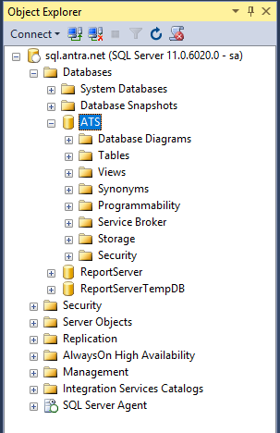
User Database
User databases are created by users (Administrators, developers, and testers who have access to create databases).

Slide 27
Database Files
A database file is nothing more than an operating system file. (In addition to database files)
Primary data files: Every database has one primary data file that keeps track of all the rest of the files in the database, in addition to storing data. By convention, a primary data file has the extension .mdf.
Secondary data files: A database can have zero or more secondary data files. By convention, a secondary data file has the extension .ndf.
Log files: Every database has at least one log file that contains the information necessary to recover all transactions in a database. By convention, a log file has the extension .ldf.

Slide 28
SQL Server T-SQL
SQL is a standard interactive and programming language for querying and modifying data and managing databases. Although SQL is both an ANSI and an ISO standard, many database products support SQL with proprietary extensions to the standard language
Transact-SQL is central to using SQL Server. All applications that communicate with an instance of SQL Server do so by sending Transact-SQL statements to the server, regardless of the user interface of the application
Source | Common Name | Full Name
ANSl/lSO Standard | SQL/PSM | SQL/Persistent Store Module
IBM | SQL PL | SQL Procedural Language
Microsoft/Sybase | T-SQL | Transact-SQL
MYSQL | MYSQL | MYSQL
Oracle | PL/SQL | Procedural language/SQL
PostgreSQL | PL/SQL | Procedural Language/PostgreSQL Structured Query Language

Slide 29
Types Of Statements
Data Definition Language (DDL) statements, which allow you to create objects in the database
CREATE object_name
ALTER object_name
DROP object_name
Data Control Language (DCL) statements, which allow you to determine who can see or modify the data.
GRANT
DENY
REVOKE
Data Manipulation Language (DML) statements, which allow you to query and modify the data
SELECT
INSERT
UPDATE
DELETE

Slide 30
Syntax Elements
Batch Directives
Comments
Identifiers
Types of Data
Variables
System Functions
Operators
Expressions
Control-of-Flow
Language Elements
Reserved Keywords

Slide 31
Retrieving Data
Retrieving Data by Using the SELECT Statement
Filtering Data
Formatting Result Sets
How Queries Are Processed
Performance Considerations

Slide 32
Result Set
Result set is a set of data, could be empty or not, returned by a select statement, or a stored procedure, that is saved in RAM or displayed on the screen.
A TSQL script can have 0 to multiple result sets.

Slide 33
Basic Select Statement
Syntax :
SELECT [ ALL | DISTINCT ] <select_list>
FROM {<table_source>} [,...n]
[ WHERE <search_condition> ]
Select Specific Columns:
USE AdventureWorks
GO
SELECT ContactID, Title, FirstName, LastName FROM Person.Contact
Select All rows and columns:
USE AdventureWorks
GO
SELECT * FROM Person.Contact

Slide 34
Select Statement
Select statements with specified column name is always preferred than using select *, for performance reasons and accuracy issues.

Slide 35
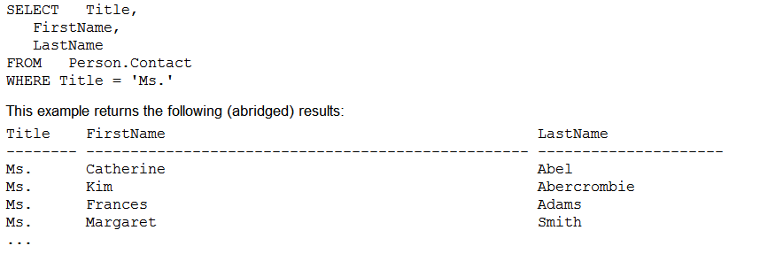
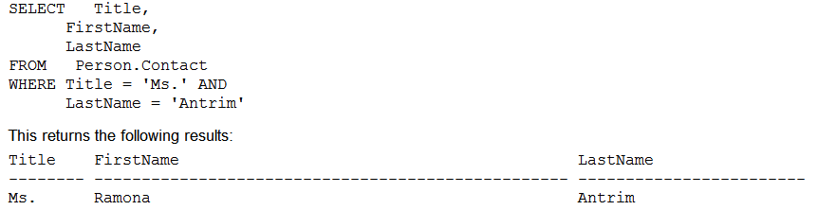
WHERE Clause
Using the WHERE Clause to Specify Rows Returned in the Result Set
Combining Search Conditions

Slide 36
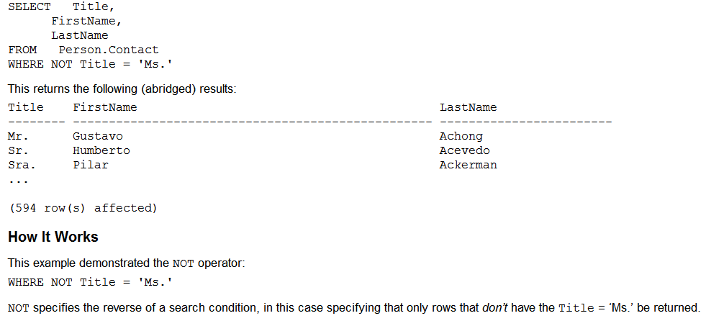
Where Clause
Negating a Search Condition
The NOT logical operator, unlike AND and OR, isn’t used to combine search conditions, but instead is used to negate the expression that follows it.

Slide 37
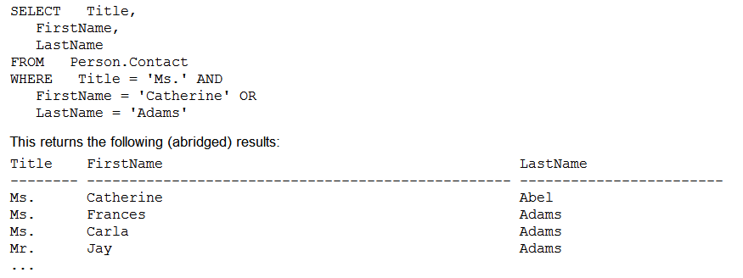
Where Clause
You can use multiple operators (AND, OR, NOT) in a single WHERE clause, but it is important to keep your intentions clear by properly embedding your ANDs and ORs in parentheses.
The AND operator limits the result set, and the OR operator expands the conditions for which rows will be returned. When multiple operators are used in the same WHERE clause, operator precedence is used to determine how the search conditions are evaluated.
For example, the NOT operator takes precedence (is evaluated first) before AND. The AND operator takes precedence over the OR operator. Using both AND and OR operators in the same WHERE clause without using parentheses can return unexpected results

Slide 38
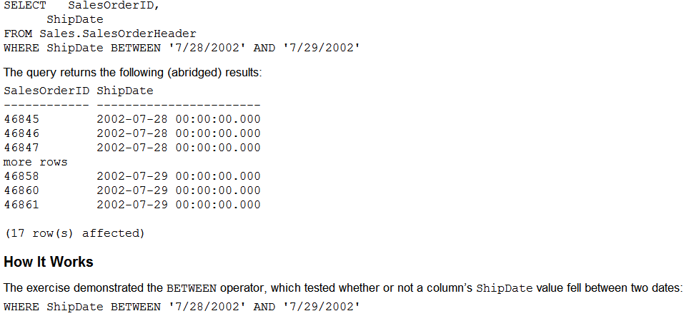
Where Clause
Using BETWEEN for Date Range Searches

Slide 39
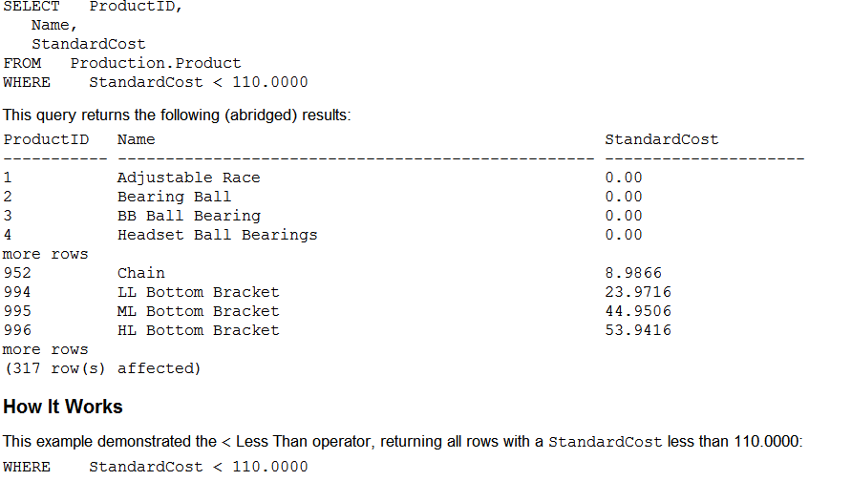
Where Clause
Using Comparisons

Slide 40
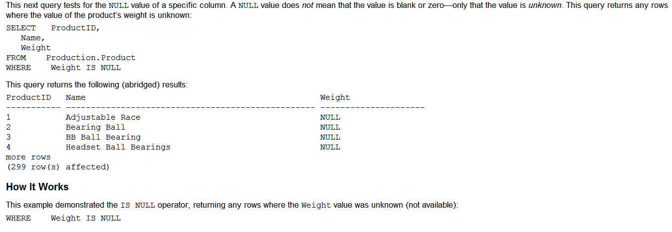
Where Clause
Checking for NULL Values
Using Is NULL

Slide 41
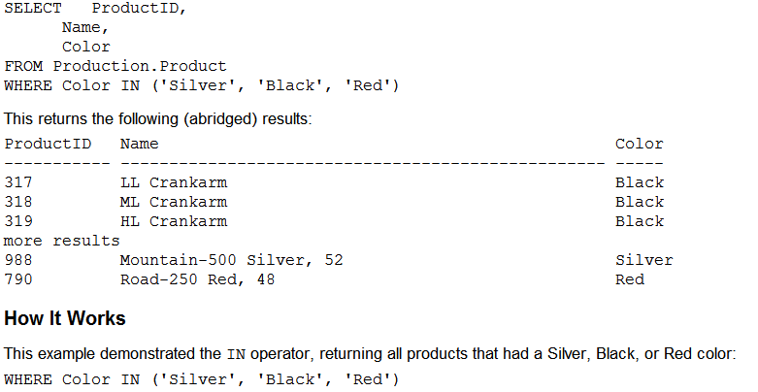
Where Clause
Returning Rows Based on a List of Values
Use of In Operator

Slide 42
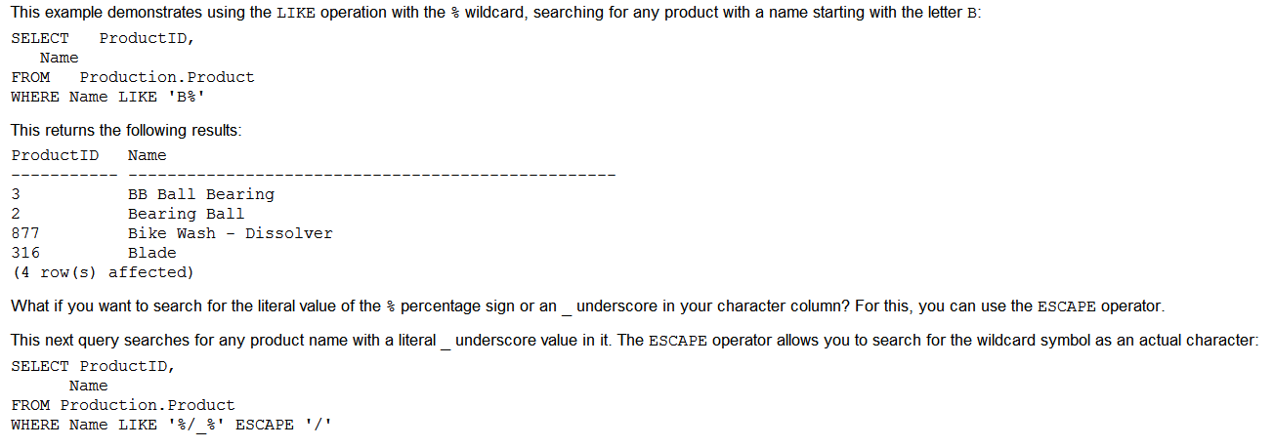
Where Clause
Wildcard | Usage
% | Represents a string of zero or more characters.
_ | Represents a single character.
[ ] | Specifies a single character, from a selected range or list.
[ ^ ] | Specifies a single character not within the specified range
Using Wildcards with LIKE

Slide 43
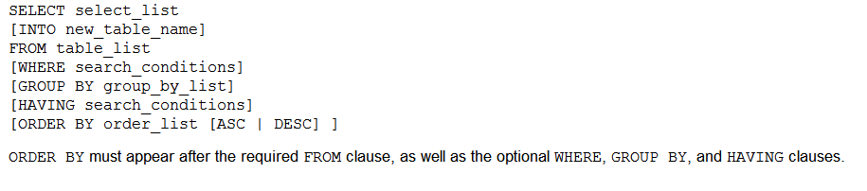
Order By
The ORDER BY clause orders the results of a query based on designated columns or expressions
The default sorting order of ORDER BY is ascending order, which can be explicitly designated as ASC too.
In this next example, DESC is used to return the results in reverse (descending) order

Slide 44
Batch Directives
SQL Server processes single or multiple Transact-SQL statements in batches. A batch directive instructs SQL Server to parse and execute all of the instructions within the batch. There are two basic methods for handing off batches to SQL Server.
GO : SQL Server utilities interpret GO as a signal to send the current batch of Transact-SQL statements to SQL Server. A GO command delineates batches of Transact-SQL statements to tools and utilities and ends the batch. A GO command is not an actual Transact-SQL statement.
EXEC :The EXEC directive is used to execute a user-defined function, system procedure, user-defined stored procedure, or an extended stored procedure; it can also control the execution of a character string within a Transact-SQL batch. Parameters can be passed as arguments, and a return status can be assigned.

Slide 45
Comments
Inline Comment
USE northwind
SELECT productname
, (unitsinstock - unitsonorder) -- Calculates inventory
-- , supplierid
FROM products
GO
Block Comment
/*
This code retrieves all rows of the products table
and displays the unit price, the unit price increased
by 10 percent, and the name of the product.
*/

Slide 46
Identifiers
Standard Identifiers:
Standard identifiers can contain from one to 128 characters, including letters,
symbols (_, @, or #), and numbers. No embedded spaces are allowed in
standard identifiers.
The first character must be an alphabetic character of a-z or A-Z.
After the first character, identifiers can include letters, numerals, or the @,
$, #, or _ symbol
Identifier names starting with a symbol have special uses:
An identifier beginning with the @ symbol denotes a local variable
or parameter.
An identifier beginning with a number sign (#) denotes a temporary
table or procedure.
An identifier beginning with a double number sign (##) denotes a global temporary object.

Slide 47
Identifiers
Delimited Identifiers
If an identifier complies with all of the rules for the format of identifiers, it can be used with or without delimiters. If an identifier does not comply with one or more of the rules for the format of identifiers, it must always be delimited
Delimited identifiers can be used in the following situations:
When names contain embedded spaces
When reserved words are used for object names or portions of object names

Slide 48
Data Types
Integer
Bit
TinyInt
SmallInt
Int
Biglnt
Float
Float
Real
Text
Char
Varchar
Text
nChar
nVarchar
nText
Decimal
Decimal
Numeric
SQL Data Types
Money
SmallMoney
Money
Date
Date Time
Small DateTime
Binary
Binary
VarBinary
Image
XML
Misc.
Cursor
Sql_veriant
Table
TimeStamp
UniqueIdentifier

Slide 49
Data Types
SQL Server recognizes 28 system-defined data types. Apart from these data types, you can create user-defined data types in T-SQL
Categories of system-defined data types :
Character strings
Unicode character strings
Date and time
Approximate numeric
Exact numeric
Integer numbers
Monetary
Binary
Special

Slide 50
Character Strings
Char /nchar
The char data type is used to store strings of fixed size. The maximum size of this data type is 8,000 characters, which is a significant increase over the 255-character limit in early versions. When a variable or a table column is assigned with a string that is shorter than its nominal size, it is padded with trailing spaces to fill the specified field length
Varchar / nvarchar
The varchar data type stores strings of variable size up to 8,000 characters long. When a character value whose length is less than the nominal size is assigned to the column or variable, SQL Server does not add trailing spaces to it, but records it as is. varchar data types occupy two additional bytes in order to record the length of the string
varchar(max)
Varchar (max) looks and operates like the varchar data type, but it is by internal structure and functionality actually much more like the text data type.
Text
The text data type is used to store huge amounts of data. One field can store up to 2GB (231 - 1 bytes) of information. Only a 16-byte pointer to this data is stored in the table. Therefore, additional processing overhead is involved with the use of text columns. There are special functions for processing text values. You cannot use union on Text.

Slide 51
Unicode Character Strings
nchar
nvarchar
nvarchar(max)
Ntext
Similar to character strings but accepts Unicode characters
Example:
Create table Contacts(ContactId char(8), Name varchar(50), Note text, Resume varchar(max))
Create table Contacts_2(ContactId nchar(8), Name nvarchar(50), Note ntext, Resume nvarchar(max)) go

Slide 52
Date Time
Date time
Small date time
Date
Datetime2
The main difference between these two data types is in the amount of space they occupy, date time occupies 8 bytes and small date time only 4 bytes. Other differences between the two types are the precision of the date stored and the range of dates that can be used. The precision of small date time is one minute, and it covers dates from January 1, 1900, through June 6, 2079, which is usually more than enough. The precision of date time is 3.33 ms, and it covers dates from January 1, 1753, to December 31, 9999.

Slide 53
Integer Numbers
Integers are whole numbers. SQL Server supports 1-, 2-, 4-, and 8-byte integers. The bit data type is used to store 1 or 0, to represent logical true and false values. The following table lists integer data types, their storage size, and range of values
Bit is usually used for bool in mssql
Date Type | Storage Size | Minimum | Maximum
Int | 4 bytes | -2, 147, 483, 648 | 2, 147, 483, 647
Smallint | 2 bytes | -32768 | 32767
Tinyint | 1 byte | 0 | 255
Bigint | 8 bytes | -9, 223, 372, 036, 854, 775, 808 | 9, 223, 372, 036, 854, 775, 808
bit | 1 bit | 0 | 1

Slide 54
Approximate Numbers
Approximate-number data types for use with floating point numeric data. Floating point data is approximate; therefore, not all values in the data type range can be represented exactly.
Data type | Range | Storage
Float | -1.79E + 308 to - 2.23E -308, 0 and 2.23E - 308 to 1.79E + 308 | Depends on the value of n
Real | +3.40E + 38 to -1.18E - 38, 0 and 1.18E - 38 to 3.40E + 38 | 4 Bytes
float [ ( n ) ] Where n is the number of bits that are used to store the mantissa of the float number in scientific notation and, therefore, dictates the precision and storage size. If n is specified, it must be a value between 1 and 53. The default value of n is 53.
n value | Precision | Storage Size
1-24 | 7 digits | 4 bytes
25-23 | 15 digits | 8 bytes

Slide 55
Decimals
Numeric and Decimal
Numeric data types that have fixed precision and scale.
decimal[ (p[ , s] )] and numeric[ (p[ , s] )]
Fixed precision and scale numbers. When maximum precision is used, valid values are from - 10^38 +1 through 10^38 - 1. The SQL-92 synonyms for decimal are dec and dec(p, s). numeric is functionally equivalent to decimal.
p (precision)
The maximum total number of decimal digits that can be stored, both to the left and to the right of the decimal point. The precision must be a value from 1 through the maximum precision of 38. The default precision is 18.
s (scale)
The maximum number of decimal digits that can be stored to the right of the decimal point. Scale must be a value from 0 through p. Scale can be specified only if precision is specified. The default scale is 0; therefore, 0 <= s <= p. Maximum storage sizes vary, based on the precision.

Slide 56
Monetary Data Types
The money and small money data types are a compromise between the precision of decimal numbers and the small size of real numbers, small money occupies 4 bytes and uses the same internal structure as int numbers.
The data can have up to four digits after the decimal point. For this reason, you can store numbers ranging from −214,768.3648 to 214,768.3647 in the small money data type.
The money data type uses the same structure for storing information as the bigint data type. It occupies 8 bytes for storage, so its values must range from −922,337,203,685,477.5808 to +922,337,203,685,477.5807.
Monetary constants can be preceded by $ or one of 18 other currency symbols (listed in SQL Server Books Online):
update Inventory
Set Rent = $0, LeaseCost = $119.95
Where InventoryId = 3432

Slide 57
Binary Data Types
Binary [ ( n ) ]
Fixed-length binary data with a length of n bytes, where n is a value from 1 through 8,000. The storage size is n bytes.
Varbinary [ ( n | max) ]
Variable-length binary data. n can be a value from 1 through 8,000. max indicates that the maximum storage size is 2^31-1 bytes. The storage size is the actual length of the data entered + 2 bytes. The data that is entered can be 0 bytes in length. The SQL-2003 synonym for var binary is binary varying.
Image: Similar varbinary(MAX)
Remarks
When n is not specified in a data definition or variable declaration statement, the default length is 1. When n is not specified with the CAST function, the default length is 30.
Use binary when the sizes of the column data entries are consistent.
Use var binary when the sizes of the column data entries vary considerably.
Use var binary(max) when the column data entries exceed 8,000 bytes.

Slide 58
Special Types:
xml :
The xml data type is a major new feature of SQL Server. Before it was introduced, users were storing XML documents as strings or binary data. The new data type allows SQL Server to parse an XML document stored in an XML column and verify that it is compliant with the schema that the user associated with the column
Unique identifier
The unique identifier data type stores 16-byte binary values. These values are often called globally unique identifiers (GUIDs). When a system generates a new GUID value, it is guaranteed that the same value cannot be produced again, neither on the same computer nor on any other computer in the world
Character string ‘{BB7DF450-F119-11CD-8465-OOAA00425D90}’
Binary constant Oxaf16a66f7f8b31d3b41d30c04fc96f46
timestamp
The timestamp data type is not designed to store date or time information, but rather is a binary value that serves as a version number of the record. The value is updated every time the record is updated, and the value is unique in the database. It is used to implement optimistic locking
JSON

Slide 59
SQL_Variant
SQL_Variant
The SQL_Variant data type is based on the same idea as the variant data type in Visual Basic. It is designed to allow a single variable, column, or parameter to store values in different data types. Internally, variant objects record two values:
The actual value
The metadata describing the variant: base data type, maximum size, scale, precision, and collation

Slide 60
Variables
Variables in Transact-SQL are the equivalent of variables in other programming languages.
Local Variables: The scope of local variables is a batch (a set of T-SQL statements that is sent to SQL Server and executed simultaneously). This restriction implicitly includes a single stored procedure (because stored procedures are defined in a batch).
Declare @LastName varchar(50),
@FirstName varchar(BO),
@BirthDate smalldatetime
Assigning Values with the Set or Select Statement :
Select @Make = 'ACME',
@Model = 'Turbo',
@EqType = 'cabadaster'
Set @Make = 'ACME'
Set @Model = 'Turbo‘
Set @EqType = 'cabadaster'

Slide 61
Variables
Global Variables: Global variables constitute a special type of variable. The server maintains the values in these variables. The only problem is technically there is no such a thing called ‘global variable’. They are system-defined functions. Call them ‘variable like global functions’.
variable like global functions name begin with an @@ prefix. You do not need, or be able, to declare them, since the server constantly maintains them
The @@identity global variable allows you to get the last identity value generated in the current session
@@error
After each Transact-SQL statement, the server sets the value of this variable to an integer value:
0 If the statement was successful
Error number If the statement has failed
@@rowcount :After each Transact-SQL statement, the server sets the value of this variable to the total number of records affected by it. It can be used to verify the success of selected operations:

Slide 62
Flow-control Statements
Statement block
If… Else
While…Break
Break
Continue GoTo
WaitFor

Slide 63
Statement Block & If - Else
The developer can group several Transact-SQL statements by using Begin…End statements in a logical unit
Begin
Insert Order(OrderDate, RequestedById, TargetDate, DestinationLocation)
Values(@OrderDate, @Contactld, @TargetDate, @LocId)
Select @OsrderId = @@Identity
if @@ErrorCode <> 0
begin RaiseError('Error occurred while inserting Order!', 16,1) Return @@ErrorCode
End
Else
Begin /* code */ end
End

Slide 64
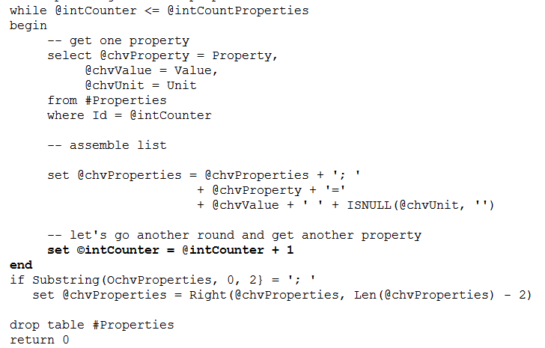
The While Statement

Slide 65
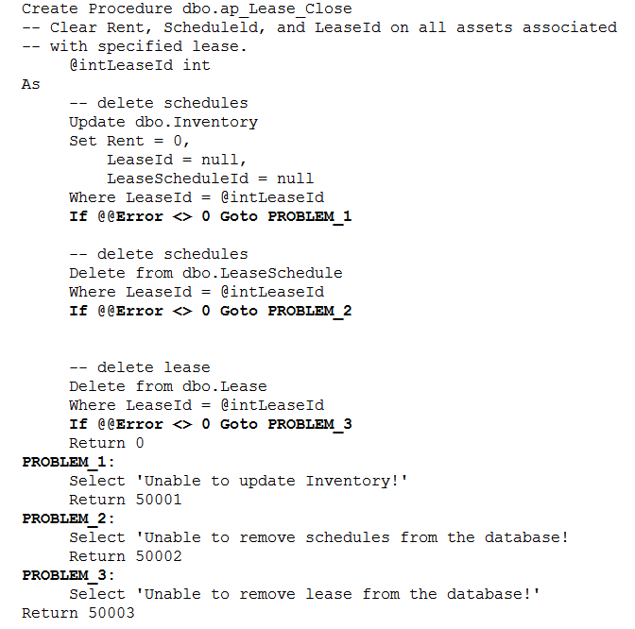
GO – To Statement

Slide 66
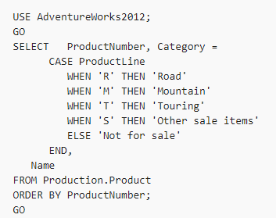
Case
Evaluates a list of conditions and returns one of multiple possible result expressions.

Slide 67
Operators
Aithmetic
+
-
*
/
%
Assignment
=
Comparison
=
>
<
>=
<=
<>
!=
!<
!>
Logical
ALL
AND
ANY
Between
Exists
IN
Like
NOT
OR
Some
Operators In SQL
String
+
Unary
+
-
~
Bitwise
&
l

Slide 68
Operators
Operator | Description
!= | Tests two expressions not being equal to each other.
!> | Tests that the left condition is not greater than the expression to the right.
!< | Tests that the right condition is not greater than the expression to the right.
< | Tests the left condition as less than the right condition.
<= | Tests the left condition as less than or equal to the right condition.
<> | Tests two expressions not being equal to each other.
= | Tests equality between two expressions.
> | Tests the left condition being greater than the expression to the right.
>= | Tests the left condition being greater than or equal to the expression to the right.
ALL | When used with a comparison operator and subquery, if all retrieved values satisfy the search condition, the rows will be retrieved.
ANY | When used with a comparison operator and subquery, if any retrieved values satisfy the search condition, the rows will be retrieved.
BETWEEN | Designates an inclusive range of values. Used with the AND clause between the beginning and ending values.
CONTAINS | Does a fuzzy search for words and phrases.
ESCAPE | Takes the character used prior to wildcard character to designate that the literal value of the wildcard character should be searched, rather than use the character as a wildcard.
EXISTS | When used with subquery EXISTS tests for the existence of rows in the subquery.

Slide 69
Operators
FREETEXT | Searches character-based data for words using meaning, rather than literal values.
IN | Provides an inclusive list of values for the search condition.
IS NOT NULL | Evaluates if the value is NOT null.
IS NULL | Evaluates whether the value is null.
LIKE | Tests character string for pattern matching.
NOT BETWEEN | Specifies a range of values NOT to include. Used with the AND clause between the beginning and ending values.
NOT IN | Provides a list of values for which NOT to return rows for.
NOT LIKE | Test character string, excluding those with pattern matches.
SOME | When used with a comparison operator and subquery, if all retrieved values satisfy the search condition, the rows will be retrieved.

