Slide 1
Insurance Term Simplifier
An AI-Powered Multilingual Insurance Education
Presented by Agisam Ranjithkumar

Slide 2
Problem Statement
Understanding insurance terms is often difficult for everyday users.
Lack of simple explanations and real-world relevance.
Language barriers prevent understanding in native languages.

Slide 3
Objective
Make insurance terms easily understandable.
Provide real-life examples for better clarity.
Generating a relevant funny fact about the term.
Enable native language support to improve accessibility.

Slide 4
Technology Stack
🧠 Google Generative AI - for explanations and examples.
🌐 Google Translate API - for multilingual translation.
💻 Streamlit - for building interactive web UI.
🧊 Python - Backend logic.

Slide 5
System Overview
User inputs an insurance term.
Model provides a simple explanation.
Real-life example and surprising fact shown on button click.
Dropdown allows users to select preferred language.
Google Translate used to convert English explanation to native language.

Slide 6
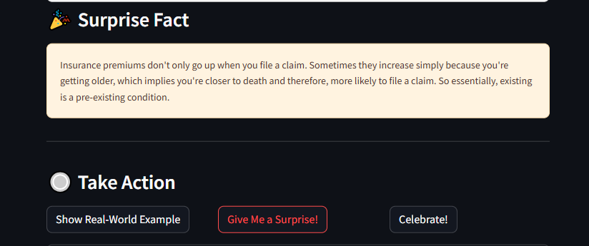
Key Features
Explain insurance terms in plain English.
One-click real-life examples.
Surprise/Funny facts to engage users.
Multilingual translation (Telugu, Hindi, Tamil, Kannada, Bengali).
Interactive and clean UI using Streamlit.

Slide 7
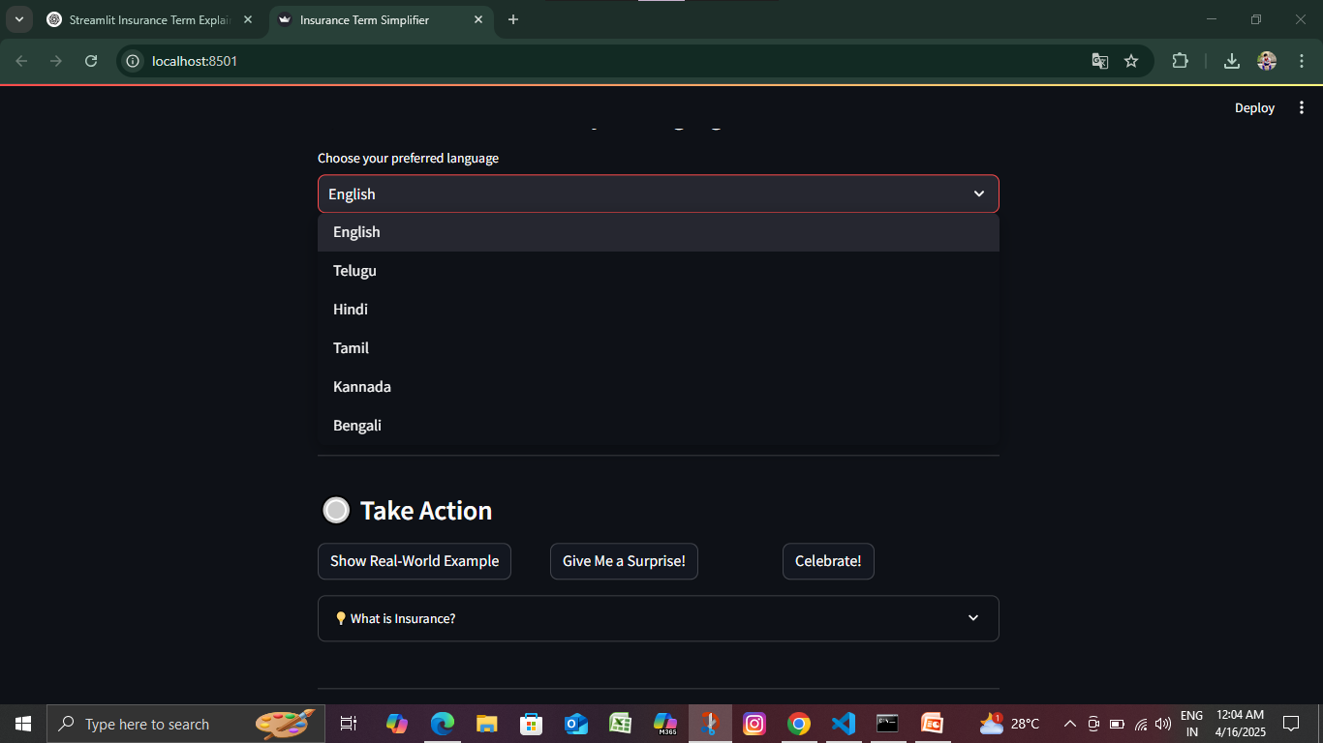
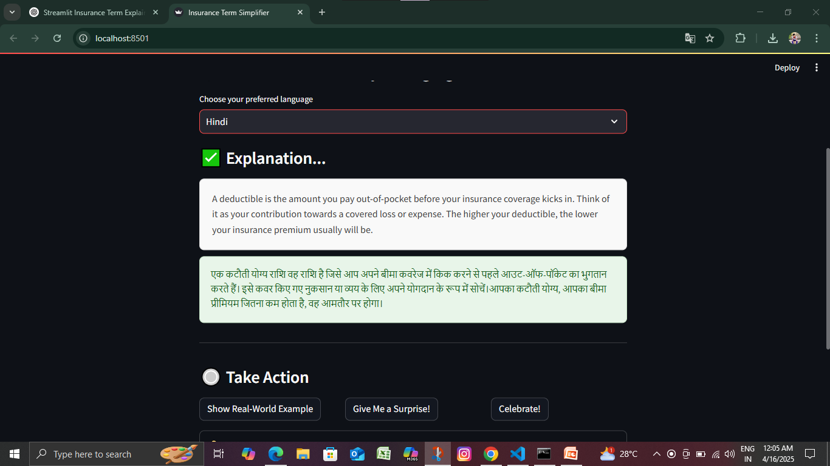
Multilingual Support
Dropdown for language selection (after term is explained in English).
Translation function converts explanation, example, and fact.
Ensures users from diverse backgrounds understand easily.

Slide 8
User Flow
1. User enters a term.
2. Model generates Simple explanation.
3. User can reveal example or surprise fact.
4. User selects preferred language for translation.
5. Translated content shown below each section.

Slide 9
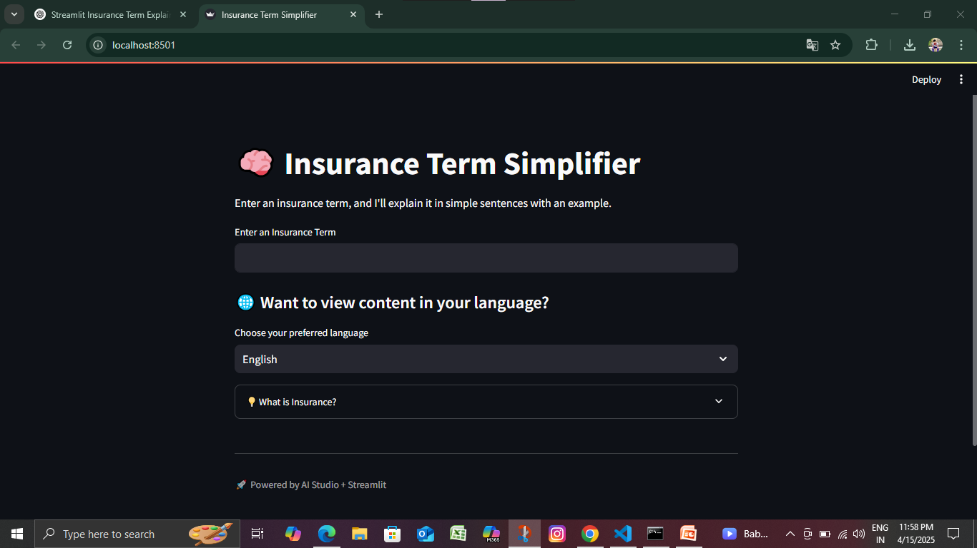
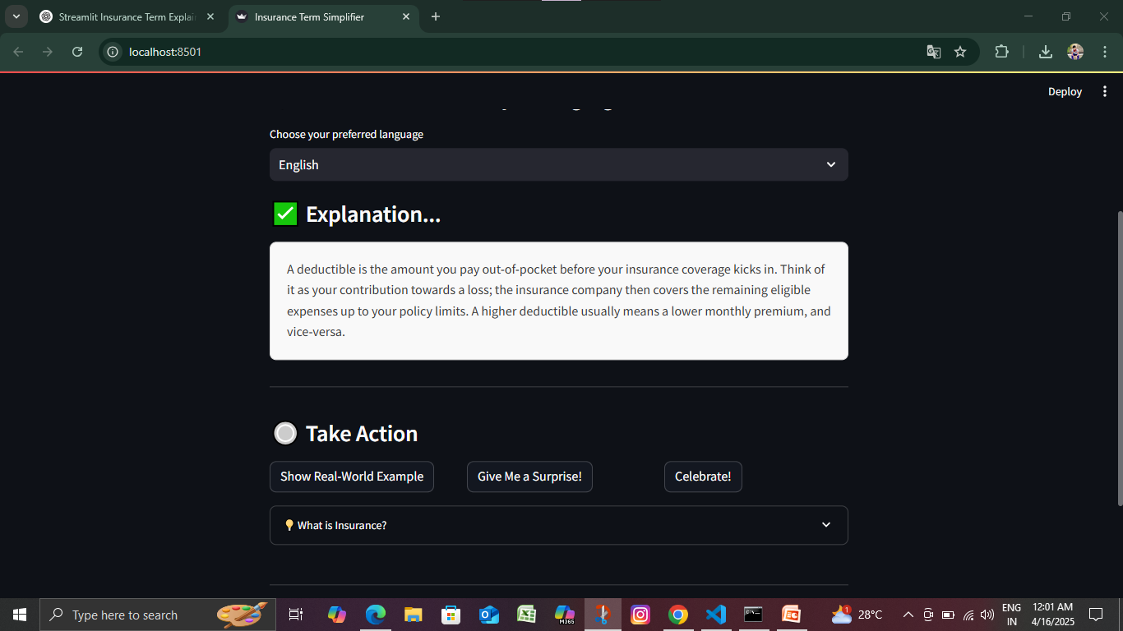
Demo Screenshots

Slide 10
Challenges & Solutions
Gemini response parsing for short, meaningful outputs.
Aligning translation with dynamic button outputs.
Streamlit layout issues (solved with better column and div structure).

Slide 11
Future Scope
🔍 Voice-based input for terms.
🌍 More language support.
📘 Save/download explained terms as PDF.
📱 Mobile-optimized version.
📊 User analytics dashboard.

Slide 12
Conclusion
Solves a real problem in understanding insurance terms.
Easy and intuitive interface for non-technical users.
Impresses with AI-powered real-time translation and fun content.
Great use of AI Studio and Google Translate for accessibility.

Slide 13
Thank You!
Any Questions? I'm happy to answer.

