Slide 1
PhotoBar
Product From ARCHI-TECH

Slide 2
What is the product?
1.Name
PhotoBar
2.Basic Functionalities
a)Photo editing
b)Photo sharing
c)Edited Photo parameters sharing
Notes:
1.The name of our product in the proposal is called PHOTOBAR.
2.There are 3 major functionalities of this on-line web application.
The first one is photo editing, the second one is photo sharing and the last one is edited photo parameters sharing.
a)The goal of photo editing is providing a easy and convenient way to the costumers to edit their photos and sharing to others through the social network.
b)Also with the edited photo parameters sharing functionality, after the costumers edited their photo, they can encapsulate the parameters that have changed into a template and then sharing the template to others. Hence, other people can use it to edit their own photo.

Slide 3
Why we produce this product?
1.Social network is hot
2.Lack of high quality photo editing functionality
3.Many people can not handle high level photo editing techniques
Notes:
So, why we want to produce such product?
There are three main reasons.

Slide 4



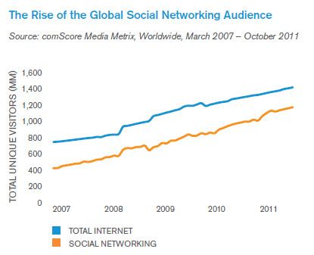
1.Social network is hot
a)Many social network site in the world
b)Large group of
potential costumers
In 2011
850 million users
Notes:
a)The first reason is that social network is popular.
since it
1) provides an opportunity to meet new people around the world.
2) and social networking sites are user friendly
3) also, they are free to use
b)Many social network sites already exist all over the world. Like weibo, facebook, renren etc. Each one of them has a large group of users. As you can see in this picture, the blue line is the total number of Internet users in the world and the orange one is the number of users who has a social network site account. In 2011, the total number of social network users is about 850 million. Hence there are a lot of potential costumers of our product.

Slide 5
2.Lack of high quality photo editing functionality
a)Users want to edit photo before sharing
-make the photo look much beautiful
-add some characters on the photo
-add some mosaic
b)Low quality
-adjust the photo size
-limited editing templates
c)Our product
-professional and advanced functionality
Notes:
Second reason is Lack of high quality photo editing functionality.
In social networking sites, photo sharing is a very often used way to tell your friends what is going on around you.
And users often want to edit their photo before they share the photo, for some reasons like to make the photo look much beautiful or something like that.
However, many of the exited social networking sites are lack of high quality photo editing functionality. They can’t fully satisfy the users’ requirements. Because you can only adjust the photo size or using the limited editing template provided by the web sites.
But, our web application provide a professional and advanced photo editing functionality.

Slide 6
3.Many people can not handle high level photo editing techniques
a)Professional photo editing software
-Hard to handle and time consuming
-No sharing property
b)Our product
-easy to handle and convenient to use
-sharing photo through social network
Notes:
What if you want to do some high quality and advanced editing on your photos?
You may use Photoshop or other professional photo editing software.
But, most of them are not easy to handle by many people and it is very time consuming. You will not spend a whole hour to edit the photo before you sharing it.
Even you can spent a lot of time in editing photo, but the professional photo editing software does not have sharing property.
Our product do solve this problem. It easy to handle and convenient to use by the users. Also, it provide sharing property through social network.

Slide 7
How to win competition
1.Who are our competitors?
2. How can we compete with them?
3. How can we earn money

Slide 8






1.Who are our competitors?
Existing:
Potential:
Notes:
Instagram is already doing quite well as an online photo-sharing application.
And at the mean time, MEITU XIUXIU is a very popular online photo-editing application.
What’s worse, there’re many potential competitors who are very likely or already somehow step in this market.
These giants are more difficult to deal with.

Slide 9
2. How can we compete with them?
By Technology?
By Propaganda?
Notes:
If we have some genius in our team, maybe we can have some advantages in technology, but it’s not very possible.
Even though we have some special functionality in our product, it doesn’t mean customers will turn to us.
Besides, propaganda in large scale will not be very effective because a lot of customers will not change his favor easily.
So it’s not feasible to compete with them directly in the very beginning, without good fame among customers and a certain number of market sharing.

Slide 10
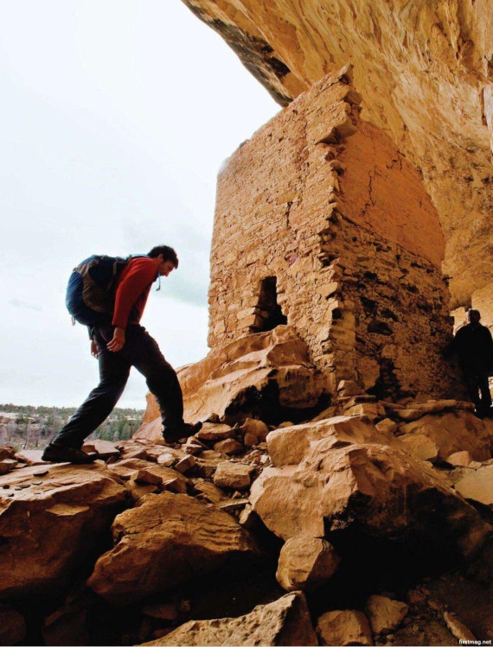
2. How can we compete with them?
Focus on a rather small part of the market
Traveler
Notes:
Therefore, we need to avoid competition in all aspects or we will die very soon.
Our team should focus on a rather small part of the customers and try to be the best in this part first.
And among all customers, traveler could be a very good choice, because every traveler will take photo and share it with friends during their trip.

Slide 11
2. How can we compete with them?
To promote PhotoBar:
1.Cooperate with tourist attraction, hotel etc.
2.Cooperate with ‘smart camera’ producer
3.Cooperate with Professional Photographer
Notes:
In order to promote PhotoBar, we shall establish good cooperating relationships with tourist attraction and hotel.
We can even cooperate with ‘smart camera’ producer and persuade them to install PhotoBar as one of initial applications in their camera.
To attract more basic customers and photo amateur, we can even employ some professional Travelers or Photographer to provide PhotoBar with high-quality photos.
Of course, other regular work

Slide 12
3. How can we earn money?
Earning money
Advertisement
Charging extra Services
Notes:
When we are able to stand steadily in this market, we can try to draw attentions from other part of customers.
What we can expect is that profit is not very poor in the beginning. And it would be very inappropriate to charge clients.
So the majority of the income would be from advertisement.
After the product become mature and has quite a number of loyal clients, we can promote some charging service, like unlimited space and other expected services discovered by market analysis.

Slide 13
Team Organization

Slide 14
Structure
Archi-tech
Marketing
Technology
Clients Representative
Researcher
Consultants
Tech Specialists
Art Designer
Promotion Team
Public relationship
Intra-Company
Inter-Company
Finance

Slide 15



Leader; People who have a whole idea of product
Consultants
Products developer; Implement functionality
Technology
Tech Specialists
Interface Designer
Implement attractive interface;
Cater for customer preference

Slide 16



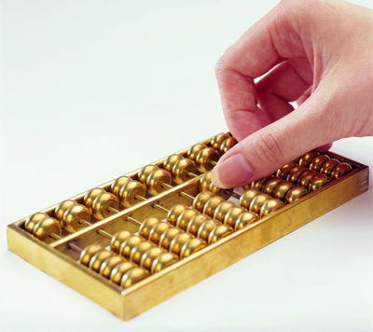
Finance

Slide 17



Market needs; Market Tends; Risks analysis
Researcher
Links between user and company; Gather feed back; Reveal user needs
Marketing
Clients Representative
Promotion Team
Advertising

Slide 18


Build harmony, active, energetic company atmosphere
Intra-Company
Public relationship
Inter-Company
Contact cooperative corporations

Slide 19
Cash Flow

Slide 20
Equipment 15%
Technology Support 15%
Marketing 20%
Public Relationship 15%
Salary 10%
Expendable funds 25%

Slide 21


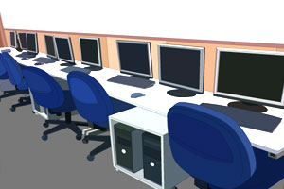
Equipment15%
Work Station (e.g.: Web Server)
Studio
Computers
Office utilities

Slide 22



Technology Support15%
Buy advanced technology
Engage consultants
Train employees

Slide 23


Marketing20%
Analysis
User Needs
Market Trends
Promotion
Advertisement
Viral Video
Leaflet

Slide 24



Public Relationship15%
Inter-Company Communication
Cooperative Company
Competitive Company
Intra-Company Communication
Staff Welfare
Organization Optimization

Slide 25

Salary10%
Technology
Finance
Marketing
Public Relationship

Slide 26

Expendable Funds25%

Slide 27
Implementation
Short Term
Long Term

Slide 28
Market Analysis
Short Term
Period
3 weeks
Budget
5,000HKD
1. Potential Clients：
Age？ Gender？ Education？Occupation？ Expectation？
2. Potential Markets：
Public？ Tourism？ Photography？
3. Competitors：
Advantages？ Disadvantages？

Slide 29
Design & Coding
Short Term
Period
2 months
Budget
50,000HKD
1. Meeting users’ requirements.
2. Leading a new fashion of picture processing.

Slide 30
Test & Adjustment
Short Term
Period
2 months
Budget
50,000HKD
1. Closed Test (2 weeks)
2. Open Beta Test (6 weeks)

Slide 31
Implementation
Short Term
Long Term

Slide 32
Market Promotion
Long Term
Period
1 year
Budget
500,000HKD
1. One new version very year
2. Advertisement
3. Investment Attraction

