Slide 1
CSCI 4430 Tutorial 2: Multi-thread Programming
LI Runhui

Slide 2
Outline
Why do we need multi-thread programming
What is Multi-thread programming
Basic Pthread Programming

Slide 3
Functionalities of Server
Response to connection requests.
Exchange data
while(1){
int sd = accept(…);
…
}
while(1){
int len = recv(…);
…
}

Slide 4
Functionalities of Server
Recall the blocking functions in the last tutorial. If we using only 1 thread:
The whole program will be blocked waiting for incoming connection requests and data.
We cannot do both with only 1 thread.
while(1){
int len = recv(…);
…
}
while(1){
int sd = accept(…);
…
}

Slide 5
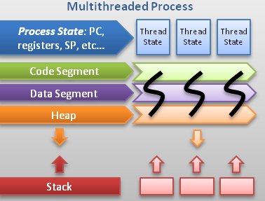
What is Multi-thread Programming
A thread is a sequence of instructions within a program that can be executed independently of other code.

Slide 6
Why Multi-thread Programming
To accomplish the functionalities of the server within one program, we use multiple threads.
The blocking operations, will block 1 thread instead of the whole program.
Thread 1:
Thread 2:
while(1){
int len = recv(…);
…
}
while(1){
int sd = accept(…);
…
}

Slide 7
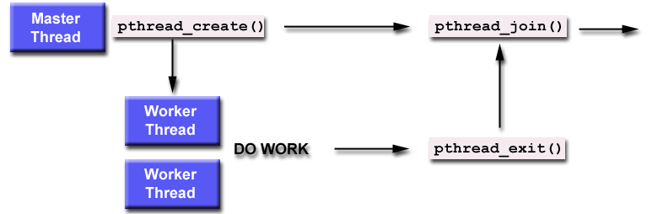
Basic Pthread Programming
Basic flow of pthread programming

Slide 8
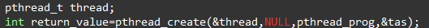
Basic Pthread Programming
pthread_create()
Syntax
int pthread_create(pthread_t * thread,
const pthread_attr * attr,
void* (*start_routine)(void *)
void* arg);
Example

Slide 9
Basic Pthread Programming
pthread_create()
Parameters
thread: the thread handler of the newly created thread
attr: the attributes of the thread, set to NULL is OK for most cases
start_routine: the pointer pointing to the function which will run in the thread
arg: the argument for the start_routine function
NULL when there is no arguments

Slide 10
Basic Pthread Programming
pthread_join()
Waiting for another thread to terminate
Syntax
int pthread_join( thread_t* th,void ** thread_ret);
th: waiting for the thread with the thread handler “th” to terminate
thread_ret: if the return value is not NULL, thread_ret will point to the place where the return value of thread th is stored
Example
pthread_join(thread,NULL);

Slide 11
Basic Pthread Programming
pthread_exit()
Termination of the calling thread
Syntax
void pthread_exit( void * ret_value)
ret_value is the return value of the thread, setting to NULL will be OK for most cases
Example
pthread_exit(NULL);

Slide 12
Basic Pthread Programming
Return value of the thread
pthread_exit() will kill the thread and will never return. Thus,
Remember that the return value cannot be of local scope, otherwise when the thread terminates, the return value will not exist.
This value can be get and examined by some other thread with function pthread_join()

Slide 13
Transfer Data Among Threads
Using global variable.
Use of mutex.
Initialize the worker threads with arguments.

Slide 14
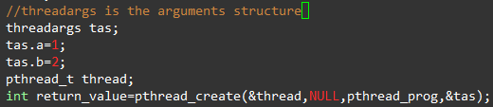
Transfer Data Among Threads
pthread_create()
Multiple arguments for start_routine
Always using a structure to pass the arguments
Example:

Slide 15
Compiling
While compiling your program, you should use “-lpthread” flag
gcc -o main main.c -lpthread
Also, when compiling the sample code in sparc machine, you need to add the flags “-lnsl -lsocket”
gcc –o main main.c –lnsl -lsocket

Slide 16
More References
There are still many details about the pthread programming, the about is enough for this assignment
Here are some links from which you can get more guidance on pthread programming
https://computing.llnl.gov/tutorials/pthreads/
http://www.yolinux.com/TUTORIALS/LinuxTutorialPosixThreads.html

Slide 17
Q&A
Thank you!

