Slide 1
CSCI4430 Tutorial 3: Hints on Assignment 1
LI Runhui

Slide 2
Outline
Main structure of Client side & Server side
Send & receive data
strcpy() or memcpy()?
Reusable port
About readdir_r()

Slide 3
Structure of Client side
Client side is very simple, a single-thread program is enough.
Connect to Server
Authentication
Wait for user input
Put or Get file

Slide 4
Structure of Server Side
It is just a suggestion, you have other choices in implementing your program.
Functionalities of server side.
Accept connection requests
Communicate with client(s)

Slide 5
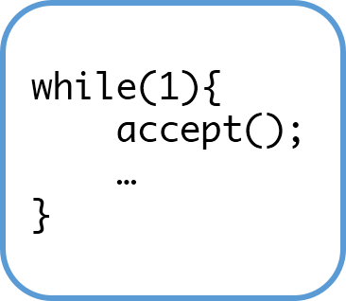
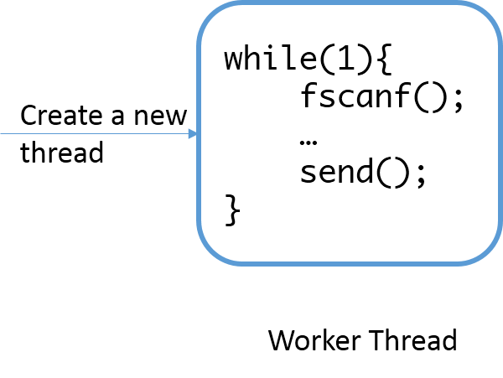
Structure of Server Side
Connection request
comes in
Main Thread

Slide 6
Whole Picture of The Program
Connect
Main
Thread:
while(1){ accept();
…
}
Worker
Thread:
while(1){ fscanf();
send();
…
}
Authenticate
Communicate
Client
Worker
Thread
Client
Server

Slide 7
Send and Receive Data
The components of a message:
Message header
Payload(optional)
Remember the return values of the send() and recv() functions?
They represent exactly how many bytes are sent/received.

Slide 8
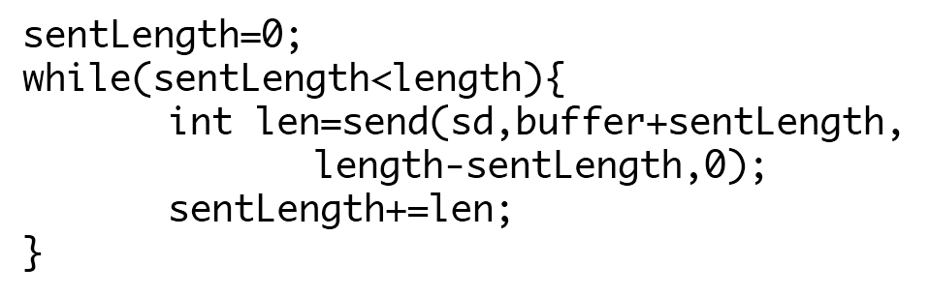
Send and Receive Data
When sending a buffer of size length

Slide 9
Send and Receive Data
Receiving is quite familiar.
For receiving data, you can first receive the message header and then the payload (if the message contains payload).

Slide 10
strcpy() or memcpy()?
The problem of strcpy():
It uses ‘\0’ to find out the end of a string
You cannot specify the size of the buffer you copied.
Use memcpy() instead:
You can specify the size you want to copy.
More details can be found at:
http://linux.die.net/man/3/memcpy

Slide 11
Reusable Port
Reusing server port
Generally, if a server crashes, when restart the server and try to bind to the same address/port. You will get an error message “bind: address already in use”
To avoid this, you need to make the port reusable

Slide 12
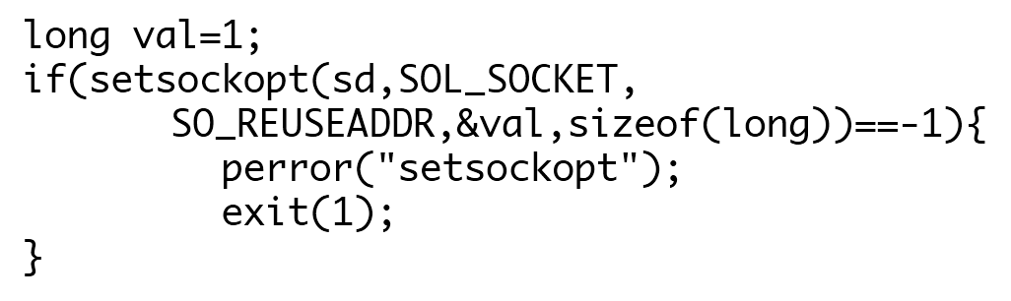
Reusable Port
Adding the following lines after calling socket():

Slide 13
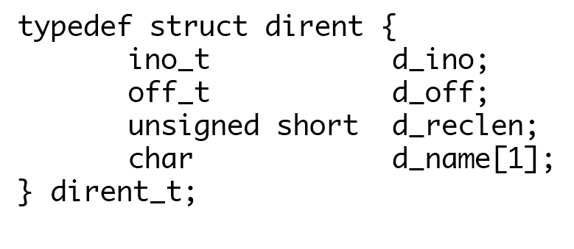
About readdir_r()
Look into the definition of dirent in SPARC machine.
This means a long filename may cause a lot of trouble for you.

Slide 14
About readdir_r()
When declaring a pointer, we use
struct dirent *entry = (struct dirent*) calloc (sizeof(struct dirent)+256,1);
Thus the d_name will not overwrite other variables.

Slide 15
Other Things to Keep in Mind
Use network byte ordering when transferring int type of short type variables.

Slide 16
Q&A

