Slide 1
CSCI4430 Tutorial 4 Assignment 2 (Milestone 1)
SUN, Mingshen

Slide 2
Outline
Overview
HTTP proxy
Multithreading model of MYPROXY
Assignment 2
Pthread
Recall basic pthread programming
Joinable or detached?
Cleanup
HTTP persistent connection
Milestone 1
Http Request Header
Resolving Host
Tips on Parsing the HTTP Header
Summary
Useful Tools

Slide 3
Overview
We will Implement a multi-threaded web proxy, MYPROXY.
High-level overview of the workflow:
A browser sends an HTTP request to MYPROXY.
Return web object if cached by MYPROXY.
Otherwise, forwards to target web server. The target return the web object.
MYPROXY caches the web object and forwards the HTTP response to browser.
HTTP request
Browser A
MYPROXY
Web server
Browser B
HTTP response

Slide 4
Multithreading model
Remember assignment 1?
Main thread
Create socket, bind and listen...
Loop accept() to accept connections from browsers
Create a new worker thread to serve accept()’ed connection
Worker thread
Receive HTTP request from browser
Parse and process HTTP request header
Send HTTP request to web server [if needed]
Receive HTTP response from web server [if needed]
Parse and process HTTP response header (and possibly cache the response body) [if needed]
Send HTTP response to browser
Milestone1: no persistent connections
Milestone2: persistent connections
Milestone3: caching

Slide 5
Assignment 2
MYPROXY
Milestone 1 (30%): no persistent connections & no caching
Milestone 2 (30%): persistent connections & no caching
Milestone 3 (40%): persistent connections & caching
Read specifications carefully!
Deadline 23:59, March 24, 2013 (Sunday).

Slide 6
Recall Basic Pthread Programming
Do you remember this flow graph? See Tutorial 2
Master Thread
pthread_create()
pthread_join()
Worker
Thread
DO WORK
pthread_exit()
Worker
Thread
DO WORK
pthread_exit()

Slide 7
Joinable or Detached?
The resources of the joinable thread won't be released until the thread is joined.
Master Thread
pthread_create()
pthread_join()
Resources is released HERE
RESOURCES
Worker
Thread
DO WORK
pthread_exit()
RESOURCES
Worker
Thread
DO WORK
pthread_exit()
…
…
…

Slide 8
Detached Thread
The resources of the detached thread can be reclaimed when that thread terminates.
Master Thread
pthread_create()
pthread_attr_destroy()
RESOURCES
Worker
Thread
DO WORK
pthread_exit()
Resources is released HERE
RESOURCES
Worker
Thread
DO WORK
pthread_exit()
Resources is released HERE
…
…
…

Slide 9
Detached Thread
To explicitly create a thread as joinable or detached, the attr argument in the pthread_create() routine is used. The typical process is:
pthread_t tid;
pthread_attr_t attr;
pthread_attr_init(&attr);
pthread_attr_setdetachstate(&attr, PTHREAD_CREATE_DETACHED);
pthread_create(&tid, &attr, routine, NULL);
When done, free library resources used by the attribute with pthread_attr_destroy(&attr)

Slide 10
Cleanup Routines
For managing resources
e.g., you have to close some open sockets and free some buffers when your thread exits in the middle of nowhere
pthread_cleanup_push(routine, arg)
pthread_cleanup_pop(1)
Any non-zero value is ok
A pthread_cleanup_push() must go with a matching pthread_cleanup_pop() in the same lexical scope!

Slide 11
Joinable or Not?
Only threads that are created as joinable can be joined. If a thread is created as detached, it can never be joined.
The programmer is able to obtain the target thread's termination return status if it was specified in the target thread's call to pthread_exit()
If you know in advance that a thread will never need to join with another thread, consider creating it in a detached state. Some system resources may be able to be freed.

Slide 12
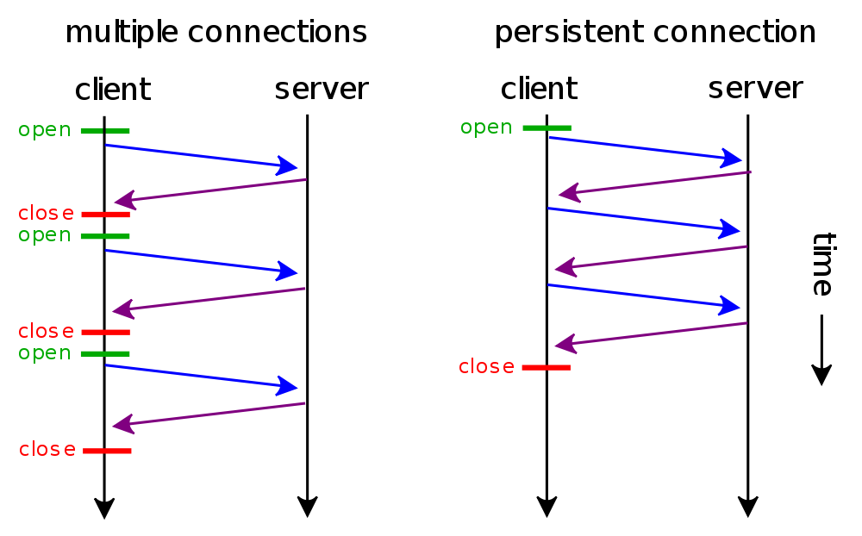
HTTP persistent connection
HTTP 1.0
Connection: keep-alive
Proxy-Connection: keep-alive
HTTP 1.1
In HTTP 1.1, all connections are considered persistent unless declared otherwise.
http://en.wikipedia.org/wiki/HTTP_persistent_connection

Slide 13
Advantages & Disadvantages
Less CPU and memory usage (because fewer connections are open simultaneously)
Enables HTTP pipelining of requests and responses
Reduced network congestion (fewer TCP connections)
Reduced latency in subsequent requests (no handshaking)
Errors can be reported without the penalty of closing the TCP connection
The webserver will keep a connection open for a certain number of seconds.
…
See Wikipedia

Slide 14
Milestone 1
No persistent connections & no caching (30%)
You have to handle HTTP requests and responses properly without caching.
Flow
Read browser request
Change ‘Connection’ or ‘Proxy-Connection’ to close
Resolve ‘Host’ (the web server)
Connect to the web server and send the modified request
Read response from the web server
Append ‘Proxy-Connection: close’ to the response header
Send response back to browser
Since there is only one pair of request/response per connection, in sending the response body, you can simply send to the browser whatever is read from the web server until the web server disconnects

Slide 15
Sample Http Request Header
GET http://www.cse.cuhk.edu.hk/ HTTP/1.1\r\n
Host: www.cse.cuhk.edu.hk\r\n
User-Agent: Mozilla/5.0 (X11; U; Linux i686; en-US; rv:1.9.2.24) Gecko/20111107 Ubuntu/10.04 (lucid) Firefox/3.6.24\r\n
Accept: text/html,application/xhtml+xml,application/xml;q=0.9,*/*;q=0.8\r\n
Accept-Language: en-us,en;q=0.5\r\n
Accept-Encoding: gzip,deflate\r\n
Accept-Charset: ISO-8859-1,utf-8;q=0.7,*;q=0.7\r\n
Proxy-Connection: keep-alive\r\n
\r\n
Declare that this is a persistent connection.
Connection: keep-alive\r\n
Proxy-Connection: keep-alive\r\n
Or not declared in HTTP 1.1 header
Demo: http://web-sniffer.net/

Slide 16
Modified Http Request Header
GET http://www.cse.cuhk.edu.hk/ HTTP/1.1\r\n
Host: www.cse.cuhk.edu.hk\r\n
User-Agent: Mozilla/5.0 (X11; U; Linux i686; en-US; rv:1.9.2.24) Gecko/20111107 Ubuntu/10.04 (lucid) Firefox/3.6.24\r\n
Accept: text/html,application/xhtml+xml,application/xml;q=0.9,*/*;q=0.8\r\n
Accept-Language: en-us,en;q=0.5\r\n
Accept-Encoding: gzip,deflate\r\n
Accept-Charset: ISO-8859-1,utf-8;q=0.7,*;q=0.7\r\n
Proxy-Connection: close\r\n
\r\n
Modify every request message to declare non-persistent connection close explicitly.

Slide 17
Resolving Host
Host: www.cse.cuhk.edu.hk\r\n
Have to connect() to the host, but first we have to know its IP and port
We can use getaddrinfo() to resolve its IP
If port is not specified, treat it as 80 in this assignment
Otherwise, use the specified port (e.g., Host: www.cse.cuhk.edu.hk:82\r\n)
See sample code getaddrinfo.c

Slide 18
Tips on Parsing the HTTP Header
In this assignment, we have to read the value of various HTTP headers and even modify them
We can first read or recv the complete HTTP header into a large buffer (e.g., 16KB)
The end of a HTTP header is marked by \r\n\r\n
Each field in a HTTP header is delimited by \r\n
A field name and its value are separated by a colon and a space
... \r\nField_1: value_1\r\nField_2: value_2\r\n ... \r\nField_n: value_n\r\n\r\n
What can you do when you want to search for ‘Field_2’?
When modifying value of a field or appending a field, we can use memmove() to move the buffer around
void *memmove(void *dest, const void *src, size_t n)
Make sure you have allocated enough space, 16KB buffer should still be enough

Slide 19
Handling HTTP Response
The HTTP response body can be very large, better not read() or recv() it in one go
while (num_recv < content_len)
{
recv(); /* receive from server */
send(); /* send to client */
}

Slide 20
SIGPIPE on write() or send()
Remote party may have closed the connection when you write() or send(), this is normal behavior
You will get SIGPIPE, which terminates your proxy by default
Solution 1: If you are using send(), supply MSG_NOSIGNAL as the flag – send(sockfd, buf, len, MSG_NOSIGNAL)
Solution 2: Ignore SIGPIPE – signal(SIGPIPE, SIG_IGN)
Either way, you will still have to handle the error returned by write() or send()

Slide 21
Summary
Browser connects to proxy when it makes a request
Proxy accepts browser’s connection
Browser
Proxy
Web server

Slide 22
Summary
Proxy modifies the request
Proxy looks up the web server from the ‘Host’ field
Proxy connects to the web server and sends the modified request
Browser
Proxy
Web server

Slide 23
Summary
Proxy waits for response from web server, and send the response to the browser when it is received
Remember to append ‘Proxy-Connection: close’ to the response header if one is not present
Browser
Proxy
Web server

Slide 24
Summary
Web server closes connection to proxy
Proxy closes connection to browser
Browser
Proxy
Web server

Slide 25
(Possibly) Useful Tools
netcat
Send a HTTP request to your proxy
cat [file with HTTP request] | nc [proxy ip] [proxy port]
Print HTTP request when using localhost:8000 as proxy
nc -l 8000
Tamper Data in Firefox
GUI for examining and tampering with the HTTP headers
Wireshark?

Slide 26
Questions?
Next tutorial: Milestones 2 and 3

