Slide 1
Socket Programming
LI Runhui

Slide 2
Outline
What is TCP?
What is socket?
Basic socket programming

Slide 3
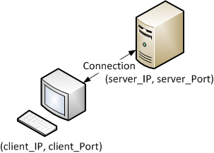
What is TCP?
A connection-oriented transport layer protocol
How to transfer data via TCP connection
Create a connection (port to port connection)
Transfer data
Reliable delivery of data

Slide 4
What is Socket?
Just something which will make sending/receiving data through network feel like reading/writing files.
How to use?
Create a socket
Bind the socket to a connection
Send/receive data
Close

Slide 5
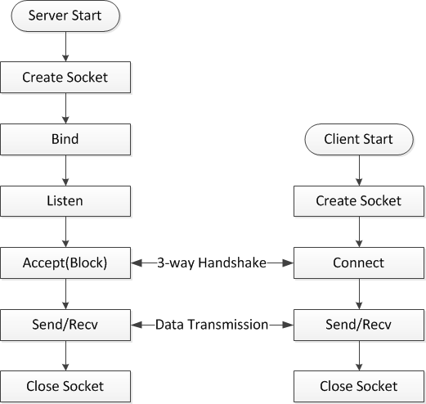
What is Socket?
Network programming for TCP

Slide 6
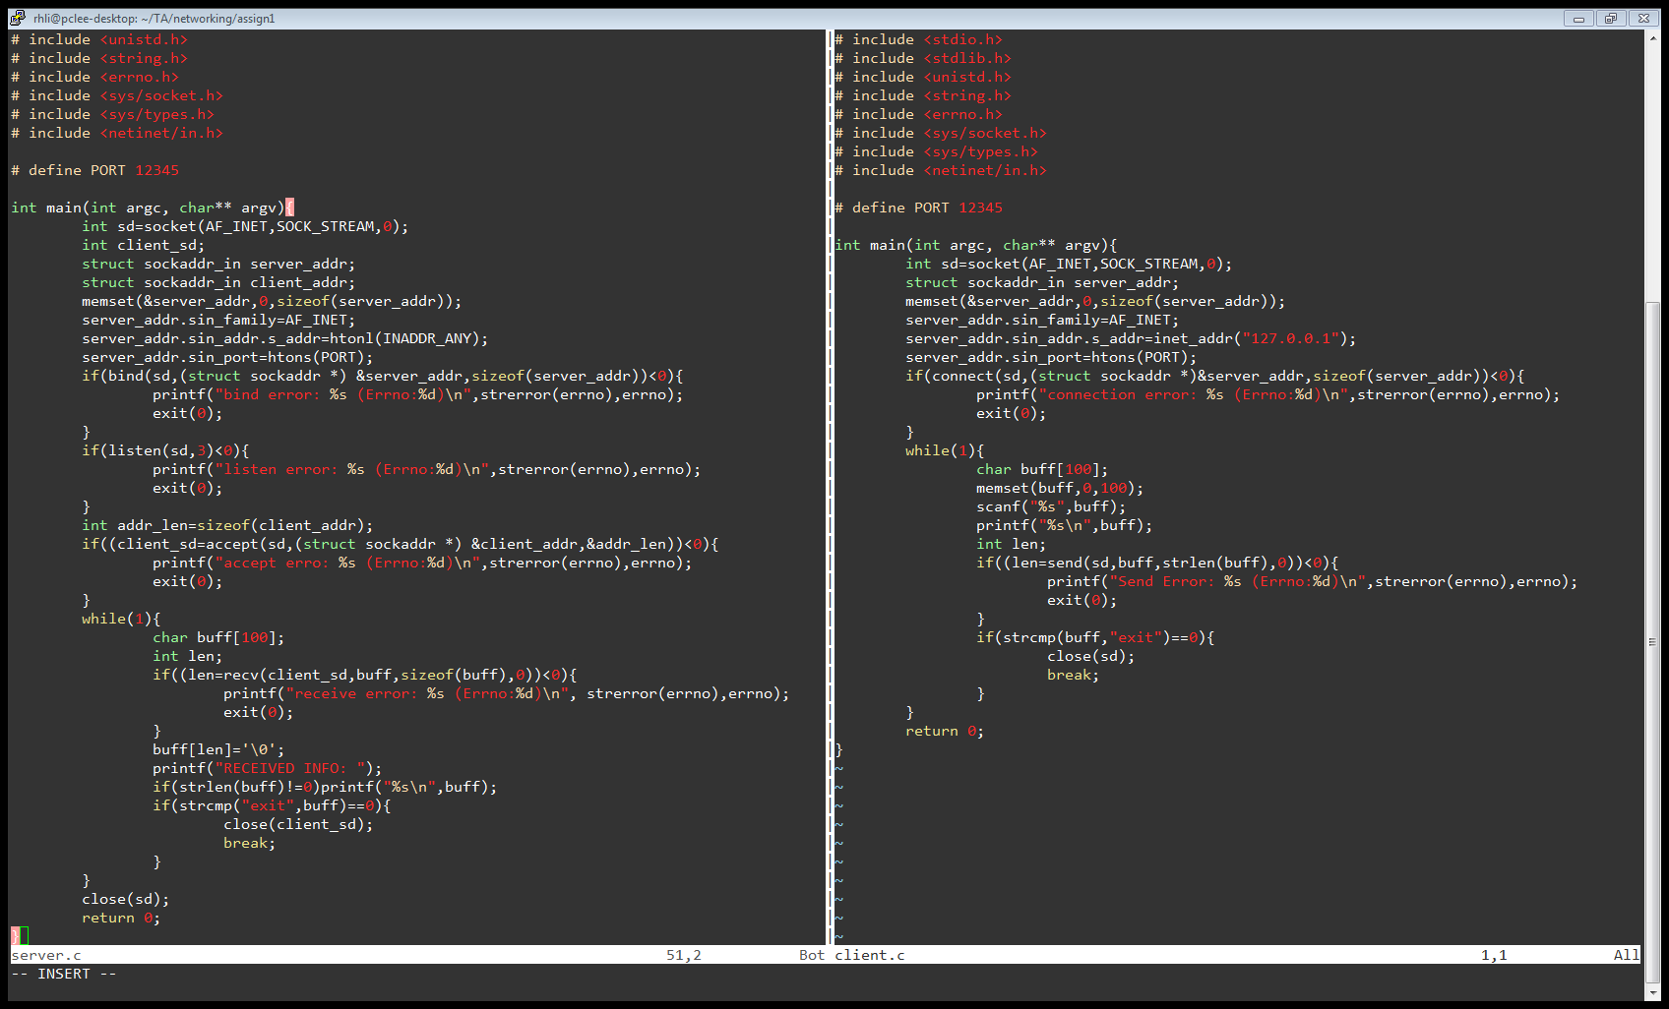
Basic Socket Programming
Create a socket(Server & Client)
Syntax:
int socket(int family, int type, int protocol);
It is like open() function for file operations, the return value is a socket descriptor
Example:

Slide 7
Basic Socket Programming
Create a socket(Server & Client)
Family: protocol family
AF_INET: ipv4 protocols
AF_INET6: ipv6 protocols
Type:
SOCK_STREAM: stream socket (for TCP)
SOCK_DGRAM: datagram socket (for UDP)
SOCK_PACKET: raw socket for Linux
Protocol: set to 0 except raw socket.
Return value: non negative integer for success and -1 for failures.

Slide 8
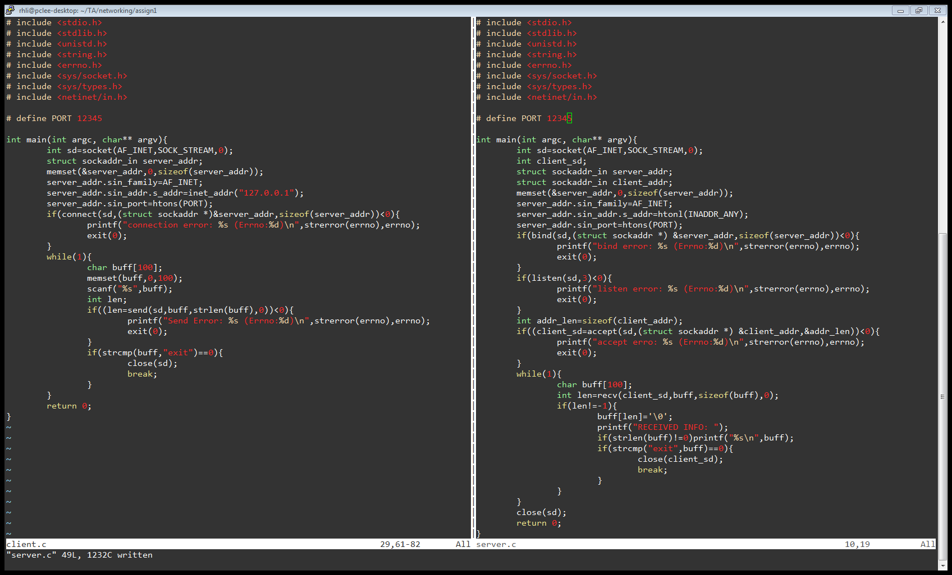
Basic Socket Programming
Bind() (Server)
Bind the socket to a port in the local machine
Syntax
int bind(int socket, struct sockaddr* addr, int addr_len);
Example:

Slide 9
Basic Socket Programming
Bind() (Server)
struct sockaddr defines a socket address
INADDR_ANY means that any IP address will be OK.

Slide 10
Network-byte Order
We know that an integer is stored in 4 bytes.
Suppose an integer 0x12345678 is stored in memory. We know the 4-bytes occupied are storing the following data:
0x12, 0x34, 0x56, 0x78
But how are they placed in memory?

Slide 11
Network-byte Order
Is 0x12345678 stored in memory as:
0x0000
0x0000
0x12
0x78
OR
0x56
?
0x34
0x56
0x34
0x78
0x12
BIG Endian
LITTLE Endian
0xffff
0xffff

Slide 12
Network-byte Order
Some machines (i.e., SPARC) use big-endian. Some use little-endian.
If we directly send 0x12345678 from a SPARC machine to an x86 machine, the x86 machine will think it gets 0x78563412.
How can we prevent this from happenning?

Slide 13
Network-byte Order
We use a consistent format when transferring data through the network.
Network-byte order (big-endian)
How to transfer to network-byte order?
uint32_t htonl(uint32_t int_type_variable);
uint16_t htons(uint16_t short_type_variable);

Slide 14
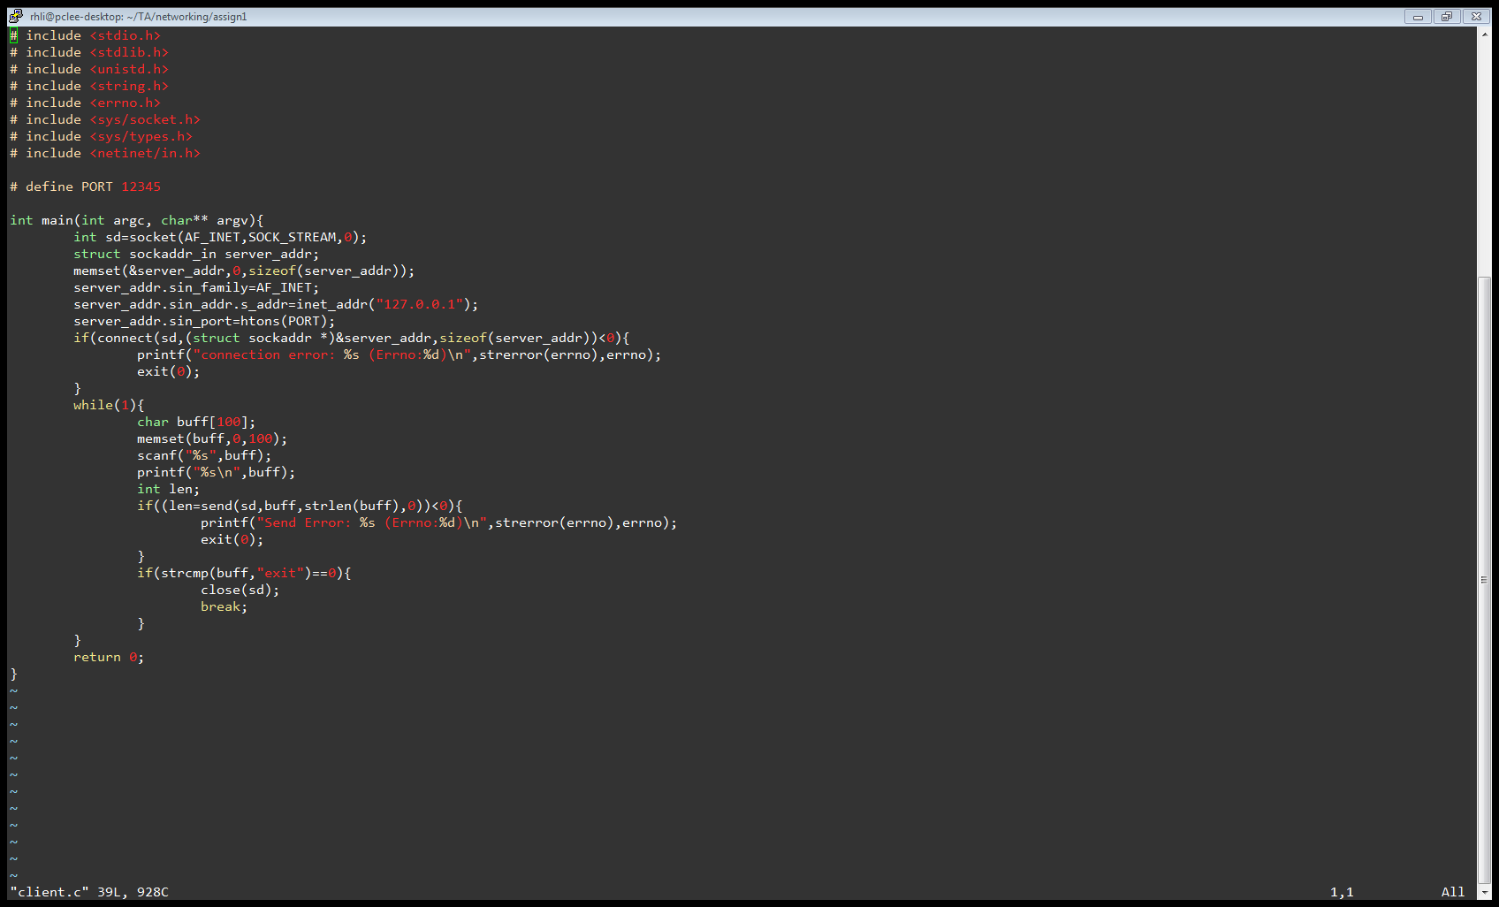
Network-byte Order
Another way to change a IP address into network-byte order
Syntax：
in_addr_t inet_addr (const char *cp);
Example:

Slide 15
Basic Socket Programming
listen() (Server)
Defines the maximum number of connections can be pending to this socket
Syntax:
int listen (int socket, int backlog);
Example:

Slide 16
Basic Socket Programming
accept() (Server)
Returns socket descriptors for new connection
Syntax
int accept(int socket, struct sockaddr *addr, int addr_len);
Example

Slide 17
Basic Socket Programming
accept() (Server)
The received value is a socket descriptor
You may find that there are 2 socket descriptors, sd and client_sd
sd is for listening to a port and accepting connections from clients
The descriptor returned by accept() is used for transferring data

Slide 18
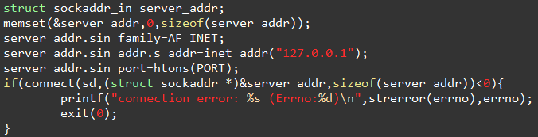
Basic Socket Programming
connect() (Client)
Connect a TCP client to a TCP server
Syntax:
int connect(int socket, struct sockaddr *addr, int *addr_len);
Example:

Slide 19

Basic Socket Programming
send()/recv() (Server & Client)
Send and receive data
Syntax:
int send (int socket, const void* msg, size_t msg_len, int flags);
int recv (int socket, void* buff, size_t msg_len, int flags);
Example:

Slide 20
Basic Socket Programming
send()/recv() (Server & Client)
Setting flags to 0 will be OK for most cases
Incomplete recv()/send(), due to the limit of the buffer size, the recv()/send() functions may input/output fewer bytes than requested.
Always check the return value, it indicate the bytes sent/received.
Use a loop to send/receive

Slide 21
Blocking Operations
If the socket is blocking, the recv() is a blocking function.
It will block the program and wait for data from the other side.
Another blocking function is accept()
How to deal?
Multi-thread programming, we will cover this in the next tutorial.

Slide 22
Q&A

