Slide 1
ENGG5189 Project Topic Recommendation System
YI WEIYING
1155026053

Slide 2
Outline
Outline Motivations Problem Definition Project Implementation Demonstration Reference
■ ■ ■ ■ ■ ■
Motivations
Problem Definition
Project Implementation
Knowledge Acquisition
Project Statistics
Fuzzy Types
Objects
Rules
Inference Structure
Demonstration
References

Slide 3
Motivations
Outline Motivations Problem Definition Project Implementation Demonstration Reference
■ ■ ■ ■ ■ ■
What is the first question?
Select a “proper" project topic.
“Proper”
Interesting
Implementable
High grade
Help students choose project topic in the future.
Notes:
1. What is the first question you came up with after you read the project specification of this course?

Slide 4
Project Definition
Outline Motivations Problem Definition Project Implementation Demonstration Reference
■ ■ ■ ■ ■ ■
Help students choose “proper” project topic in the future.
“Proper”
Interesting
Meet YOUR interest
Otherwise I have no motivation
Implementable
Can be achieved before deadline
High grade
As high as possible
Notes:
Interesting:
For example if you hate CE. And I ask you to implement something about CE. You may just ignore my request.
Implementable:
The topic can be achieved before deadline. If you know nothing about some areas, the system will not recommend topic in those areas.
High grade
As high as possible that you can get.
For example, if you have a lot of time to do the project. The system will not recommend simple topic to you since simple usually means lower grade.
If you only have one day, the system will not recommend complex topic to you since you don’t have enough time to finish it.

Slide 5
Project Implementation - Knowledge Acquisition
Outline Motivations Problem Definition Project Implementation Demonstration Reference
■ ■ ■ ■ ■ ■
Project topic
Students in ENGG5189
Previous project
Certainties of rules
Logically and rationally assumptions

Slide 6
Project Implementation – Project Statistics
Outline Motivations Problem Definition Project Implementation Demonstration Reference
■ ■ ■ ■ ■ ■
Number of objects
16
Number of fuzzy types
8
Level of inference
3
Number of rule sets
150
Average number of rules per output project
22

Slide 7
Project Implementation – Fuzzy Types
Outline Motivations Problem Definition Project Implementation Demonstration Reference
■ ■ ■ ■ ■ ■
Number of objects
8 out of 16
Object list
time_you_have
marks_you_want
system_complexity
interest_in_sport
interest_in_games
interest_in_travel
rate_on_it_information
interest_in_it

Slide 8
Project Implementation – Fuzzy Types (cont.)
Outline Motivations Problem Definition Project Implementation Demonstration Reference
■ ■ ■ ■ ■ ■
system_complexity
How complex the recommended system should be?
Depends on time_you_have and marks_you_want.
interest_in_sport
How interest?
Depends on time_on_sports and BMI_index.
Interest_in_game
How interest?
Depends on time_on_games and num_of_games.

Slide 9
Project Implementation – Fuzzy Types (cont.)
Outline Motivations Problem Definition Project Implementation Demonstration Reference
■ ■ ■ ■ ■ ■
interest_in_travel
How interest?
Depends on num_of_places and time_on_travel.
Interest_in_it
How interest?
Depends on is_programmer and rate_on_it_information.

Slide 10
Project Implementation – Objects
Outline Motivations Problem Definition Project Implementation Demonstration Reference
■ ■ ■ ■ ■ ■
Total number of objects
16
Objects
time_you_have
marks_you_want
system_complexity
time_on_sport
BMI_index
Interest_in_sport

Slide 11
Project Implementation – Objects (cont.)
Outline Motivations Problem Definition Project Implementation Demonstration Reference
■ ■ ■ ■ ■ ■
Objects
time_on_games
Num_of_games
interest_in_game
num_of_places
money_on_travel
interest_in_travel

Slide 12
Project Implementation – Objects (cont.)
Outline Motivations Problem Definition Project Implementation Demonstration Reference
■ ■ ■ ■ ■ ■
Objects
is_programmer
rate_on_it_infomation
Interest_in_it
System_list

Slide 13
Project Implementation – Rules
Outline Motivations Problem Definition Project Implementation Demonstration Reference
■ ■ ■ ■ ■ ■
Total number of rules
150
Too many to list them all
9 for system_complexity
9 for interest_in_sport
9 for interest_in_game
9 for interest_in_travel
6 for interest_in_it
108 for system_list

Slide 14
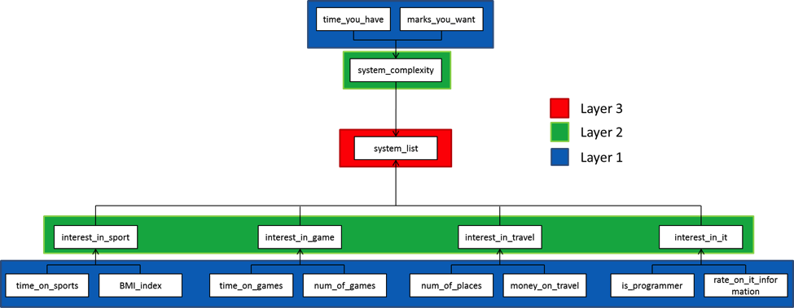
Project Implementation – Inference Structure
Outline Motivations Problem Definition Project Implementation Demonstration Reference
■ ■ ■ ■ ■ ■

Slide 15
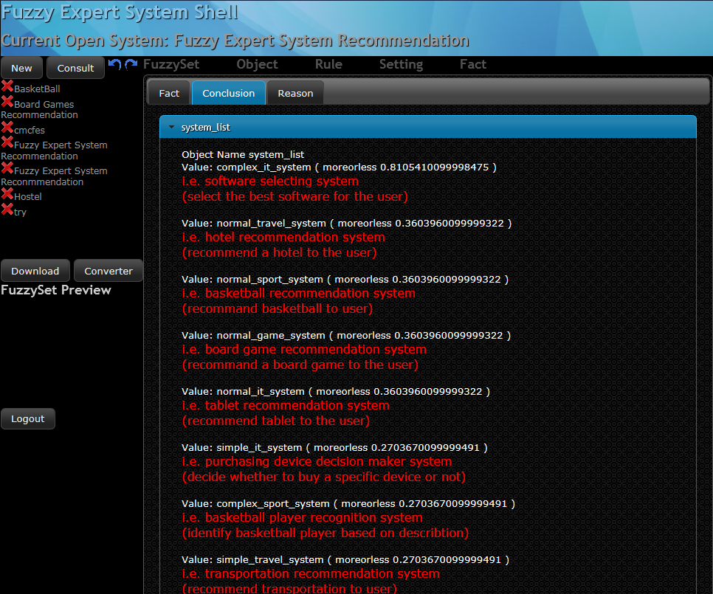
Demonstration
Outline Motivations Problem Definition Project Implementation Demonstration Reference
■ ■ ■ ■ ■ ■

Slide 16
Reference
Outline Motivations Problem Definition Project Implementation Demonstration Reference
■ ■ ■ ■ ■ ■
BMI, Body Mass Index, http://en.wikipedia.org/wiki/Body_mass_index

Slide 17
Thanks

