Slide 1
Lab1 of CENG4480
CSE CUHK
Lecture: Terrence Mak
TA: Zong Wen

Slide 2
Objectives
1. Learn to use mbed chip
2. Try to use accelerometer ADXL332

Slide 3
Scores
1. Show me your system works
A) Print the input voltage on the serial port terminal
B) Calculate and print the tilt
2. Hand in the answers of the questions in the lab manual

Slide 4
ADXL332 introduction
Description:
The ADXL322 is a small, thin, low power, complete, dual-axis accelerometer with signal conditioned voltage outputs, which are all on a single monolithic IC. The product measures acceleration with a full-scale range of ±2 g(typical). It can also measure both dynamic acceleration (vibration) and static acceleration (gravity).

Slide 5
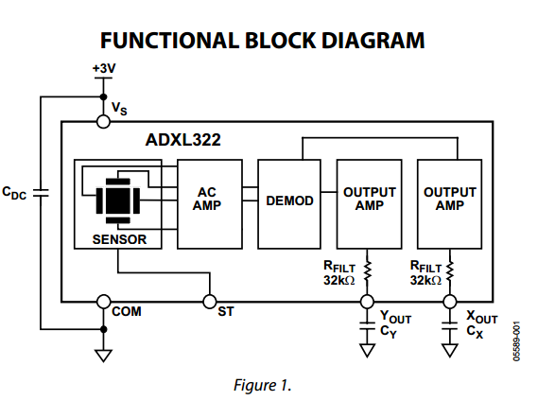
ADXL332 introduction
Function block diagram

Slide 6
Printing the voltage
while(1) {
tempX = X_axis * 3.3;
tempY = Y_axis * 3.3;
//print current temp
printf("X = %5.2F ; Y = %5.2F \n\r", tempX, tempY);
wait(.5);
}

Slide 7
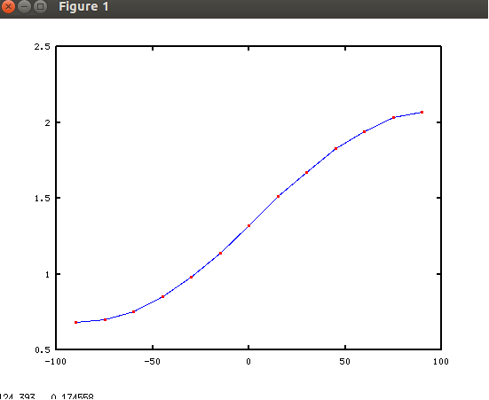
The voltage-tilt curve

Slide 8
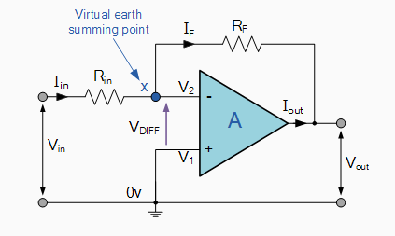
Operational Amplifier
For ideal op-amps there are two very important rules to remember about inverting amplifiers, these are: "no current flows into the input terminal" and that "V1 equals V2", (in real world op-amps both of these rules are broken).

Slide 9
From voltage to angle
Imagine vmin, v0 and vmax are the value of voltages we get at -90, 0, and +90 degree.
Inversely we can get the angle with this formula
A = asin( 2*(v – v0)/(vmax – vmin))

Slide 10
Deadline
Before Oct. 3 6:00 PM

Slide 11
Contact information
Office 1005 HSH Engineering Building
Email: wzong@cse.cuhk.edu.hk
Mobile: 59886697

