Slide 1
263F Project Proposal
Shixuan Sun, Xiaoyang Zhao
Notes:
Quick self intro

Slide 2

Simulation of a ladder under operation
What is the time revolution of ladder deformation under a climb loading?
Will the step twist, and does it need reinforcement?
Investigate whether step reinforcement reduces twist deformation
Notes:
So our project is about to simulate a ladder under operation. Such an idea actually comes from a very common but interesting scenario, which is we all know that when a person clumbs up a ladder, the ladder actually bends and sometimes slight twist.
We want to understand this deformation behavior using the numerical method. So our research question will be……..

Slide 3
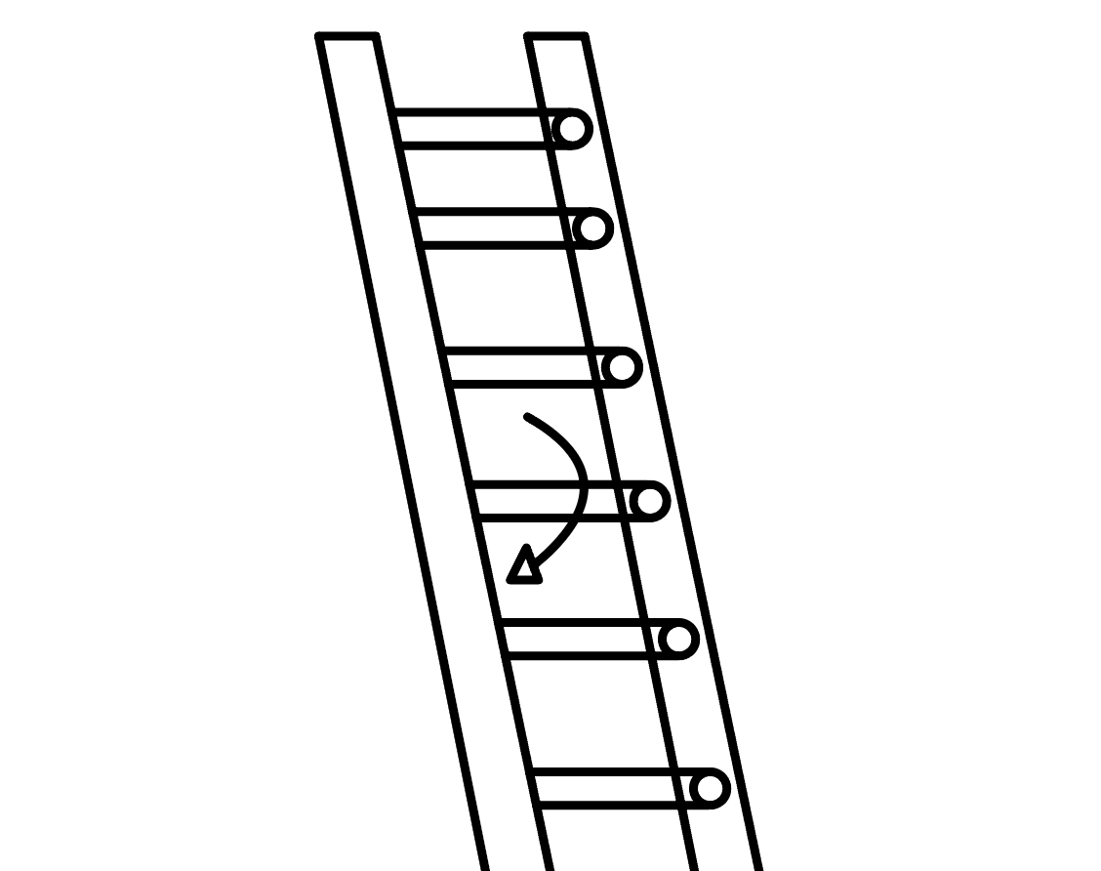
Our Approach
The ladder will be modeled as two vertical elastic rods connected by several horizontal steps
Utilize the implicit-Euler method to simulate the deformation of the ladder
Use the Elastic Discrete Rod approach to determine if twist is present
The load from a person is applied as a moving external force along the steps
Notes:
Well, as for the model setup,

