Slide 1

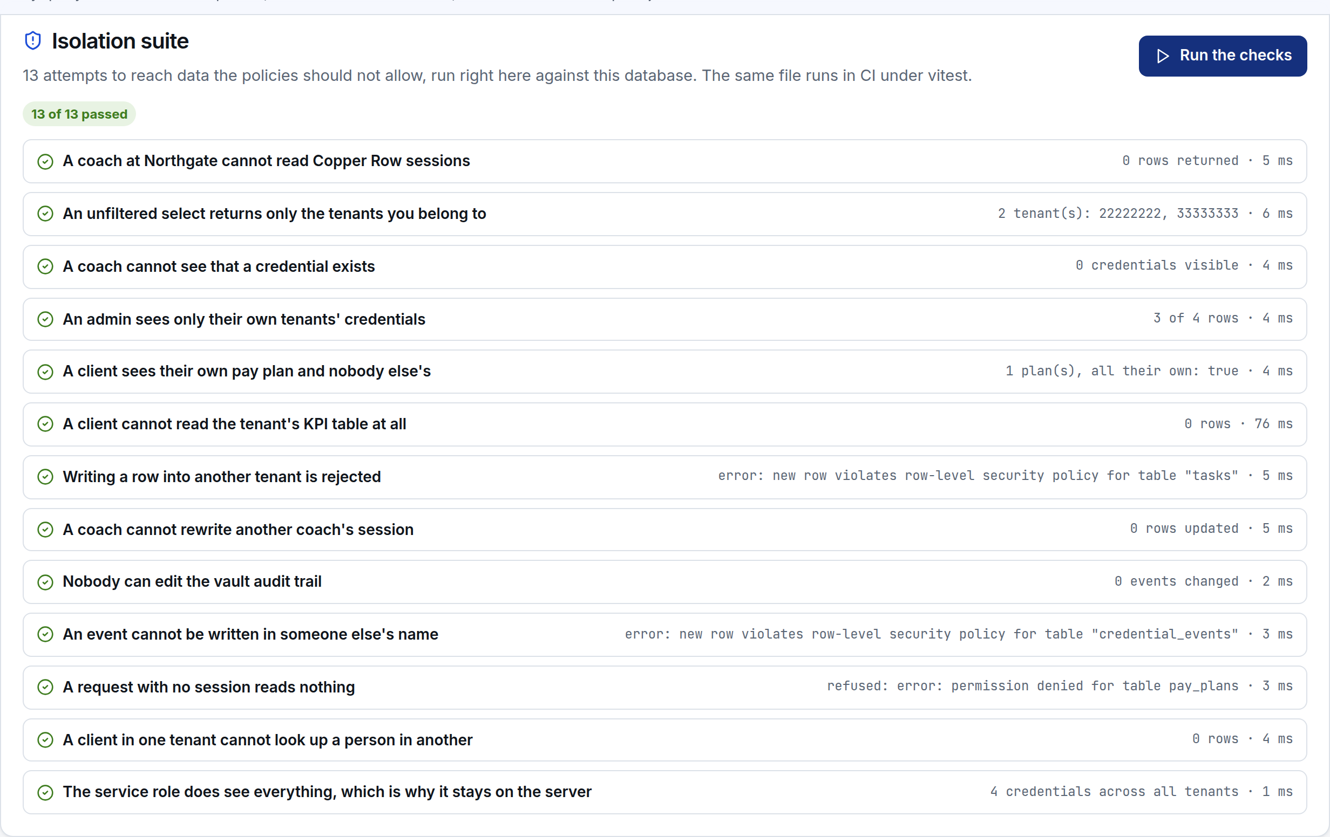
Valdis Licis · Full-stack and platform work
MULTI-TENANT PLATFORM · DELIVERY PLAN
Tenant isolation you can attack, not a diagram you have to trust
A working slice of the platform on your stack: Next.js 14 App Router, TypeScript strict, Supabase-shaped Postgres with row level security, Vercel and an installable PWA
The isolation suite, run in the browser against real policies
13 isolation checks run live and in CI · 4 roles enforced in Postgres
Encrypted credential vault, the trial module, working
Prepared by Valdis Licis · 23 September 2026

Slide 2
1. SUMMARY
A slice of the platform, built before bidding
Trelvane Performance is a fictional agency used for the demo; the architecture is the one I would deliver
Your post fixes the stack and the shape of the work, so rather than describe experience I built the part that is hardest to judge from a CV: multi-tenancy with row level security, and the credential vault you have chosen as the paid trial. Both run in a browser against a real Postgres, so you can attack them yourself before we speak.
13 / 13
4
isolation checks passing
roles enforced in Postgres
17
0
Isolation you can test: 13 attacks on the policies, run on the page and in CI
The trial module, working: envelope encryption, reveal with a reason, rotation, append-only audit
Daily modules: KPIs, watch and alert engine, tasks, rota, holidays, SOPs
Installable: service worker, offline shell, notifications, and the push path written out
tests: policies, crypto, watch engine
tenant filters in page code
The tenant is never taken from the request. It comes from the membership table, checked inside the policy, so a forgotten filter in application code is not a leak.
Trelvane platform · Multi-tenant SaaS: technical and delivery plan · 2

Slide 3
2. YOUR BRIEF
Every requirement in the post, and where it is answered
You asked for | How it is met | Slide
Next.js 14 App Router, TypeScript strict | Built on 14.2.35, strict plus noUncheckedIndexedAccess, no any | 5, 29
Supabase: Postgres, RLS, Auth | One migration, auth.uid()/auth.jwt(), anon/authenticated/service_role, policies per table | 6 to 9
Multi-tenant scaffolding | Tenants, memberships, tenant_id everywhere, membership-resolved policies | 7, 8
Role-based auth | Owner, admin, coach, client: rows and tables, not menus | 9
Encrypted vault (trial project) | Envelope encryption, per-tenant keys, rotation, append-only audit | 12 to 14
Migration of 3 live apps | Map, import into a copy, parallel read-only, rehearsed cutover | 15, 16
Pay plans and coaching workflows | Plans, arrears, session lifecycle, client view | 17
KPI dashboard and watch/alert engine | Metrics per tenant, rules as rows, pure evaluator, alert hygiene | 18, 19
Task, rota and holiday module | Board, rota, requests with approval split by policy | 20
PWA with push notifications | Manifest, worker, install, cache policy, VAPID path, iOS caveat | 22, 23
Gemini video analysis | Queued jobs, signed URLs, structured output validated before storage | 24
In-app SOP repository | Agency-wide and tenant SOPs under one policy | 21
Claude Code, sprints, pricing | The loop, five caught mistakes, sprint shape and fixed price per sprint | 25 to 27, 30
Trelvane platform · Multi-tenant SaaS: technical and delivery plan · 3

Slide 4
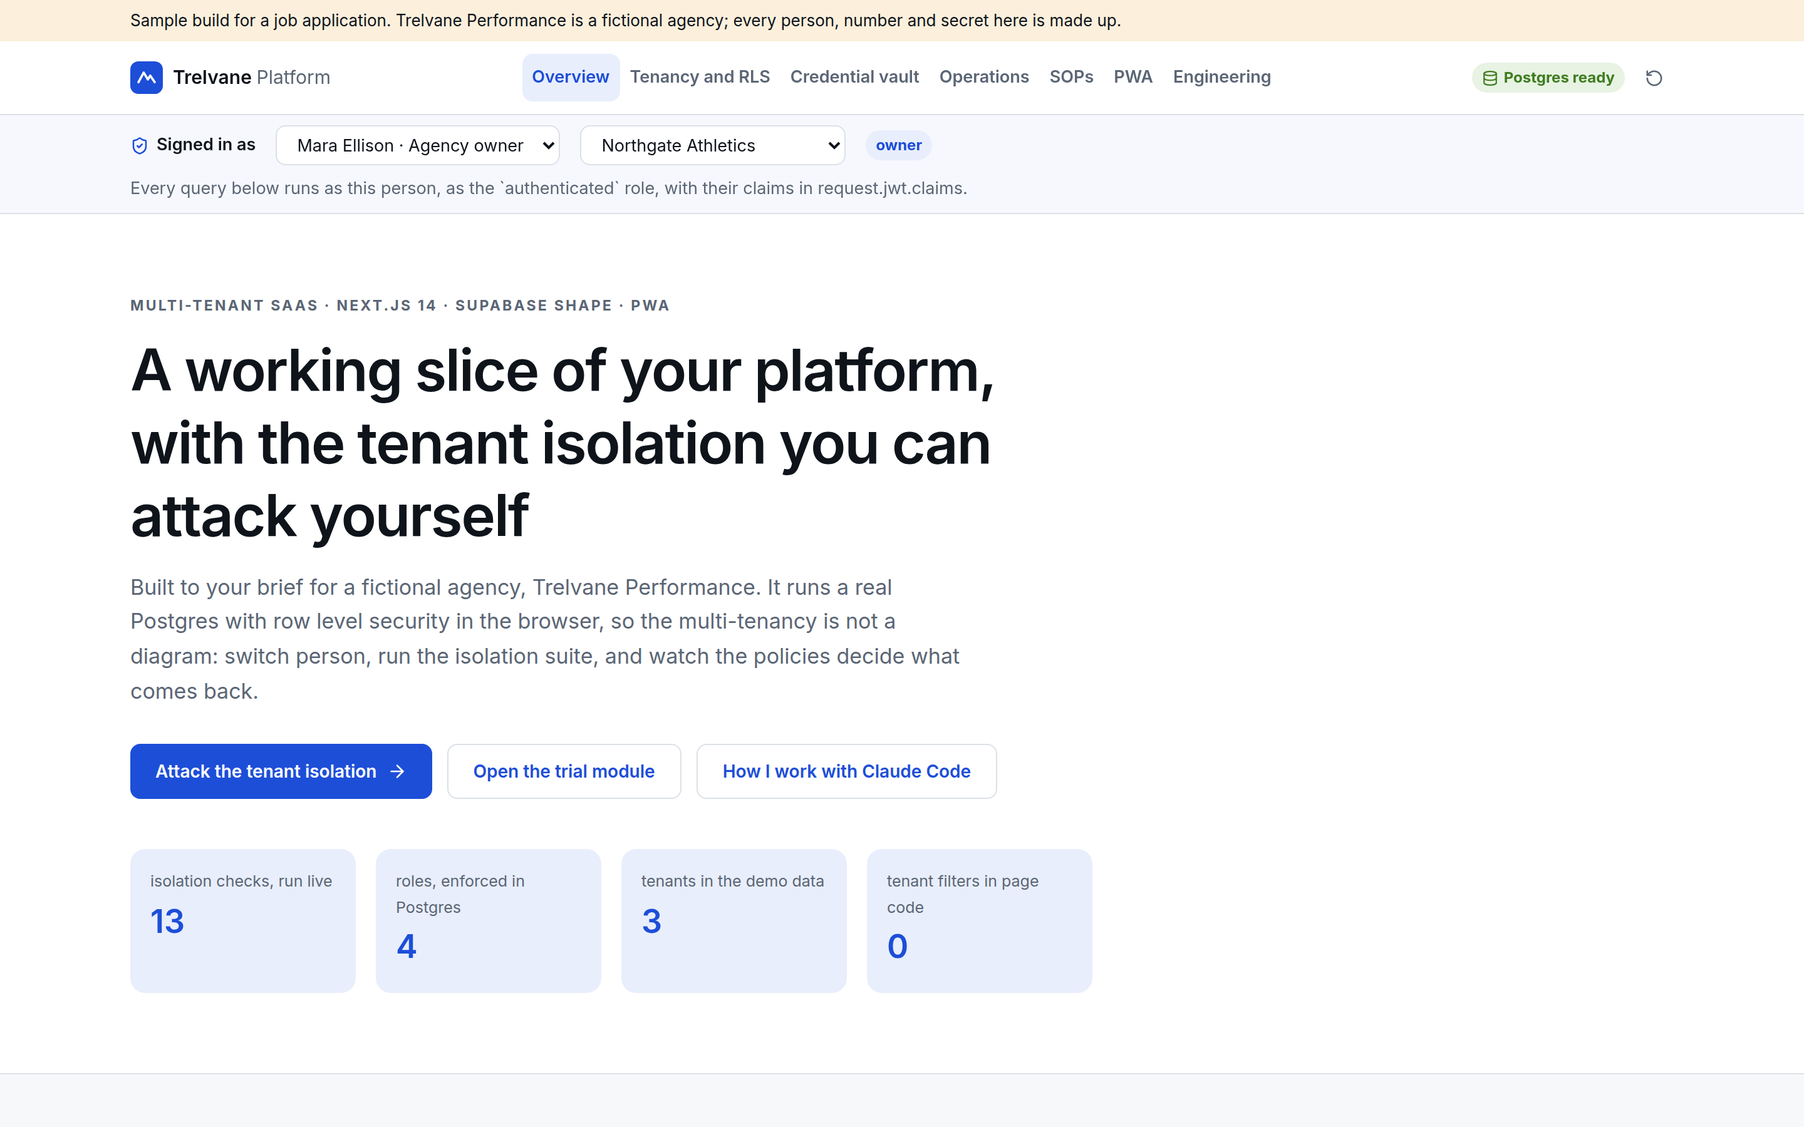
2. YOUR BRIEF
What the demo contains
Everything below runs in the browser: no account, no server, nothing typed leaves the tab
Page | What it shows
Tenancy and RLS | Same SQL as four people, service role beside it, 13 live checks
Credential vault | The trial module, end to end
Operations | KPIs, watch engine, tasks, rota, holidays
SOPs | Agency-wide and tenant procedures
PWA | Worker, cache policy, install, notification
Engineering | Claude Code loop, mistakes, sprints, migration
The demo is deliberately not connected to a hosted Supabase project. It runs Postgres 16 compiled to WebAssembly, so the migration, roles and policies are the ones I would deploy, and the same files run in the test suite.
The overview page, with the modules and the stack as specified
Trelvane platform · Multi-tenant SaaS: technical and delivery plan · 4

Slide 5
3. ARCHITECTURE
The stack you specified, with the parts that carry risk marked
Browser and PWA
Next.js 14 App Router
Vercel
server components, actions
Supabase Postgres
RLS, migrations
Supabase Auth
JWT with claims
Cloudflare
DNS, WAF, cache rules
Storage
signed URLs, private buckets
Edge and cron
watch engine, push send
Gemini
video analysis, queued
Web push
VAPID, per-device subs
Observability
logs, Sentry, audit trail
One codebase, one type system: schema types generated from the database, shared by server components, actions and the client
Service role stays on the server: the browser only ever holds the anon key and a user JWT
Everything tenant-owned carries tenant_id: no per-tenant schemas, no connection juggling, one set of policies
Cloudflare in front: WAF rules, cache rules for the image optimiser, and a place to mitigate framework issues quickly
Trelvane platform · Multi-tenant SaaS: technical and delivery plan · 5

Slide 6
3. ARCHITECTURE
The data model, one migration file
app.tenants id, name, slug, plan
app.users id, email, full_name, is_staff
app.memberships user_id, tenant_id, role -- owner | admin | coach | client
app.credentials tenant_id, label, ciphertext, iv, wrapped_key, key_version
app.credential_events tenant_id, credential_id, actor_id, action, reason, at
app.pay_plans tenant_id, client_id, amount_cents, cadence, status, next_charge_on
app.sessions tenant_id, coach_id, client_id, starts_at, status, notes
app.metrics tenant_id, metric, recorded_on, value
app.watch_rules tenant_id, metric, comparator, threshold, window_days, severity
app.alerts tenant_id, rule_id, observed, message, status
app.tasks tenant_id, title, assignee_id, due_on, status
app.shifts tenant_id, staff_id, on_date, starts, ends, role
app.holidays tenant_id, staff_id, from_date, to_date, status
app.sops tenant_id (nullable = agency-wide), title, body, tags
Nullable tenant means agency-wide: one SOP table, one policy, no second code path
Events, not flags: the vault audit trail is append-only rows, so history cannot be quietly rewritten
Rules as rows: watch rules are data, so the team changes thresholds without a deploy
Indexes where the reads are: tenant_id first on every hot table, gin on SOP tags
Migrations are checked in and run in CI against a scratch database before they reach staging, so a policy change is reviewed like code.
Trelvane platform · Multi-tenant SaaS: technical and delivery plan · 6

Slide 7
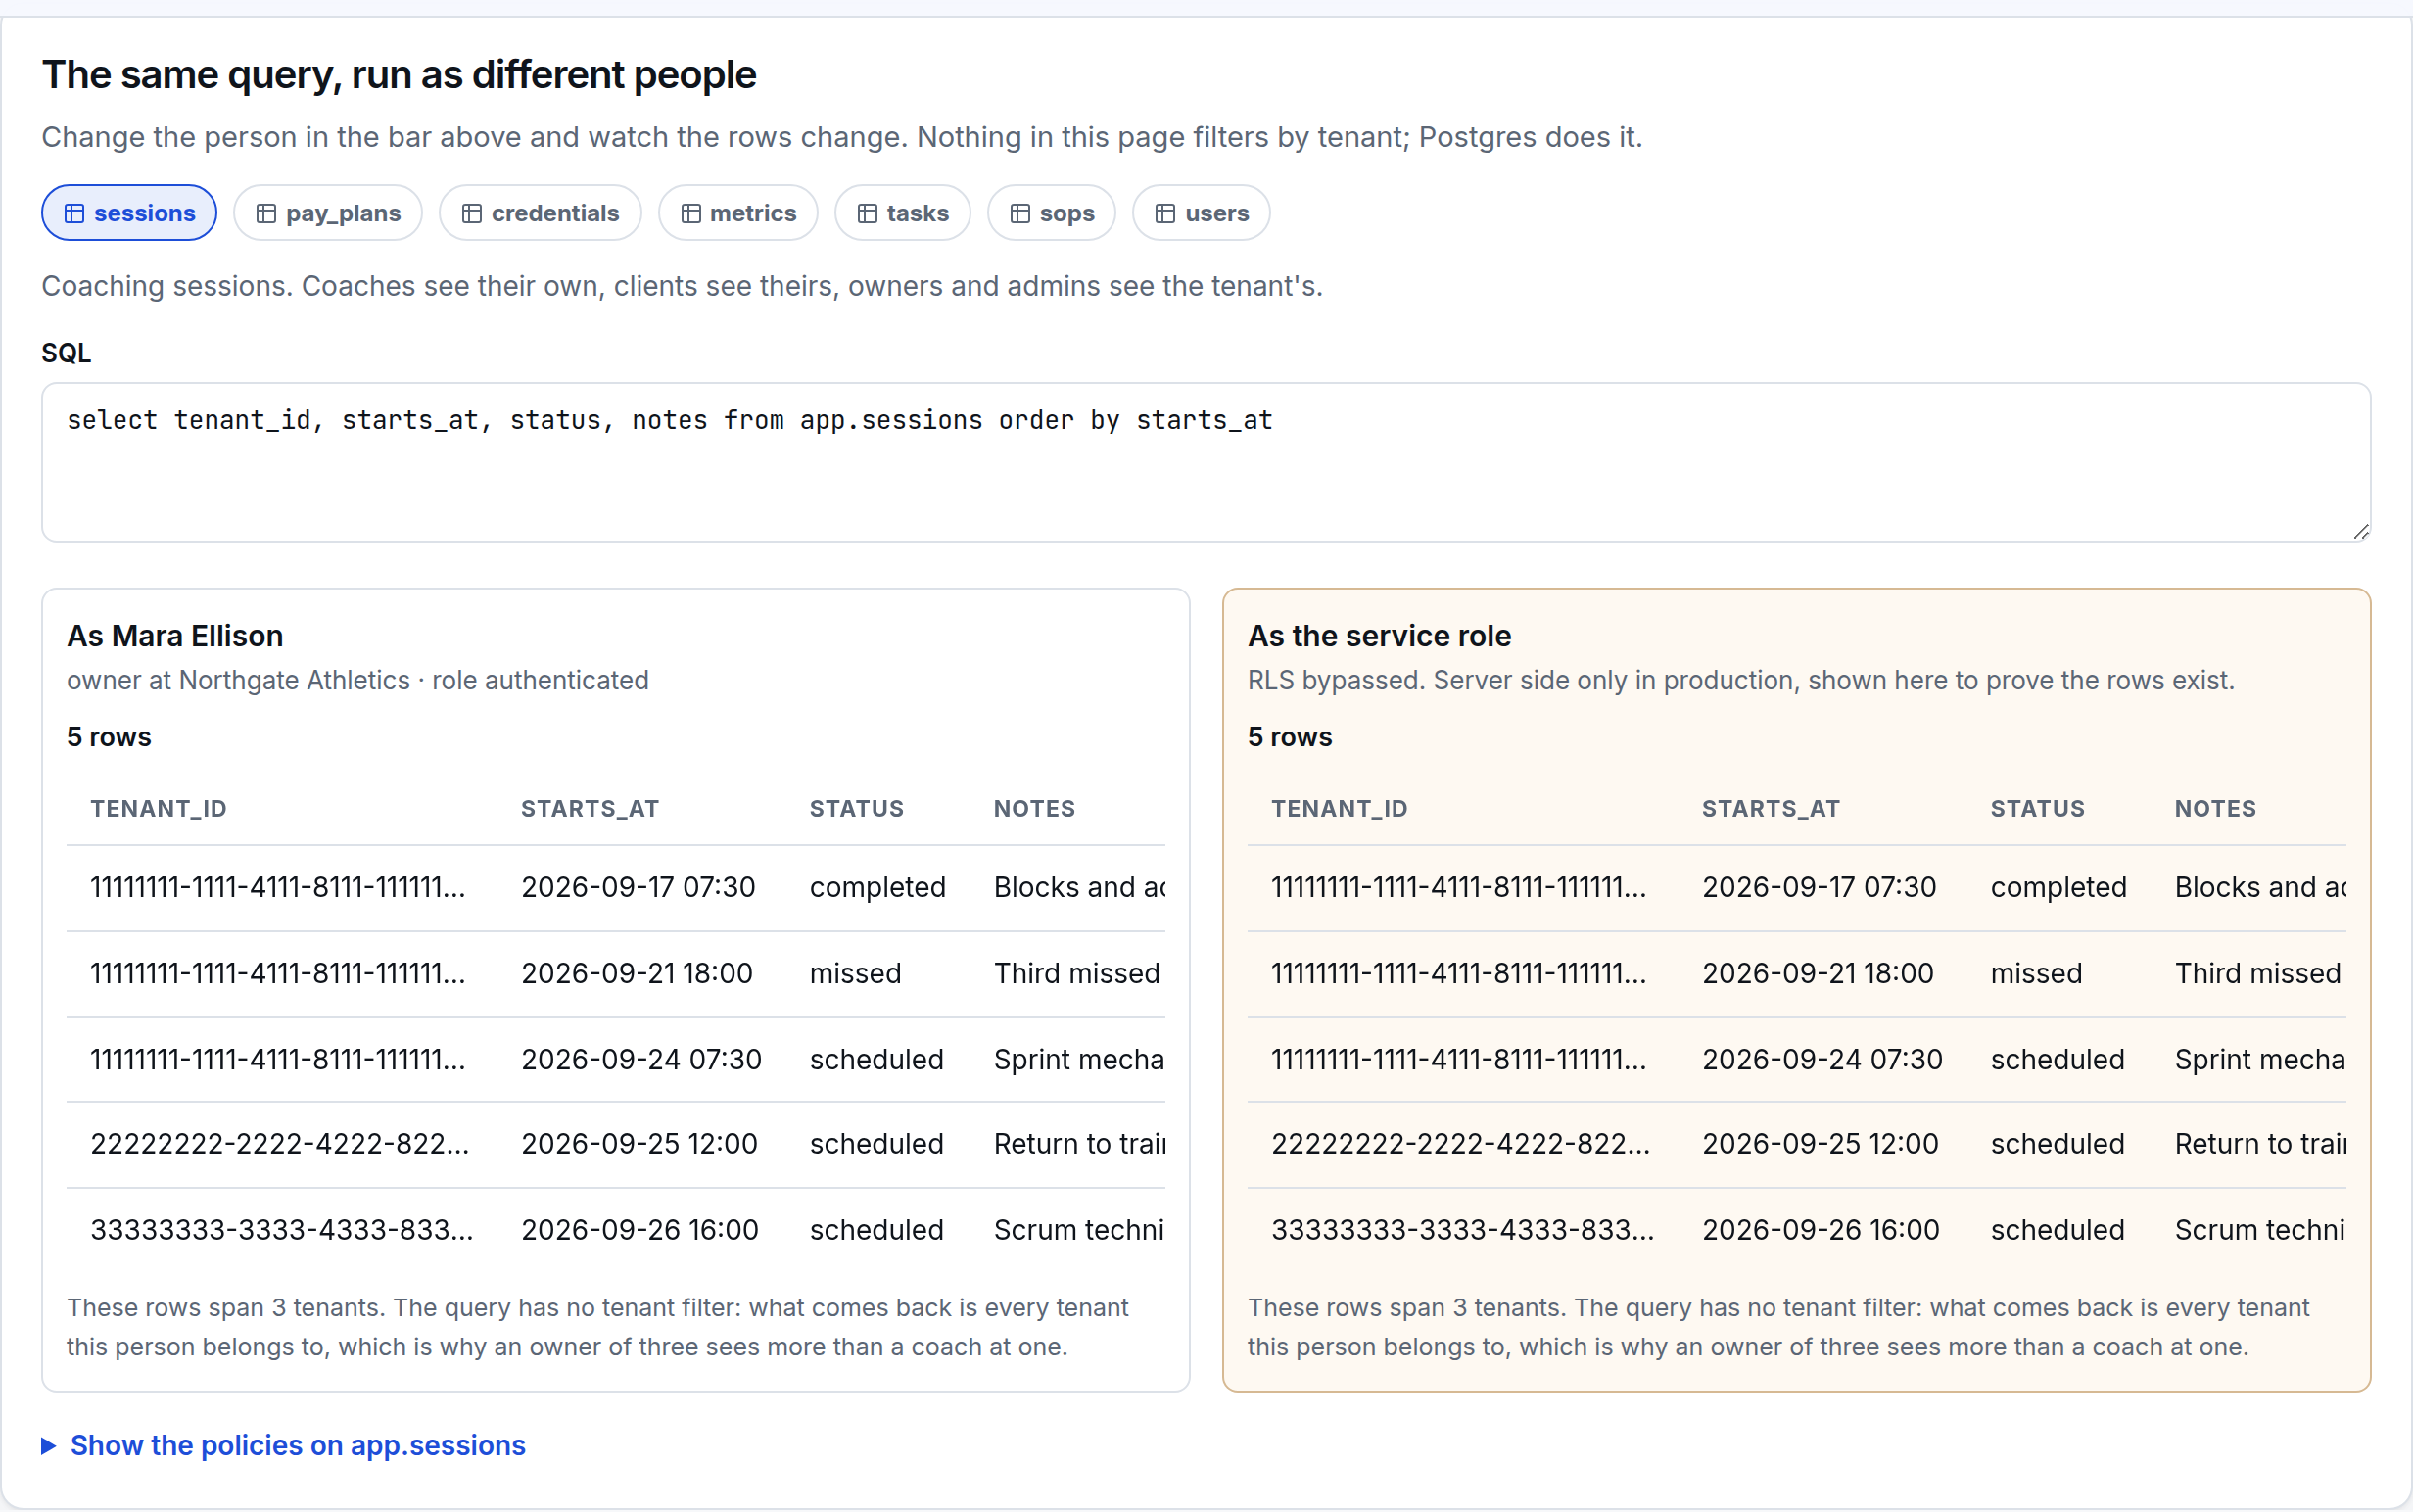
4. MULTI-TENANCY
One rule: the tenant comes from the membership table, never from the request
create or replace function app.is_member(t uuid) returns boolean
language sql stable security definer set search_path = app, pg_temp as $$
select exists (select 1 from app.memberships m
where m.tenant_id = t and m.user_id = auth.uid())
$$;
create policy sessions_read on app.sessions for select using (
app.has_role(tenant_id, 'owner', 'admin')
or (app.is_member(tenant_id) and (coach_id = auth.uid() or client_id = auth.uid()))
);
Why not a tenant id in the JWT: a claim is set at sign-in and can go stale; a membership row is the truth and can be revoked in one place
Why security definer: the check runs without giving every user read access to the whole memberships table
Why search_path is pinned: a definer function with a loose search path is a privilege escalation waiting to happen
Result: application code can forget the tenant filter and still not leak
Trelvane platform · Multi-tenant SaaS: technical and delivery plan · 7

Slide 8
4. MULTI-TENANCY
The same query, four different answers
Selected person on the left, service role on the right, with the policy underneath
An owner of three tenants sees rows from three
An admin of two sees two, and cannot write into the third
A coach sees their own sessions and no vault at all
A client sees their own plan and sessions, and no KPIs
Signed out reads nothing: auth.uid() is null and every check fails
The page runs the SQL you can see. Editing it is allowed: the policies decide, not the page.
The tenancy page: one SQL statement, run as the signed-in person and as the service role
Trelvane platform · Multi-tenant SaaS: technical and delivery plan · 8

Slide 9
4. MULTI-TENANCY
What each role can reach, enforced in the database
Table | Owner | Admin | Coach | Client
Tenant settings and memberships | Read and write | Read and write | Read | None
Credential vault and its audit | Read and write | Read and write | None | None
Pay plans | Read and write | Read and write | None | Own plan only
Coaching sessions | All in tenant | All in tenant | Own sessions | Own sessions
KPI metrics and watch rules | Read and write | Read and write | Read | None
Alerts | Read and write | Read and write | Read and write | None
Tasks | All in tenant | All in tenant | Own tasks | None
Rota | Read and write | Read and write | Read | None
Holiday requests | Approve | Approve | Raise own | None
SOPs | Agency and tenant | Agency and tenant | Read | Read agency-wide
Every cell above is a policy, not a condition in a component. The client column matters most: a client account is the one most likely to be handed to someone outside the agency.
Trelvane platform · Multi-tenant SaaS: technical and delivery plan · 9

Slide 10
5. PROOF
Thirteen attacks on the policies, run live and in CI
Cross-tenant read by id, and by forgetting the filter
A coach reaching the vault, or another coach's session
A client reading the tenant's KPI table
Writing a row into a tenant you do not belong to
Forging an audit event in someone else's name
Editing the append-only audit trail
A request with no session at all
The service role, to prove the rows are really there
A policy that returns the right rows today is not evidence. These checks fail loudly the moment a policy is loosened, which is what makes them worth keeping in CI.
Run on the tenancy page. The same file runs under vitest in CI.
Trelvane platform · Multi-tenant SaaS: technical and delivery plan · 10

Slide 11
5. PROOF
What row level security does not cover, and what covers it
Gap | Risk | What I do about it
The service role key | Bypasses every policy | Server only, never in a client bundle, rotated on staff change, and used in named helpers rather than ad hoc
Storage buckets | Files are not rows | Private buckets, tenant-prefixed paths, signed URLs with short expiry, and access checked in the function that signs
Edge functions and cron | Run with elevated rights | Each one takes a tenant argument and re-checks membership before writing
Realtime channels | Subscriptions can over-share | Channel names scoped per tenant, authorised on connect
Aggregates and counts | Leak by inference | Counts computed inside policies-aware views, never over the service role
Backups and exports | Copies outside the policies | Encrypted, access logged, and restores tested into a scratch project
This slide is the one I would want to see from a contractor. Row level security is the floor, not the ceiling.
Trelvane platform · Multi-tenant SaaS: technical and delivery plan · 11

Slide 12
6. TRIAL MODULE
The credential vault: envelope encryption
Master key
KMS or Supabase Vault
Tenant key
derived per tenant and version
Data key
one per secret, AES-256-GCM
Row
ciphertext, iv, wrapped key, version
const dek = await crypto.subtle.generateKey({ name: "AES-GCM", length: 256 }, true, ["encrypt"]);
const iv = crypto.getRandomValues(new Uint8Array(12));
const ciphertext = await crypto.subtle.encrypt(
{ name: "AES-GCM", iv, additionalData: enc.encode(tenantId + ":" + credentialId) }, dek, plaintext);
const wrapped = await crypto.subtle.wrapKey("raw", dek, await tenantKey(master, tenantId, version), { name: "AES-GCM", iv: wrapIv });
Bound to its row: the tenant and credential id are additional data, so a ciphertext copied into another row will not open
Nothing reusable in the database: the wrapped key is useless without the master key, which is not stored there
Rotation is cheap: re-wrap the small data keys; ciphertext is never rewritten, so rotation cannot corrupt a secret
Trelvane platform · Multi-tenant SaaS: technical and delivery plan · 12

Slide 13
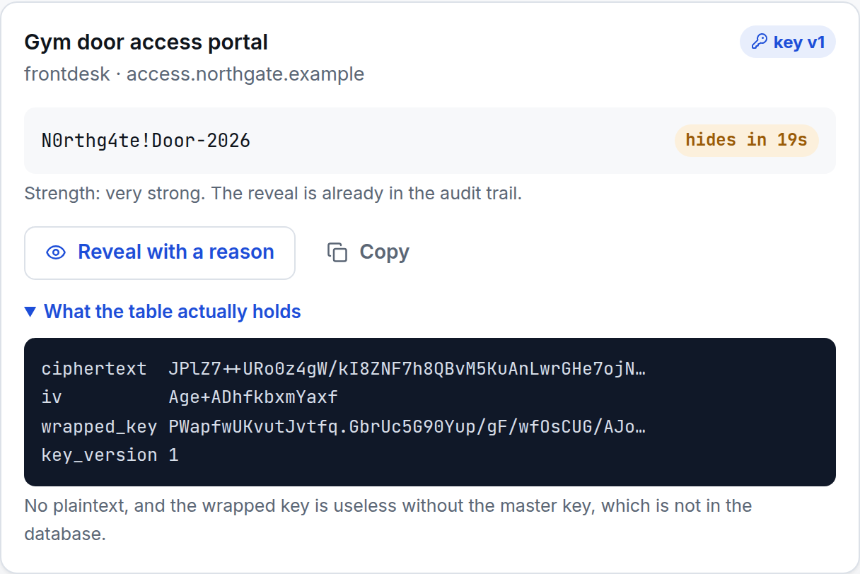
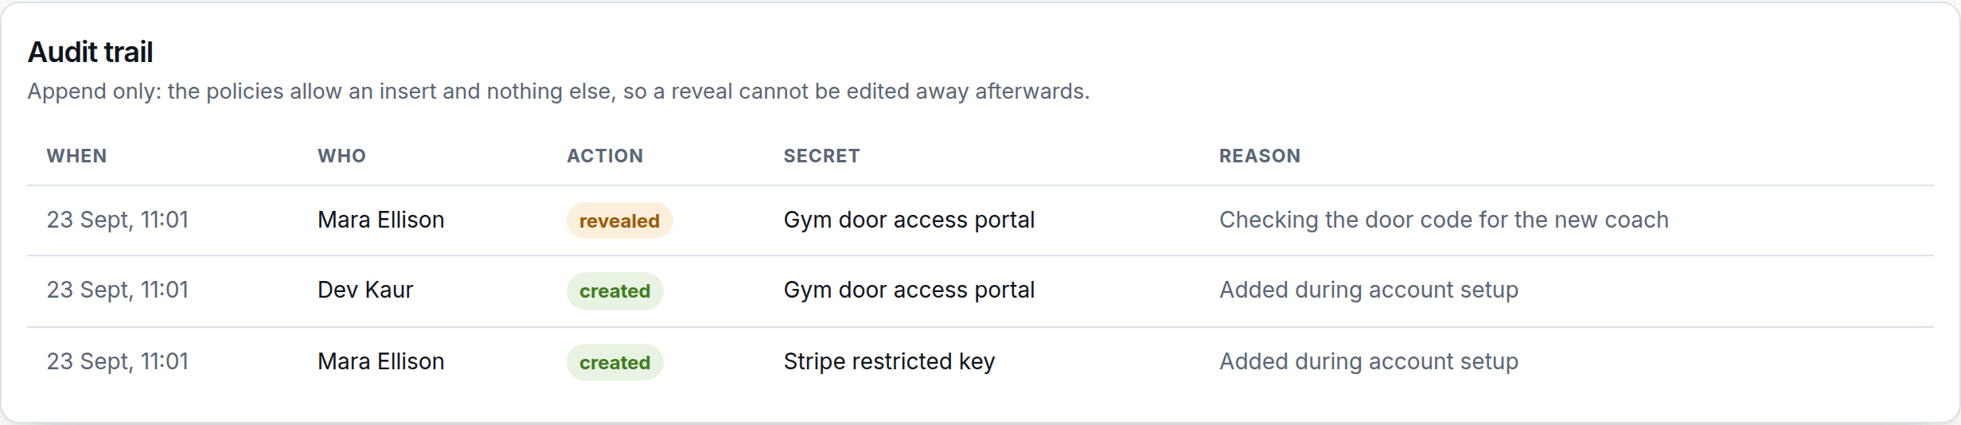
6. TRIAL MODULE
In use: reveal with a reason, and what the table holds
The audit trail: append-only by policy
A reason is required: under five characters and nothing is revealed or recorded
Copy is a reveal: the clipboard is the weak point, so it is logged the same way
Auto-hide: the plaintext leaves the screen after twenty seconds and is never put in application state longer than that
A secret revealed for twenty seconds, with the stored row underneath
In production this runs in a server action with the master key in a KMS. The demo runs it in the browser with a demo key so you can try it without an account.
Trelvane platform · Multi-tenant SaaS: technical and delivery plan · 13

Slide 14
6. TRIAL MODULE
If something leaks, what does an attacker have?
What leaks | What they get | What stops it spreading
A database dump | Ciphertext and wrapped keys | No master key in the database, so nothing opens. Rotation limits the value of an old dump
One tenant's key | That tenant's secrets only | Keys are derived per tenant and per version, so the blast radius is one account
A stolen JWT | That person's rows for its lifetime | Short-lived tokens, roles checked per query, and a reveal leaves the person's name in the audit trail
The service role key | Everything | Server only, never in a bundle, rotated on staff change, and usage is logged
A copied ciphertext | Nothing | The tenant and row id are bound in as additional data, so it will not decrypt elsewhere
A curious coach | Nothing | The policy hides existence, not just content: an empty list, not a permission error
Trelvane platform · Multi-tenant SaaS: technical and delivery plan · 14

Slide 15
7. MIGRATION
Three live apps, moved without a bad weekend
1. Map
2. Import into a copy
3. Parallel, read-only
4. Cut over
One document per app: tables, which tenant each row belongs to, dead fields, identifiers that must survive
A repeatable script, run as often as needed, with row counts and checksums per table and per tenant
The new app reads migrated data while the old one stays the system of record; people find the differences
Short freeze, final delta, smoke checklist per app, rollback that has been run on the copy
Decision to make early | Why it matters
Which app is the source of truth for a person | The three apps almost certainly disagree about names, emails and who is active
What a tenant means in each app | If one app is per-location and another per-client, the mapping is a business decision, not a technical one
What history you actually need | Moving five years of logs costs sprint time; archiving them costs a day
Who signs off each cutover | One named person per app, with the checklist in front of them
Trelvane platform · Multi-tenant SaaS: technical and delivery plan · 15

Slide 16
7. MIGRATION
The cutover checklist, written before the day
Freeze writes in the old app and post the notice the team has already seen in rehearsal
Run the final delta import; compare row counts and checksums against the frozen source
Run the smoke checklist: sign in as each role, open the five screens that matter, create one record of each kind
Point DNS or the feature flag at the new module; keep the old app readable for two weeks
Watch the error rate and the audit trail for the first working day, with a named person on call
Rollback, if needed: flip the flag back, restore the frozen copy, and the old app is still the system of record
Check | Target
Row counts per table | Exact match
Checksums on money fields | Exact match
Orphaned foreign keys | Zero
People without a tenant | Zero
Smoke checklist | All green
Time to roll back | Measured, under 30 minutes
A rollback that has never been run is a hope. I run it against the copy during the rehearsal, and the time it took goes in the plan.
Trelvane platform · Multi-tenant SaaS: technical and delivery plan · 16

Slide 17
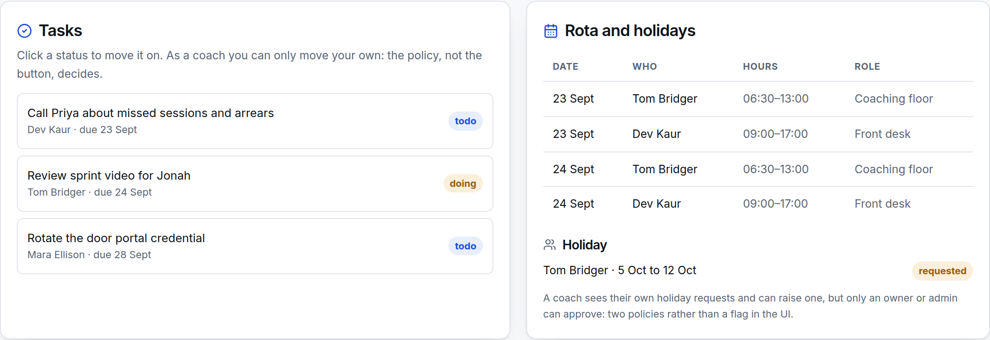
8. MODULES
Pay plans and coaching workflows
Plans are records, not a status field: amount, cadence, next charge date and a state that moves through active, paused, arrears and ended
Arrears is a state, not a report: it is set by the same job that raises alerts, so the number on the dashboard and the badge on the client agree
A client sees only their own plan: the policy, not the page, is what stops a link to another plan working
Sessions carry the coach and the client: which makes the coach view, the client view and the attendance metric one query each
Money paths get tests first: state changes and any proration are covered before a client sees the screen
Tasks and rota from the same tenant
Payments themselves stay with your provider. This module tracks intent and state; the provider stays the source of truth for a charge.
Trelvane platform · Multi-tenant SaaS: technical and delivery plan · 17

Slide 18
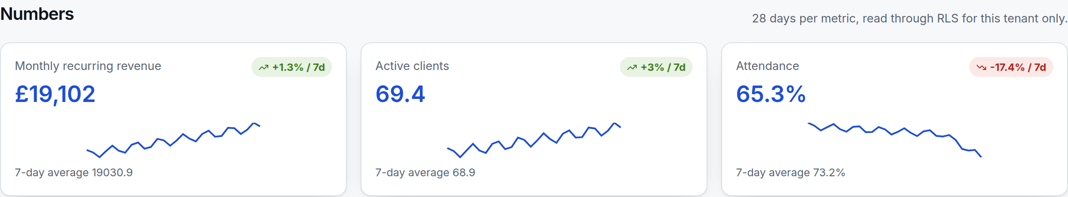
8. MODULES
KPI dashboard: one metrics table, read through the policies
Three metrics for one tenant, 28 days each, with the seven-day trend
Metrics are rows: tenant, metric, date and value, with a unique key so a re-import cannot double count
Written by jobs, read by everyone: the numbers on a phone and the numbers in a review meeting come from the same table
Coaches read, admins write: a coach seeing the tenant's numbers is useful; a coach editing them is not
Trelvane platform · Multi-tenant SaaS: technical and delivery plan · 18

Slide 19
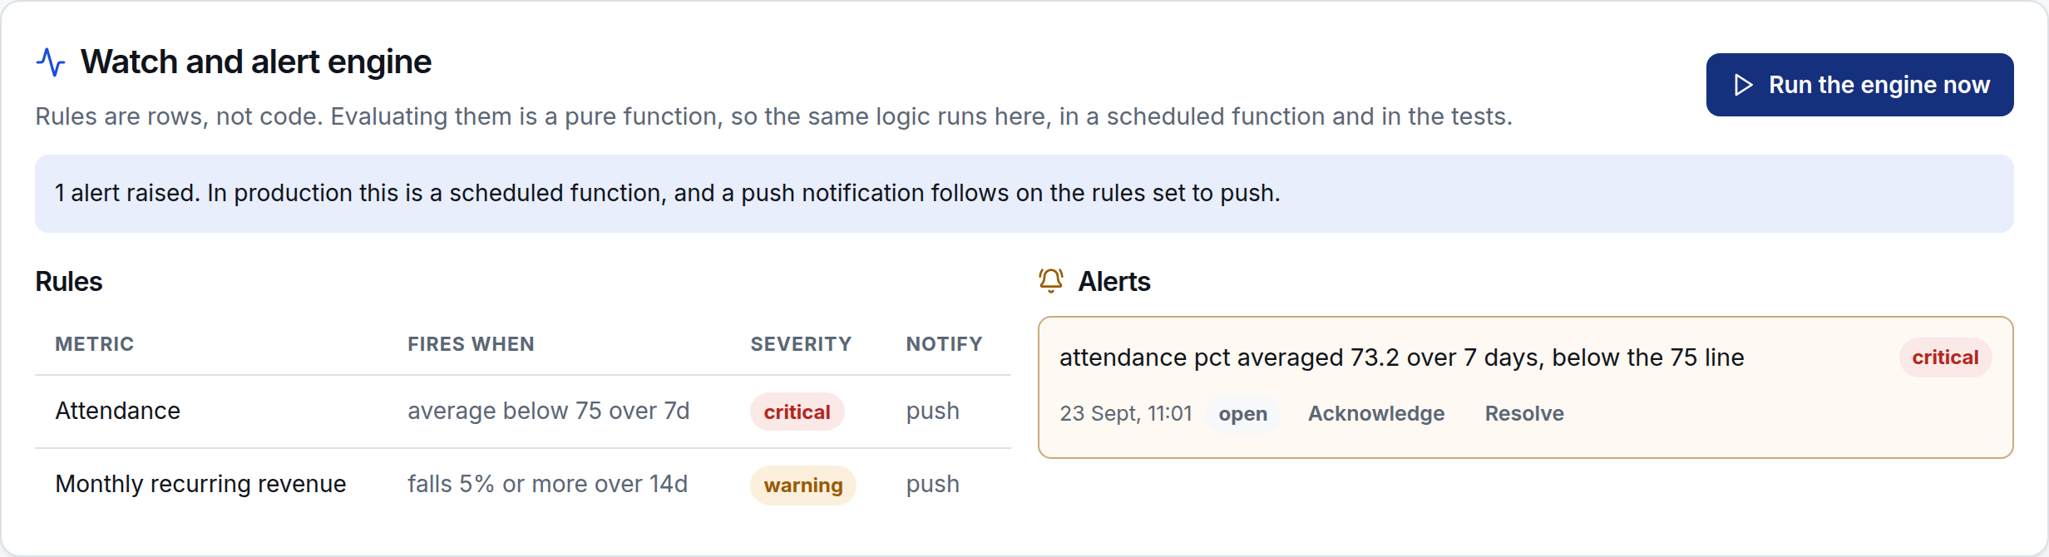
8. MODULES
The watch and alert engine, and how it avoids being ignored
Rules are data: metric, comparator, threshold, window, severity and how to notify. Changing one is not a deploy
Windows, not spikes: comparisons use a window average, so one bad Monday does not page anyone
No repeats while open: a rule that has already fired stays quiet until the alert is resolved
One tag per rule: a phone that was off all day shows one current alert per rule, not forty
Same function everywhere: browser, scheduled job and tests run the identical evaluator
Rules as rows; the engine can be run by hand here and on a schedule in production
Alert fatigue is the failure mode for this module. Thresholds that fire every day get muted, and then the one that mattered is muted too.
Trelvane platform · Multi-tenant SaaS: technical and delivery plan · 19

Slide 20
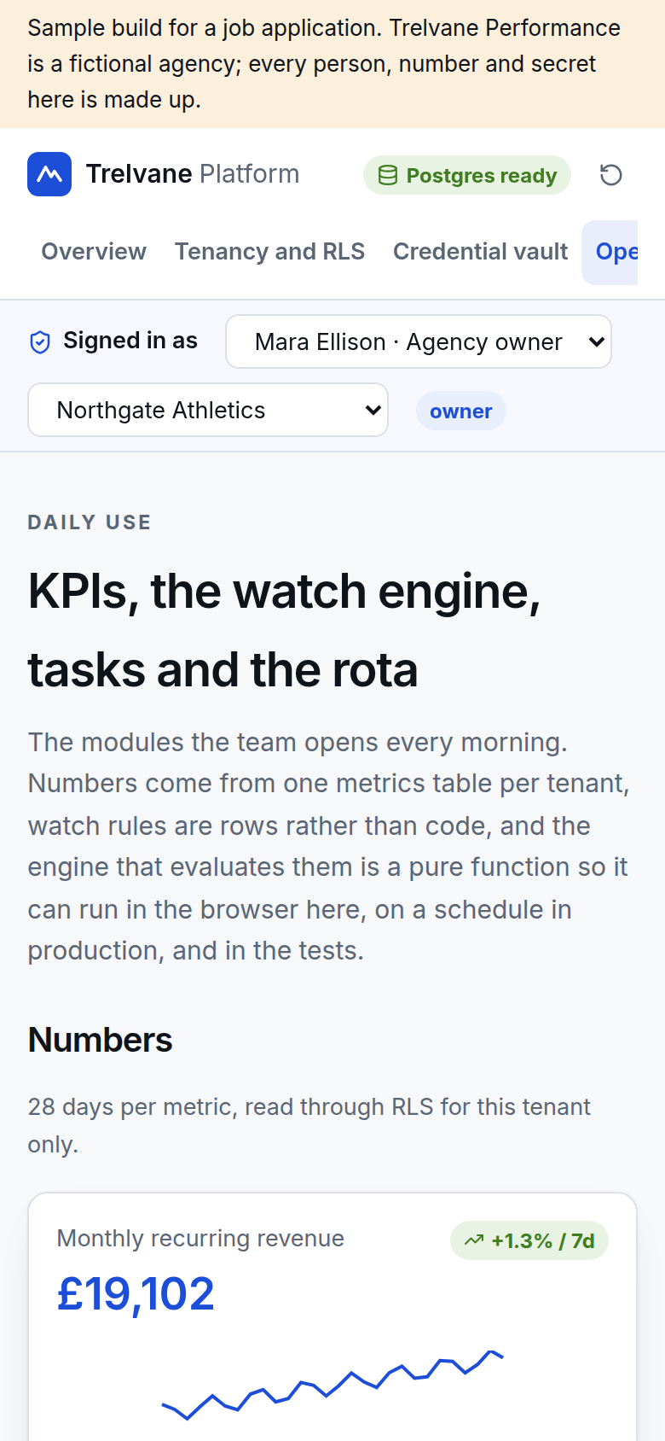
8. MODULES
Tasks, rota and holidays
Raise your own, approve if you may: a coach can request holiday and move their own tasks; approving is an owner or admin policy
Rota is read-only for coaches: they see the week, they do not rewrite it
Cover before approval: the SOP says name the cover first, and the module records who it is
Everything is tenant scoped: a coach working across two tenants sees two rotas, not one merged view
The task board and the rota, with a holiday request awaiting approval
The same board on a phone
Trelvane platform · Multi-tenant SaaS: technical and delivery plan · 20

Slide 21
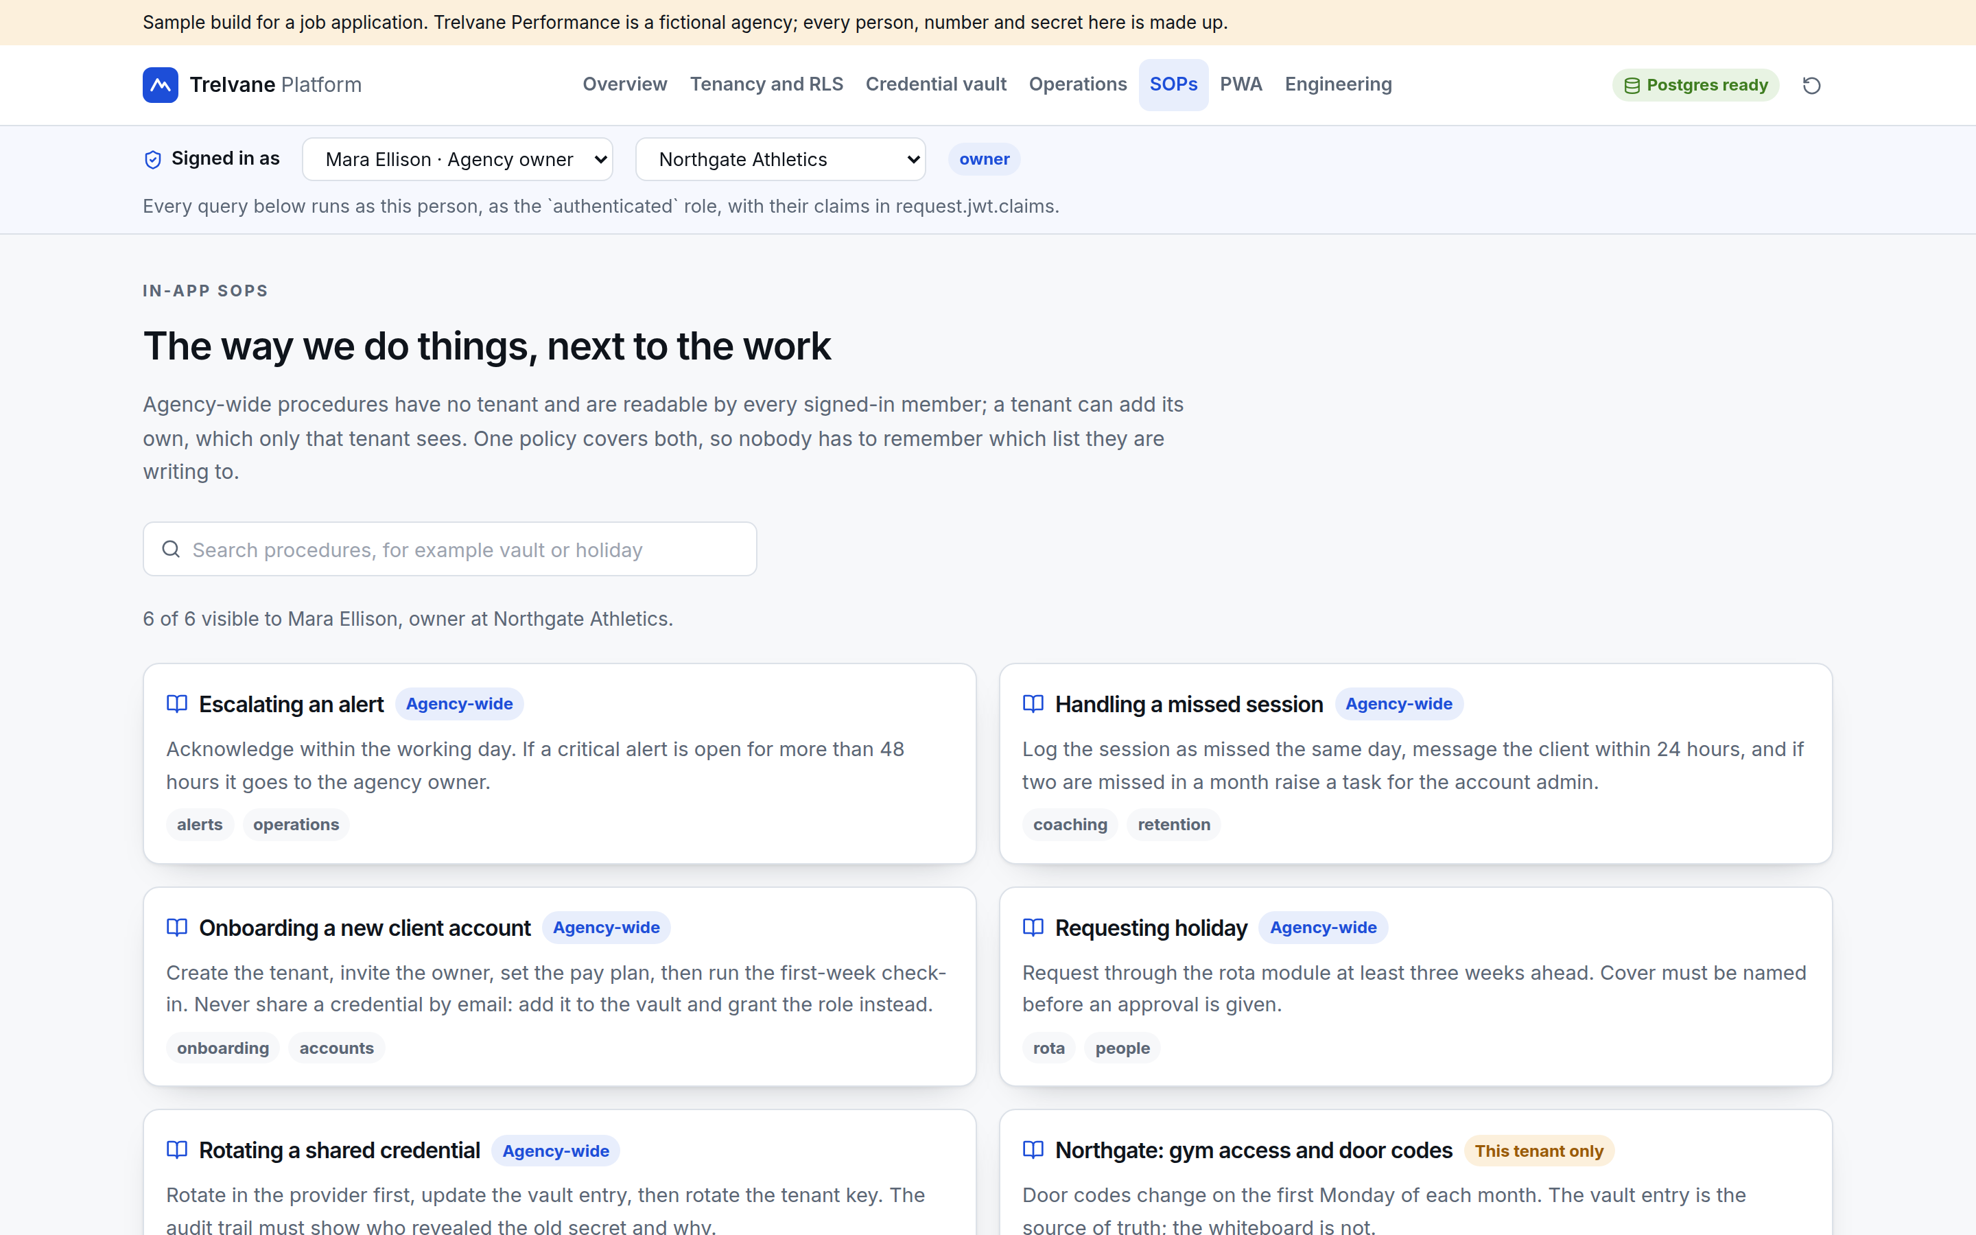
8. MODULES
The SOP repository
One table, one policy: a null tenant means agency-wide, so there is no second code path to forget
Tagged and searchable: gin index on tags, plain text search on title and body
Written where the work is: the escalation SOP is one click from the alert it describes
Versioned later: SOPs change; when they do, the same pattern as plans applies, an immutable version per edit
Agency-wide procedures, plus one that belongs to a single tenant
Trelvane platform · Multi-tenant SaaS: technical and delivery plan · 21

Slide 22
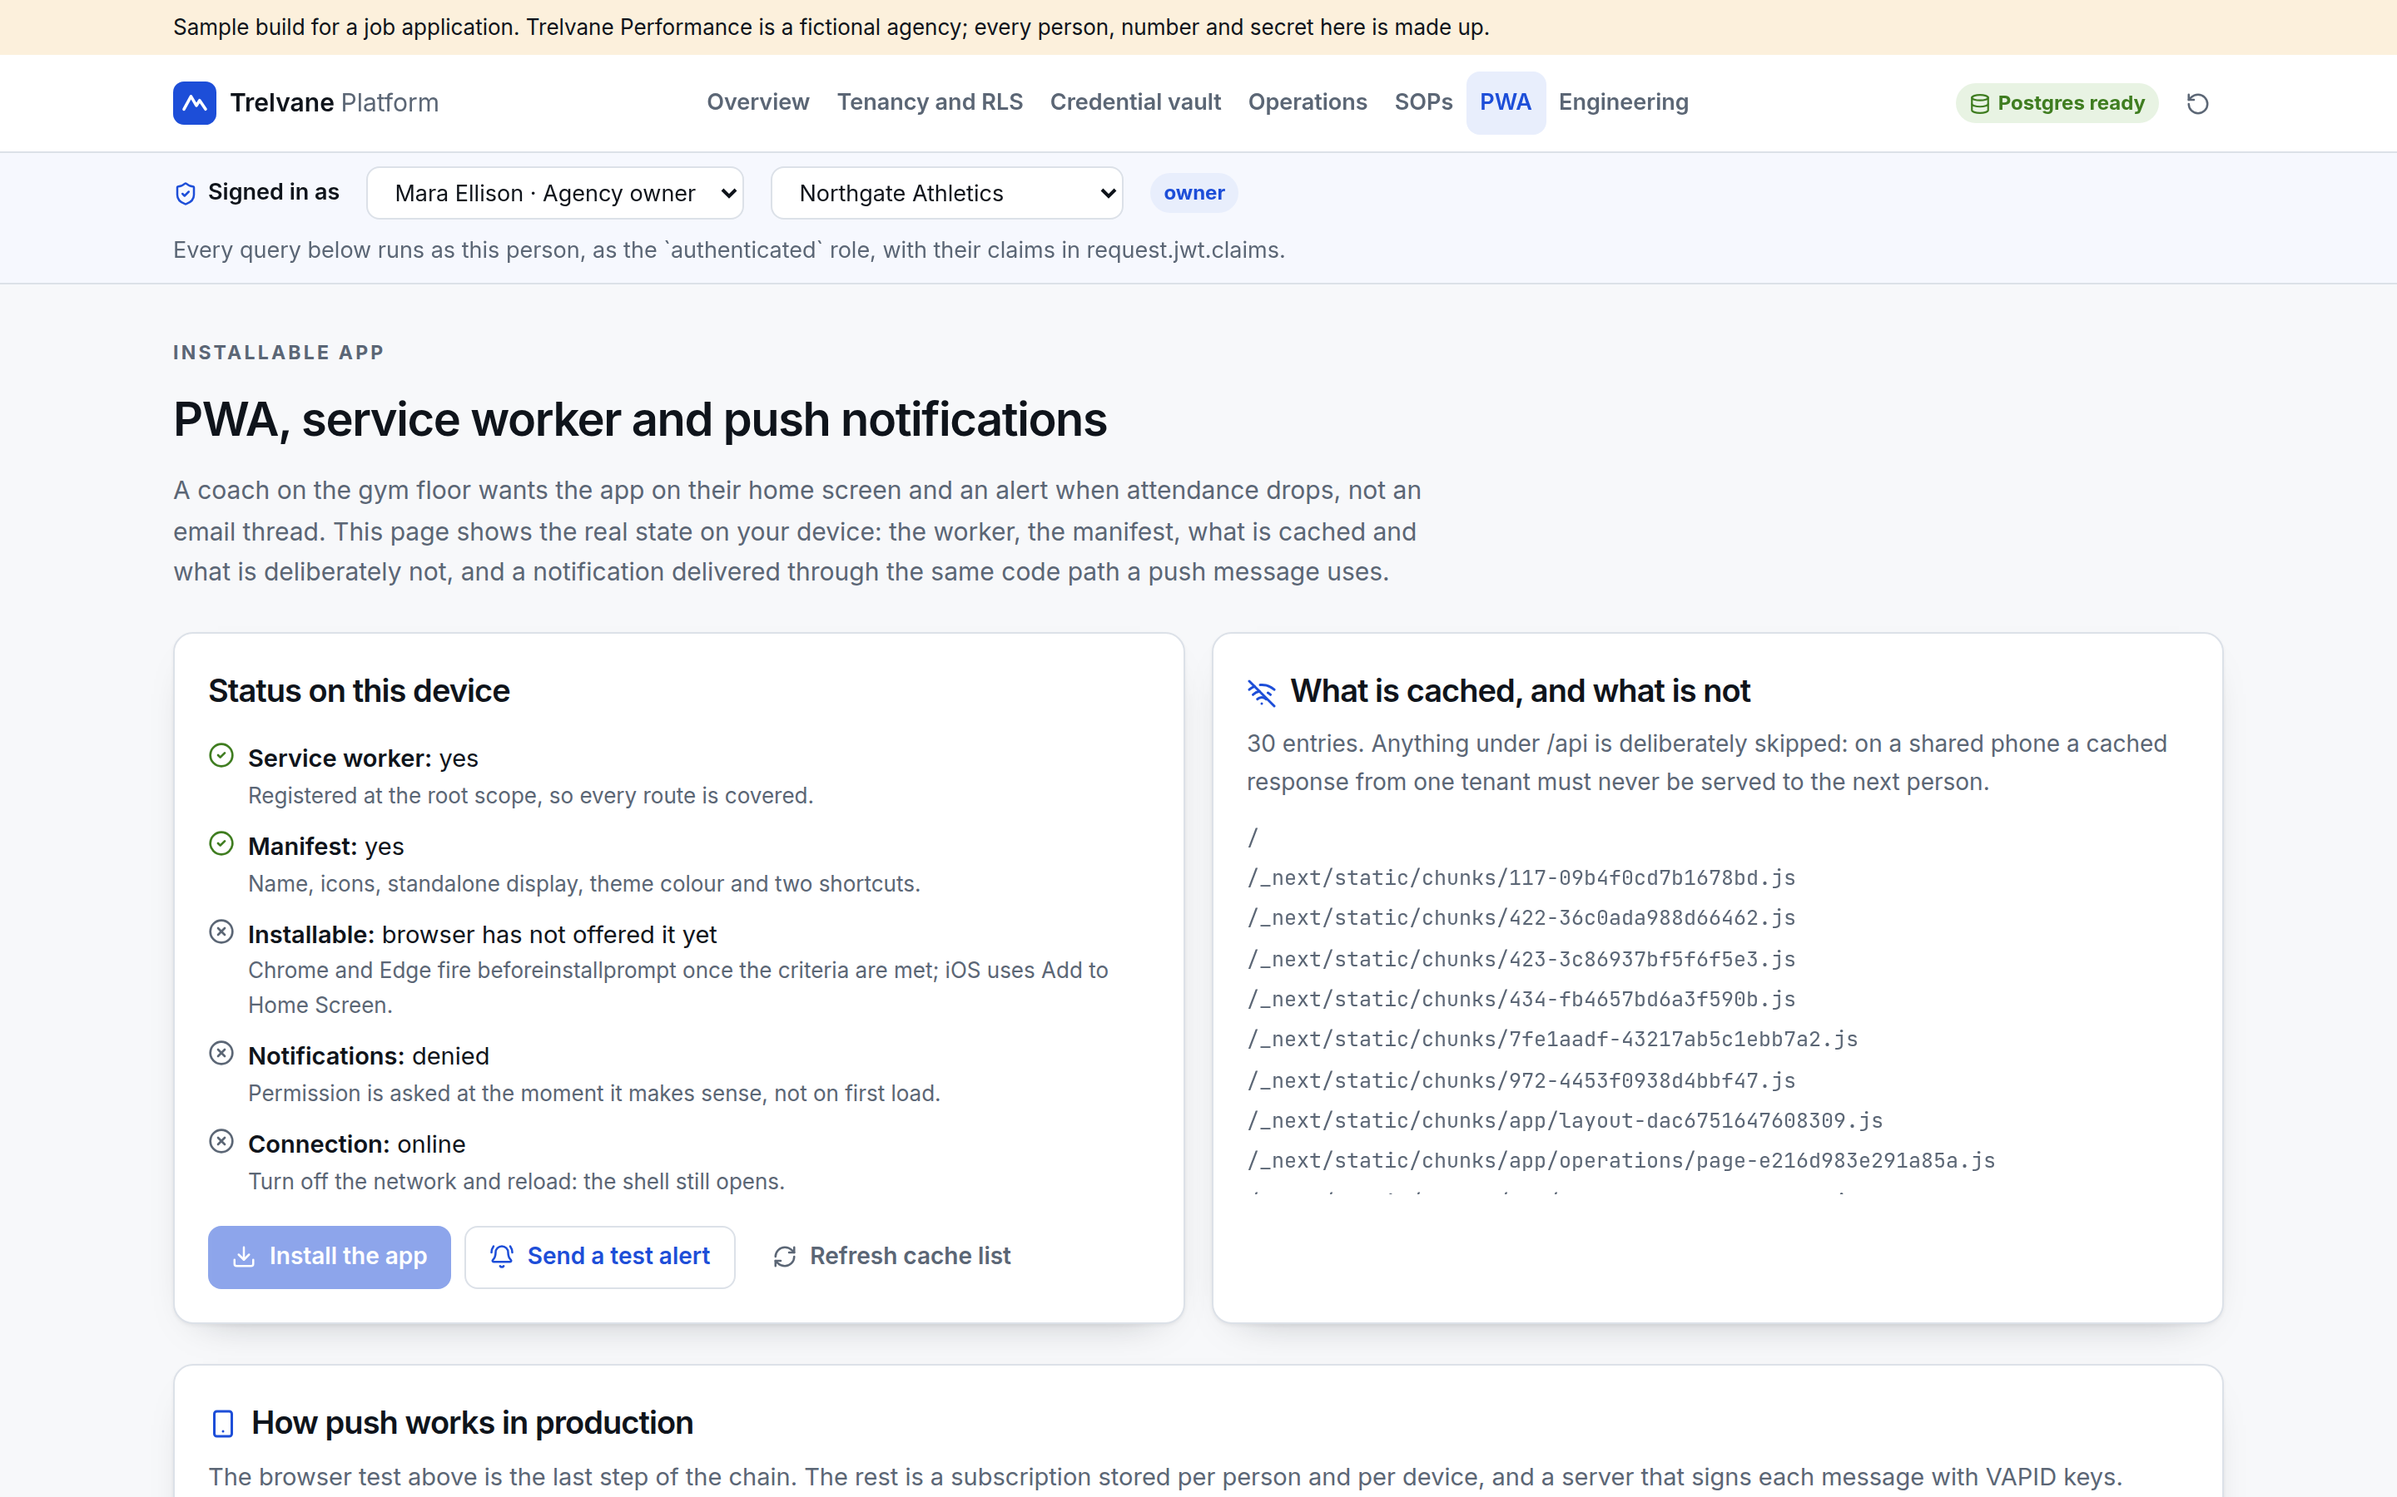
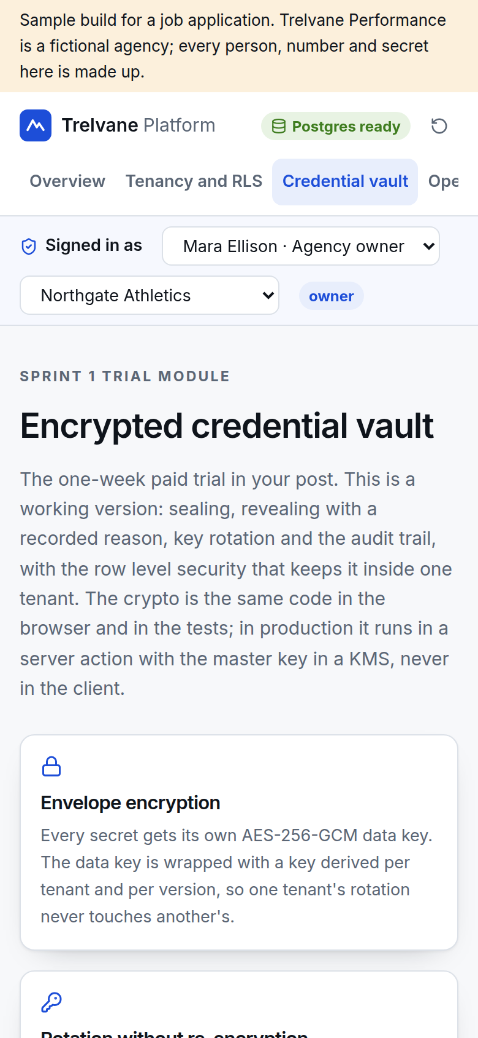
9. PWA
Installable, offline, and careful about what it caches
Shell cached, data not: on a shared phone a cached tenant response must never reach the next person, so /api is skipped
Network first for pages: a signed-in person online always gets fresh data; the cache is the fallback
Versioned cache: old caches are deleted on activate, so a new build cannot serve yesterday's shell
Offline page: the app opens and says what it can and cannot do
Live state on the device: worker, manifest, install, notifications, connection
The vault on a phone
Trelvane platform · Multi-tenant SaaS: technical and delivery plan · 22

Slide 23
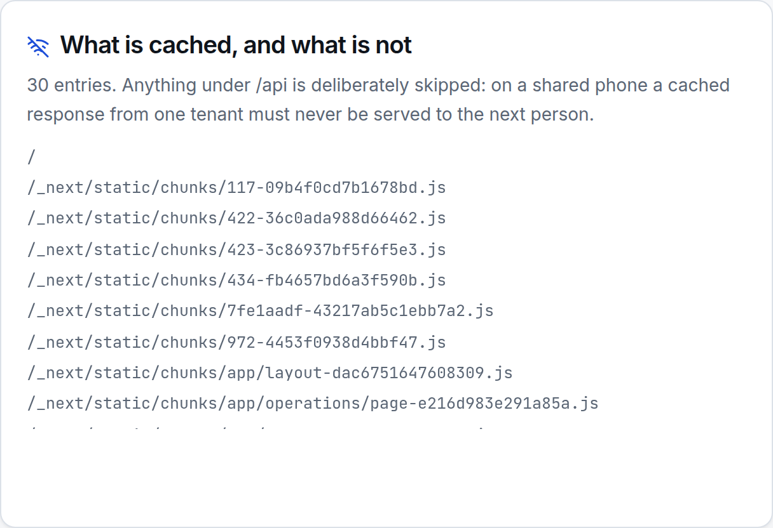
9. PWA
Push notifications, end to end
// once per device, after the person agrees
const sub = await registration.pushManager.subscribe({
userVisibleOnly: true, applicationServerKey: VAPID_PUBLIC_KEY });
await supabase.from("push_subscriptions").insert({ user_id, tenant_id, endpoint: sub.endpoint, keys: sub.toJSON().keys });
// in the scheduled function, when the watch engine raises an alert
const res = await webpush.sendNotification(sub, JSON.stringify({ title, body, url: "/operations", tag: rule_id }));
if (res.statusCode === 404 || res.statusCode === 410) await deleteSubscription(sub.endpoint);
Subscriptions expire: the send path deletes dead endpoints, or the table fills with noise and the send job slows down
iOS needs the install: web push only reaches an installed PWA on iOS 16.4 or later, so installing is part of onboarding
No client detail in the body: the notification names the metric and the tenant; the detail is behind the sign-in
Per person and per device: a coach with a phone and a tablet gets one notification on each, with the same tag
What is cached, and what is deliberately not
Trelvane platform · Multi-tenant SaaS: technical and delivery plan · 23

Slide 24
10. VIDEO ANALYSIS
Gemini video analysis, shaped so a slow model never blocks a request
Upload
signed URL, private bucket
Job row
queued, tenant scoped
Worker
calls Gemini, retries
Validate
schema check before storage
Result
rows a coach can act on
Nothing synchronous: the upload returns immediately; analysis is a job with a status the client can poll or subscribe to
Validated before it is stored: model output is checked against a schema, and a failure is recorded as a failed job rather than saved as data
Cost is visible: each job records duration and token cost per tenant, so the plan tier can be priced on real numbers
Private by default: video lives in a private bucket with short-lived signed URLs, and the model call carries no client names
Fallbacks: if the model is unavailable the job retries with backoff and the coach sees the video with a note, not an error page
Trelvane platform · Multi-tenant SaaS: technical and delivery plan · 24

Slide 25
11. HOW I WORK
Claude Code inside a loop, not instead of one
1. Contract first
2. Small branches
3. A test that fails first
4. Run the real thing
Schema, policies and types before any UI. It fills in shapes that exist; it invents badly.
One module, a plan in the prompt, and a diff I read line by line.
Every generated behaviour gets a test written to fail. The isolation suite exists for this reason.
Local Postgres and a deployed preview. Most mistakes survive a green typecheck and die on first contact.
What I never delegate: policies and auth, money paths, the vault, migrations and cutovers
What it is very good at: filling in a schema-shaped module, test scaffolding, repetitive UI, and reading a large codebase quickly
How much it writes: most of the routine code, none of the decisions, and nothing that reaches production unread
Trelvane platform · Multi-tenant SaaS: technical and delivery plan · 25

Slide 26
11. HOW I WORK
Five mistakes I caught, and how
You asked for this specifically. All five passed a typecheck and looked reasonable in review
What it got wrong | How it was caught
Set an error workflow in the settings that was never published, so failures raised nothing at all | A test that broke the downstream service on purpose and asserted an alert arrived
Treated an HTTP 200 as success when the response body said ok:false | A stand-in API that returned 200 with ok:false in one scenario
Wrote a PDF route that worked locally and returned 500 on the platform because binaries were missing from the bundle | Testing the deployed preview, not only the local build
Applied one module's matching rules to every provider type, so an equipment supplier was marked as not allowing pets | Reading the rendered output rather than the code, then a test for the type guard
Let a deploy create a project named after the folder it ran in | Checking the deployment list straight after the first deploy
The pattern: the model is confident about things it cannot observe, such as whether a config is active, what a third party returns on failure, or what the bundler ships. So anything it cannot observe has to be observed by a test.
Trelvane platform · Multi-tenant SaaS: technical and delivery plan · 26

Slide 27
12. QUALITY
What is tested, and what runs in CI
Suite | Covers | Runs
Isolation | 13 attacks on the policies against a real Postgres built from the migration | Every push, and on the tenancy page
Crypto | Seal, open, rotate, tamper detection, cross-tenant and cross-row separation | Every push
Watch engine | Each comparator, window averages, no repeat alerts while one is open | Every push
Type and build | TypeScript strict with noUncheckedIndexedAccess, production build | Every push
Preview | A deployed preview per pull request, with the smoke checklist | Every pull request
Migrations run in CI: against a scratch database, so a policy change is reviewed like code and cannot silently fail on staging
Seed data is part of the test: three tenants and four roles, because a single-tenant fixture hides exactly the bugs that matter here
What is not covered yet: load testing, and end-to-end browser tests for the modules built in later sprints
Trelvane platform · Multi-tenant SaaS: technical and delivery plan · 27

Slide 28
12. QUALITY
Security and privacy, beyond the policies
Area | What is in place
Secrets | Service role key server side only; the vault master key in a KMS; nothing sensitive in NEXT_PUBLIC_
Headers | Strict CSP, nosniff, referrer policy, permissions policy and HSTS set in next.config, noindex across the demo
Sessions | Supabase Auth with short-lived JWTs; roles resolved per query rather than cached in the client
Audit | Append-only events for the vault, with the actor taken from the JWT and not from the request body
Data on devices | No tenant data in the service worker cache; the PWA holds a session and nothing else
People leaving | One membership row removed ends access everywhere, including anything already cached on their phone after the next request
Personal data | Client records stay in one tenant; exports are a named function with an audit entry, not an ad hoc query
Trelvane platform · Multi-tenant SaaS: technical and delivery plan · 28

Slide 29
13. ONE DECISION
Next.js 14 is fixed in your brief. Here is what that costs
The demo runs on 14.2.35, the newest release in the 14 line, because your post fixes the version. The advisories patched this year, including App Router cache poisoning, a server component denial of service and the image optimiser issues, are fixed in the 15.5 line only. There is no 14.x release carrying them.
Advisory | Fixed in
App Router cache poisoning | 15.5.16
Server component denial of service | 15.5.15 and 15.5.16
Image optimiser denial of service | 15.5.10
Cache-busting collisions | 15.5.16
CSP nonce cross-site scripting | 15.5.16
If you stay on 14: put Cloudflare rules in front of the image optimiser and the cache, and write down the decision and its review date
If you move to 15: nothing in this codebase uses an API that changed, so it is a version bump, a test run and a preview
Either way: the code is written so the choice stays open, and I would not spend sprint time on a rewrite for it
Raised now because it is cheap to decide in sprint one and expensive to discover in sprint five.
Trelvane platform · Multi-tenant SaaS: technical and delivery plan · 29

Slide 30
14. DELIVERY
Five sprints, plus the paid trial week
Stage | Module | Hours
Trial week | Encrypted credential vault | 30
Sprint 1 | Multi-tenant scaffolding and role-based auth | 70
Sprint 2 | Migration of the three live apps | 80
Sprint 3 | Pay plans and coaching workflows | 70
Sprint 4 | KPI dashboard, watch engine, PWA and push | 75
Sprint 5 | Tasks, rota and holidays, SOPs, video analysis | 70
 | Total | 395
395 h
estimated across trial and five sprints
$15,800
at a $40/h planning rate, fixed per sprint once scoped
Fixed price per sprint, agreed from the written scope before the sprint starts. The trial week is priced separately and stands alone, so you can stop after it with a working vault module.
Each sprint ends with the module in use on staging behind a flag, its tests in CI, and a short written handover. A retainer after launch suits me: the same person who built the modules keeps them running.
Trelvane platform · Multi-tenant SaaS: technical and delivery plan · 30

Slide 31
15. RISKS
What could go wrong, and how it is handled
Risk | Likelihood | Mitigation
The three apps disagree about people and tenants | High | Mapping document and a source of truth per entity agreed in sprint 2, before any import
Scope grows inside a fixed-price sprint | Medium | Written scope per sprint; anything new is priced into the next one rather than absorbed
A policy is loosened by accident later | Medium | The isolation suite fails the build; new tables require a policy and a check in the same pull request
Push is unreliable on iOS | Medium | Install is part of onboarding, with email as the fallback channel on rules that matter
Video analysis cost grows quietly | Medium | Cost per job recorded per tenant, with a monthly cap and an alert when it is approached
Staying on Next.js 14 | Medium | Cloudflare mitigations now, and a one-sprint upgrade path kept open
Solo contractor availability | Low | Everything in your repository, tests in CI, written handover per sprint, and no undocumented local setup
Trelvane platform · Multi-tenant SaaS: technical and delivery plan · 31

Slide 32
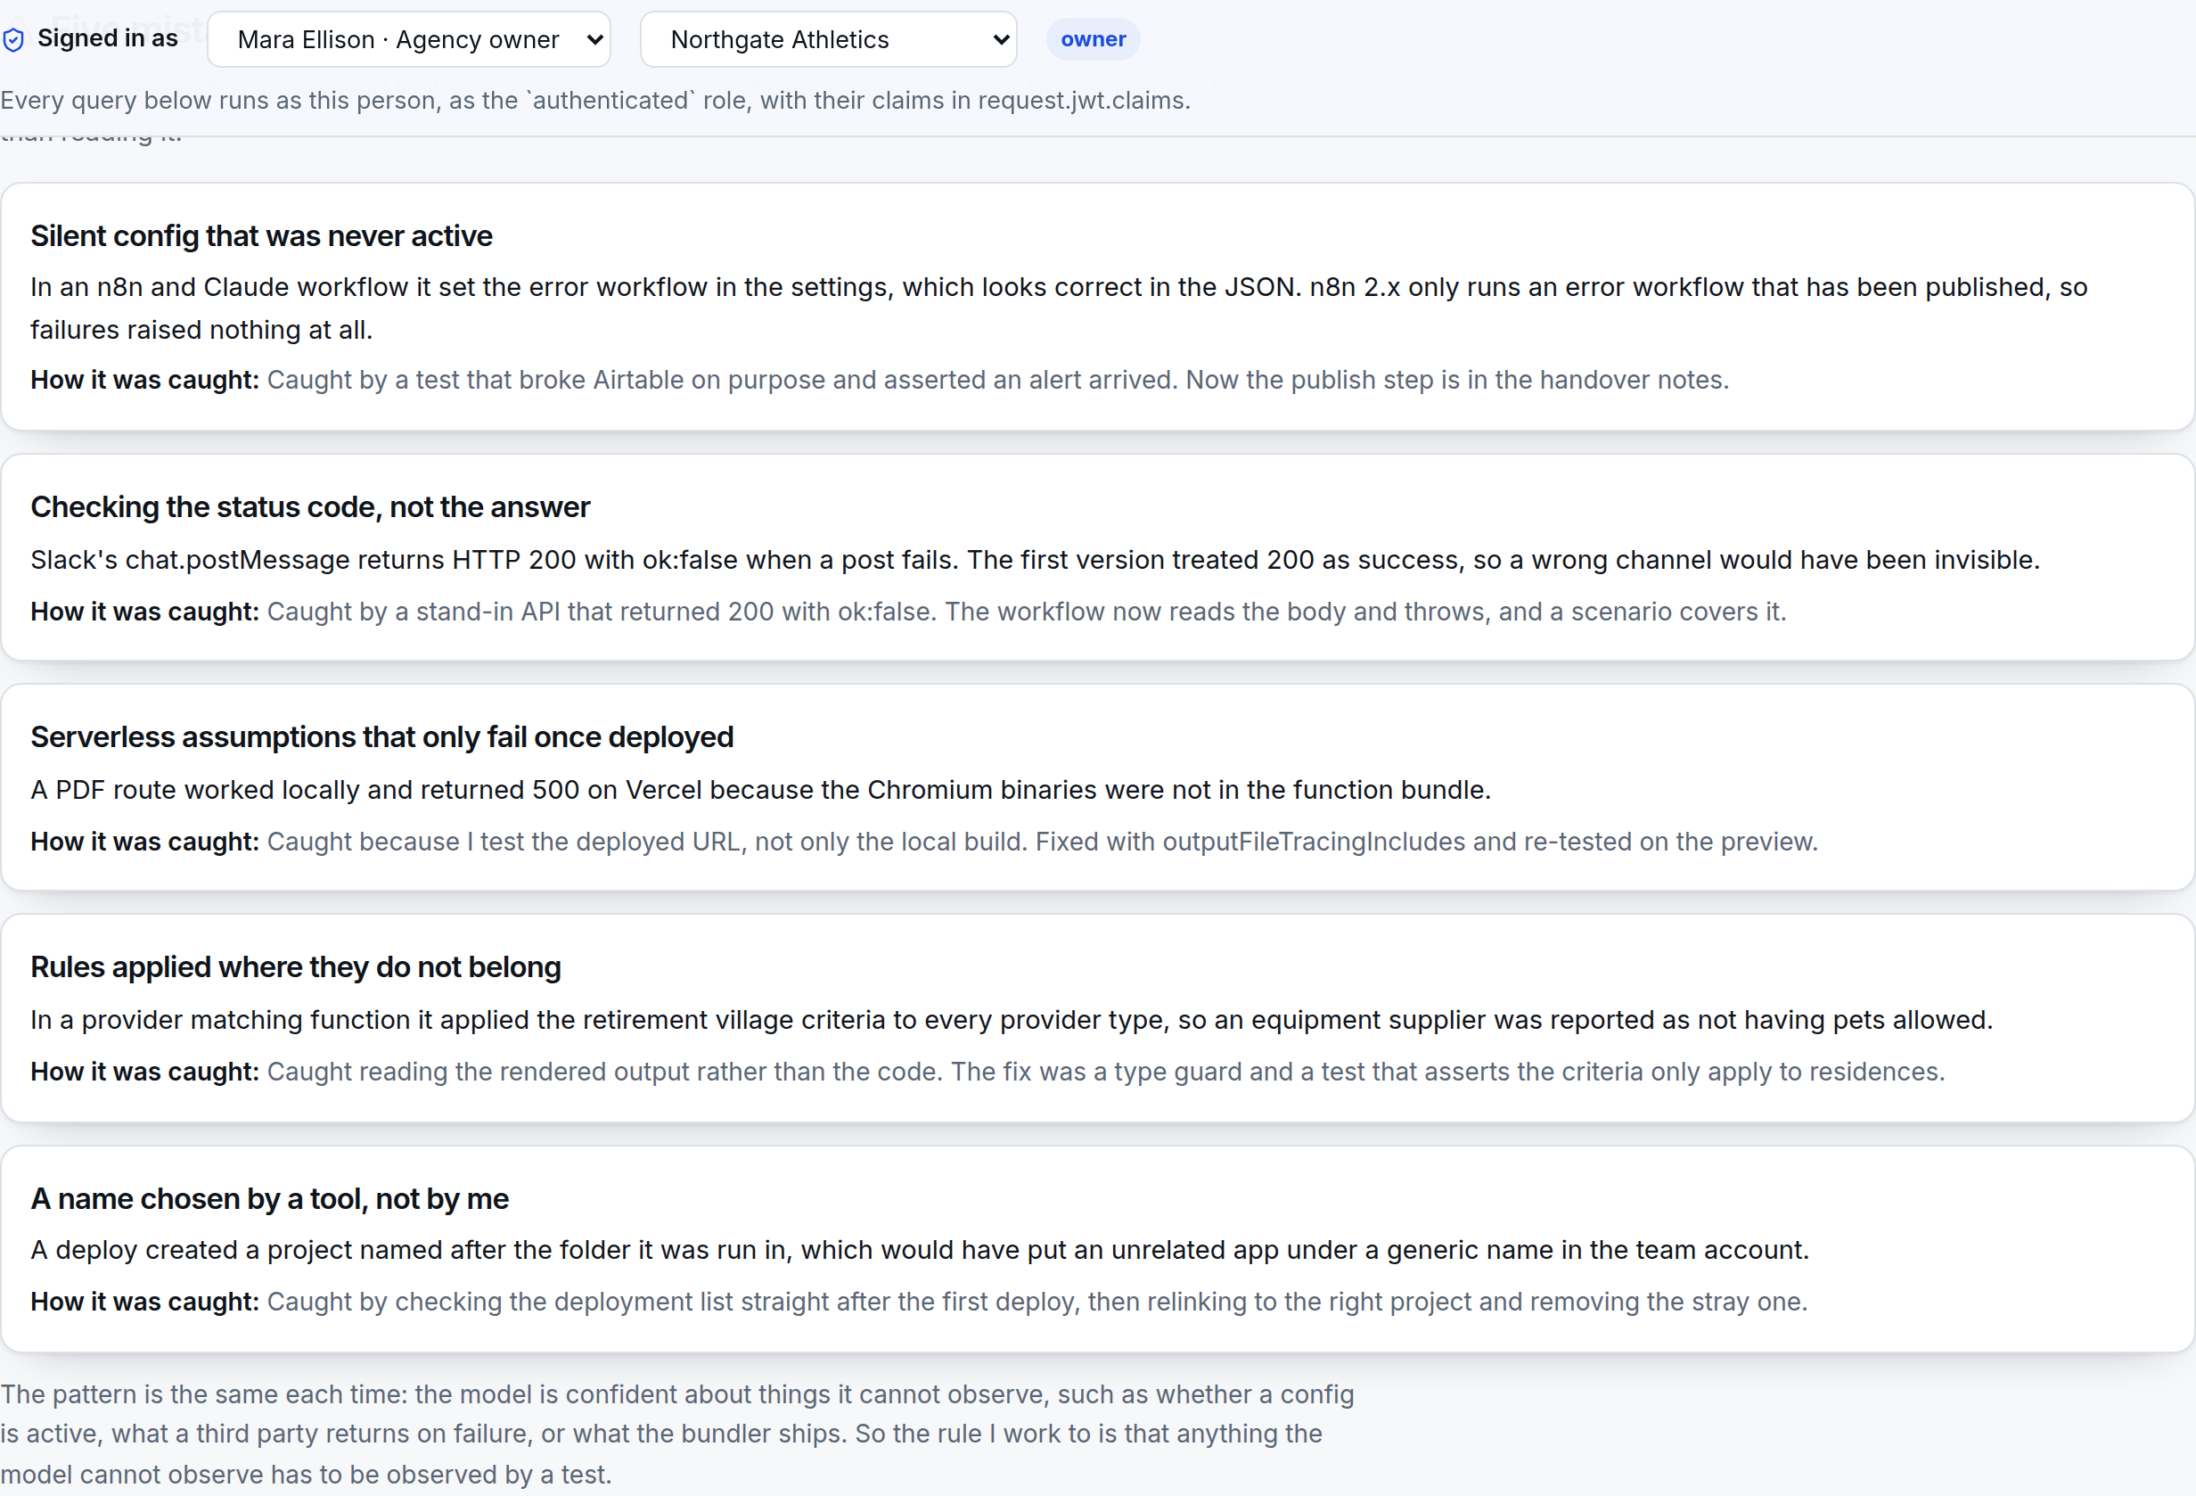
Valdis Licis · Full-stack and platform work
Next step: the brief under NDA, then the trial week
Send the full brief; I will come back with a fixed price per sprint
Tell me which of the three live apps has the messiest data
Confirm the Next.js 14 decision, or plan the upgrade into sprint 1
Give me a Supabase project and a repository for the trial week
Agree what done means for the vault module, in writing
Five mistakes caught, from the engineering page of the demo
Prepared by Valdis Licis

Slide 33
APPENDIX
Sources and notes
Topic | Source
Next.js security advisories and fixed versions | GitHub Advisory Database entries for Next.js, checked 23 September 2026
Row level security, auth.uid() and the three roles | Supabase documentation, Row Level Security and Auth
Postgres in the browser (PGlite) | ElectricSQL PGlite, Postgres 16 compiled to WebAssembly
Web push and VAPID | MDN Push API and Web Push Protocol documentation
Web push on iOS requires an installed PWA | Apple, Web Push for Home Screen web apps (iOS 16.4)
Envelope encryption pattern | AES-GCM key wrapping with WebCrypto; KMS envelope encryption practice
Demo test results | Own runs on 23 September 2026: 17 tests, 13 isolation checks
Hours and price | Planning figures at a $40/h rate, to be agreed and fixed per sprint
Trelvane Performance, its tenants, staff, clients and secrets are fictional and exist only to demonstrate the platform.
Trelvane platform · Multi-tenant SaaS: technical and delivery plan · 33

