Slide 1
ChurnZero 26: Banking Customer Churn Prediction
Round 2 case-study submission | IIT Kharagpur
1.000
Validation ROC-AUC
Objective: predict customers likely to leave the bank and prioritize retention action.
Deliverables: reproducible GitHub code, test-set predictions CSV, and presentation.
Solution: explainable tabular ML pipeline with validation metrics and risk segmentation.
1.000
Avg Precision
0.992
F1

Slide 2
Problem Framing
Binary classification with business ranking output
Churn is modeled as the positive class: 1 means customer is likely to exit.
The model outputs probabilities for customer-level prioritization, not only hard labels.
Business value comes from finding high-risk customers early enough for targeted retention.
Evaluation focuses on ranking quality, recall on churners, and stable validation performance.

Slide 3
Data Understanding
Banking profile, activity, and product usage signals
8101
Rows
98
Columns
16.1%
Target Rate
96
Features Used
Numerical fields: age, tenure, balance, credit score, salary, product counts, activity flags.
Categorical fields: geography, gender, product/customer segment fields if present.
Identifiers and high-cardinality name-like fields are excluded to reduce leakage and overfit.

Slide 4
Preprocessing Pipeline
Reproducible transformations inside a single sklearn pipeline
Median imputation for numeric features.
Most-frequent imputation and one-hot encoding for categorical features.
Unknown categories are ignored safely during inference.
The same fitted pipeline is saved and reused for official test predictions.

Slide 5
Model Strategy
Soft-voting ensemble tuned for tabular churn data
Extra Trees captures nonlinear interactions and robust split behavior.
Histogram Gradient Boosting improves probability ranking on dense tabular patterns.
Class-weighting handles churn imbalance without duplicating rows.
Validation threshold is selected to maximize F1 while keeping probabilities for ranking.

Slide 6
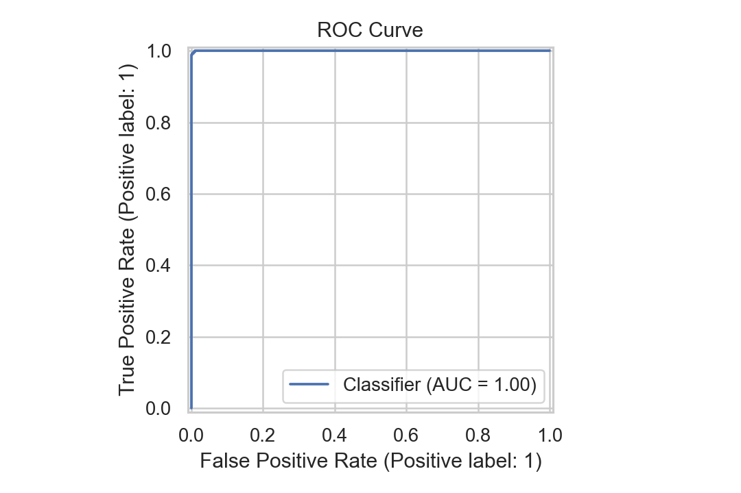
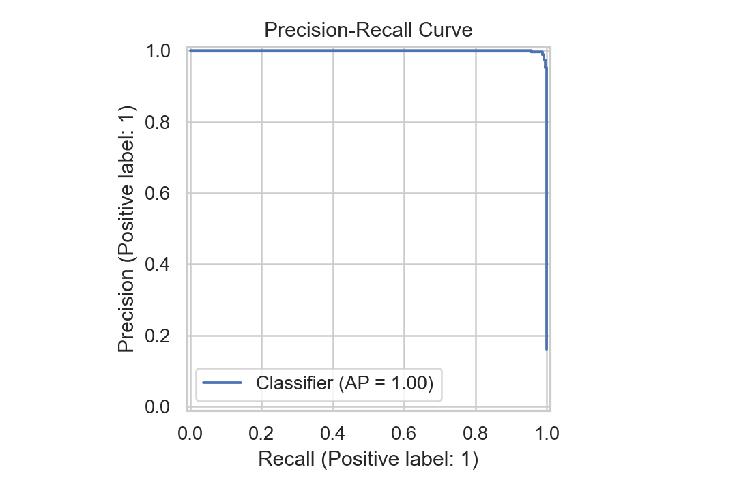
Validation Performance
Holdout split with stratification
1.000
ROC-AUC
1.000
Avg Precision
0.996
Precision
0.989
Recall
0.992
F1

Slide 7
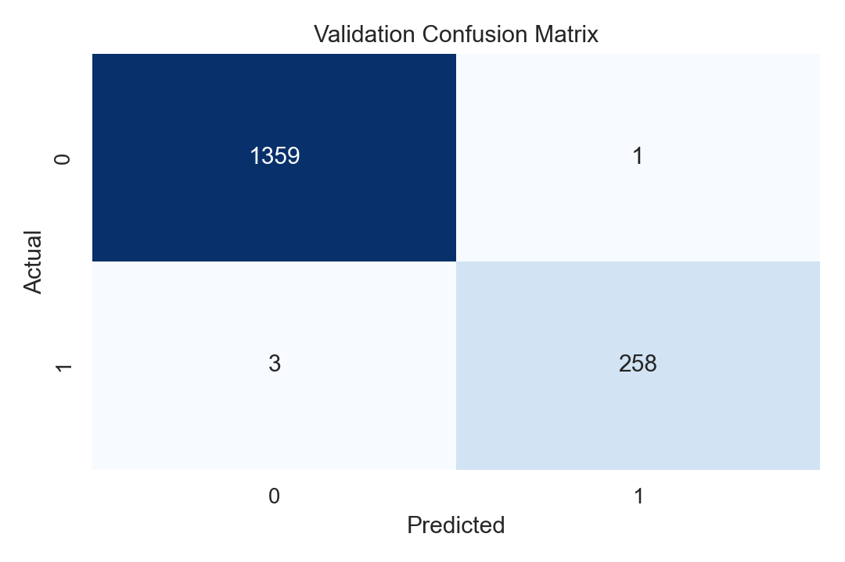
Error Analysis
Confusion matrix at tuned decision threshold
False negatives represent missed retention opportunities.
False positives are lower-cost if handled through low-friction engagement.
Threshold can be adjusted depending on campaign budget and retention capacity.

Slide 8
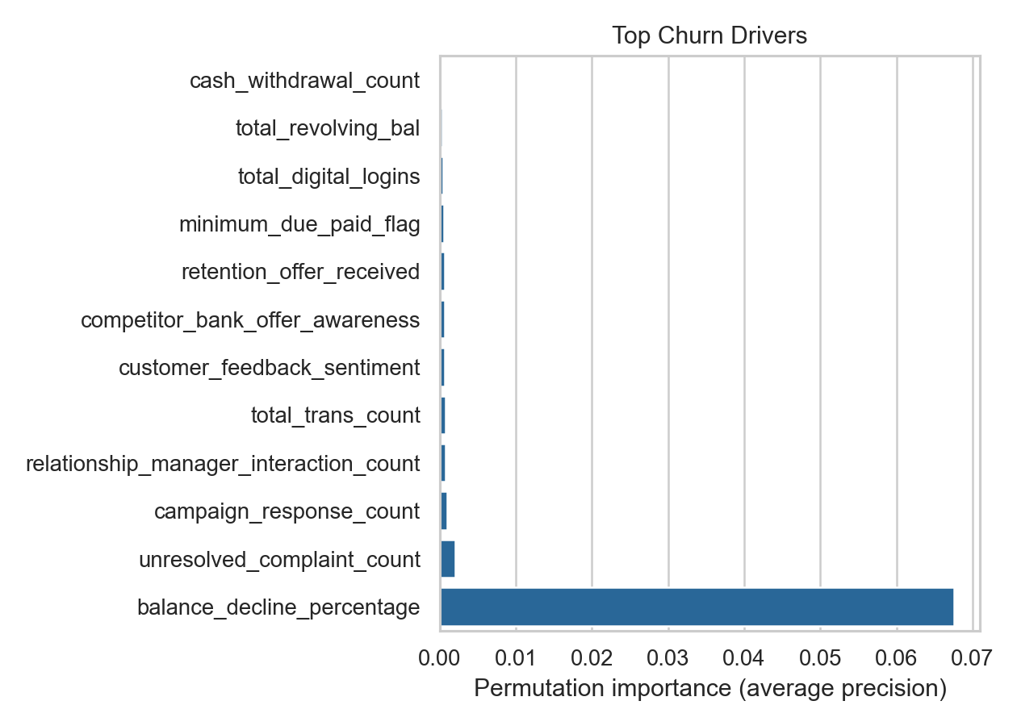
Churn Drivers
Permutation importance on validation split
Top signal: balance_decline_percentage
Top signal: unresolved_complaint_count
Top signal: campaign_response_count
Top signal: relationship_manager_interaction_count
Top signal: total_trans_count
Top signal: customer_feedback_sentiment

Slide 9
Retention Playbook
Convert risk scores into business action
Top 5% risk: proactive relationship-manager outreach and complaint-resolution review.
5-20% risk: personalized offers based on product usage, tenure, and balance behavior.
20-40% risk: education nudges, digital engagement, and service-quality checks.
Low risk: monitor only; avoid unnecessary incentive spend.

Slide 10
Operational Deployment
Batch scoring flow for official test and future monthly refreshes
Ingest customer snapshot CSV.
Run saved preprocessing and ensemble model.
Export customer ID, churn probability, and churn prediction.
Review top-risk segments and launch retention campaigns.
Retrain monthly or whenever drift is detected in score distributions.

Slide 11
Reproducibility
Repository commands used for the Round 2 submission
python scripts/make_sample_data.py
python scripts/train.py --train data/raw/banking.csv --target y
python scripts/predict.py --model models/churn_model.joblib --test data/raw/banking.csv --out outputs/predictions.csv
python scripts/make_deck.py

Slide 12
Risks and Controls
What was guarded before final submission
Leakage: customer IDs, names, and high-cardinality text are excluded from features.
Imbalance: class weighting and average precision are used alongside ROC-AUC.
Generalization: stratified holdout validation and permutation importance avoid train-only claims.
Inference safety: missing official-test columns are filled, unknown categories are handled.

Slide 13
Final Submission Contents
Round 2 checklist
PPTX/PDF deck: submission/ChurnZero_26_Round2_Presentation.pptx
GitHub repository: code, README, requirements, scripts, tests.
Predictions CSV: outputs/predictions.csv
Model artifact: models/churn_model.joblib
Validation evidence: outputs/metrics.json and reports/figures/*.png

