Slide 1

Your Smart School Companion
One app for the whole school — plus a personal AI tutor in five languages.

Slide 2

THE PROBLEM
School life is scattered across a dozen tools.
— Parents miss everything grades & notices lost in WhatsApp groups and paper notes
— Teachers drown in admin attendance, grading and messaging in separate apps
— No tutoring for most kids private tutors cost ₪150+/hour
— Nothing speaks their language few tools support Arabic, Hebrew, Russian & French

Slide 3
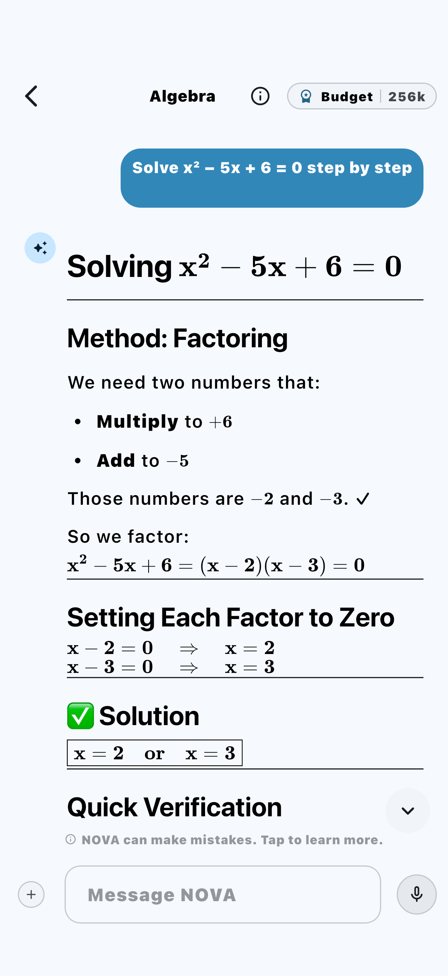
MEET NOVA
A personal AI tutor for every student.
— Explains, never just answers step-by-step, like a real tutor
— Perfect math rendering real equations, not plain text
— Five languages ask in Arabic, get help in Arabic
— Safe & scoped education-only, with guardrails

Slide 4
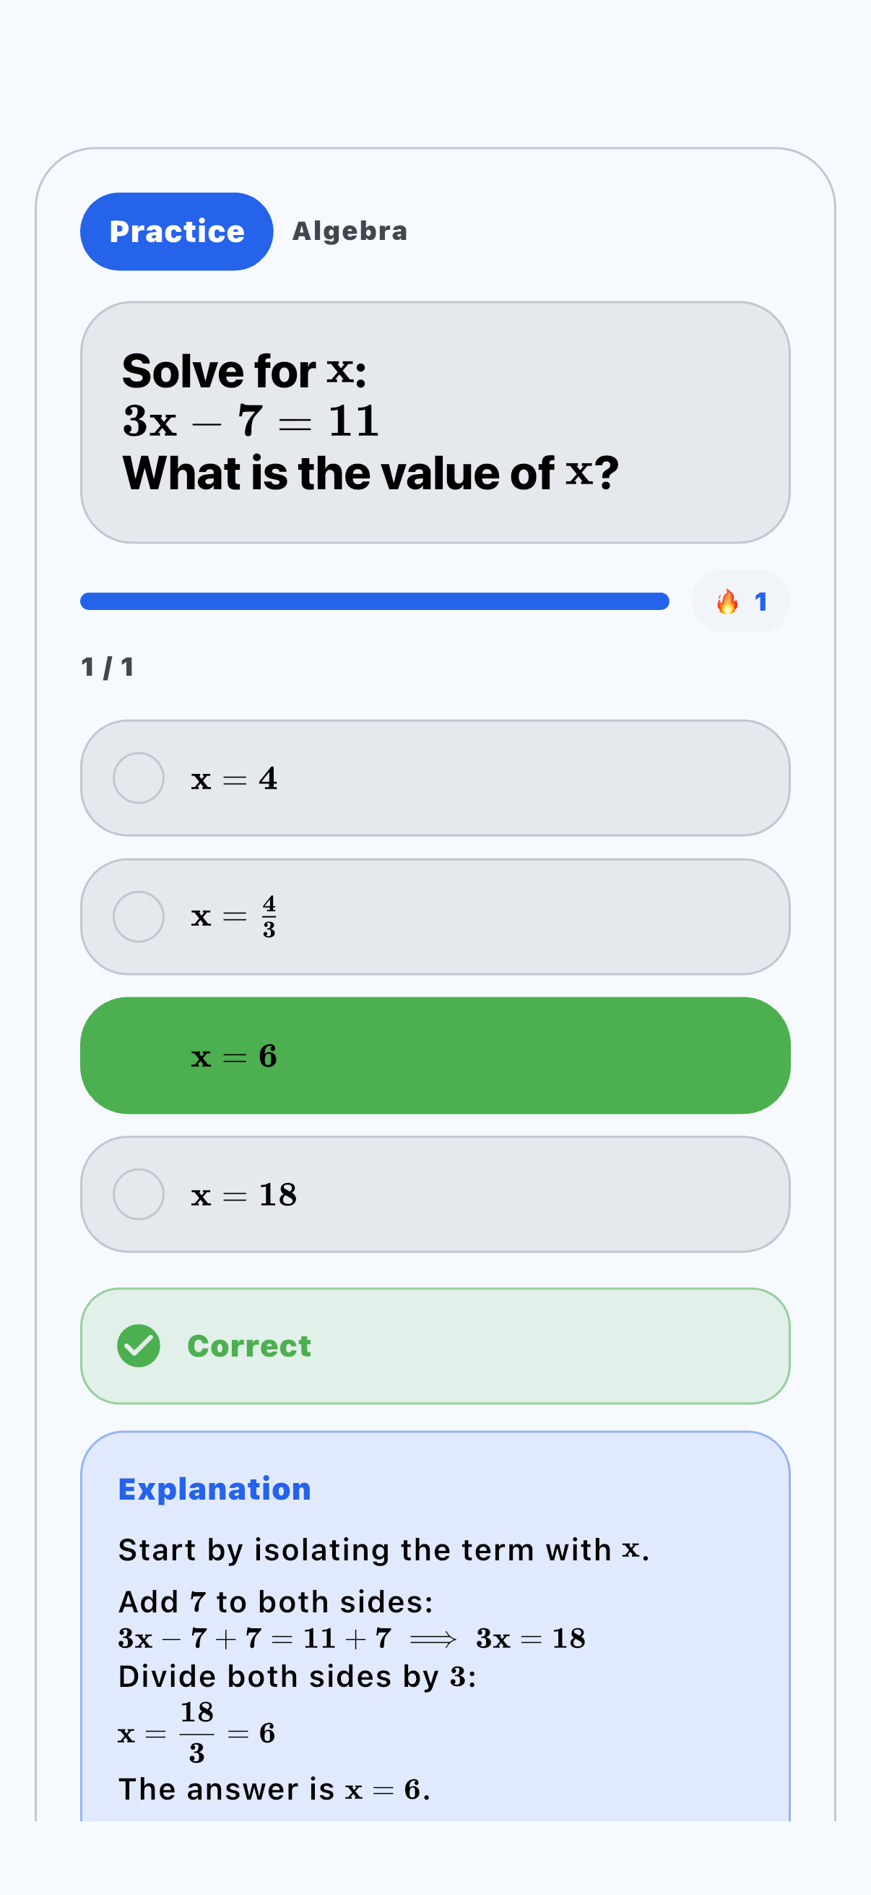
PRACTICE
Master any topic, one question at a time.
— Adaptive questions generated for each student
— Instant feedback with full worked explanations
— Every subject math, sciences, languages & more
— Builds streaks keeps students coming back

Slide 5
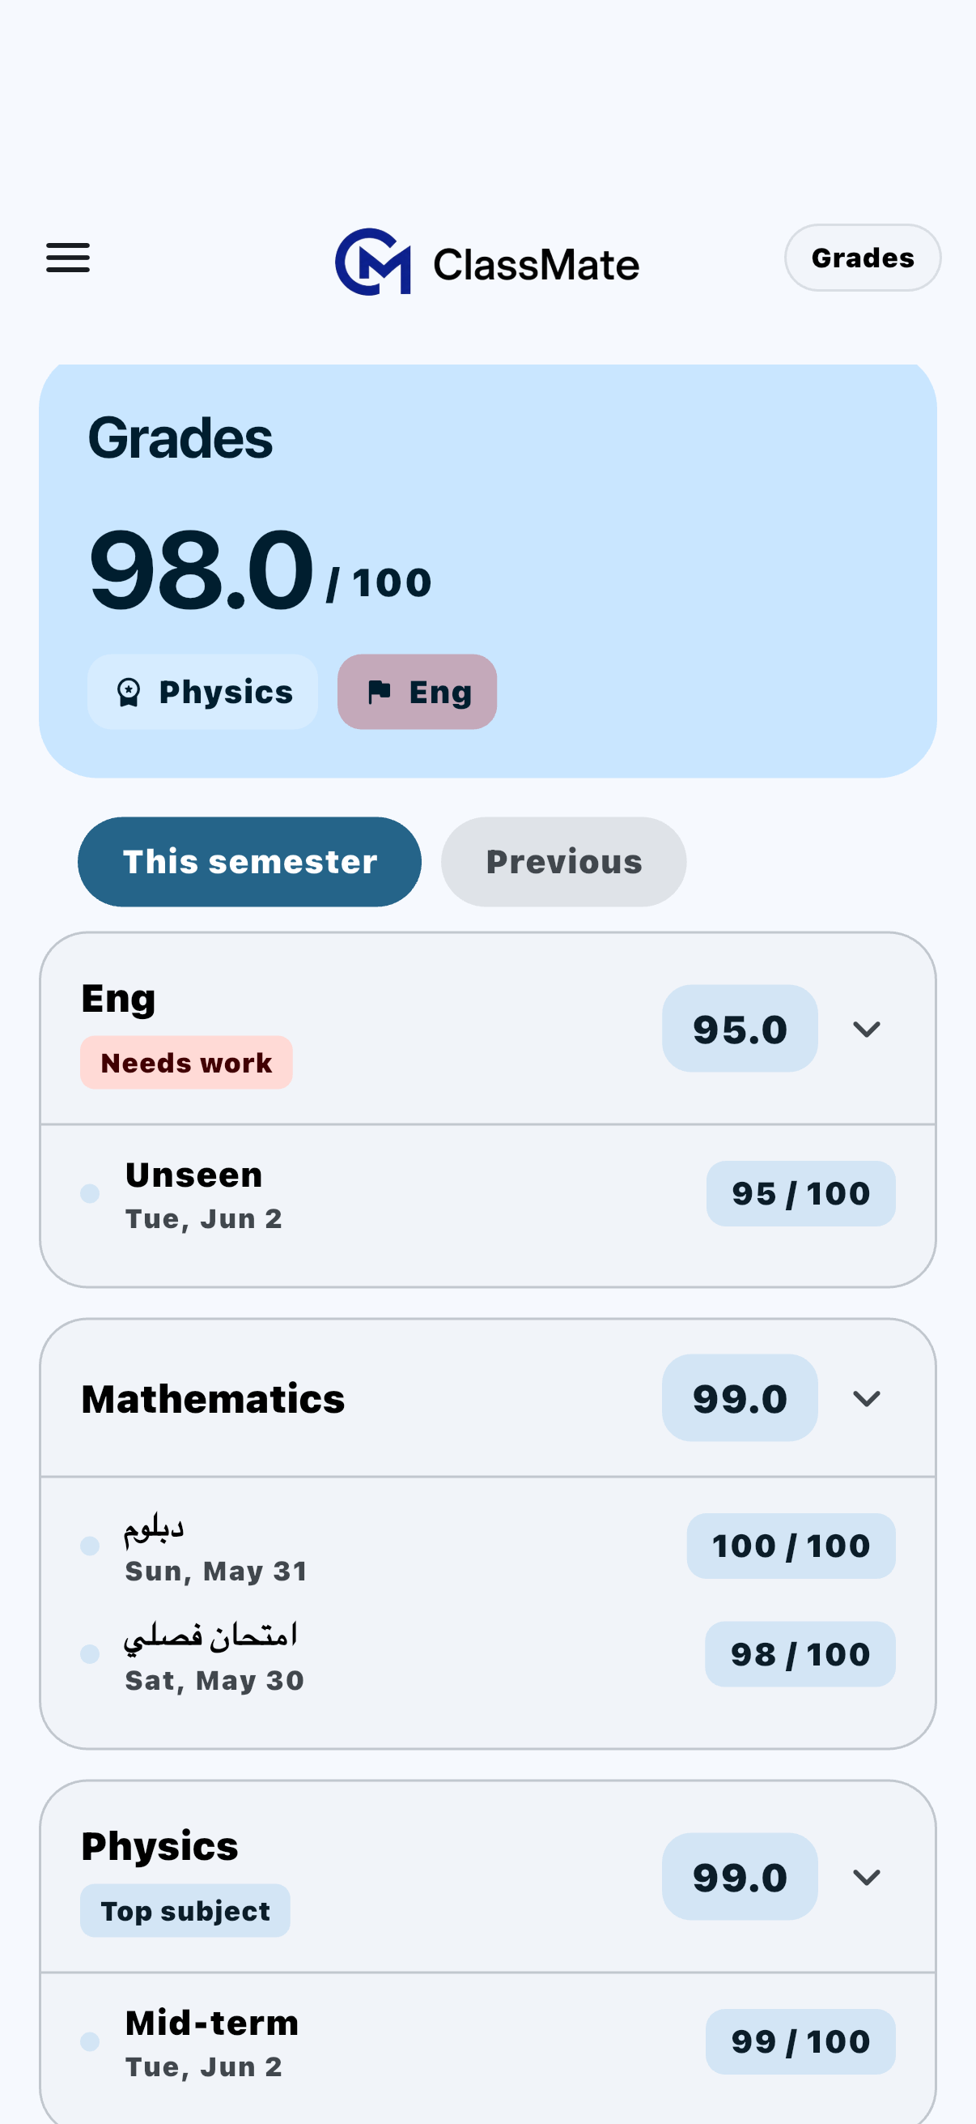
GRADES & SEMESTERS
Live results, organised by semester.
— Every grade in real time the moment a teacher posts it
— This-semester / previous one tap to switch
— Smart highlights “Top subject”, “Needs work”
— Fully multilingual exams shown in Arabic, Hebrew & more
↑ Real exam names in Arabic — native, not translated labels.

Slide 6
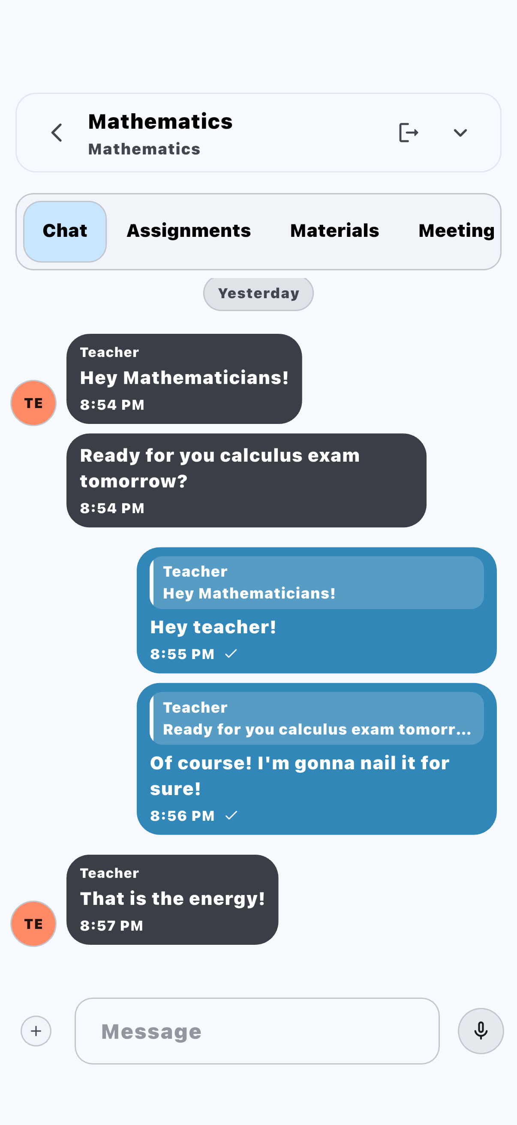
COMMUNICATION
Teachers, parents and students — connected.
— Class & direct chats secure and in-app
— Read receipts know it was seen
— Assignments & materials shared in the same thread
— No more lost notes every parent reached

Slide 7
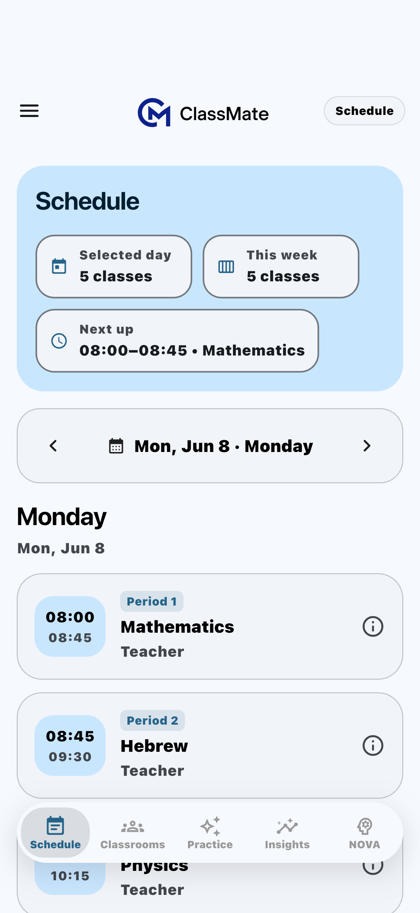
SCHEDULE
The whole week, beautifully clear.
— Periods, times & rooms at a glance
— “Next up” at a tap never miss a class
— Per-day & per-week views switch instantly
— Built for every role students, teachers, admins

Slide 8
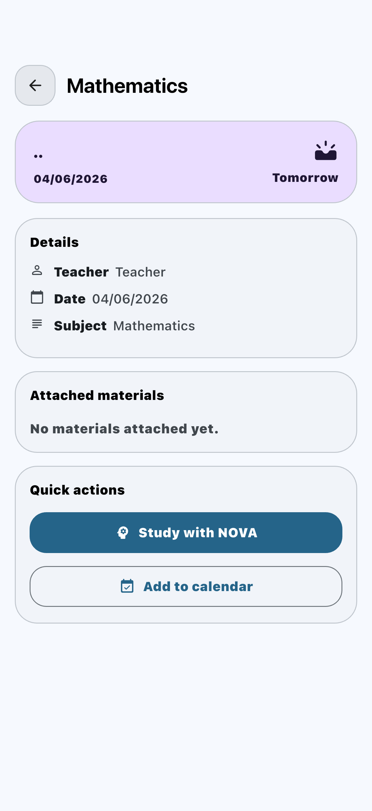
EXAM PREP
Every exam comes with a study plan.
— See what's coming scheduled exams, front and centre
— “Study with NOVA” revise the exact topic in one tap
— Add to calendar never get caught off guard
— Materials attached everything in one place
A scheduled exam — with NOVA revision built right in.

Slide 9
BUILT FOR EVERY FAMILY
Fully native in five languages.
Aa
ع
א
Éé
Я
English
العربية
עברית
Français
Русский
Every screen, every role — full right-to-left for Arabic & Hebrew.

Slide 10
WHY CLASSMATE WINS
Not just another school portal.
An actual AI tutor
True five-language support
everyone else gives a portal; we give a tutor
Arabic + Hebrew RTL, underserved everywhere
Branded to your school
Safe & private by design
your logo & name — it feels like your app
scoped AI, role-based access, your data stays yours
Premium on every device
One app, not ten
phone, tablet & web — feels native
replaces the patchwork you use today

Slide 11
SIMPLE, FAIR PRICING
Less than a coffee — per student, per year.
₪10
per student / month
or ₪100/year — 2 months free
Whole platform + NOVA included. Free single-grade pilot to start.

Slide 12
Give every student a smarter school.
Let's set up your free pilot.
Tony Aboud • tony@classmateapp.org • classmateapp.org

