Slide 1

Capstone Presentation
Sentiment Analysis for Amazon Reviews Using NLP
Michael Koffie

Slide 2

Executive Summary
• Built an NLP sentiment classification pipeline
• Preprocessed and vectorized text using TF-IDF
• Evaluated multiple ML models
• Best model: Logistic Regression + SMOTE
• Enables automated monitoring of customer sentiment

Slide 3
Business Problem
Amazon hosts millions of product reviews—manual analysis is impractical.
Negative reviews often highlight key product quality or customer experience issues.
The business needs an automated sentiment classification system to quickly extract insights and support data-driven decisions.

Slide 4

Dataset Overview
Source: Kaggle Amazon Reviews
90% positive, 10% negative (imbalanced)
Features: review text, ratings, metadata

Slide 5
NLP & Preprocessing Workflow
Text cleaning
Tokenization
Lemmatization
Stopword removal
TF-IDF (1–2 grams)

Slide 6
Handling Class Imbalance (SMOTE)
• Positive reviews dominate the dataset
• SMOTE generates synthetic samples for minority classes
• Helps model learn negative sentiment patterns

Slide 7
Models Evaluated
• Logistic Regression (Balanced)
• Logistic Regression + SMOTE
• Linear SVM (Balanced)
• Random Forest (and tuned version)
• Naïve Bayes

Slide 8
Model Performance Comparison
Model | Accuracy | Macro F1 | Notes
LogReg + SMOTE | 0.926 | 0.583 | ⭐ Best balance
SVM (Balanced) | 0.936 | 0.549 | High accuracy but imbalanced
LogReg (Balanced) | 0.919 | 0.582 | Still weaker on recall_macro
RF (Tuned) | 0.925 | 0.508 | Poor minority-class recall
NB | 0.905 | 0.317 | Weak for bigram features

Slide 9
Final Model Choice
Selected Model: Logistic Regression + SMOTE
Why?
Best macro F1
Best minority-class detection
Interpretable coefficients
Fast & scalable

Slide 10
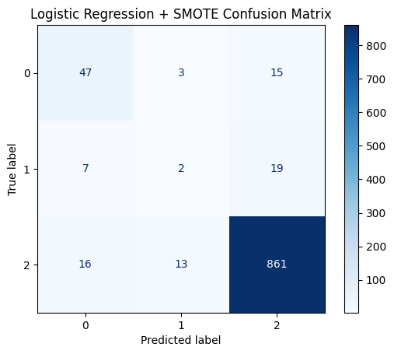
Confusion Matrix
Overall, the confusion matrix confirms that Logistic Regression with SMOTE provides more balanced and fair performance across classes.

Slide 11
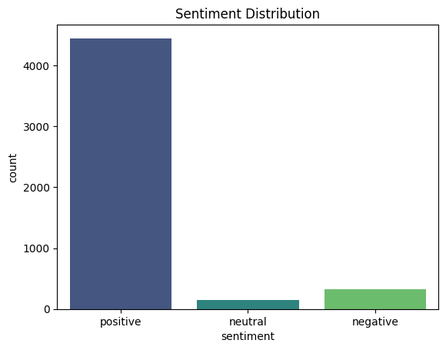
Sentiment Distribution
Highlights the imbalance across sentiment categories.

Slide 12
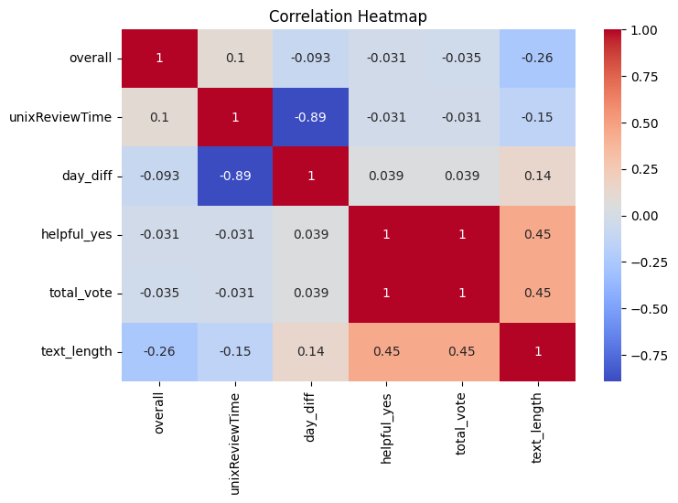
Correlation Heatmap
Shows relationships between engineered numeric features.

Slide 13
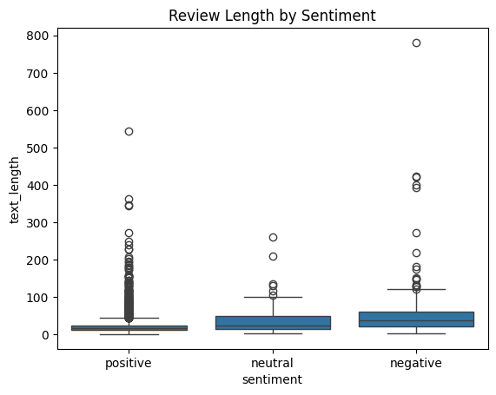
Review Length by Sentiment
Longer reviews tend to be more negative, while shorter ones lean positive

Slide 14
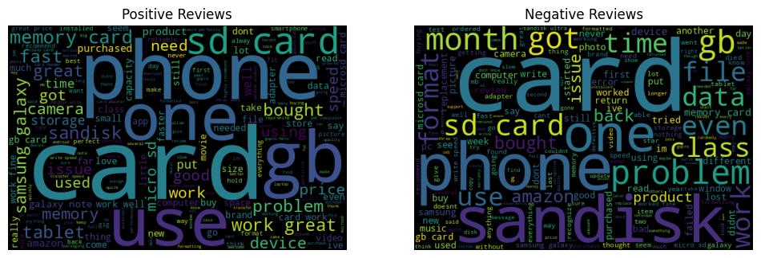
Word Cloud

Slide 15
Key Insights
Dataset heavily imbalanced toward positive sentiment
Negative reviews often short and urgent
LR + SMOTE offered best balanced performance
Text length correlates with 'helpful' votes

Slide 16
Business Recommendations
1. Implement automated review monitoring
2. Investigate recurring negative-review terms for product improvement
3. Route potential negative experiences to support teams quickly

Slide 17
Future Work
• Add neutral-sentiment model
• Explore transformer models like BERT
• Perform topic modeling to uncover product defect themes
• Deploy system as a real-time REST API

Slide 18

Thank You / Q&A
Questions and discussion

