Slide 1
RETAIL SALES PERFORMANCE
Generated June 06, 2025

Slide 2
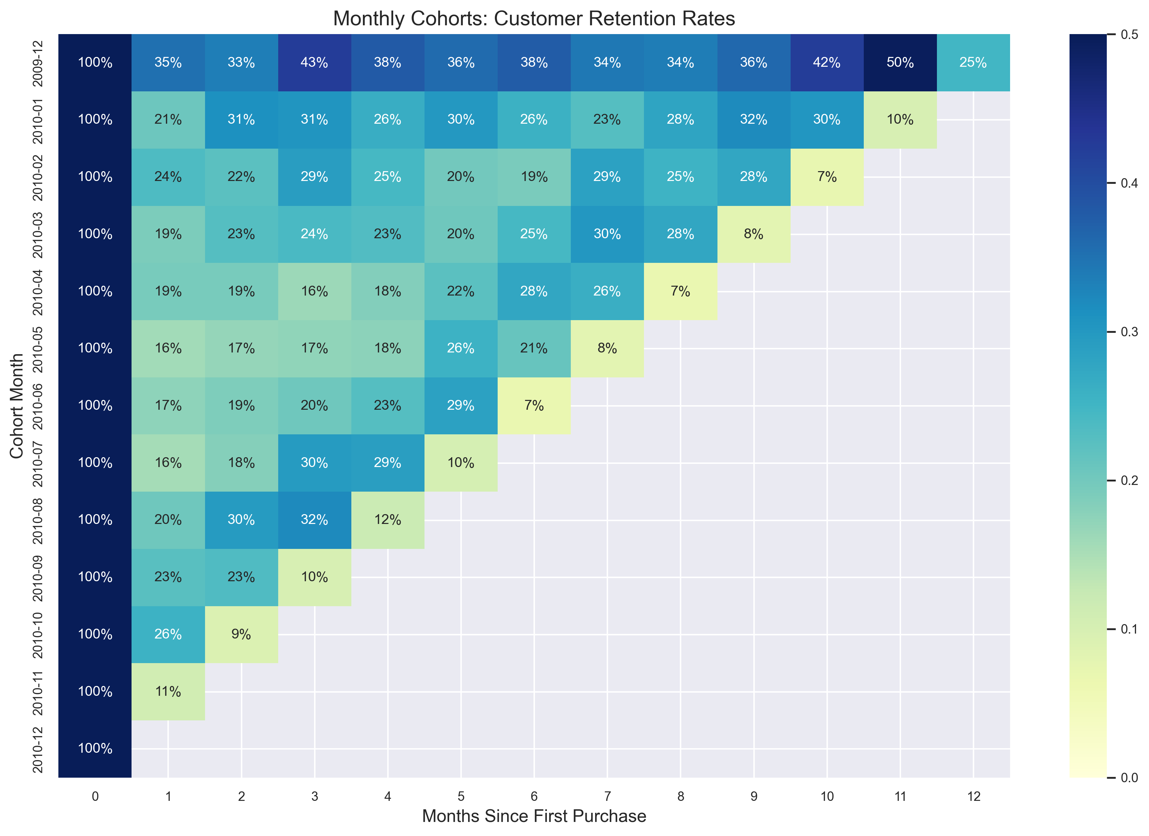
Customer Retention Analysis
Monthly cohort retention rates showing customer loyalty trends

Slide 3
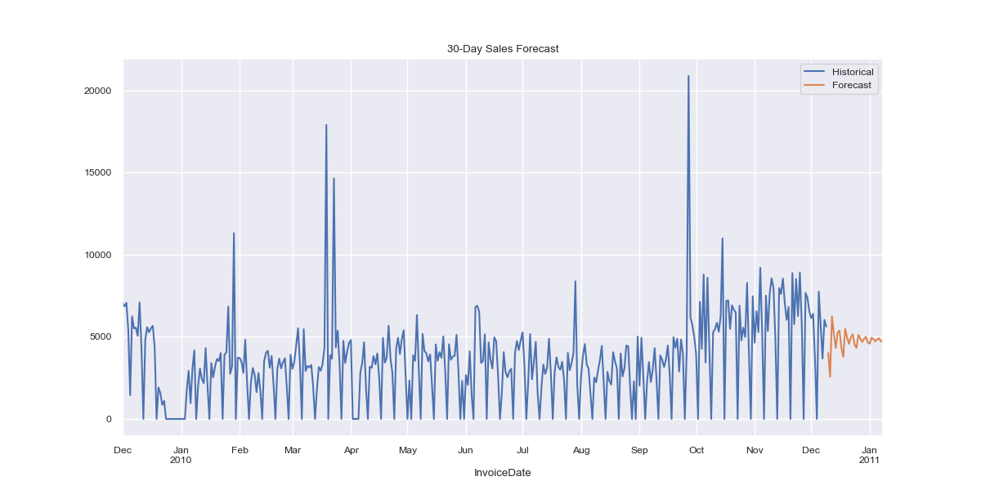
30-Day Sales Forecast
ARIMA model projection of future sales performance

Slide 4
Key Customer Metrics
Customer ID | Segment | Total Spend
14911 | Green | $31,567.34
14156 | Green | $18,695.87
17841 | Green | $15,215.85
15760 | Green | $13,916.34
14063 | Green | $13,443.55

