Slide 1
CIS 4517/5517: Data Intensive and Cloud Computing Distributed file systems
Dr. Xubin He
Computer and Information Sciences
Temple University

Slide 2
Outline
Introduction
Google File System
Apache Hadoop
HDFS
Courtesy: Some slides are adopted and modified from J.F. Paris, Kennedy, C. Borcea and N. Venkatasubramanian, and the papers of GFS and HDFS.
.

Slide 3
Why Hadoop and MapReduce?
It’s the DATA!

Slide 4
How much data is there?
Lots of data have been collected and stored: web, scientific data, ecommerce transactions, digital media, financial institutes, social network…
The amount of data in the world was estimated to be 44 zettabytes at the dawn of 2020.
By 2025, the amount of data generated each day is expected to reach 463 exabytes globally.
Google, Facebook, Microsoft, and Amazon store at least 1,200 petabytes of information.
By 2025, there would be 75 billion Internet-of-Things (IoT) devices in the world.
1T=2⁴⁰
1P=2⁵⁰
1E=2⁶⁰
1Z=2⁷⁰
Source: https://seedscientific.com/how-much-data-is-created-every-day/, accessed 9/26/2024

Slide 5
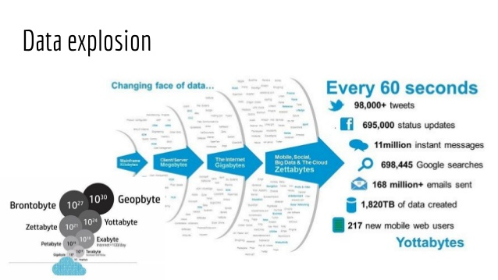
Source: slideshare.net

Slide 6
Big data challenges
Knowledge discovery from large and fast growing datasets is challenging. With rapid advancement and sophistication of experiment instrumentation, data is being generated at a high speed unprecedented in history.
High variety of big data in data types, representation, and semantic interpretation makes general-purpose storage systems or conventional databases unacceptably inefficient and slow. The design for systems support for big data analytics must be semantics- and application-aware.
As the size and complexity of storage systems scale up to accommodate big data, the frequency of hardware, system or software failures grows proportionally.

Slide 7
A fundamental question
In the era of big data, how to process data efficiently in a timely and cost-effective manner?
A platform→Hadoop
A programming model→MapReduce
Together, a reliable, scalable, and distributed computing platform for parallel processing of very large datasets.

Slide 8


Slide 9

Brief history of Hadoop
2005: Doug Cutting and Michael J. Cafarella developed Hadoop to support distribution for the Nutch search engine project.
The project was funded by Yahoo.
2006: Yahoo gave the project to Apache Software Foundation.
July 2008: Hadoop Wins Terabyte Sort Benchmark: One of Yahoo's Hadoop clusters sorted 1 terabyte of data in 209 seconds, beating the previous record of 297 seconds.
http://hadoop.apache.org/

Slide 10
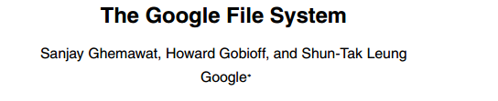

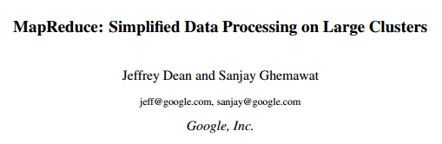


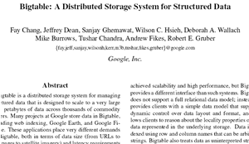

Google Origins
2003
2004
2006

Slide 11
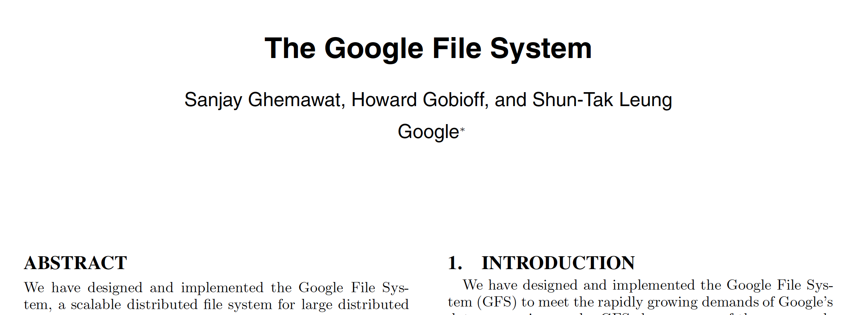
Let’s first look at Google File System
The original paper on Google File System published in SOSP conference [2003]
https://static.googleusercontent.com/media/research.google.com/en//archive/gfs-sosp2003.pdf
Courtesy: slides are from http://www2.cs.uh.edu/~paris/

Slide 12
THE GOOGLE FILE SYSTEM
S. Ghemawat, H. Gobioff, and S.‐T. Leung.
SOSP 2003

Slide 13
An unusual environment
Component failures are the norm, not the exception
Scale and component quality
Files are huge by traditional standards
Most files contain many application objects (web pages)
Most file updates are append-only
Very few random writes
Once written, files are only read
GFS was co-designed with the applications using it

Slide 14
Design Assumptions (I)
System is built from many inexpensive commodity components
Must constantly monitor itself
Must quickly recover from component failures
System will store a modest number of large files
Over a million files
Typically 100MB or more

Slide 15
Design Assumptions (II)
Workload primarily consists of
Large streaming reads (1MB or more)
Small sequential reads (a few KBs)
Many large sequential writes
Append data to files
Very few random updates
Many concurrent appends to the same file by multiple clients
Need efficient implementation of well-defined semantics
High sustained bandwidth is more important than latency

Slide 16
User interface (I)
Quite familiar
Files organized in directories
Usual primitives for creating, deleting, opening, closing, writing to and reading from files

Slide 17
User interface (II)
Two new operations
Snapshots
Create copies of files and directories
Record appends
Allow multiple clients to concurrently append data to the same file
Useful for implementing
Multi-way merge results
Producer-consumer queues

Slide 18
The files
Files are divided into fixed-size chunks of 64MB
Similar to clusters or sectors in other file systems
Each chunk has a unique 64-bit label
Assigned by the master node at time of creation
GFS maintains logical mappings of files to constituent chunks
Chunks are replicated
At least three times
More for critical or heavily used files

Slide 19
GFS clusters
GFS Cluster
A master
Multiple chunkservers
Concurrently accessed by many clients
Chunkserver
Master
Chunkserver
Chunkserver

Slide 20
Architecture

Slide 21
The master server
Single master server
Stores chunk-related metadata
Tables mapping the 64-bit labels to chunk locations
The files they make up
Locations of chunk replicas
What processes are reading or writing to a particular chunk, or taking a snapshot of it
Communicates with its chunkservers through heartbeat messages
Also controls
Garbage collection of orphaned chunks
Chunk migration between chunk servers

Slide 22
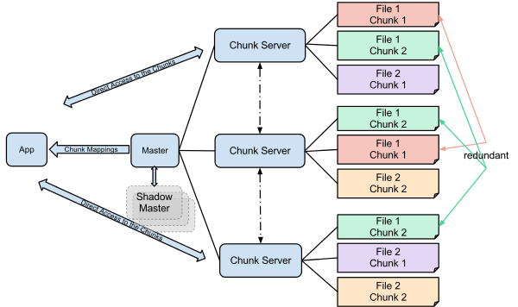

Slide 23
The chunk servers
Store chunks as Linux files
Transfer data directly to/from clients
Neither the clients nor the chunk servers cache files
Little benefits in a streaming environment
Omitting it results in a simpler design
Linux I/O buffers already keep in RAM frequently accessed chunks

Slide 24
Accessing a file
Client converts (file name, file offset) into (file name, chunk index)
Sends (file name, chunk index) to master
Master replies with chunk handle and replica locations
Client caches this information
Client selects a chunk server and sends (chunk handle, byte range within the chunk)

Slide 25
Chunk size
Large chunk sizes
Reduce the number of interactions between clients and master
As clients are more likely to perform many operations on the same chunk, they reduce the number of TCP connection requests
Reduce the size of the metadata stored on the master
Large chunk sizes also increase the likelihood of observing hot spots.
Not a real problem and replication helps

Slide 26
Metadata
Master stores metadata in memory
File and chunk namespaces
Mapping from files to chunks
Locations of each chunk's replica
First two types of metadata are kept persistent by logging mutations to an operation log stored on the mater's HD
Not true for the locations of chunk replicas
Obtained from the chunkservers themselves

Slide 27
Chunk locations
Obtained from chunkservers
At startup time
Maintained up to date because master
Controls all chunk placement
Monitors chunkserver status though heartbeats
Simplest solution

Slide 28
Operation log
Contains historical record of critical metadata changes
Acts a logical time line for the order of all concurrent operations
Replicated on multiple remote machines

Slide 29
Consistency model
All file namespace mutations are atomic
Handled exclusively by the master
Status of a file region can be
Consistent: all clients see the same data
Defined: all clients see the same data, which include the entirety of the last mutation
Undefined but consistent: all clients see the same data but it may not reflect what any one mutation has written
Inconsistent : clients see different versions of the same data

Slide 30
Data mutations
Writes:
Cause data to be written at a specific offset
Record appends:
Cause data to be automatically appended at least once at an offset of GFS choosing
Consistency is ensured by
Applying mutations to a chunk in the same order
Using chunk version numbers

Slide 31
Mutations
Client requests a lease from master server
Master server grants update permission to a client for a finite period of time (60 seconds)
Client pushes data to all the replicas
Data end in internal LRU buffer cache of each chunkserver
Once the replicas have all ACKed receiving the data, client sends a write request to the primary replica. Primary assigns a serial number to the mutation and applies it to its local state
Primary replicas forwards the write request to all secondary replicas, which apply the mutation in the same serial order.
Secondary replicas reply to the primary once they have completed the operation
Primary notifies to the client the mutation is completed

Slide 32
Atomic record appends
GFS appends the new data
At least once
Atomically
At an offset of GFS choosing
Returns that offset to the client
Widely used to implement concurrent access

Slide 33
Now let’s move to HDFS
Many concepts are similar to the Google File System.

Slide 34
What is Apache Hadoop?
Open source software framework designed for storage and processing of large scale data on clusters of commodity hardware
https://hadoop.apache.org/
Latest version:
3.4.0, March 17, 2024

Slide 35
Goals/Features
Abstract and facilitate the storage and processing of large and rapidly growing data sets
Structured and non-structured data
Simple programming models
High scalability and availability
Use commodity hardware
Fault-tolerance via replication
Move computation rather than data

Slide 36
Hadoop project
The project includes major components:
Hadoop Common: The common utilities that support the other Hadoop modules.
HDFS: A distributed file system that provides high-throughput access to application data.
Hadoop YARN: A framework for job scheduling and cluster resource management.
Hadoop MapReduce: A YARN-based system for parallel processing of large data sets.
Hadoop Ozone: An object store for Hadoop.
http://hadoop.apache.org/

Slide 37
Hadoop project (2)
Ambari: A web-based tool
HBase: Database model built on top of Hadoop to process large tables (Google BigTable)
Hive: Hadoop processing with SQL
Mahout: A Scalable machine learning and data mining library.
Pig: Hadoop processing with scripting
ZooKeeper: coordination service for distributed applications.
And more….
http://hadoop.apache.org/

Slide 38
Uses for Hadoop
Data-intensive text processing
Assembly of large genomes
Graph mining
Machine learning and data mining
Large scale social network analysis
And more….

Slide 39
More on Hadoop
An open source, scalable, fault tolerant platform for distributed computing and storage developed by Apache
Initiated by the papers on MapReduce and Google File System
Started as open source DFS and MapReduce, but evolved to support other computational parts as Pig, Hive, etc.
Written in Java
Hadoop is evolving to an OS for data center
For a discussion on OS for data centers, check:
The datacenter needs and OS

Slide 40
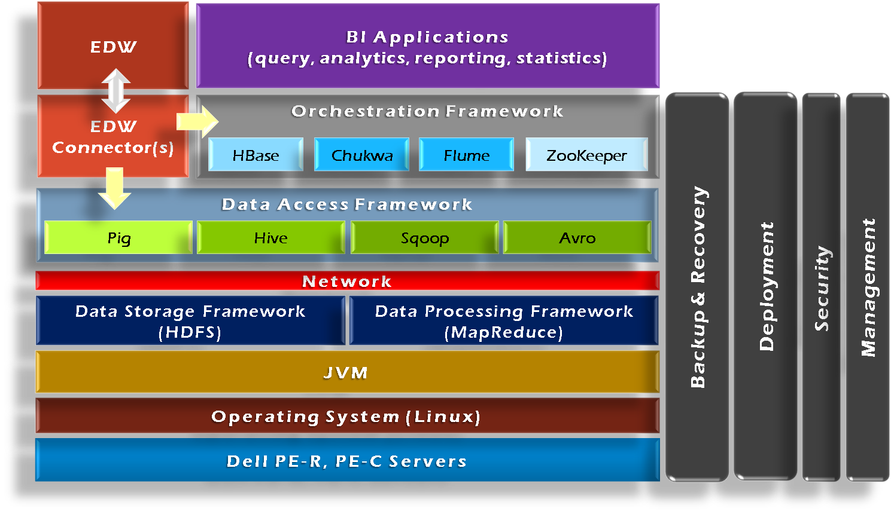
Hadoop Framework Tools
Essential modules: HDFS and MapRedcue

Slide 41
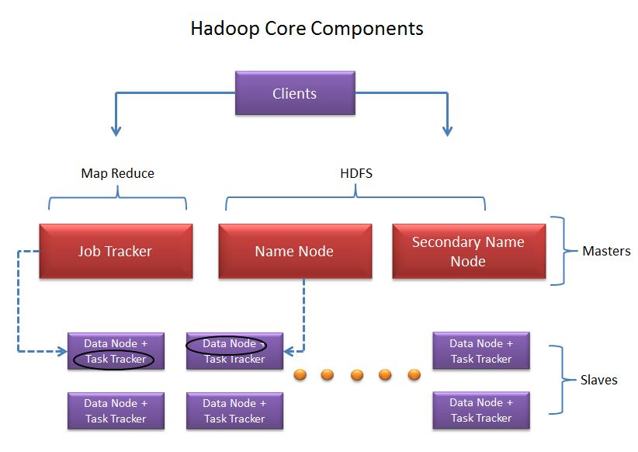
Hadoop Master-Slave Architecture
Source: http://saphanatutorial.com/hadoop-cluster-architecture-and-core-components/
Notes:
Secondary name node is not a backup, it severs as a house keeping.

Slide 42
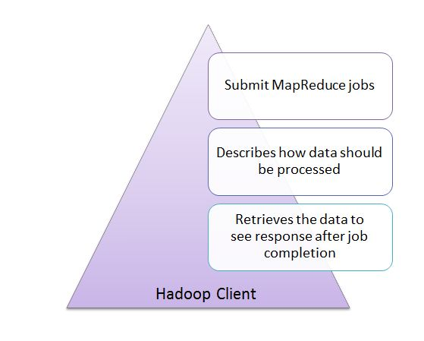
Clients
Source: http://saphanatutorial.com/hadoop-cluster-architecture-and-core-components/

Slide 43
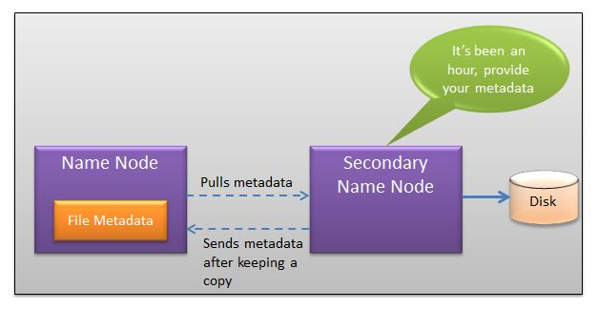
Namenode and secondary namenode
Source: http://saphanatutorial.com/hadoop-cluster-architecture-and-core-components/

Slide 44
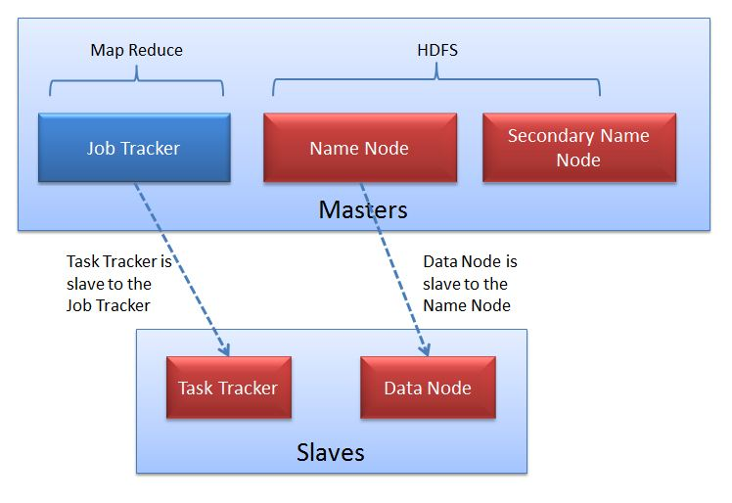
Slaves
Source: http://saphanatutorial.com/hadoop-cluster-architecture-and-core-components/

Slide 45
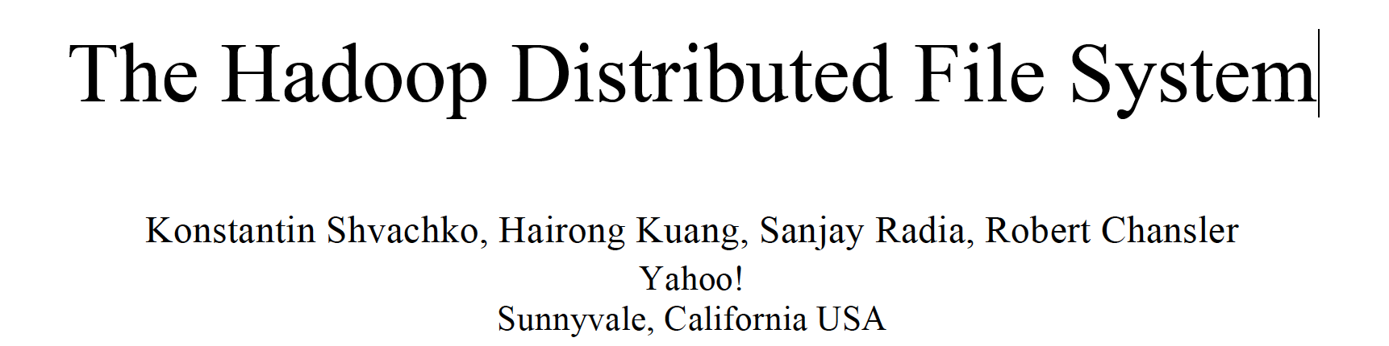
HDFS
The Hadoop Distributed File System (HDFS) is the file system component of Hadoop. It is designed to 1) reliably store very large data sets and to 2) deliver those data sets with high throughput to user applications, achieved by replicating file content on multiple machines (DataNodes).
Courtesy: Some of the following slides are adopted from:
https://cse.buffalo.edu/~okennedy/courses/cse704fa2012/2.2-HDFS.pptx

Slide 46

HDFS
Inspired by Google FS
Master/slave architecture
NameNode is master (meta-data operations, access control)
DataNodes are slaves

Slide 47
HDFS blocks
HDFS is a block-structured file system: Files are divided into blocks (or chunks) with a default size of 128MB.
A file may consist of many blocks, which are stored across a cluster of one or more machines.
Each block of a file is replicated across a number of machines (3 by default).

Slide 48
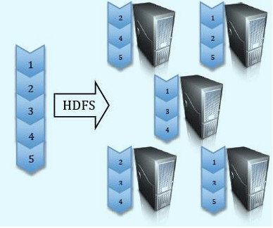
HDFS block replication

Slide 49
NameNode and DataNodes
HDFS stores file system metadata and application data separately.
Metadata refers to file metadata(attributes such as permissions, modification, access times, namespace and disk space quotas).
HDFS stores metadata on a dedicated server, called the NameNode (Master). Application data are stored on other servers called DataNodes (Slaves).
All servers are fully connected and communicate with each other.

Slide 50
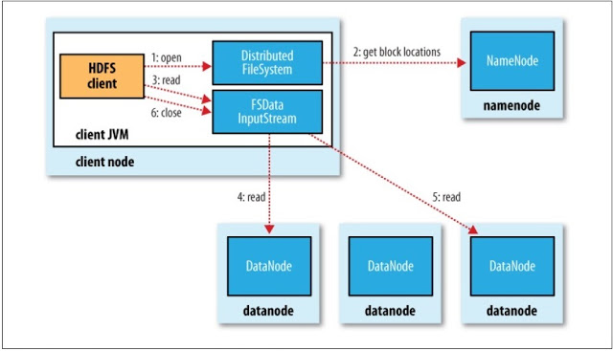
Reading data from HDFS
http://malsolo.com/blog4java/?p=516

Slide 51
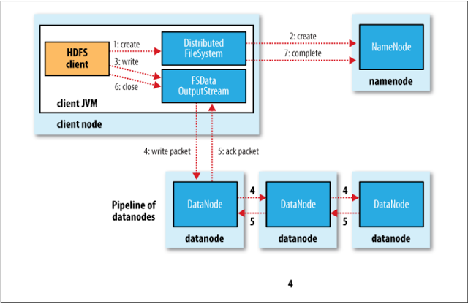
Writing data to HDFS
http://malsolo.com/blog4java/?p=516

Slide 52
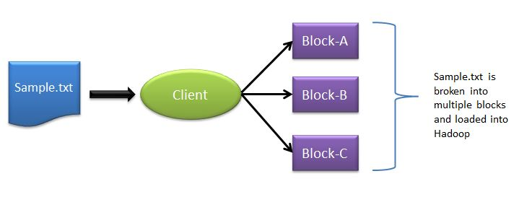
Typical workflow in HDFS
How is data loaded?
Source: http://saphanatutorial.com/hadoop-cluster-architecture-and-core-components/

Slide 53
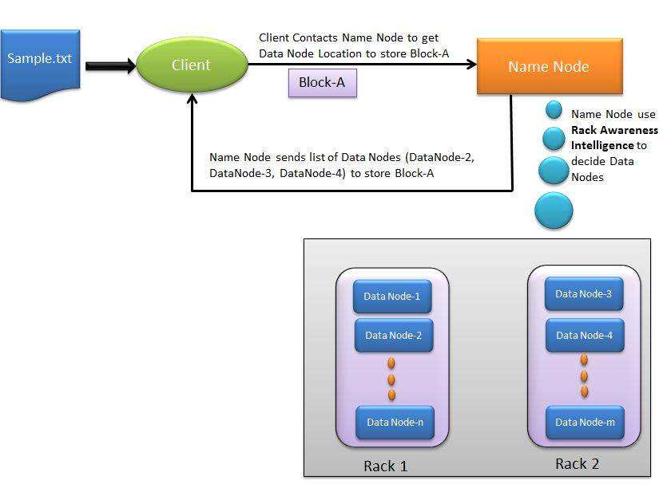
Typical workflow in HDFS
Where to load?
Source: http://saphanatutorial.com/hadoop-cluster-architecture-and-core-components/

Slide 54
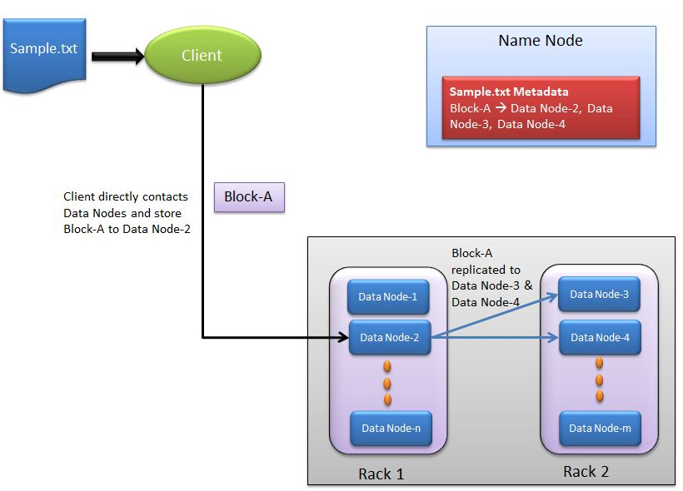
Typical workflow in HDFS
How to replicate?
Source: http://saphanatutorial.com/hadoop-cluster-architecture-and-core-components/

Slide 55
Distributed System: Problems
“You know you have a distributed system when the crash of a computer you’ve never heard of stops you from getting any work done.” –Leslie Lamport
Distributed systems must be designed with the expectation of failures.

Slide 56
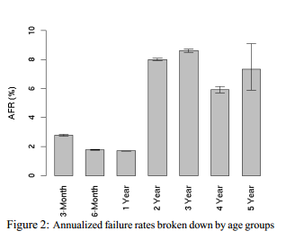
Failures
In large data centers, the Annualized Failure Rates (AFRs) of disk drives are more than 3%.
The observed disk AFRs range from from 1.1% to as high as 25%, which are by a factor of up to 30 higher than the datasheet AFRs. [BSchroeder and Gibson]
Concurrent failures are not rare. 37% failures are concurrent. [Ford et al, OSDI’10]
Source: Pinheiro et al, “Failure Trends in a Large Disk Drive Population“, FAST’07

Slide 57
How to detect failures?
NameNode and DataNode: Heartbeats.
Every DataNode sends heartbeats to the NameNode periodically to confirm that the DataNode is functional.
“I am alive.”

Slide 58
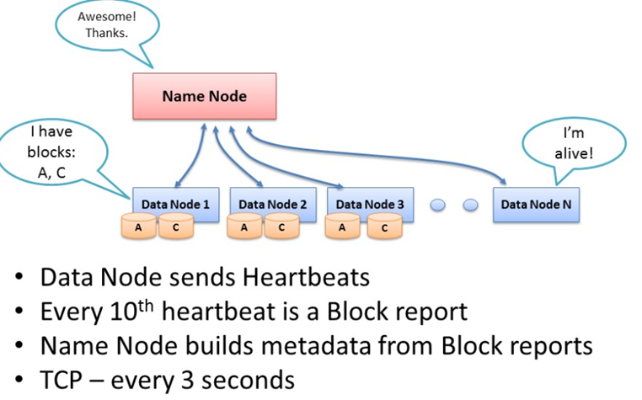
Heartbeats

Slide 59
Block reports
A DataNode identifies block replicas in its possession to the NameNode by sending a block report. A block report contains the block id, the generation stamp and the length for each block replica the server hosts.
Block reports provide the NameNode with an up-to-date view of where block replicas are located on the cluster and nameNode constructs and maintains latest metadata from block reports.

Slide 60
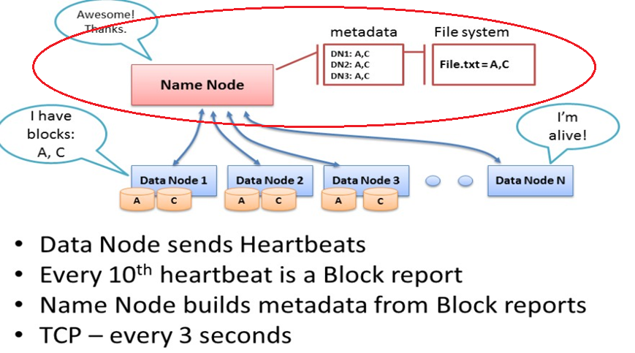
Metadata update

Slide 61
Failure Recovery
. The NameNode does not directly call DataNodes. It uses replies to heartbeats to send instructions to the DataNodes. The instructions include commands to:
Replicate blocks to other nodes:
DataNode died.
copy data to local.
Remove local block replicas;
Re-register or to shut down the node;

Slide 62
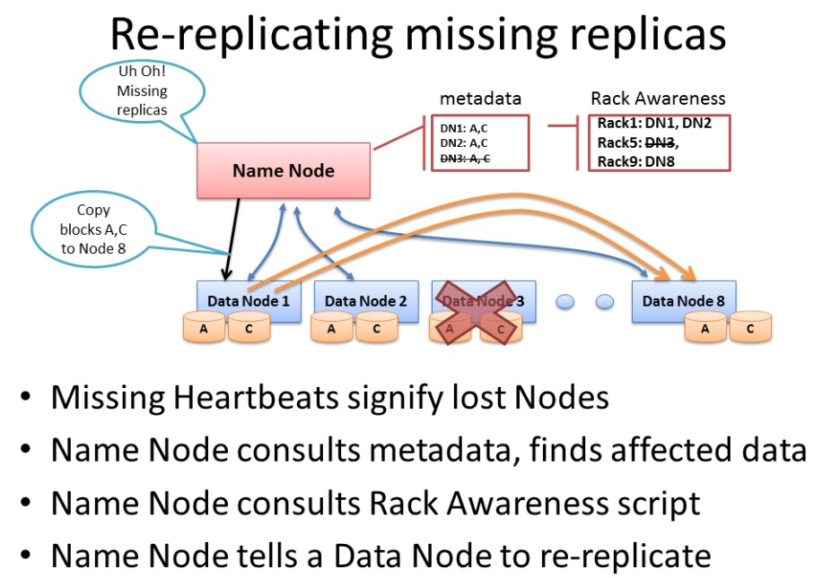
Re-replicating blocks

Slide 63
Failure recovery
When a dataNode dies, NameNode will notice and instruct other dataNode to replicate data to new dataNode.
How about if the NameNode dies?

Slide 64
Name node failure
Journaling/checkpointing
Multiple namenodes (backup namenodes)

Slide 65
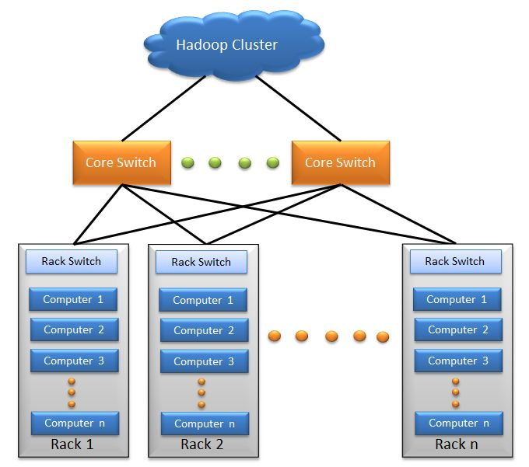
Hadoop Cluster
Source: http://saphanatutorial.com/hadoop-cluster-architecture-and-core-components/

Slide 66
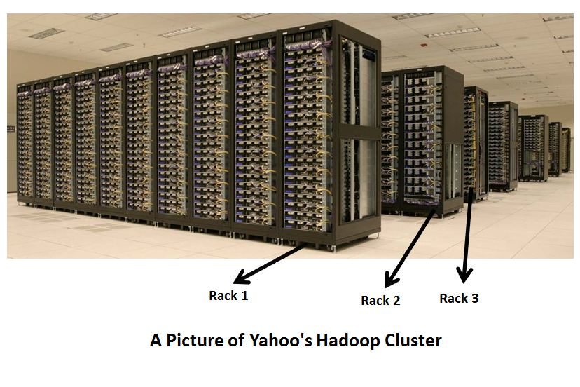
A real Hadoop cluster
Source: http://saphanatutorial.com/hadoop-cluster-architecture-and-core-components/

Slide 67
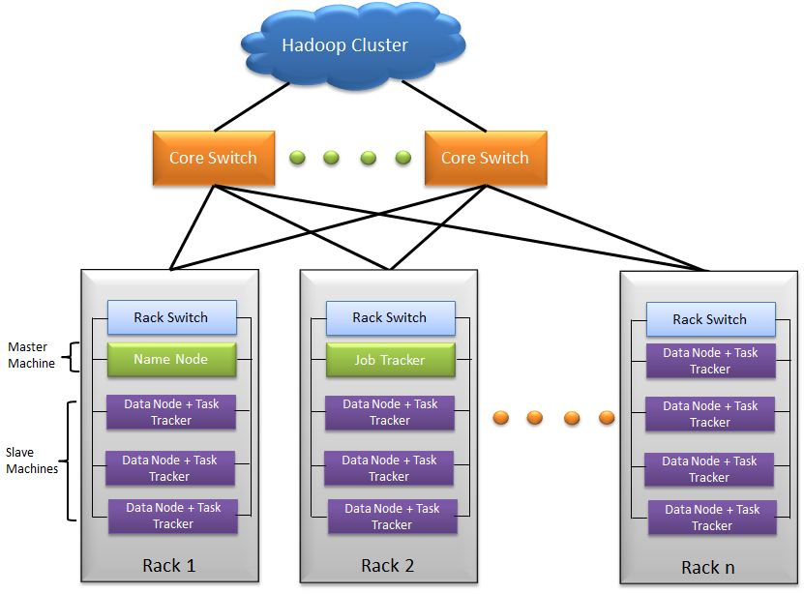
Hadoop cluster architecture
Source: http://saphanatutorial.com/hadoop-cluster-architecture-and-core-components/

Slide 68
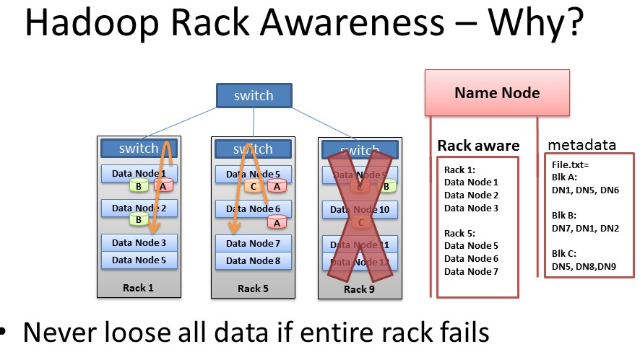
Erasure coding vs replication?
A topic we will discuss later in cloud storage.

Slide 69
Installation
Hadoop supports Linux and Windows
Easy to install and set up on Linux
Windows supported well in Hadoop 2 and after
Can use virtual machine to run locally
Requires several pieces of software
Java 1.6 and above
ssh/sshd
Cygwin (for Windows shell support)

Slide 70
Installation on EC2
Create a cluster
Using prebuilt or custom AMI
Distribute Hadoop to the cluster
Similar to single node setup, but for each node in the cluster
Configure Master node(s) for NameNode, Secondary NameNode and ResourceManager
Configure Slave node(s) for NodeManager and DataNode
A step by step guide is posted in the course canvas.

Slide 71
Distributing Hadoop to EC2 cluster
If using a custom AMI, have Hadoop preloaded
Distribute common configuration files instead
Create configuration locally and use scp to push to each instance
If using a public AMI without Hadoop, distribute entire Hadoop install
Include configuration in scp-based push
Bandwidth expensive and inefficient
http://hadoop.apache.org/docs/r2.7.3/hadoop-project-dist/hadoop-common/ClusterSetup.html

Slide 72
A video on Hadoop
Demystifying Hadoop, ~22 minutes

Slide 73
Try these offline:
Configure Hadoop on AWS
Remember to stop Hadoop and your instances when you are finished
Use EBS or S3 to save your persistent changes
Don’t forget to make local copies of debugging results
Documentation
Hadoop control commands

Slide 74
Useful links
Apache Hadoop: http://hadoop.apache.org/
MapReduce Tutorial
Analyzing bigdata with Amazon EMR
If you have problem with the instruction on setting up single-node cluster use the following link:
http://hadoop.apache.org/docs/r2.7.3/hadoop-project-dist/hadoop-common/SingleCluster.html#Pseudo-Distributed_Operation
If you have problem with configuring a multi-cluster setup, follow:
http://pingax.com/install-apache-hadoop-ubuntu-cluster-setup/
http://hadoop.apache.org/docs/r2.7.3/hadoop-project-dist/hadoop-common/ClusterSetup.html
If you are not confident enough to try setting Hadoop on AWS, then first try on your local machine
User VirtualBox (for Windows or Mac) or KVM (for Linux) with Ubuntu image to create VM and try setting up Hadoop in the VM(s)

Slide 75
References
The original paper on HDFS published in the IEEE MSST conference [2010]
https://storageconference.us/2010/Papers/MSST/Shvachko.pdf
The original paper on Google File System published in SOSP conference [2003]
https://static.googleusercontent.com/media/research.google.com/en//archive/gfs-sosp2003.pdf
A presentation on HDFS:
https://cse.buffalo.edu/~okennedy/courses/cse704fa2012/2.2-HDFS.pptx
Hadoop and HDFS:
https://hadoop.apache.org/docs/current/hadoop-project-dist/hadoop-hdfs/HdfsDesign.html
Introduction to HDFS:
https://www.ibm.com/developerworks/library/wa-introhdfs/index.html
MapReduce: Simplified Data Processing on Large Clusters, OSDI’2014
https://research.google.com/archive/mapreduce-osdi04.pdf

Slide 76
Next
Next topic: MapReduce
Keep working on your project

