Slide 1
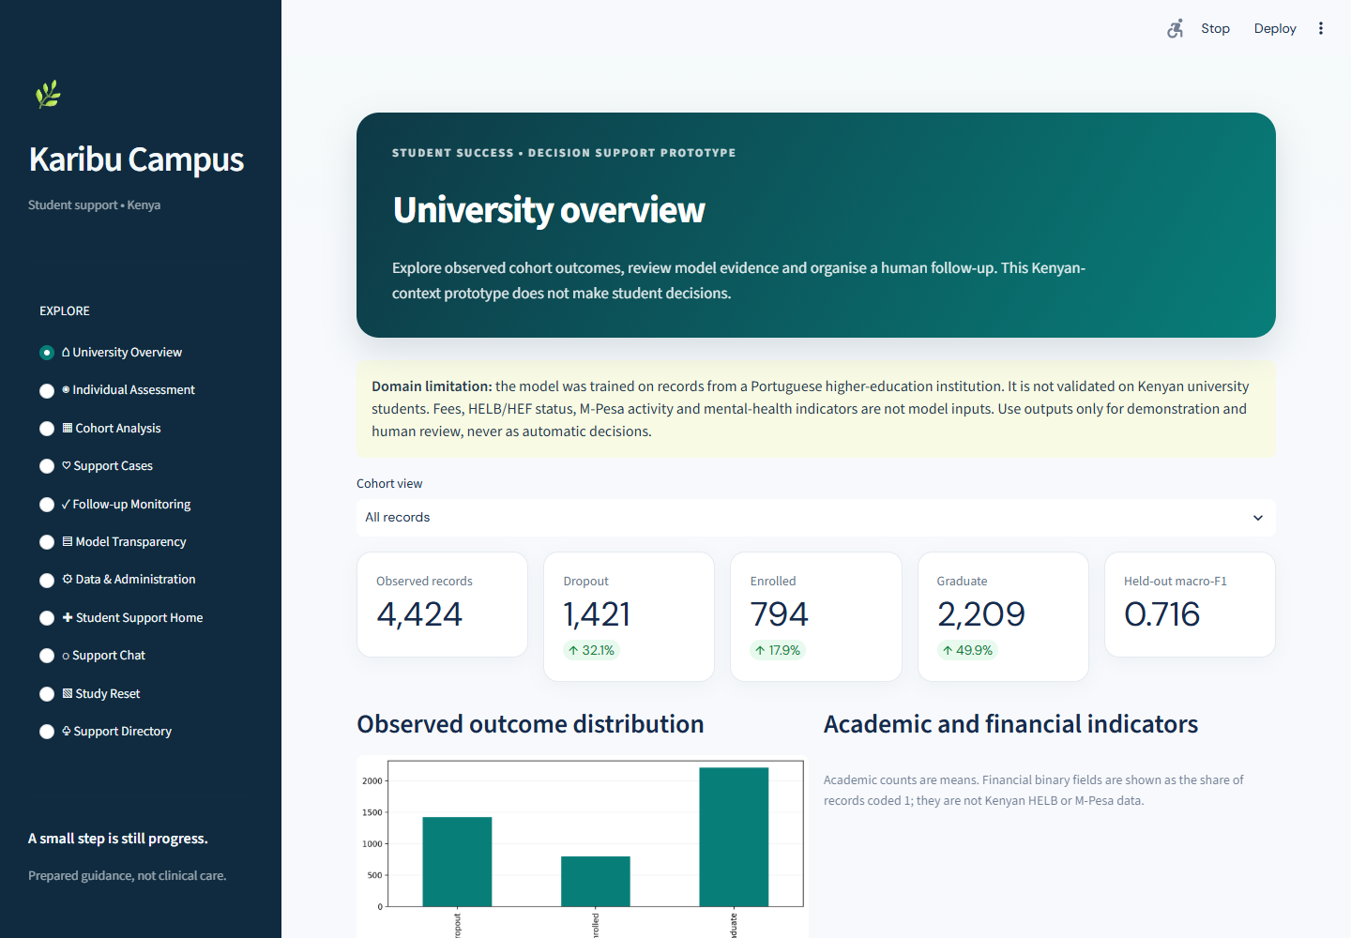
KCA UNIVERSITY | CPP 4201
KARIBU
CAMPUS
Student Support and
Academic Outcome Prototype
Accessible student support alongside analysis of historical academic outcomes.
Advanced Python Programming | Project Presentation
University Overview · source cohort and held-out metric
Notes:
Suggested speaking time: 40 seconds
Good morning. We are presenting Karibu Campus, a KCA University project for CPP 4201, Advanced Python Programming. The prototype brings two separate capabilities into one Streamlit application: a student support hub with practical campus oriented routes to help, and a machine learning component that explores historical academic outcomes. The support hub responds to challenges such as exam pressure, money worries, anxiety and isolation. The analytics side is an educational demonstration, not a Kenyan prediction service. I will first show how the parts fit together, then explain its interface, source data and model before we open the live system.
Transition: The project starts with the pressures it is designed to address.

Slide 2
01 | PURPOSE
The problem and our approach
Student pressures overlap, while support routes and outcome insights can be difficult to bring together.
CAMPUS CHALLENGES
TWO COMPLEMENTARY COMPONENTS
CATs, exams, coursework and disengagement
Student Support Hub
Student Support Home · Intent-based Chat
Study Reset planner · Support Directory
Fees, HELB or HEF uncertainty, upkeep and transport
Finding a practical, trusted support route
Academic Outcome Analytics
Learning from patterns in historical academic outcomes
Historical dataset · Classifier comparison
Individual assessment · Cohort analysis
The support hub and outcome model remain separate within the prototype.
KCA UNIVERSITY | CPP 4201
02
Notes:
Suggested speaking time: 45 seconds
University students can face overlapping pressures: CATs and exams, fees or upkeep, and difficulty finding human support. Historical academic data can also help us inspect patterns in recorded outcomes. Karibu Campus responds with two distinct pillars. The Student Support Hub offers Student Support Home, prepared intent based chat, Study Reset and Support Directory. Academic Outcome Analytics validates a historical dataset, compares classifiers and presents synthetic individual assessment and cohort summaries. They coexist in the application but remain separate: the chatbot does not call the model, and model scores do not trigger support cases automatically. Next, let us look at the interface.
Transition: The screenshots show how a student or demonstrator moves through those features.

Slide 3
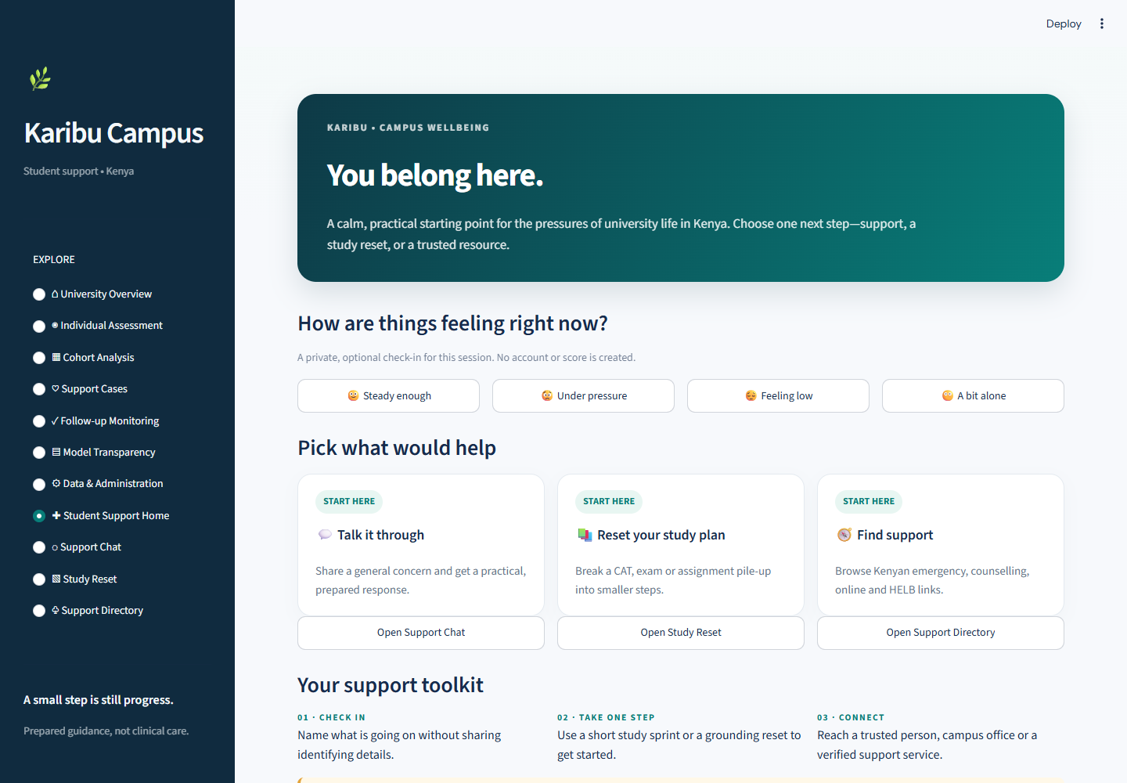
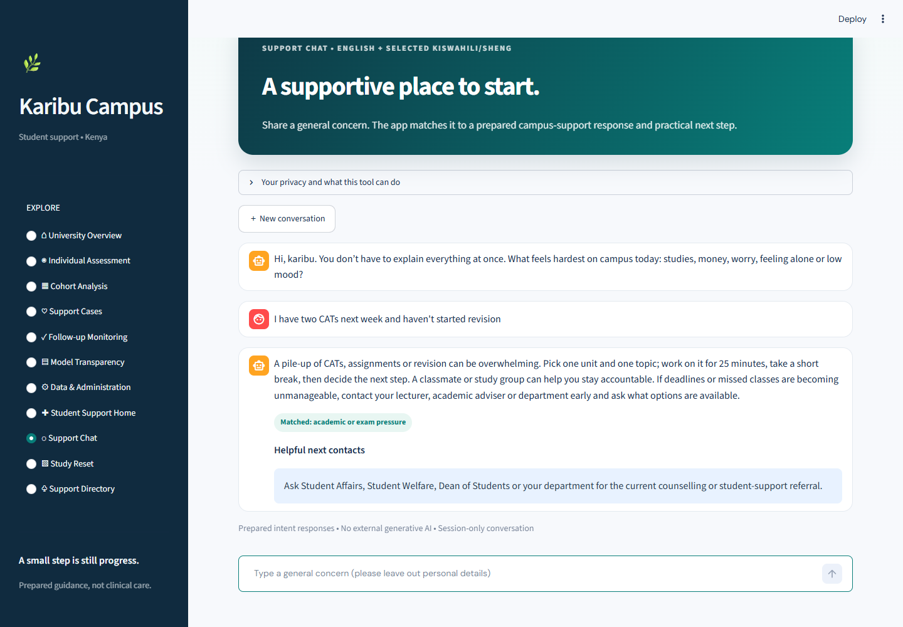
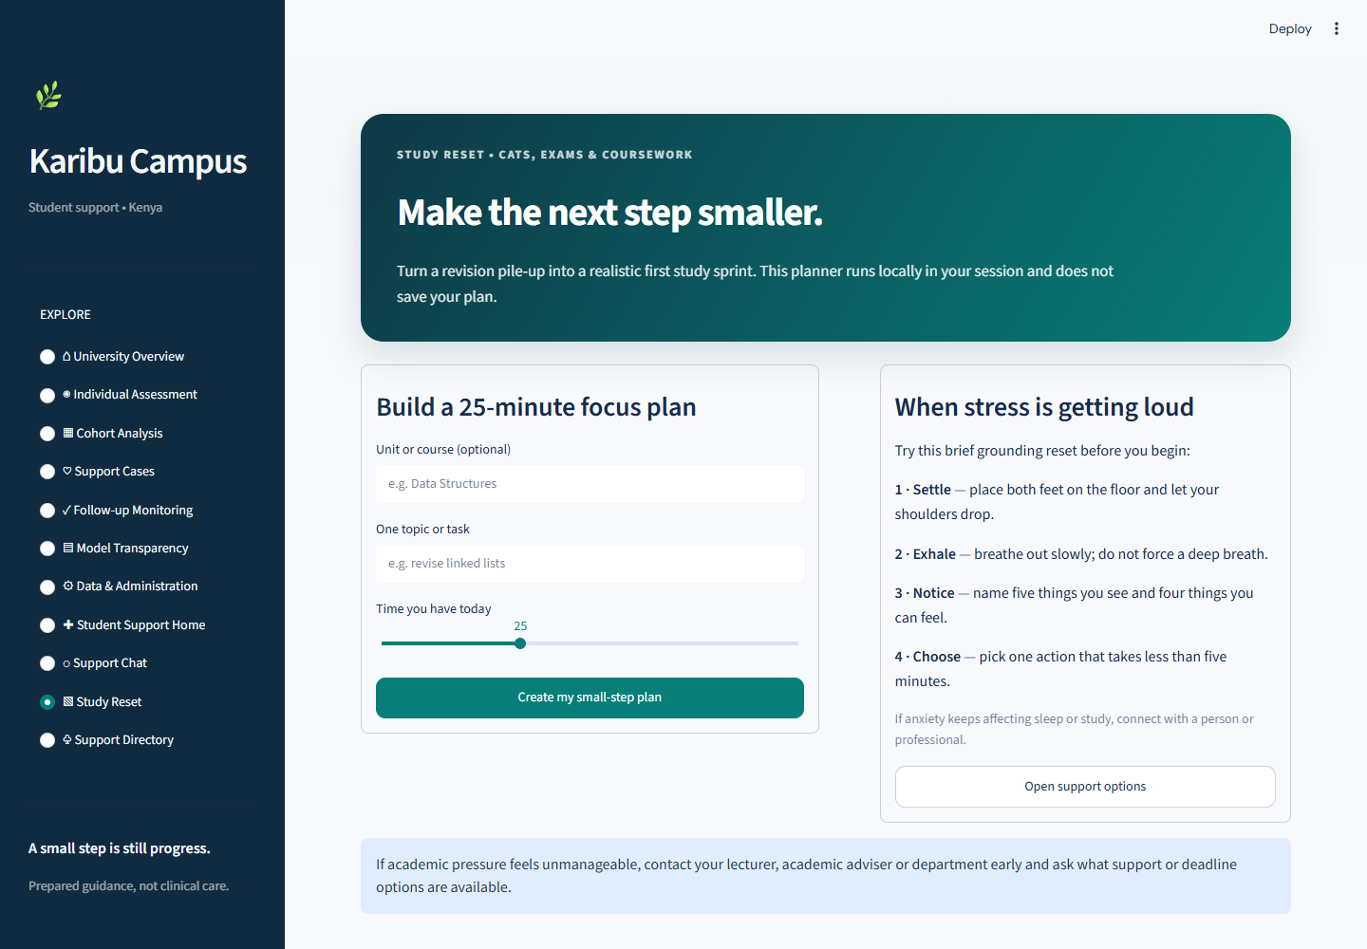
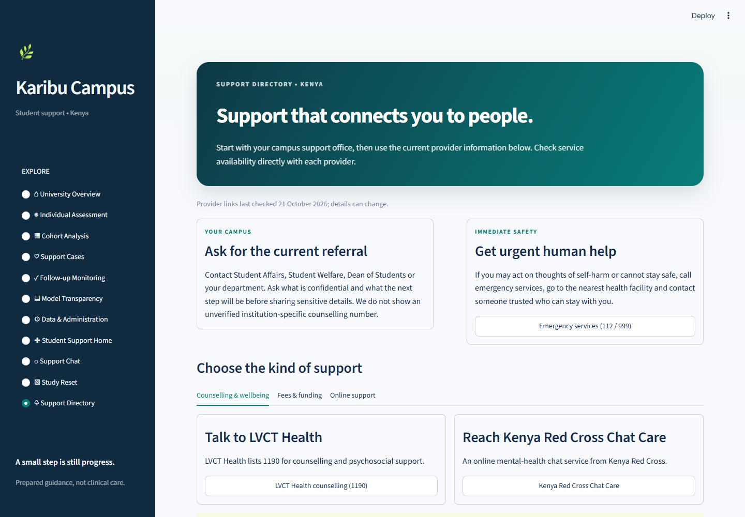
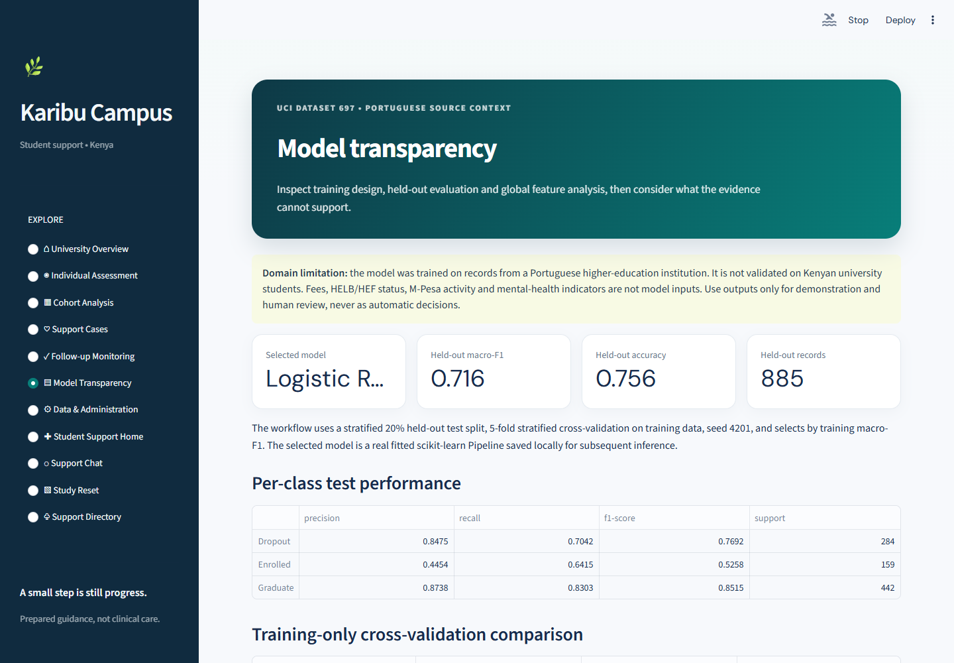
02 | APPLICATION INTERFACE
Five views preview one navigable application
STUDENT SUPPORT HOME
SUPPORT CHAT
STUDY RESET
SUPPORT DIRECTORY
MODEL TRANSPARENCY
The sidebar connects the student support journey with separate analytics and administration views.
KCA UNIVERSITY | CPP 4201
03
Notes:
Suggested speaking time: 50 seconds
The Student Support Home is the entry point and links to Support Chat, Study Reset and Support Directory. The chat matches a limited set of phrases, such as CAT pressure, to a prepared response. It is deterministic pattern matching, not a generative AI service. Study Reset turns a study task into a small plan and a grounding prompt. The directory points students toward campus offices and external resources. The analytics view shows the recorded outcomes and model evidence. These are genuine captures from the repository. The sidebar keeps eleven views available in one application, while the support and analytics tasks stay distinct.
Transition: The next slide identifies the historical data behind the analytics views.

Slide 4
03 | DATASET
UCI 697 powers the outcome modelling component
Portuguese higher-education records
RECORDED TARGET CLASSES
4,424 records | 36 predictors | 1 target
FEATURE CATEGORIES IN THE SOURCE DATA
Demographic information
Educational background and admission
Financial indicators
Semester enrolment and performance
Historical data from Portugal; the model has not been validated on Kenyan university students.
KCA UNIVERSITY | CPP 4201
04
Notes:
Suggested speaking time: 45 seconds
The modelling dataset is UCI dataset 697, Predict Students’ Dropout and Academic Success. The inspected file contains 4,424 records, 36 numeric predictors and one Target column. Its records come from a Portuguese higher education institution. The predictors cover demographic and educational background, course and admission information, financial indicators such as tuition status and debtor status, and academic performance across semesters. The target contains three recorded outcomes: Dropout, Enrolled and Graduate. The chart shows their actual counts. The campus support language is localized for Kenya, but the model dataset is not Kenyan university data.
Transition: With the data source clear, I will summarize how the pipeline turns it into reported results.

Slide 5
04 | METHOD AND RESULTS
A reproducible workflow, with class-level limits
Stratified 80:20 split · preprocessing inside the scikit-learn Pipeline · select on training CV
Official UCI
Validate
Preprocess
Compare
Evaluate
Present
Download or read CSV
Schema and labels
Scale + one-hot encode
3 classifiers · 5 folds
885 held-out records
Prediction + analytics
0.705
0.716
75.6%
0.526
Mean CV macro-F1
Held-out macro-F1
Held-out accuracy
Enrolled class F1
CV standard deviation: 0.030
Enrolled is the weakest class. All scores describe a held-out split of Portuguese data, not Kenyan validation.
KCA UNIVERSITY | CPP 4201
05
Notes:
Suggested speaking time: 50 seconds
The pipeline obtains or reads the official UCI file, validates its schema and target labels, and preprocesses features inside a scikit learn Pipeline. Numeric variables are scaled and nominal codes are one hot encoded. The team compared Logistic Regression, Random Forest and Gradient Boosting using stratified five fold cross validation on the training partition. The selected model was evaluated on 885 held out records. Mean cross validation macro F1 was 0.705, held out macro F1 was 0.716 and held out accuracy was 75.6 percent. Enrolled was the weakest class by F1 at 0.526. These scores describe this Portuguese dataset split only.
Transition: I will now move from the introduction into the live demonstration.

Slide 6
05 | LIVE DEMONSTRATION
What we will demonstrate
A short route from student support to model-backed analytics
STUDENT SUPPORT
DATA AND ANALYTICS
1
Student Support Home
5
Data & Administration
2
Support Chat: CAT or HELB example
6
Prepare the dataset and train the model
3
Study Reset planner
7
Individual Assessment + Cohort Analysis
4
Support Directory
LIVE APP
https://karibu-campus.onrender.com
Let’s explore Karibu Campus.
KCA UNIVERSITY | CPP 4201
06
Notes:
Suggested speaking time: 45 seconds
We will start at Student Support Home, then send a sample CAT or HELB message to see its matched intent and prepared response. We will create a small Study Reset plan and open the Support Directory. On the analytics side, Data and Administration validates the source file and prepares the local model artifacts. Individual Assessment and Cohort Analysis then show the prototype outputs. Those model pages depend on the dataset preparation and training step being complete. The live application link is shown here. Karibu Campus is a prototype for exploration, and its outcomes model still needs Kenyan validation before any local use.
Transition: Let’s open the application and explore Karibu Campus.

