Slide 1
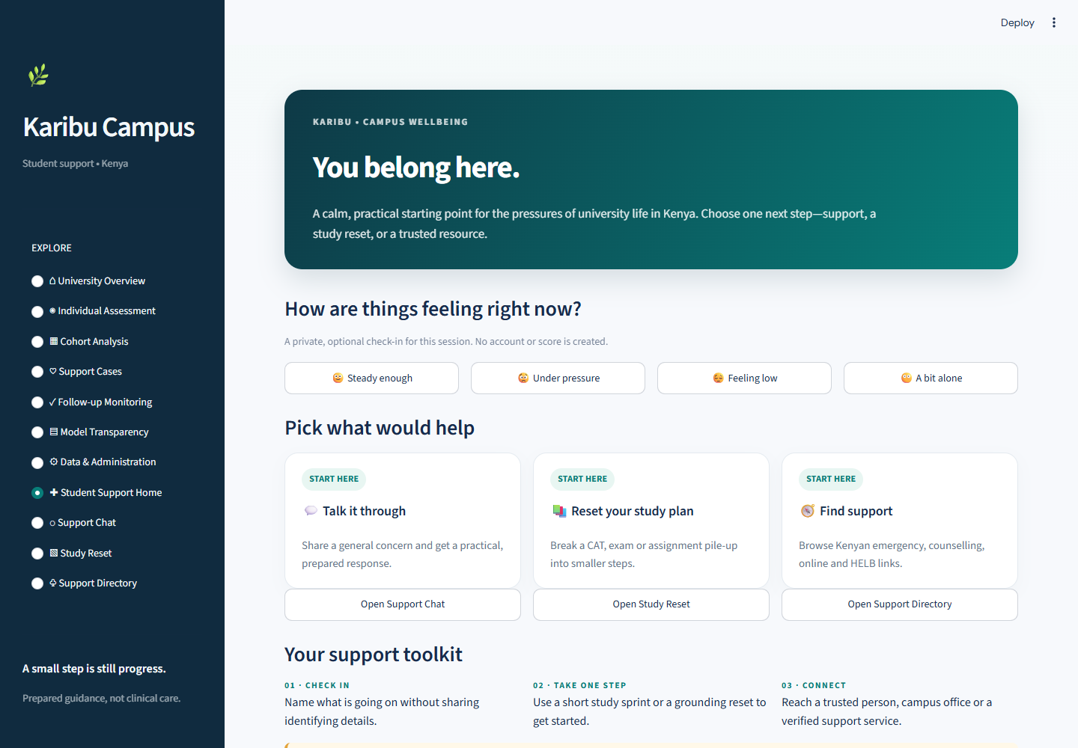
KCA UNIVERSITY | CPP 4201
KARIBU
CAMPUS
Student Support and
Academic Outcome Prototype
Advanced Python Programming | Project Presentation
Tony Kenga 24/03652
Baraka Blessings 24/04272
Linet Maina 24/00632
A Kenyan campus support interface with a separate outcome analytics pipeline
karibu-campus.onrender.com
Notes:
Suggested time: 30 seconds
Good morning. We are presenting Karibu Campus, a student-support and academic-outcome prototype developed for CPP 4201 at KCA University. The application brings a student-facing support hub and a retrospective machine-learning pipeline into one Streamlit interface, while keeping their roles separate. I will show the interface first, then explain the dataset and what the model results do and do not tell us. The team members are listed here.

Slide 2
01 | PURPOSE
Student pressure and support access
University life can combine academic pressure with financial and social strain.
CAMPUS CHALLENGES
TWO COMPLEMENTARY PROTOTYPE PATHS
CATs, exams, deadlines and missed coursework
Student support hub
Optional session check-in, prepared intent-based chat, study reset and a directory of human support routes.
Fees, HELB/HEF uncertainty, upkeep, rent or fare
Anxiety, isolation, low mood and difficulty finding help
Academic outcome analytics
Historical outcome analysis and synthetic-profile model assessment using the public UCI dataset.
The support chat and model remain separate; model scores never create support cases.
KCA UNIVERSITY | CPP 4201
02
Notes:
Suggested time: 45 seconds
The problem framing reflects pressures that a Kenyan university student may recognise: exam and CAT pile-ups, fee or upkeep worries, anxiety, loneliness and low mood. The prototype gives students a simple route to prepared guidance and human signposting. A separate analytics side explores historical academic outcomes. These parts appear in the same application, but the chatbot does not receive model scores, and a model flag never opens a support case by itself. That separation matters because wellbeing support and prediction have different purposes, risks and data needs. Next I will show how those paths fit together technically.

Slide 3
02 | DESIGN
Two paths inside one Streamlit application
STUDENT SUPPORT PATH
DATA AND MODEL PATH
Streamlit navigation
Student support hub
Data preparation
Scikit-learn Pipeline
11 views in one prototype
Check-in, chatbot, planner, directory
UCI download, schema checks, split
Fold-fitted encoding and scaling
Human-owned cases
Model evaluation
Analytics views
Pseudonymous local JSON demo
CV comparison, holdout metrics, artifacts
Assessment, cohort, transparency
The support chat routes text to prepared replies. The modelling path reads the historical dataset and writes a local model plus reporting artifacts.
KCA UNIVERSITY | CPP 4201
03
Notes:
Suggested time: 45 seconds
The application uses one Streamlit entry point with eleven views. On the support side, a student can complete an optional session-only check-in, use prepared chat responses, plan a short study reset and browse support links. A separate local case workflow demonstrates human follow-up. The data side extracts and validates UCI records, constructs a preprocessing and classifier pipeline, compares models, evaluates a selected model and saves artifacts for the analytics pages. The diagram is editable in PowerPoint. Notice that the two paths share the interface, not a decision process: chat does not call prediction, and prediction does not automatically create a case.

Slide 4
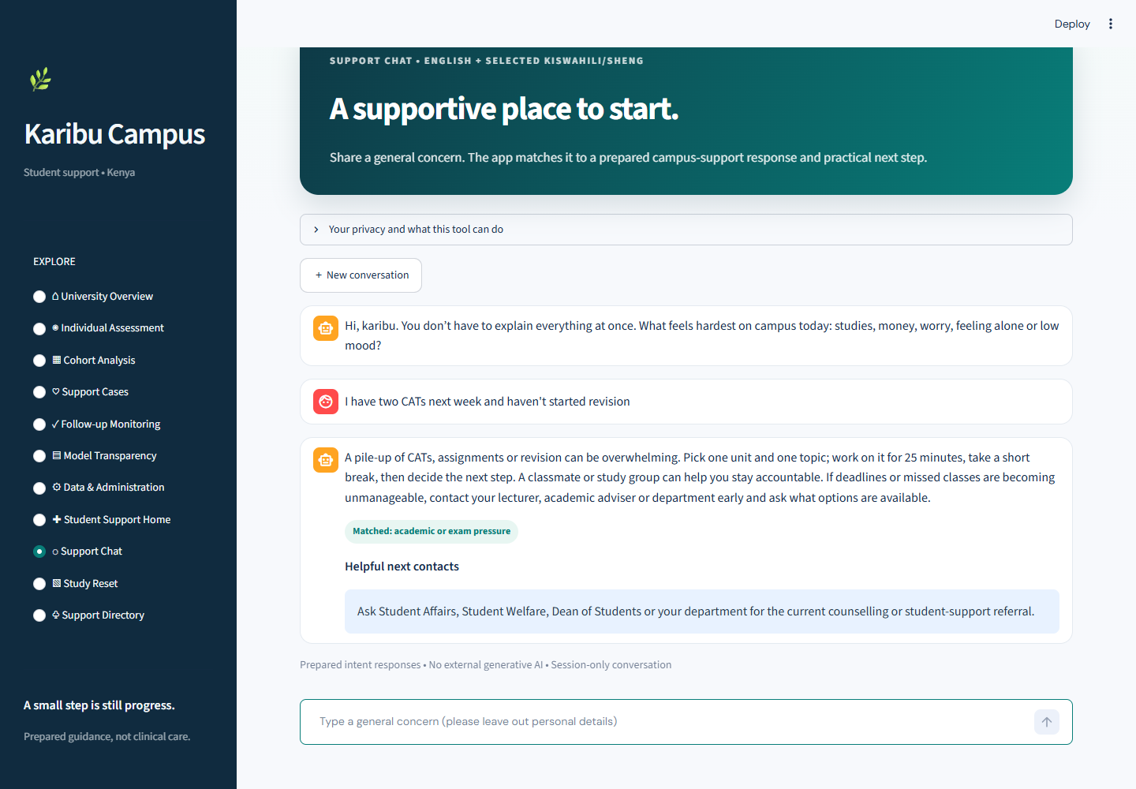
03 | STUDENT SUPPORT
Student-facing navigation and intent-based chat
STUDENT SUPPORT HOME
SUPPORT CHAT · CAT / REVISION EXAMPLE
Optional check-in stays in the current session; the page links to chat, study planning and resources.
Ordered regex patterns select a prepared reply and a human support next step.
KCA UNIVERSITY | CPP 4201
04
Notes:
Suggested time: 60 seconds
These are genuine application screenshots from the repository. The support home uses an optional check-in that stays in the current session and does not create a score or record. Navigation links to the chat, Study Reset and Support Directory. On the right, the example message mentions CATs and revision, common campus terms. The app labels the matched academic or exam pressure intent and shows a prepared response suggesting one small study block and early contact with a lecturer or adviser. The chat uses ordered regular-expression patterns and fixed response text. It does not send the message to a generative AI service. I will return to the planner and directory during the demo sequence.

Slide 5
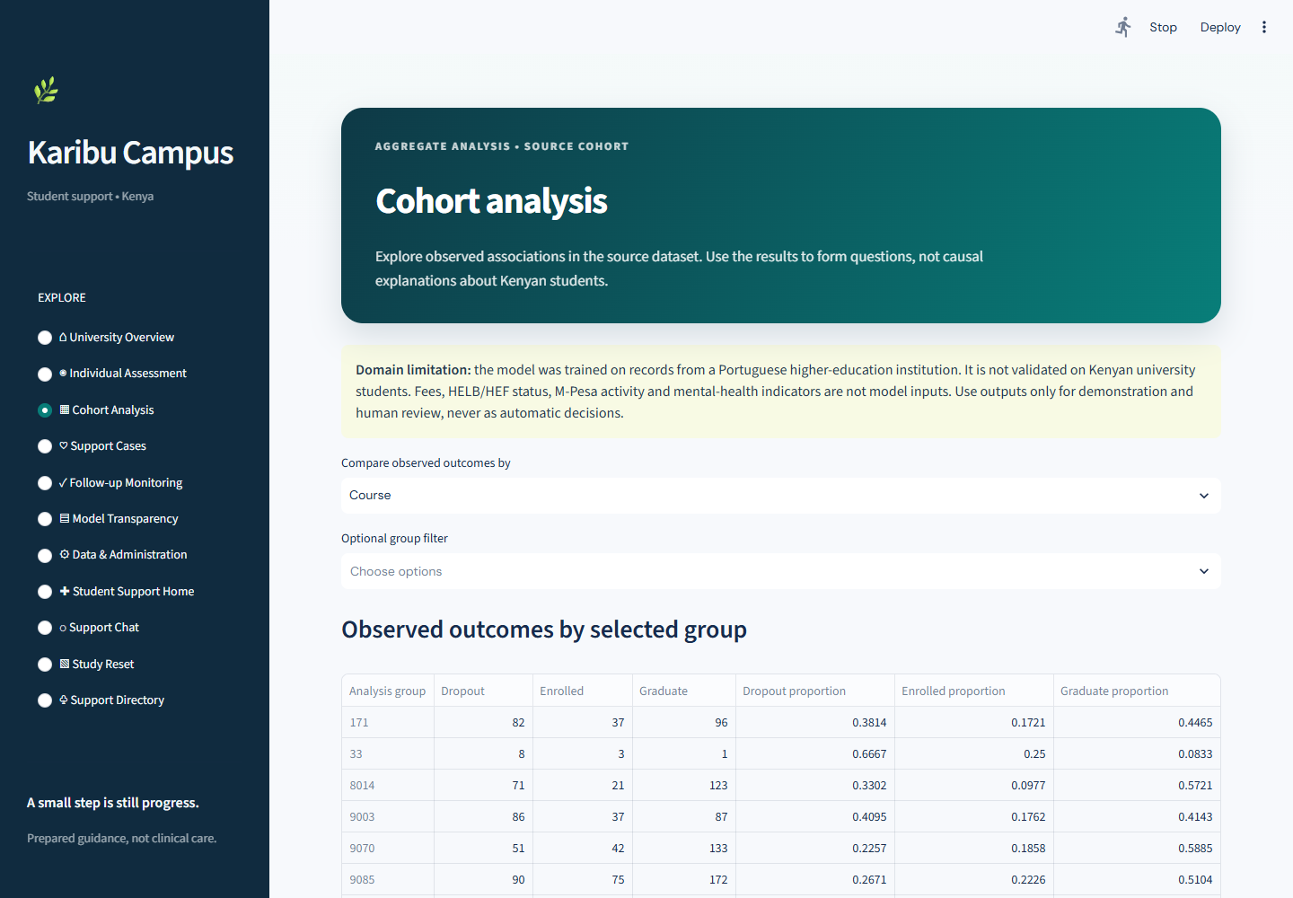
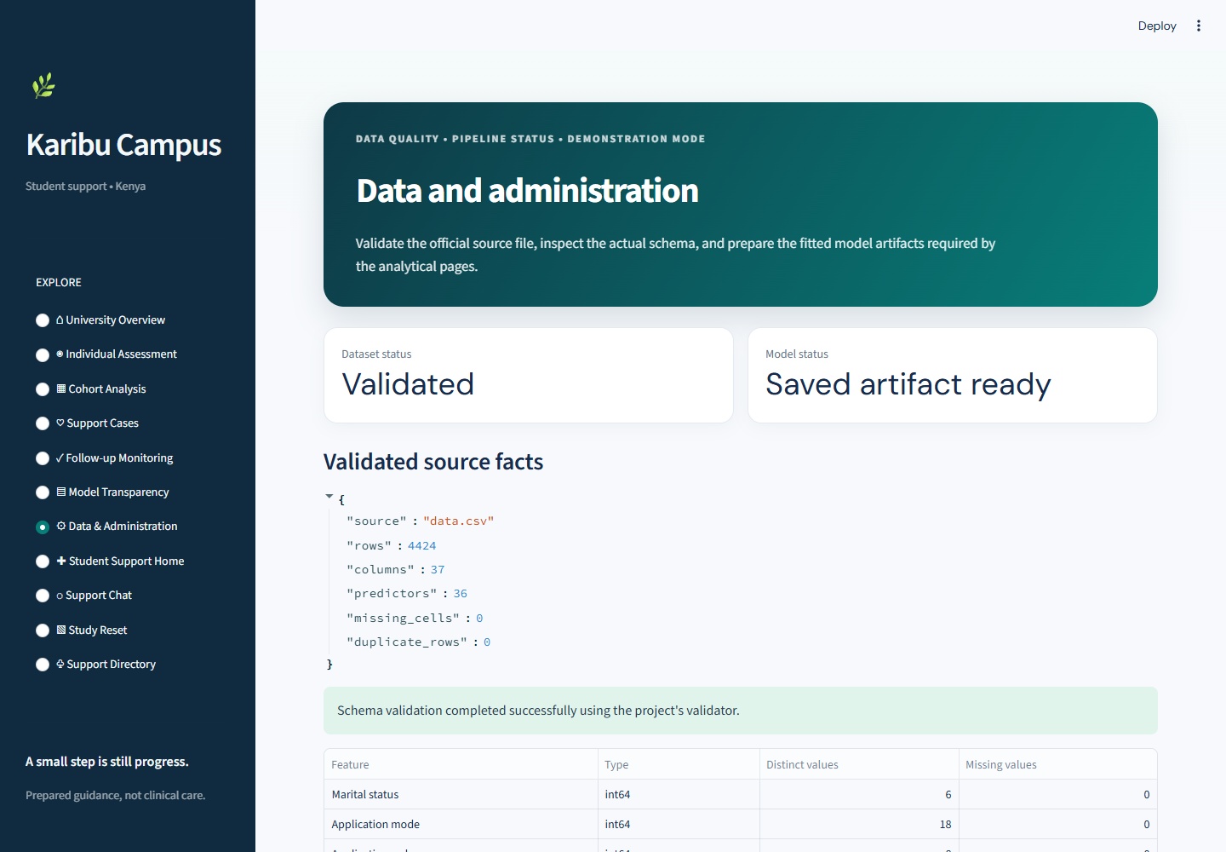
04 | ANALYTICS AND ADMINISTRATION
Administrative views support demonstration and review
COHORT ANALYSIS
DATA & ADMINISTRATION
Filters and grouped outcome counts describe the source cohort.
Schema checks and local training create artifacts for model-backed views.
Other views: Individual Assessment | Support Cases | Follow-up Monitoring | Model Transparency
KCA UNIVERSITY | CPP 4201
05
Notes:
Suggested time: 60 seconds
The navigation also serves an administrator or lecturer demonstrating the prototype. Cohort Analysis filters the Portuguese source records and reports observed class counts and proportions by groups such as course or other recorded indicators. It supports exploration but not causal claims about Kenyan students. Data and Administration reports the actual schema checks and whether local artifacts exist, and can run the pipeline. Individual Assessment uses a synthetic row, Model Transparency shows comparisons and evaluation, and Support Cases plus Follow-up Monitoring demonstrate a local human-owned workflow. The case register stores pseudonymous demo records as JSON, without authentication or production security. These are prototype capabilities, not an institutional early-warning service.

Slide 6
05 | DATA
UCI 697: source, structure and target
4,424 records
36 numeric predictors
1 observed outcome
OBSERVED TARGET CLASS COUNTS
Public UCI dataset 697, from a Portuguese higher-education institution. The CSV contains 37 columns and no missing cells in the inspected copy.
FEATURE GROUPS IN THE REPOSITORY
Student demographics and background
Admission, course and prior education
Fees, debtor and scholarship indicators
Semester enrolment, approvals, grades and evaluations
National economic indicators
Enrolled 794 · Dropout 1,421 · Graduate 2,209
The Kenyan campus setting describes the support interface; it does not change the dataset’s country of origin.
KCA UNIVERSITY | CPP 4201
06
Notes:
Suggested time: 55 seconds
The model uses dataset 697, Predict Students’ Dropout and Academic Success, from the UCI Machine Learning Repository. The repository inspection records 4,424 observations, 36 predictors and one target column. The target labels are Dropout, Enrolled and Graduate. The chart shows the observed class counts: Graduate is the largest class, while Enrolled is the smallest. Predictors include demographic and educational background, course and application codes, financial indicators such as debtor and tuition status, semester performance, and macroeconomic measures. The validation module checks the expected schema and labels. The project’s Kenyan campus framing applies to support language and referrals; it does not make Portuguese records representative of Kenyan students. Source: UCI dataset 697, CC BY 4.0, https://archive.ics.uci.edu/dataset/697/predict+students+dropout+and+academic+success.

Slide 7
06 | METHOD
A reproducible pipeline with fold-fitted preprocessing
One stratified holdout for final evaluation; training folds for model selection.
Extract
Validate
Split
Cross-validate
Evaluate & save
Official UCI archive
CSV read with source delimiter
37-column schema
Rows, types and labels
80% train / 20% test
Stratified, seed 4201
5 stratified folds
Fit transform per fold
Choose by CV macro-F1
Test once; save artifacts
INSIDE EACH MODEL PIPELINE
CANDIDATES
SELECTION RULE
Numeric features are scaled. Nominal codes are one-hot encoded with unknown categories ignored. The transformed features then enter the classifier.
Logistic Regression
Random Forest
Gradient Boosting
Highest mean training CV macro-F1. Logistic Regression won.
KCA UNIVERSITY | CPP 4201
07
Notes:
Suggested time: 60 seconds
The command-line workflow downloads or reads the official CSV, validates it, separates features from the target, and creates a stratified 80/20 train/test split with seed 4201. The training portion contains 3,539 rows and the untouched held-out portion contains 885. During five-fold cross-validation, a scikit-learn Pipeline fits its ColumnTransformer inside each fold: numeric features are scaled and nominal integer codes are one-hot encoded. This matters because each validation fold must not influence the transformations learned from its training fold. The code compares balanced Logistic Regression, balanced Random Forest and Gradient Boosting. It selects the highest mean training macro-F1, then evaluates that selected pipeline once on the held-out test data and writes the model and report artifacts.

Slide 8
07 | RESULTS
Held-out performance is uneven across outcome classes
Selected model: Logistic Regression
PER-CLASS HELD-OUT F1
Training CV macro-F1
0.705 ± 0.030
Held-out test set
885 records
Macro-F1 0.716
Accuracy 0.756
Enrolled F1 is 0.526; scores reflect Portuguese test data, not Kenya.
KCA UNIVERSITY | CPP 4201
08
Notes:
Suggested time: 60 seconds
The training-only cross-validation mean macro-F1 for Logistic Regression was 0.705, with a standard deviation of 0.030. Macro-F1 averages the three class F1 scores equally, so the smaller Enrolled group has the same influence as Graduate. The held-out test contained 885 records and produced macro-F1 0.716 and accuracy 0.756. In plain terms, the model assigned the correct recorded outcome to about three quarters of test records, but class performance varies. Enrolled has F1 about 0.526, compared with 0.769 for Dropout and 0.852 for Graduate. Therefore, the overall accuracy should not be read as uniformly reliable predictions. The test comes from the same Portuguese dataset, not a Kenyan campus.

Slide 9
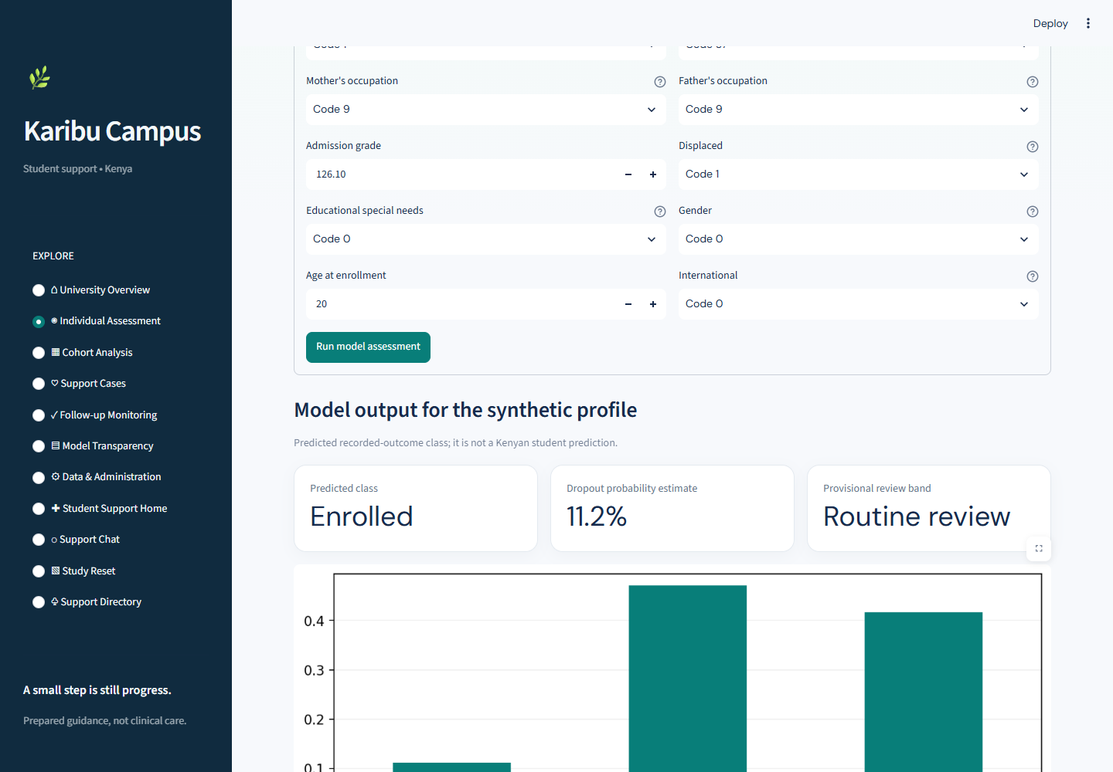
08 | INTERPRETATION
Assessment outputs invite review, not automated action
WHAT THE PAGE SHOWS
Three probabilities for the dataset’s observed outcome classes
A dropout probability and adjustable provisional review band
Synthetic starting profile from medians and category modes
REVIEW BANDS
Routine below 0.35
Consider follow-up from 0.35
Priority human review from 0.65
Probabilities are not calibrated confidence or causal explanations.
Repository screenshot · synthetic profile
KCA UNIVERSITY | CPP 4201
09
Notes:
Suggested time: 45 seconds
Individual Assessment begins with a synthetic profile assembled from observed medians and category modes. After the user adjusts the fields, the saved scikit-learn pipeline returns probabilities for Dropout, Enrolled and Graduate. The interface also shows a dropout probability and a review band with adjustable thresholds: routine below 0.35, consider follow-up from 0.35, and priority human review from 0.65. These thresholds are provisional examples. The probabilities are not calibrated confidence scores, and the band does not prove what will happen or why. The lecturer or adviser would need to interpret the information with context. The screenshot explicitly labels the profile synthetic and the output not a Kenyan student prediction.

Slide 10
09 | RESPONSIBLE USE
Limits that shape any responsible interpretation
DATA TRANSFER
Portuguese institution; no external validation on Kenyan university students.
TIMING
Semester performance can be recorded close to the outcome, limiting early-intervention value.
CLASS PERFORMANCE
Enrolled has lower test F1. No subgroup fairness, calibration or prospective-impact study is reported.
CHAT SCOPE
Deterministic regex routing and prepared replies. It does not diagnose, monitor or understand every context.
CASE SECURITY
Pseudonymous local JSON demo without authentication, encryption, access controls or audit trail.
REFERRALS
Use current institutional routes and recheck provider details. The application is not a monitored emergency service.
KCA UNIVERSITY | CPP 4201
10
Notes:
Suggested time: 45 seconds
The main limitation is domain shift: the records come from Portugal, and the model has not been validated on Kenyan students. Semester performance can also appear late in a student’s trajectory, so this evaluation does not establish an early-warning system. Enrolled is the weakest class, and the project does not report subgroup fairness analysis, probability calibration or prospective intervention outcomes. The chatbot follows a limited set of regular-expression patterns and prepared text. It cannot diagnose or monitor messages. Finally, support cases live in local JSON without production security. Do not enter real student data. The resource page gives referral pathways, but exact institution contacts must be confirmed locally. Emergency and provider details should be checked before use. The National Police Service currently lists 999, 112 and 911. LVCT Health publishes 1190 as a toll-free tele-counselling line. Kenya Red Cross describes its Chat Care service on the official page. Sources: https://www.nationalpolice.go.ke/sites/default/files/2025-01/NPS%20Service%20Standards.pdf ; https://lvcthealth.org/mental-health/ ; https://redcross.or.ke/chat-care/.

Slide 11
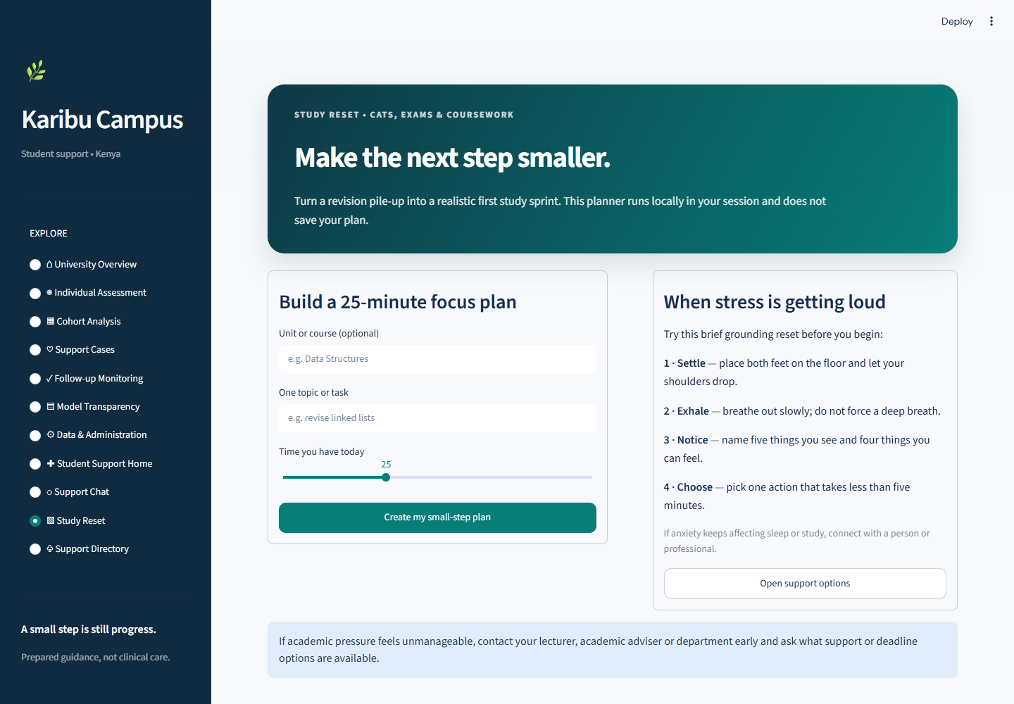
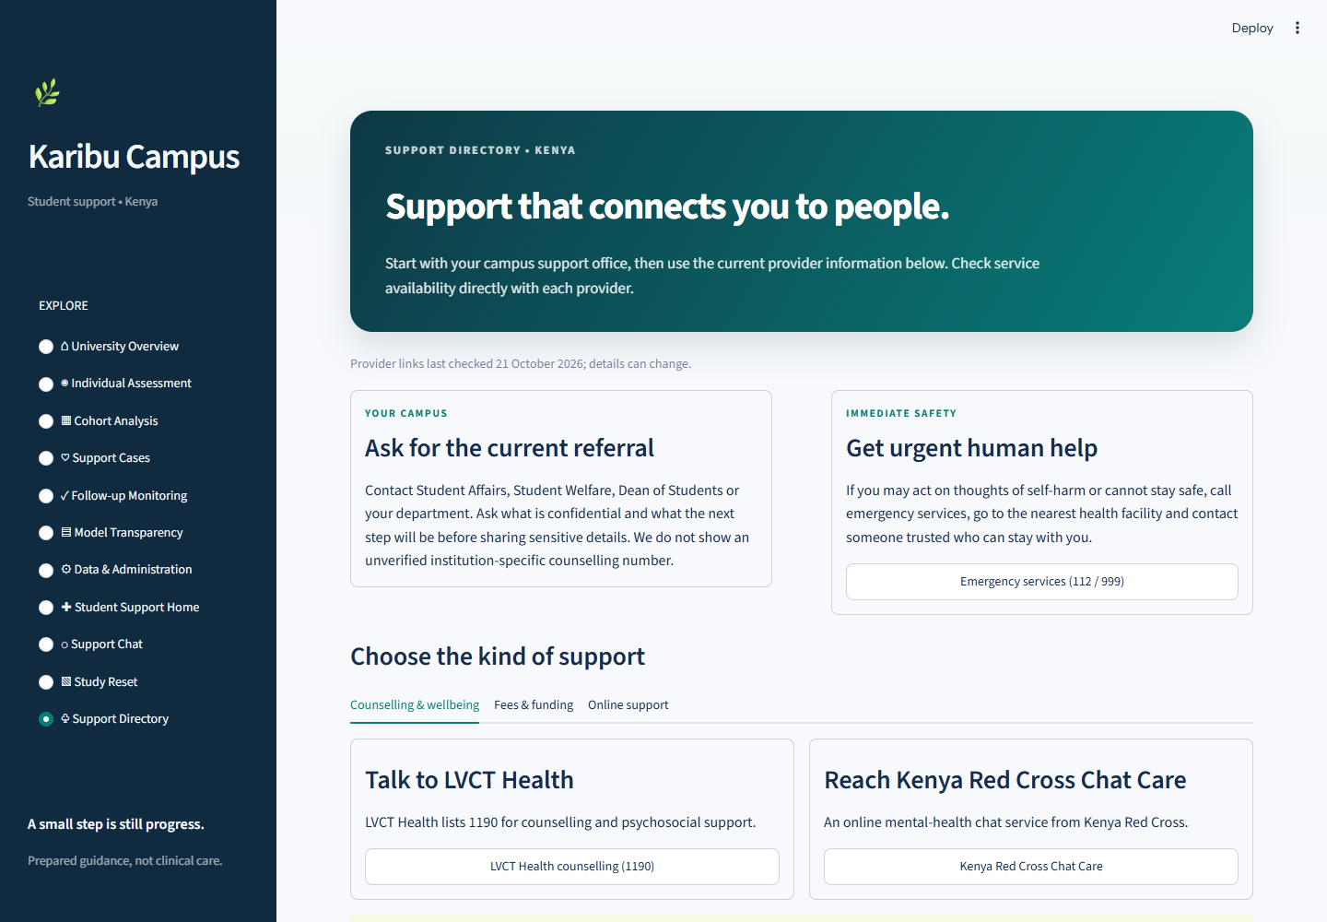
10 | DEMONSTRATION
A live tour links the student and analytics paths
STUDY RESET
SUPPORT DIRECTORY
DEMO SEQUENCE
1 Student Support Home
2 Support Chat: CAT or HELB example
3 Study Reset planner
4 Support Directory
5 Data & Administration
6 Prepare UCI data and train
7 Individual Assessment
8 Cohort Analysis
LIVE APP
https://karibu-campus.onrender.com
NEXT STEPS
Co-design with Kenyan students and support staff. Obtain governed local data, validate across groups and time, then add secure access and verified campus referrals.
For model pages, run the documented CLI to download, validate, train and create local artifacts before the live demo.
KCA UNIVERSITY | CPP 4201
11
Notes:
Suggested time: 60 seconds
For a concise live demonstration, open Student Support Home and point out the optional, session-only check-in. In Support Chat, enter “I have two CATs next week and haven’t started revision”; identify the academic intent and prepared response. Open Study Reset and enter a unit and topic to create a small-step plan. Then show the Support Directory and its campus referral, emergency, counselling, online-support and HELB paths. Move to Data and Administration to show validation and local artifact status. If model artifacts are ready, show Individual Assessment and Cohort Analysis. The current live app is at https://karibu-campus.onrender.com. Future work begins with co-design and governed representative Kenyan data, followed by external and subgroup validation, secure access, and campus-approved referral routes.

Slide 12
KARIBU CAMPUS | KCA UNIVERSITY
Thank you
Questions & Discussion
A prototype can connect support access with outcome analysis. Responsible use still depends on Kenyan validation, privacy safeguards and meaningful human oversight.
KCA University | CPP 4201 | Advanced Python Programming
karibu-campus.onrender.com
Notes:
Suggested time: 35 seconds
Karibu Campus demonstrates how a student-support hub and academic-outcome analytics can sit in one prototype while serving different roles. The current model results describe a Portuguese source dataset, and the support routes need local confirmation. Any responsible next version would require representative Kenyan data, privacy safeguards and human oversight. Thank you. I welcome your questions.

