Slide 1
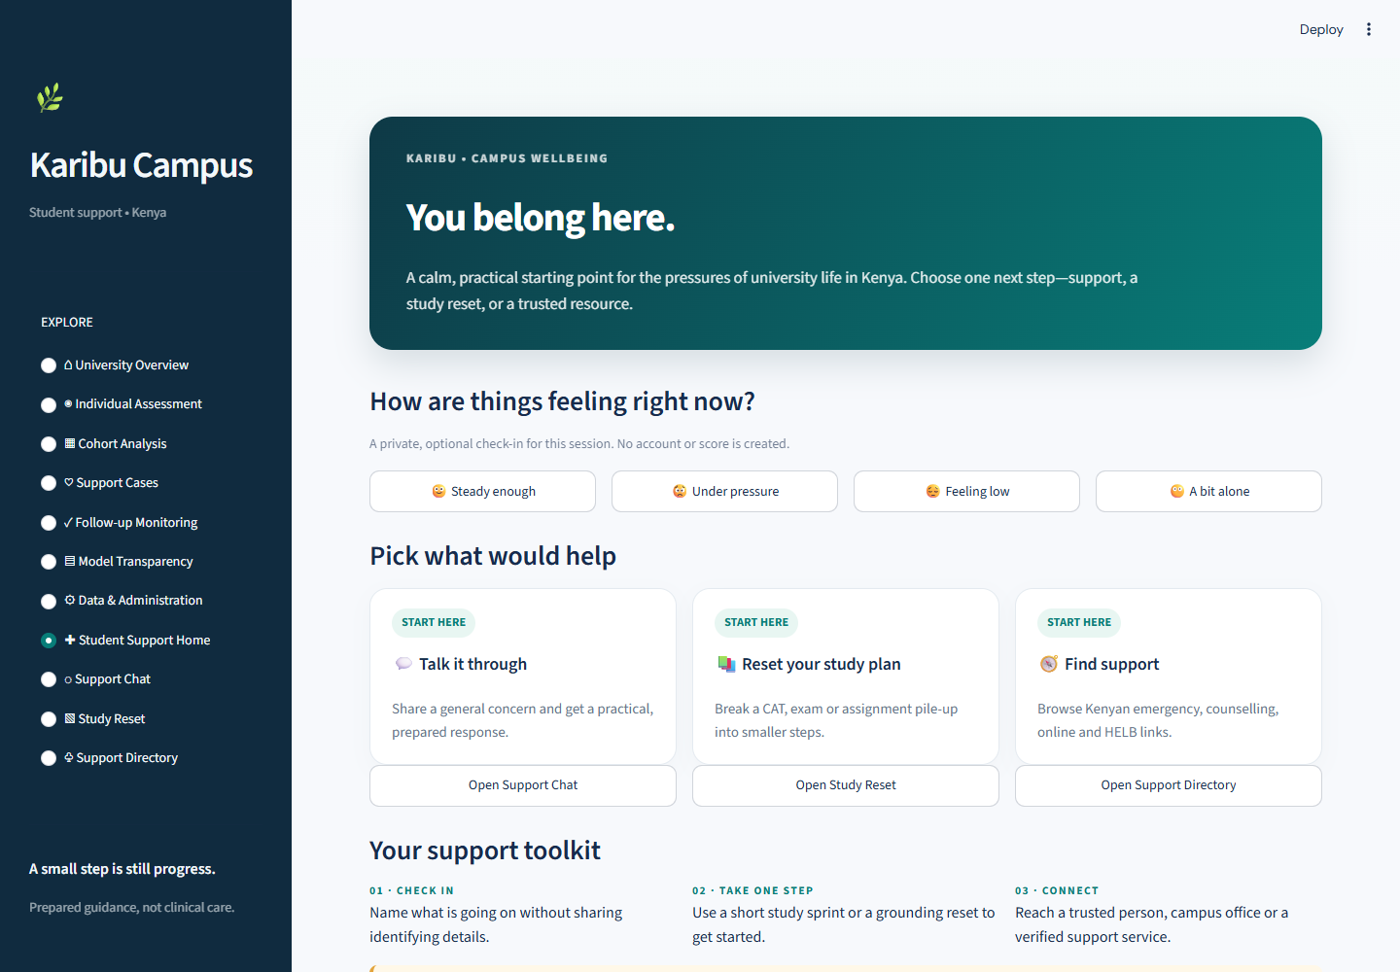
01 / 11 • STUDENT SUPPORT • 40 sec
Student Support Home
FOLLOW THESE ACTIONS
1
Click Student Support Home in the left sidebar.
2
Optionally choose “Under pressure” to show the session-only check-in.
3
Point to the Chat, Study Reset, and Support Directory entry cards.
OPTIONAL CHECK-IN
2
SAY
“This is the student-support starting point. Students can check in privately, open a prepared chat, make a small study plan or find a support route. The check-in is optional and stays in this session.”
START HERE
1
LOOK FOR Optional check-in; three support routes.
Pre-open Render; full word-for-word talk tracks are in PowerPoint Presenter Notes.
KARIBU CAMPUS • PRESENTER’S LIVE DEMO GUIDE
1 / 11
Notes:
ACTION
Open the hosted app. Click “Student Support Home” in the sidebar. If time allows, select “Under pressure” in the optional check-in and point to the Support Chat, Study Reset and Support Directory routes.
SAY
“This is the student-support starting point. A student dealing with CAT pressure, fees or loneliness can choose a small next step or find a route to human support. The check-in is optional and stays in this session. It is a support prototype, not clinical care or a monitored service.”
TRANSITION
“Before opening the support tools, I’ll show the University Overview and explain where its data comes from.”

Slide 2
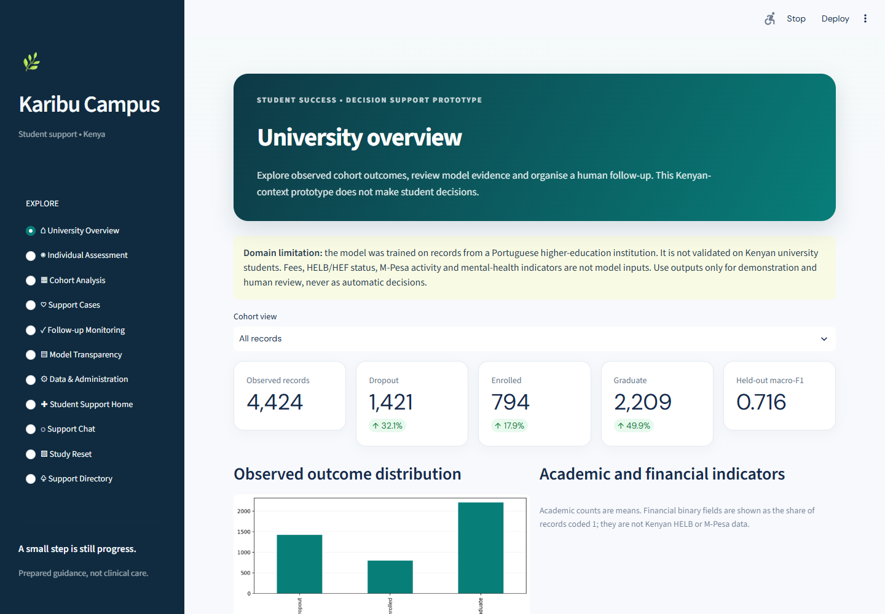
02 / 11 • APPLICATION TOUR • 45 sec
University Overview
FOLLOW THESE ACTIONS
1
Click “University Overview” in the left sidebar.
2
Point out the cohort summary and held-out model metric.
3
Use one available filter and read the updated summary.
WHAT THIS PAGE SHOWS
A descriptive snapshot of the source dataset and saved model results. It does not show wellbeing check-ins or individual Kenyan student records.
SAY
“This overview summarizes the outcomes in the source dataset and the saved model results. I can filter the cohort to explore the groups. The source data are from Portugal, so these numbers do not describe Kenyan university students.”
LOOK FOR Cohort counts, filters and the Portugal-to-Kenya domain notice.
Source data is Portuguese, not Kenyan campus data.
KARIBU CAMPUS • PRESENTER’S LIVE DEMO GUIDE
2 / 11
Notes:
ACTION
Click “University Overview” in the left sidebar. Point to the domain notice, the record and outcome cards, the held-out model metric and the observed-outcome chart. Choose one cohort filter and show the summary update.
SAY
“This page summarizes the historical dataset used by the prediction component and the saved model results. The captured run contains 4,424 records, but they come from a Portuguese higher-education institution. These figures describe that source cohort; they do not describe Kenyan campus students or validate predictions for Kenya.”
TRANSITION
“Now I’ll switch to the student-support side and enter a general CAT-pressure message in Support Chat.”

Slide 3
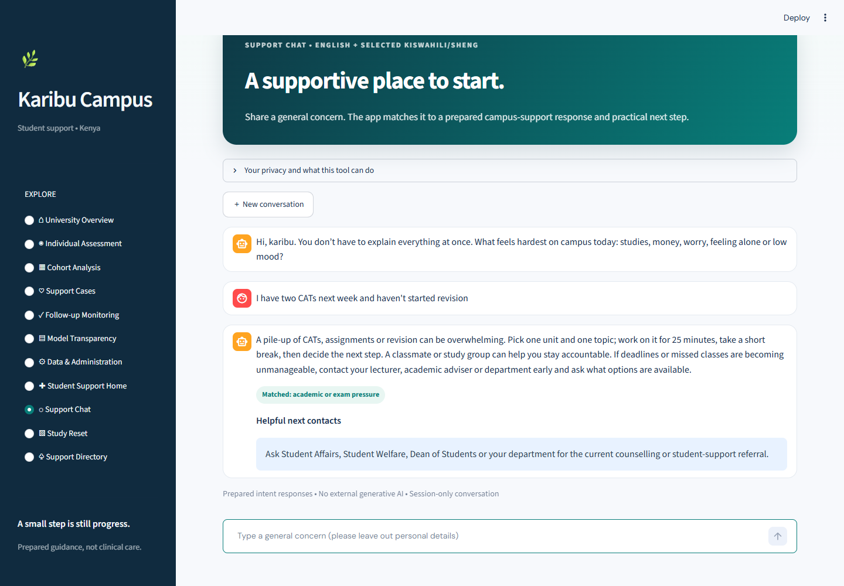
03 / 11 • STUDENT SUPPORT • 60 sec
Support Chat: CAT-pressure example
FOLLOW THESE ACTIONS
1
Select Support Chat in the sidebar.
2
Enter the CAT sample shown here, then press Enter.
3
Point out the matched intent and prepared response.
SAY
READ RESPONSE
“A pile-up of CATs can feel overwhelming. The reply suggests one practical first step.”
2
SAMPLE TO TYPE
I have two CATs next week and haven’t started revision.
TYPE + ENTER
LOOK FOR Intent tag + response; no LLM.
1
Do not enter names, IDs, HELB logins, or M-Pesa PINs.
KARIBU CAMPUS • PRESENTER’S LIVE DEMO GUIDE
3 / 11
Notes:
ACTION
Click “Support Chat” in the sidebar. Click the chat input, enter: “I have two CATs next week and haven't started revision”. Press Enter. Point to the matched intent and prepared response.
SAY
“I’m entering a general academic-pressure concern without a name or identifying details. The app matches it to academic or exam pressure and suggests a manageable revision step, with a route to human support if needed. The reply comes from prepared intent rules. This is not a generative AI counsellor, and nobody is monitoring the chat.”
TRANSITION
“The reply suggests starting with a small study block. I’ll show the Study Reset planner next.”

Slide 4
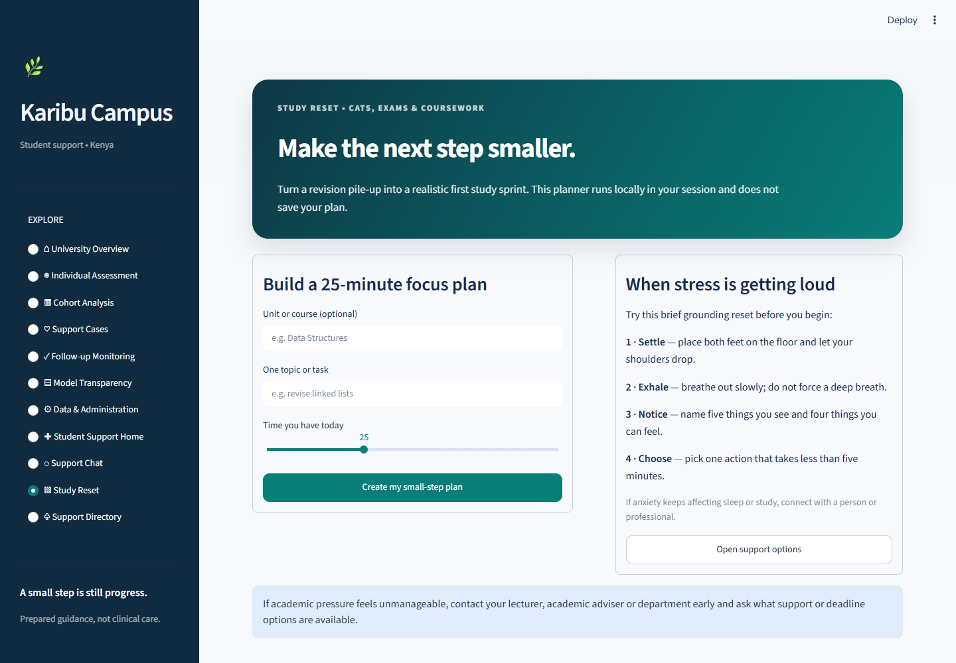
04 / 11 • STUDENT SUPPORT • 45 sec
Study Reset planner
FOLLOW THESE ACTIONS
1
Unit: optional. Enter “Data Structures.”
2
Topic: “revise linked lists”; keep 25 minutes.
3
Click Create my small-step plan. Output appears below the form.
UNIT + TOPIC
SAY
25 MIN
“One topic, one short focus block, then a break and a next step.”
1
2
3
LOOK FOR Focus task + four practical steps.
The plan is session-only; it is not a timer or saved calendar event.
KARIBU CAMPUS • PRESENTER’S LIVE DEMO GUIDE
4 / 11
Notes:
ACTION
Click “Study Reset.” Leave Unit blank or enter “Data Structures.” In “One topic or task,” enter “revise linked lists.” Keep 25 minutes selected and click “Create my small-step plan.” Point to the focus task, break and next step below the form.
SAY
“This planner turns a large revision goal into one topic and a short focus period. It then suggests a break and a small next step, which can make it easier to begin when coursework feels overwhelming. The plan is a prompt only: it does not run a timer or save a calendar event.”
TRANSITION
“If a student needs a person or service, the Support Directory provides routes to explore.”

Slide 5
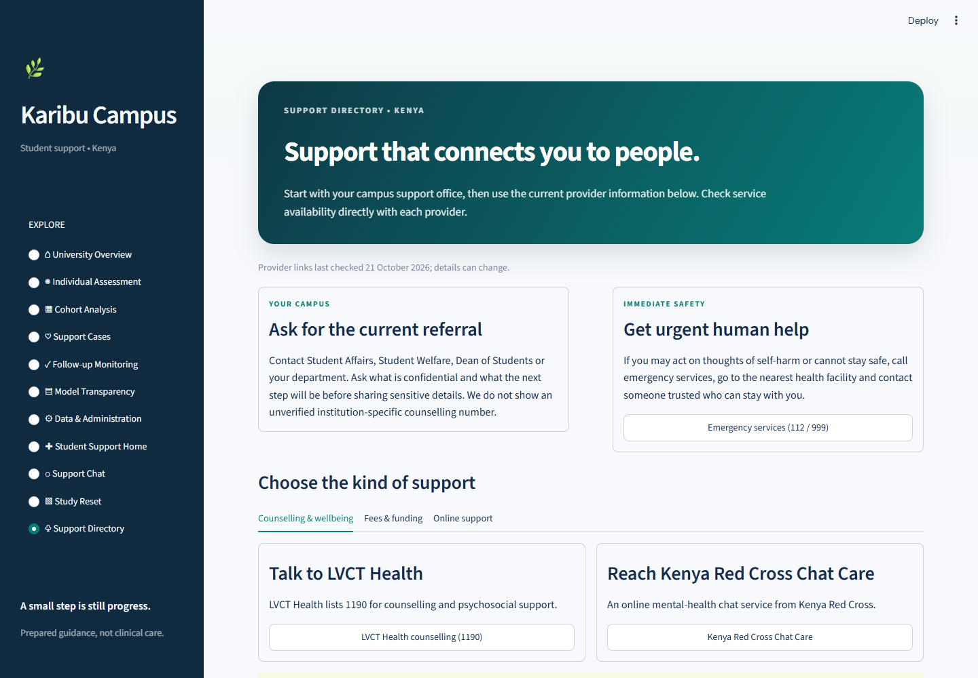
05 / 11 • STUDENT SUPPORT • 40 sec
Support Directory
FOLLOW THESE ACTIONS
1
Select Support Directory in the sidebar.
2
Show campus and immediate-safety guidance.
3
Click Fees & funding for HELB; identify the other tabs.
SAY
“This directory points students toward people and current provider information.”
RESOURCE CATEGORIES
1
LOOK FOR Campus route + resource categories.
2
Do not invent campus contacts; verify provider details.
KARIBU CAMPUS • PRESENTER’S LIVE DEMO GUIDE
5 / 11
Notes:
ACTION
Click “Support Directory.” Point to the campus and immediate-safety guidance. Select “Fees & funding” to show the HELB route; identify the Counselling & wellbeing and Online support tabs.
SAY
“This directory groups support routes relevant to Kenyan university life, including counselling, fees and online support. For campus help, it points students toward offices such as Student Affairs, Student Welfare, the Dean of Students or their department. The page links to official information, but provider details should be checked before relying on them.”
TRANSITION
“When staff and a student agree on a next step, the Support Cases page can demonstrate how that follow-up is recorded.”

Slide 6
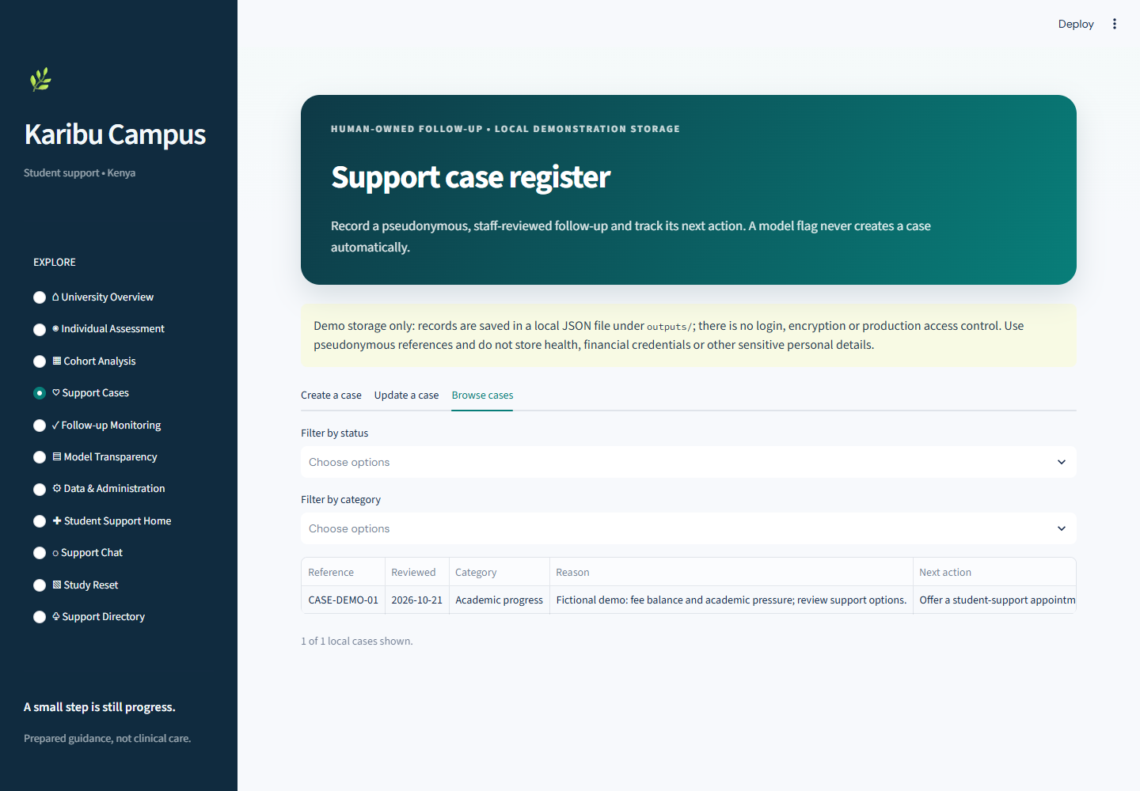
06 / 11 • STUDENT SUPPORT • 50 sec
Support Cases
FOLLOW THESE ACTIONS
1
Click “Support Cases” in the left sidebar.
2
Show the Create, Update and Browse cases tabs.
3
Browse the fictional case row; describe how staff review next actions.
WHAT THIS PAGE SHOWS
A staff-owned register for pseudonymous, reviewed follow-up. Case records save locally in a JSON file.
SAY
“A staff member records a case only after reviewing the concern and agreeing on a next step. The case has an owner and follow-up date. These examples are fictional and stored locally.”
LOOK FOR Case reference, category, responsible role, next action and follow-up date.
Demo storage has no login or access control. Use fictional data only.
KARIBU CAMPUS • PRESENTER’S LIVE DEMO GUIDE
6 / 11
Notes:
ACTION
Click “Support Cases” in the sidebar. Leave “Browse cases” selected and point to the fictional CASE-DEMO-01 row. Show the Create a case and Update a case tabs so the workflow is clear.
SAY
“This is a human-owned follow-up register. A staff member reviews a concern and agrees on a next action before recording a pseudonymous case reference, responsible role and follow-up date. A model does not create cases automatically. This prototype stores demo cases in local JSON and has no login or production access controls.”
TRANSITION
“Once a follow-up date is recorded, this next page helps staff see which open actions are due.”

Slide 7
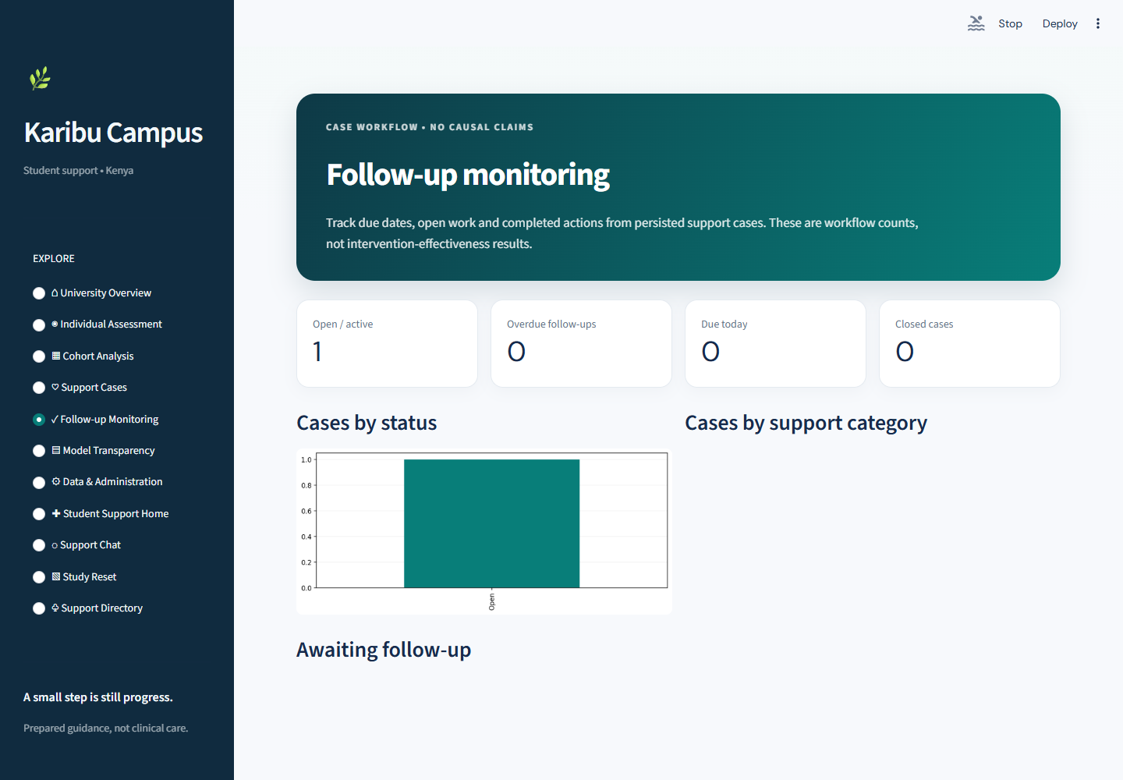
07 / 11 • STUDENT SUPPORT • 40 sec
Follow-up Monitoring
FOLLOW THESE ACTIONS
1
Click “Follow-up Monitoring” in the left sidebar.
2
Read the open, due and overdue workflow counts.
3
Inspect the due table and completed-action section.
WHAT THIS PAGE SHOWS
Summarizes case follow-up dates and status. Date rules identify due or overdue open work and exclude closed cases.
SAY
“This page highlights open follow-up work and due dates. It can show what is due or overdue, but it sends no alerts. These counts describe workflow status, not whether support worked.”
LOOK FOR Counts and rows tied to the case follow-up date.
The app sends no SMS, email or due-date alerts.
KARIBU CAMPUS • PRESENTER’S LIVE DEMO GUIDE
7 / 11
Notes:
ACTION
Click “Follow-up Monitoring” in the sidebar. Point to the open, due and overdue summary cards, then to the follow-up table and completed-actions section.
SAY
“This screen summarizes case workflow by status and follow-up date. It can show open work that is due or overdue, while closed cases are excluded from due counts. These numbers track the workflow only: the app sends no alerts and cannot tell us whether the support changed a student’s outcome.”
TRANSITION
“I’ll now show how the model results are evaluated and the limits we need to keep in mind.”

Slide 8
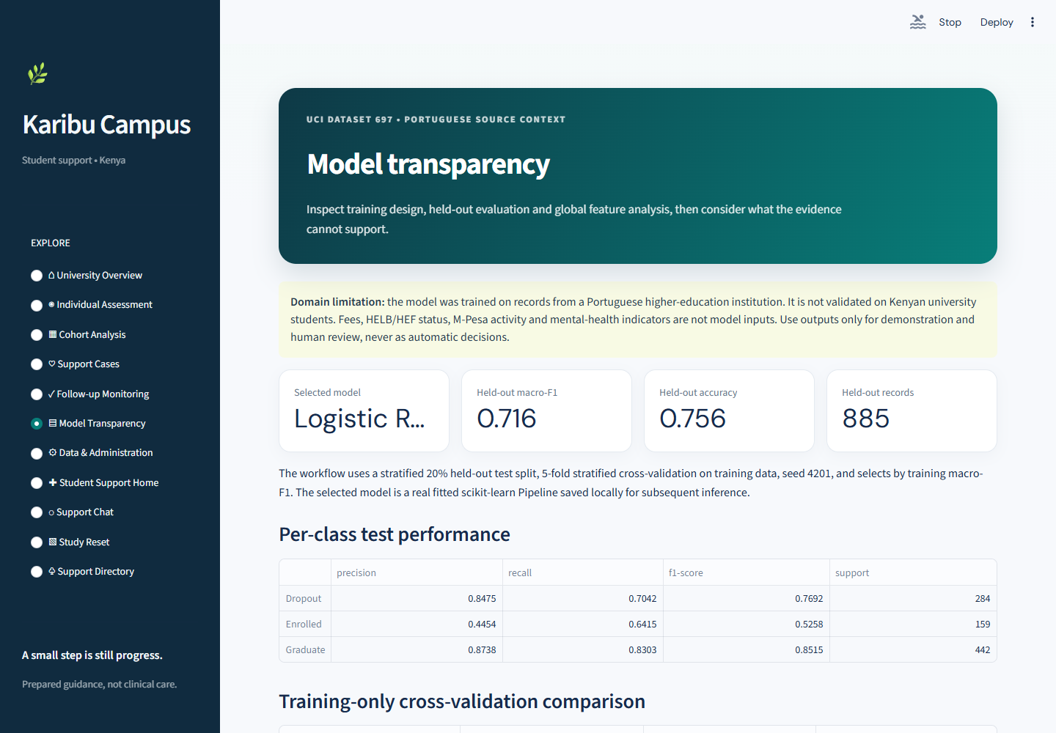
08 / 11 • DATA & ANALYTICS • 50 sec
Model Transparency
FOLLOW THESE ACTIONS
1
Click “Model Transparency” in the left sidebar.
2
Identify the selected model and held-out metrics.
3
Read the per-class report, confusion matrix and importance plot.
WHAT THIS PAGE SHOWS
Explains how the saved model was evaluated and where class-level errors occur. Permutation importance shows predictive reliance, not cause.
SAY
“Here we see the model’s held-out results and its performance for each outcome. The confusion matrix shows correct and incorrect predictions. The test data are from Portugal, not a validated Kenyan cohort.”
LOOK FOR Model name, held-out results, class report and domain limitations.
Metrics do not prove clinical or Kenyan predictive validity.
KARIBU CAMPUS • PRESENTER’S LIVE DEMO GUIDE
8 / 11
Notes:
ACTION
Click “Model Transparency” in the sidebar. Identify the selected model and held-out metrics. Point to the per-class report, confusion matrix and permutation-importance plot.
SAY
“This page shows retrospective test results for the saved model. In the captured run, Logistic Regression achieved a held-out macro-F1 of 0.716 and accuracy of 0.756 across 885 records. The confusion matrix shows where predictions were right or wrong, while permutation importance shows predictive reliance rather than cause. The cohort is from Portugal, so these metrics do not establish Kenyan predictive validity.”
TRANSITION
“These model artifacts come from the dataset and training workflow shown under Data & Administration.”

Slide 9
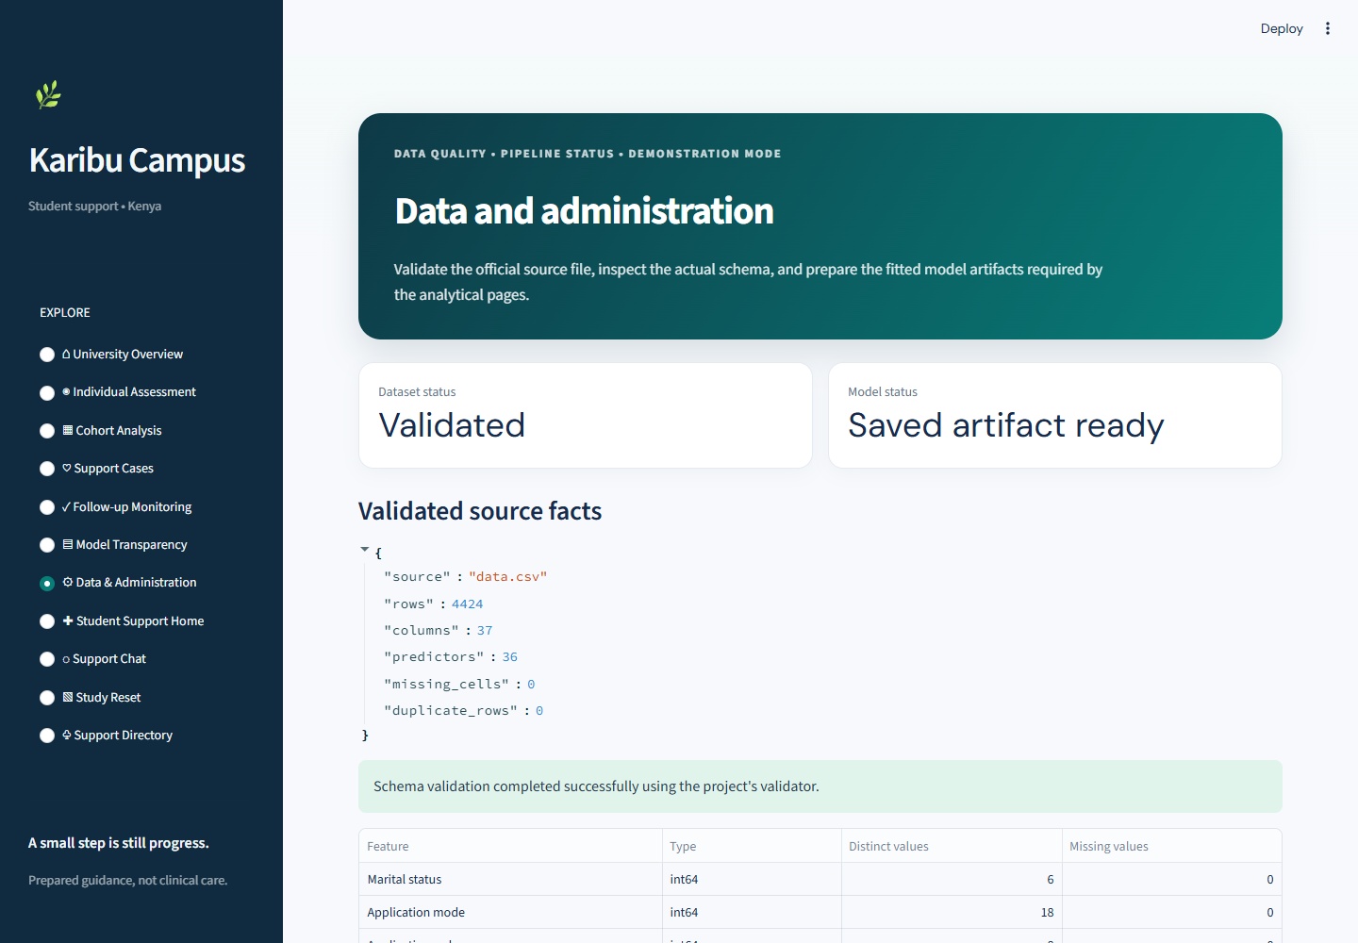
09 / 11 • DATA & ANALYTICS • 45 sec
Data & Administration
FOLLOW THESE ACTIONS
1
Click Data & Administration in the sidebar.
2
Check Dataset status and Model status.
3
Point to validated source facts: 4,424 rows, 36 predictors, 1 target.
DATASET STATUS
MODEL STATUS
1
2
SAY
“The model dataset is from a Portuguese higher-education institution—not a Kenyan campus cohort.”
3
LOOK FOR Validated file + saved model status.
Download button appears only when the CSV is missing.
KARIBU CAMPUS • PRESENTER’S LIVE DEMO GUIDE
9 / 11
Notes:
ACTION
Click “Data & Administration” in the sidebar. Point to Dataset status and Model status, then the validated source summary and schema. In the captured ready state, show “Validated” and “Saved artifact ready.”
SAY
“This page validates the source file and shows whether the trained model is ready for the analytical pages. The source has 4,424 records, 36 predictors and one outcome column. It comes from a Portuguese higher-education institution. The app’s support examples are localized for Kenyan students, but the prediction model has not been trained or validated on Kenyan student data.”
TRANSITION
“I’ll stay on this page and scroll down to show where the dataset preparation and training action lives.”

Slide 10
10 / 11 • DATA & ANALYTICS • 75 sec
Prepare dataset and train model
REPRODUCIBLE RUN
1
Download official UCI CSV (only if absent)
2
Validate rows, schema, labels and quality
3
Fit preprocessing + compare 3 classifiers
VALIDATED
ARTIFACT READY
4
Stratified 5-fold CV; held-out test: 885 rows
1
2
5
Save fitted pipeline and evaluation artifacts
CONTROL IS BELOW THE CAPTURED VIEW
Scroll past the schema table → click
“Prepare dataset and train the model”.
↓
For the timed demo, prepare artifacts beforehand; show the ready status.
KARIBU CAMPUS • PRESENTER’S LIVE DEMO GUIDE
10 / 11
Notes:
ACTION
On “Data & Administration,” scroll below the schema table to “Prepare dataset and train the model.” If the CSV is missing in a fresh setup, first click “Download official dataset” and wait for validation. For this demo, leave the model ready and explain the button rather than starting a multi-minute run.
SAY
“When needed, this action runs the pipeline: it loads and validates the UCI file, prepares the features, compares three classifiers using stratified five-fold cross-validation, evaluates the selected model on held-out records and saves the model and metrics. Training can take several minutes, so I prepared the artifacts before the presentation. Individual Assessment later loads the saved pipeline for inference instead of retraining for every profile.”
TRANSITION
“With the saved pipeline ready, I’ll run the synthetic assessment and then compare outcomes in the cohort view.”

Slide 11
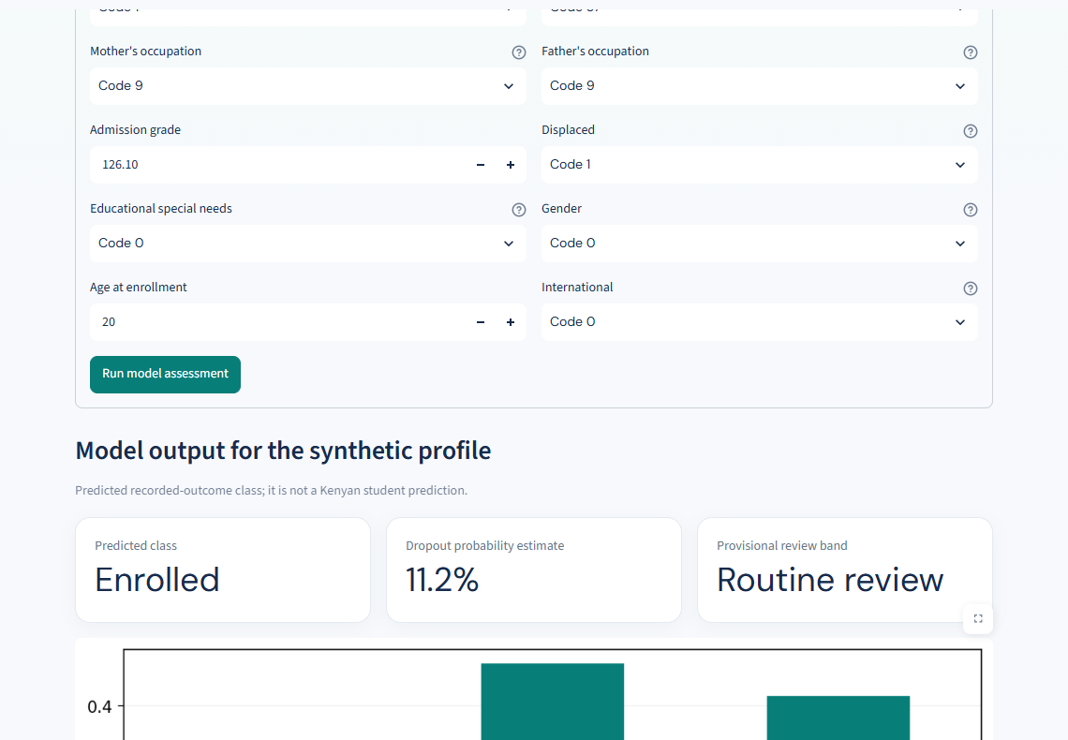
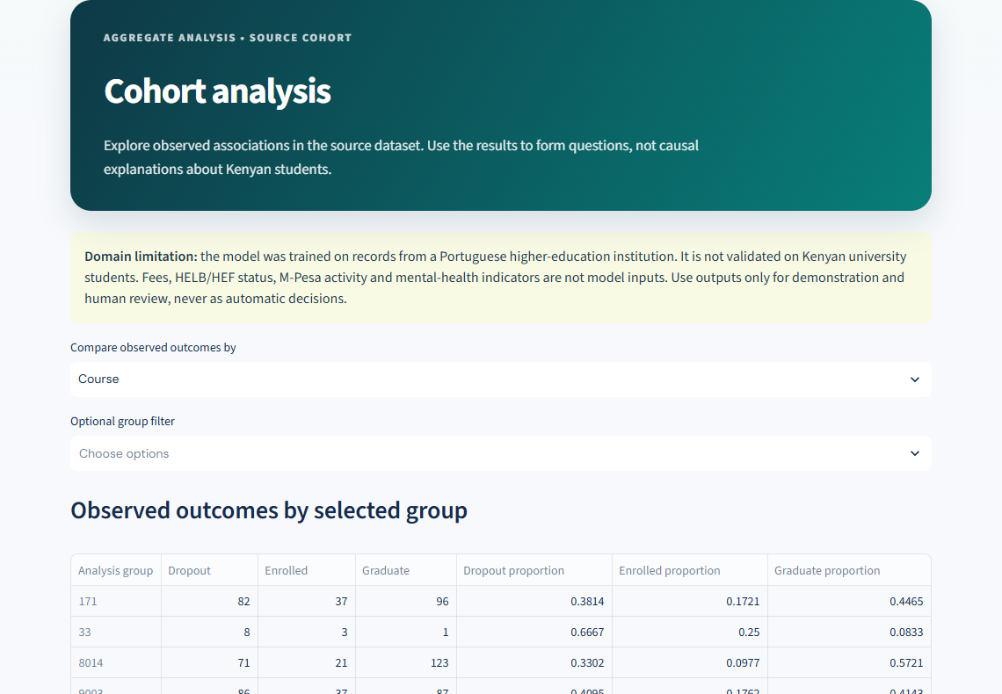
11 / 11 • DATA & ANALYTICS • 85 sec
Individual Assessment + Cohort Analysis
A • INDIVIDUAL ASSESSMENT
B • COHORT ANALYSIS
1
3
SYNTHETIC INPUTS
GROUP FILTER
2
PREDICTION OUTPUT
4
OUTCOME COUNTS
USE THE PREFILLED SYNTHETIC PROFILE
READ COUNTS WITH PROPORTIONS
Click Individual Assessment in the sidebar. Keep the synthetic inputs; select Run model assessment and read the class, probability chart and review band.
Click Cohort Analysis in the sidebar. Filter by Course and compare the aggregate outcome chart with its table.
END: “That is the walkthrough. I’m happy to take your questions.”
KARIBU CAMPUS • PRESENTER’S LIVE DEMO GUIDE
11 / 11
Notes:
ACTION
A. Click “Individual Assessment.” Point to the domain and synthetic-profile notices, input tabs and provisional threshold sliders.
B. Keep the prefilled values. Click “Run model assessment.” Point to the predicted class, dropout probability, review band, probability chart and human-review warning.
C. Click “Cohort Analysis,” select “Course,” and show the filter, chart and count/proportion table.
SAY
“This form starts with a synthetic profile built from dataset medians and category modes, not a real or typical Kenyan student. Category values such as Code 0 are labels, not rankings.
“When I click Run model assessment, one row goes through the saved scikit-learn pipeline. It predicts Dropout, Enrolled or Graduate and shows estimates for all three classes. The review band is a separate provisional rule: the defaults are 35% for follow-up and 65% for priority human review. These estimates are not calibrated or validated for Kenya, and must never automate decisions. The captured example shows Enrolled, an 11.2% dropout estimate and Routine review; live results can vary. The optional follow-up button prepares a draft, it does not save a case.
“Cohort Analysis compares observed outcomes by group. These Portuguese source-data patterns are descriptive, not causal, and do not establish what happens on Kenyan campuses.”
TRANSITION
“That completes the assessment and cohort walkthrough. The model is a demonstration that requires human review, not a validated Kenyan student-risk tool.”

